Slide 1

Aerodynamic Analysis and Shape
Optimization of Non-axisymmetric
Bodies of Revolution
Manideep Reddy Desham
Under the guidance of
Prof. Rajkumar S. Pant
LTA systems Laboratory
Aerospace Engineering department
IIT Bombay
M.Tech Project seminar, 22-June-2018

Slide 2
LAYOUT
Introduction and Motivation
Literature survey
Validation of CFD results
Envelope geometry parameterization
Surrogate model and genetic algorithm optimizer
Results and discussion
Conclusions and scope for future work

Slide 3
Literature survey
Year | Author | Title
1950 | Gertler, M. | Resistance Experiments on a Systematic Series of Streamlined Bodies of Revolution For Application to the Design of High-Speed Submarines,
1999 | Gillett et.al | “Air-ship technology,” text book (Cambridge Aerospace Series: 10, Cambridge University Press)
2004 | Kanikadale et al | Multi-disciplinary optimization of airship envelope shape
2005 | Kale et. al | A generic methodology for determination of drag coefficient of an aerostat envelope using CFD
2009 | Wang et al. | Experimental Investigations on Aerodynamic Characteristics of the ZHIYUAN-1 Airship
2010 | Ram & Pant | Multidisciplinary Shape Optimization of Aerostat Envelopes
2011 | Suman et. al | Evaluation of the assumed-transition- point criterion in context of RANS simulations around Lighter-Than-Air vehicles
2013 | Ghani, O. A | Design optimization of aerodynamic drag at the rear of generic passenger cars using nurbs representation
2014 | Paul et. al | 2-D shape optimization of aerostat envelopes using Kriging
2017 | Alam et. al | Multidisciplinary Approach for Solar Area Optimization of Stratospheric Airships”, Energy Conversion & Management.
2017 | Alam et. al | Surrogate Based Shape Optimization of Airship Envelopes
2018 | Alam | PhD thesis and APS reports

Slide 4
Introduction and Motivation

Slide 5
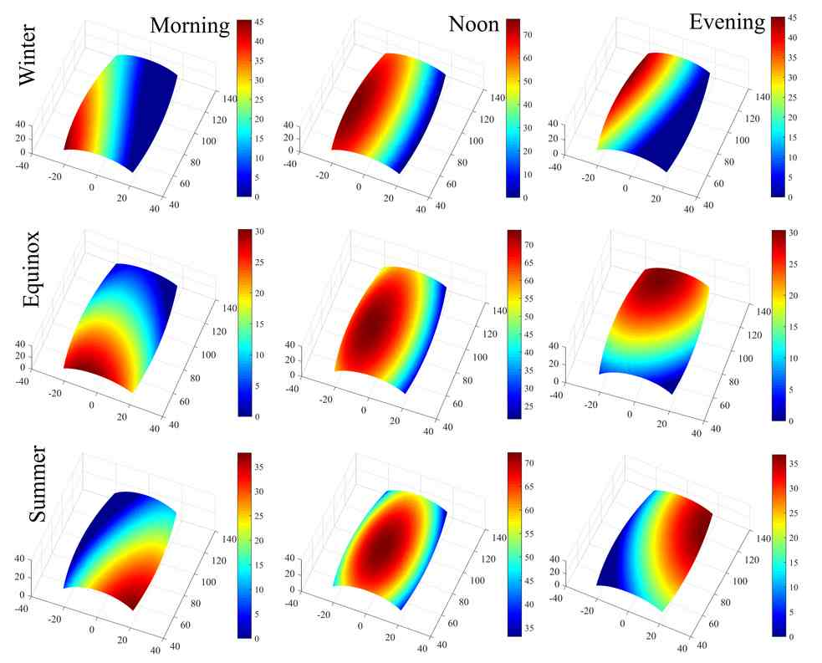

Slide 6
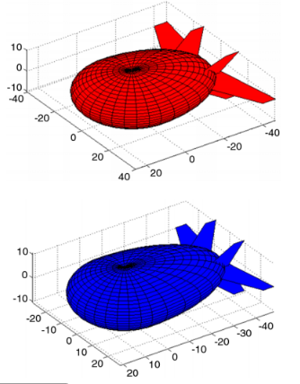
Non axisymmetric shapes

Slide 7
Softwares / tools used
(All open source..!)
Operating srystem : ubuntu 16.04 LTS
Programming : Python, Octave, bash
Meshing : BlockMesh, SnappyHexMesh
CFD solver : OpenFOAM 4.1
CFD post-processing : ParaView
Report typesetting : LaTex
PPT presentation : LibreOffice Impress

Slide 8
Validation of CFD results.

Slide 9
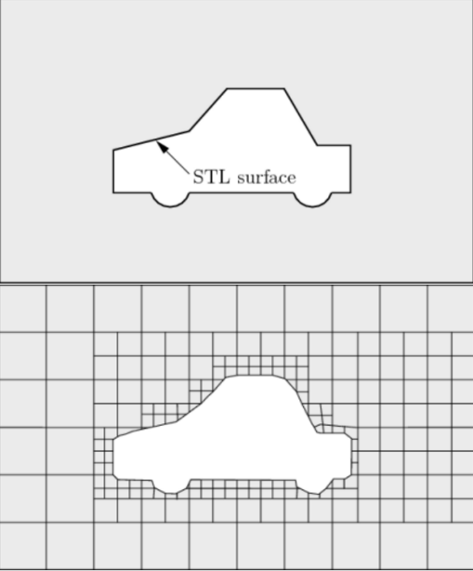
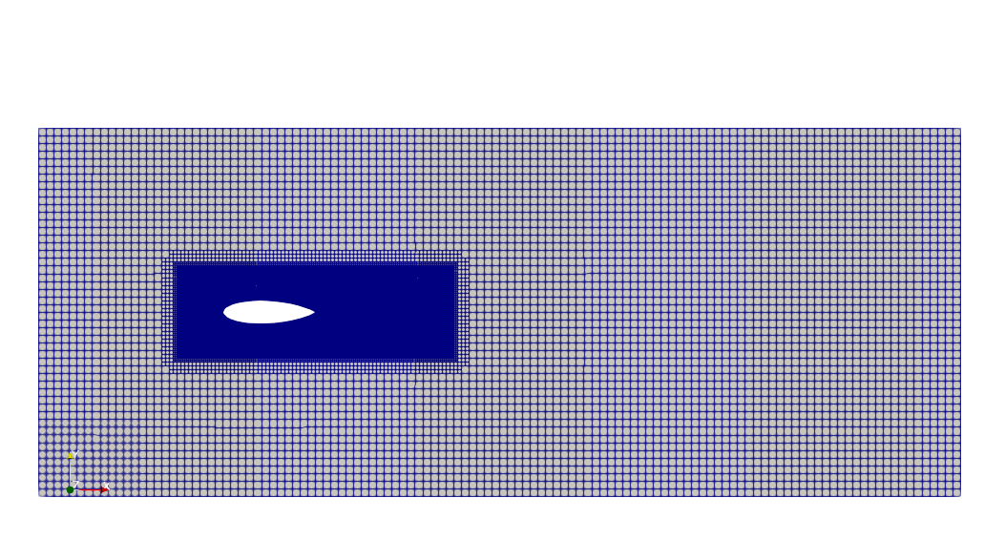
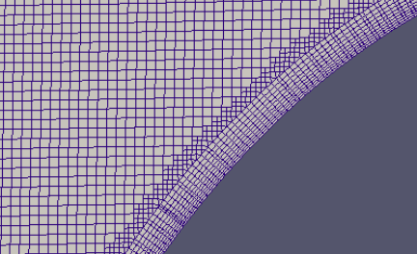
Meshing with SnappyHexMesh

Slide 10
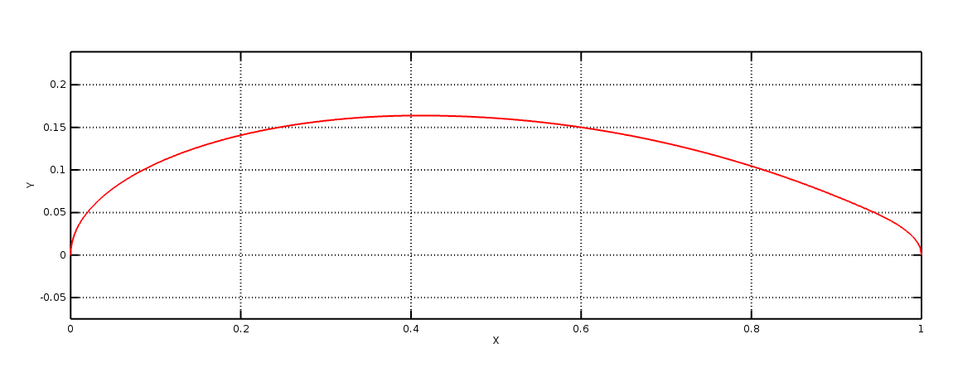
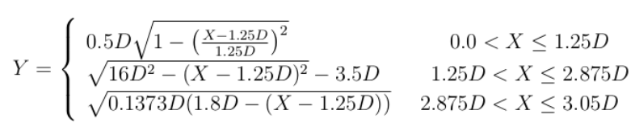
GNVR shape
Narayana, C. L., and Srilatha, K. R., July 2000, “Analysis of aerostat configurations by panel methods,” BLISS Project Document CF 0010 (National Aerospace Laboratories, Bangalore, India)
Kanikdale, T., Marathe, A., and Pant, R., 2004, “Multi-disciplinary optimization of airship envelope shape,” in 10th AIAA/ISSMO Multidisciplinary Analysis and Optimization Conference, p. 4411

Slide 11
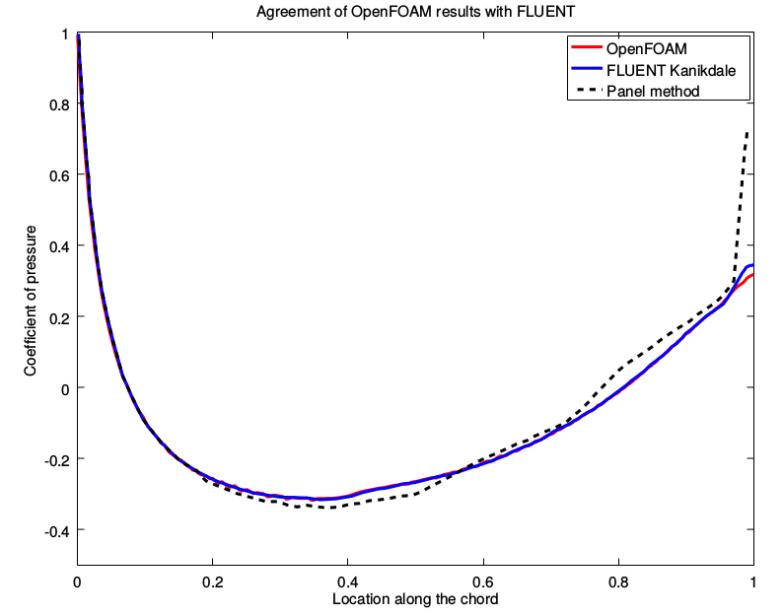
Mesh type | No.of cells (Million) | C_{DV}
Coarse | 0.19 | 0.01565
Fine | 0.64 | 0.01555
Very fine | 1.44 | 0.01572

Slide 12
Envelope geometry parameterisation

Slide 13
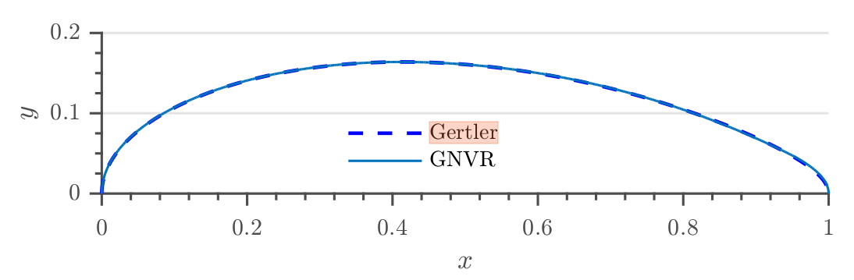
Geometry parameterization
a_{1 ,} a₂ ... a₆ are the shape coefficients, whose values are driven by geometrical parameters, viz.,
m Location of maximum diameter
r₀ Nose radius
r₁ Tail radius
C_{p} Prismatic coefficient
L/D Ratio of length to max. dia

Slide 14
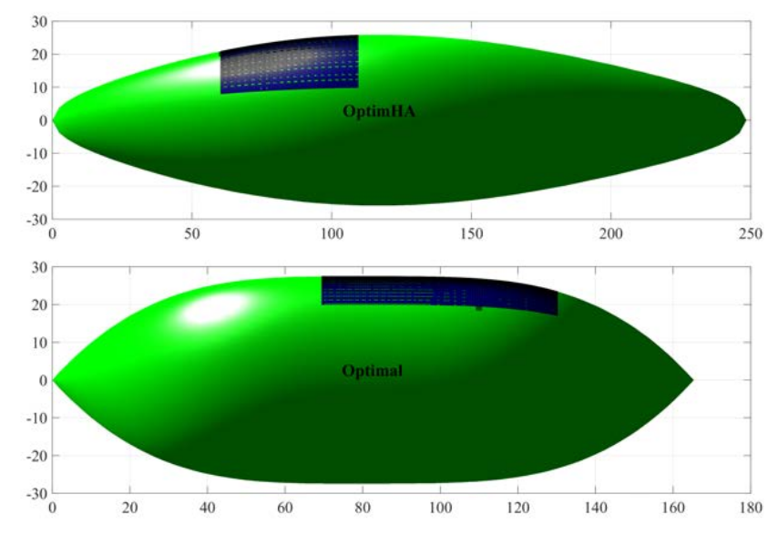
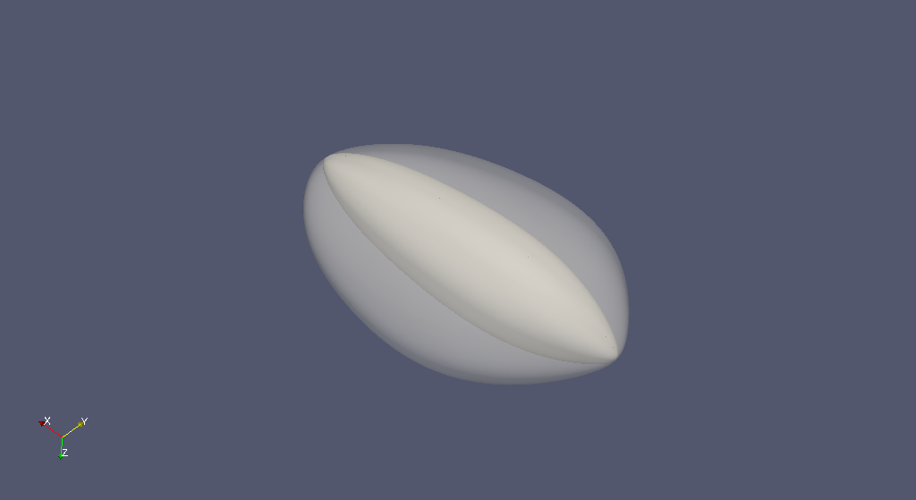
Effect of scaling using new parameter Scale_{y}

Slide 15
Design space
Design Parameter | Min. | Max.
Point of max dia (m) | 0.35 | 0.50
Nose radius (r₀) | 0.20 | 0.80
Tail radius (r₁) | 0.1 | 0.5
Prismatic coefficient (C_{p}) | 0.55 | 0.70
Fineness ratio (l/d) | 2.50 | 6.00
Scaling parameter (Scale_{y}) | 1.00 | 3.00

Slide 16
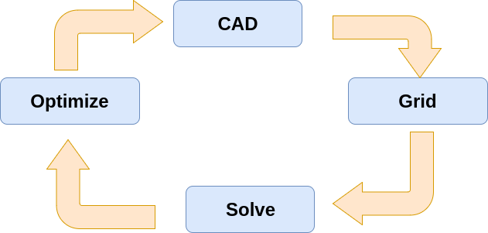
Direct shape optimisation approach

Slide 17
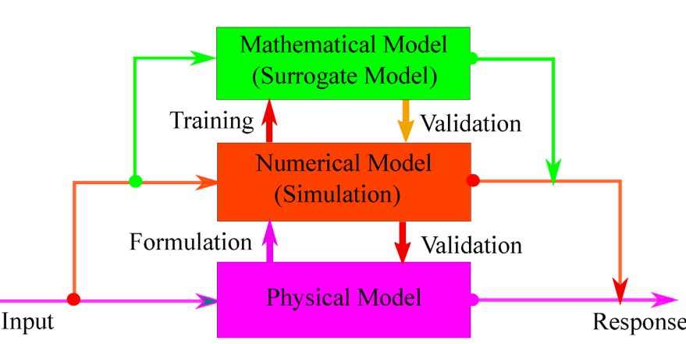
We need surrogate model..!

Slide 18
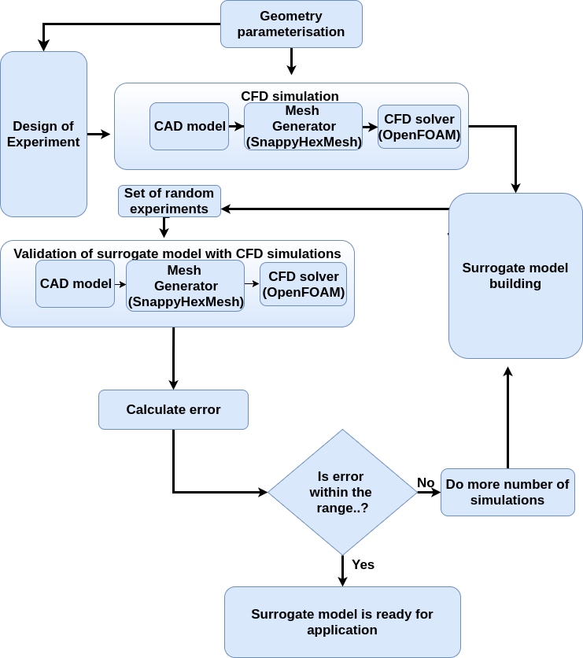

Slide 19
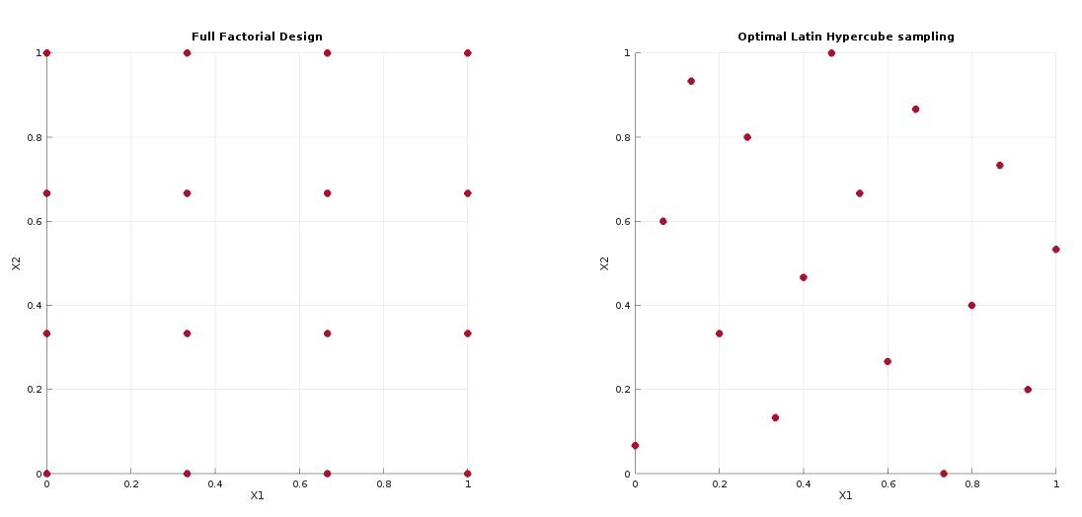
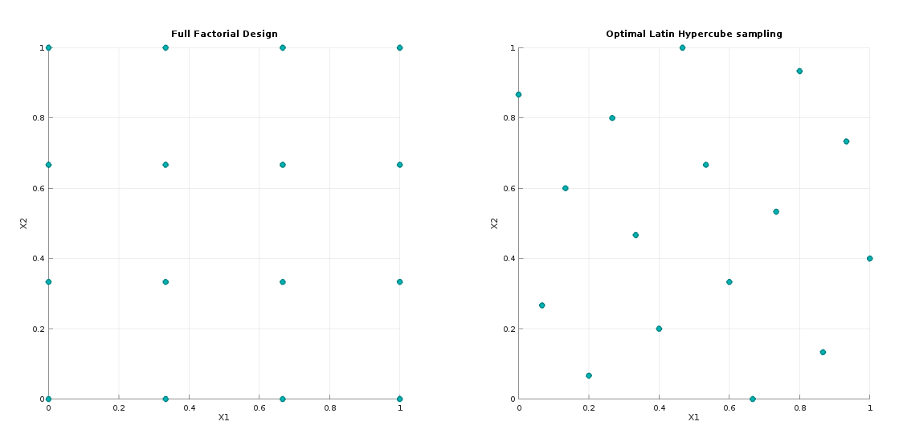
DOE study to extract maximum information

Slide 20
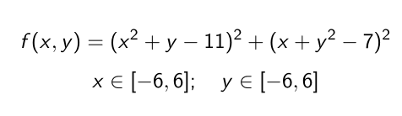
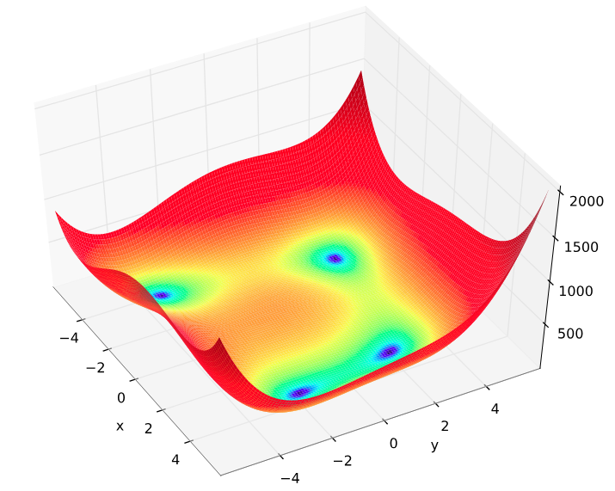
Himmelblau test function
The Himmelblau function is defined as
It has one local maximum at (-0.27, -0.92) where f(x,y)=181.61, and four identical local minima at ( 3 , 2 ), ( -2.8 , 3.1 ),( -3.7 , -3.2 ),( 3.5 , -1.8 ) where f(x,y)=0

Slide 21
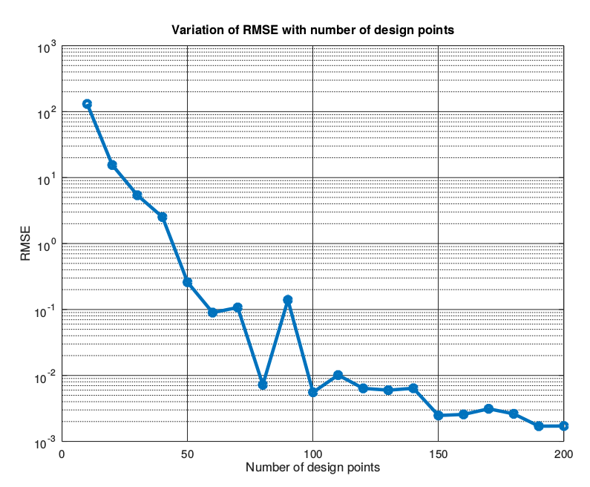

Slide 22
Write def. Of modified himmelblau function.
Parameter | Value
Population size | 100
Crossover probability | 0.9
Mutation probability | 0.1
Number of generation | 50
Selection scheme | Roulette wheel selection method
 | X | Y | Function value
Actual Function | -3.7793 | -3.2832 | 1.6725e-11
Surrogate model | -3.7791 | -3.2828 | 2.5643e-03
% Error | 0.006 | 0.013

Slide 23
 | X | Y | Function value
Actual Function | -3.7793 | -3.2832 | 1.6725e-11
Surrogate model | -3.2205 | -2.9549 | -6.3131
% Error | 14.79 | 10.00

Slide 24
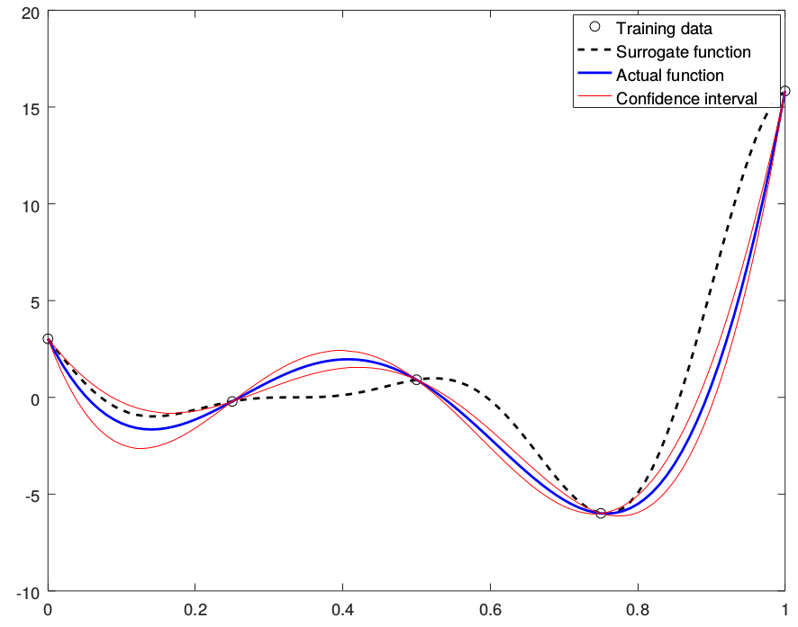

Slide 25
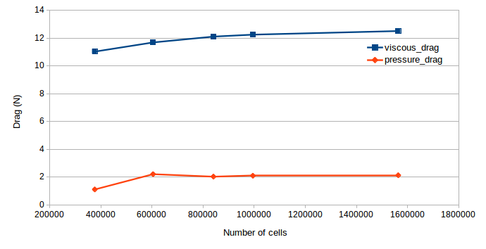
Parameter | Value
Reynolds number based on volume Re | 3.01*10⁶
Pressure (N/m²) | 87500
Density, (Kg/m³) | 1.057
Speed, (m/s) | 51
Mesh | BlockMesh and SnappyHexMesh
Solver | SimpleFOAM (Incompressible steady state solver)
Laminar / Turbulent | Turbulent
Turbulence model | K-Omega SST

Slide 26
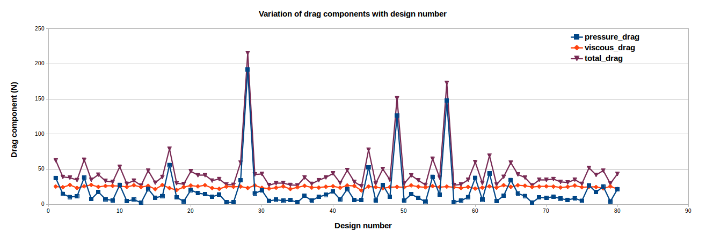
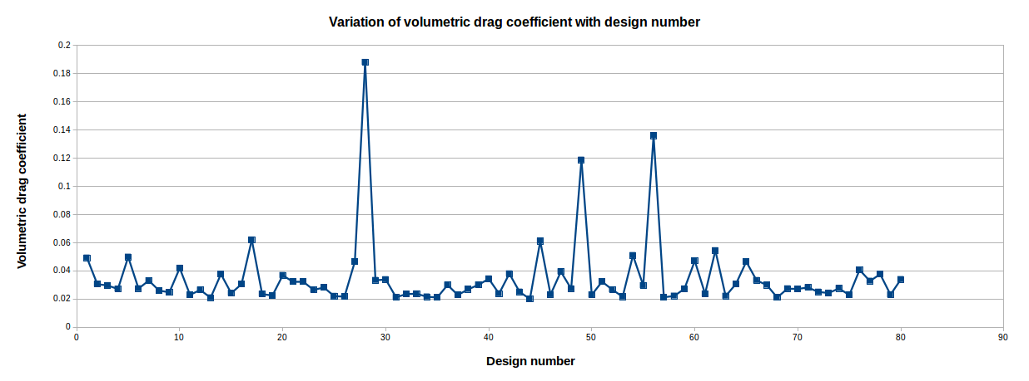

Slide 27
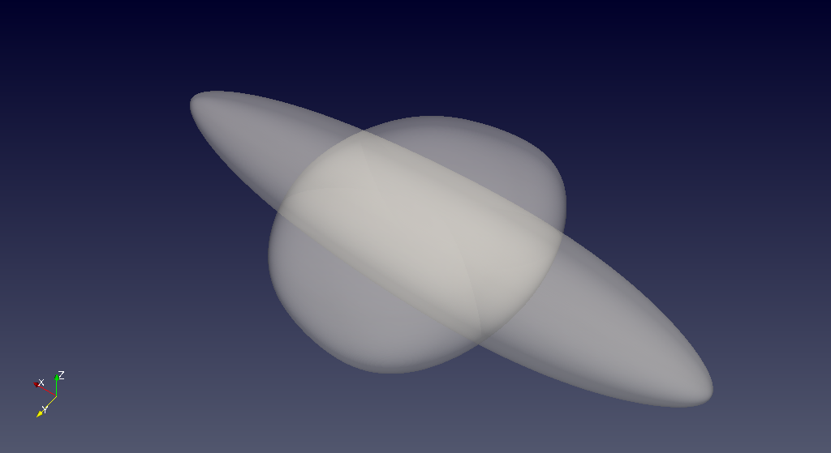
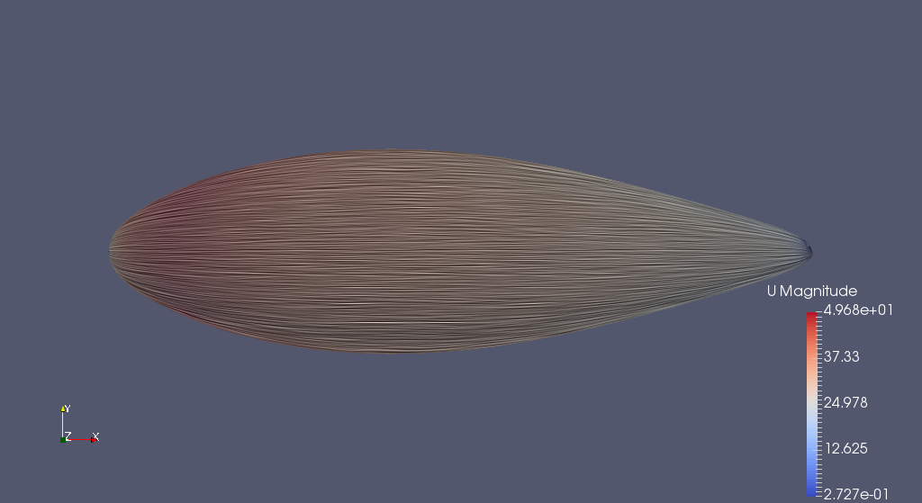
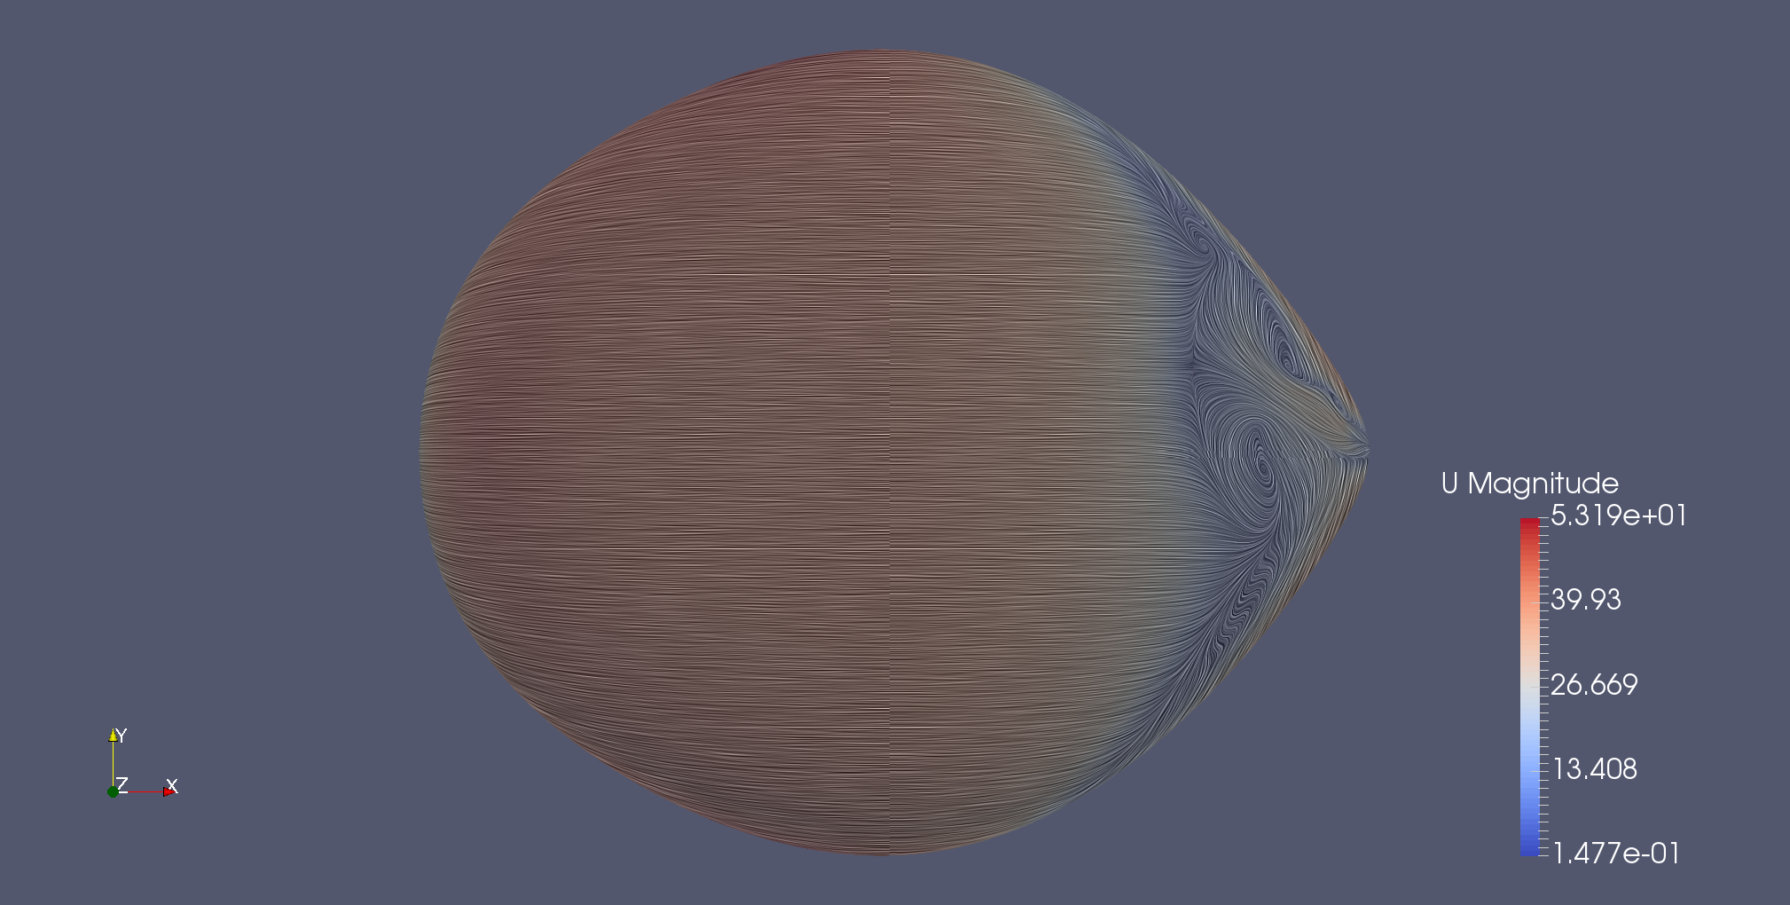

Slide 28
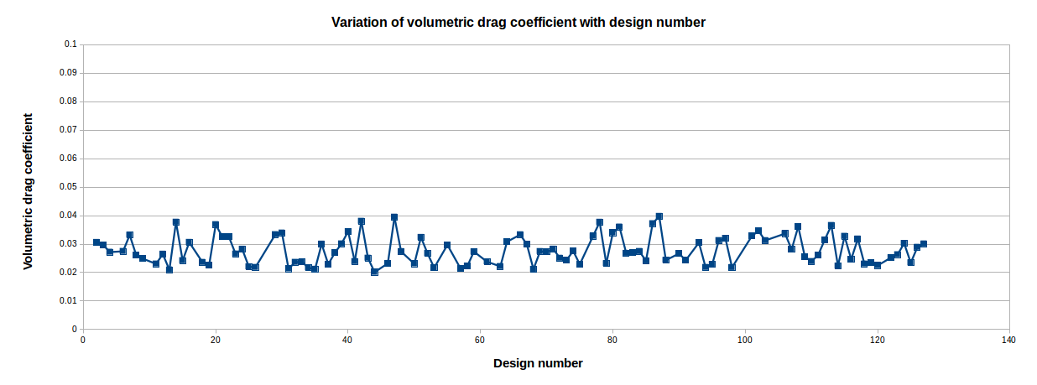

Slide 29
Random Exp.No | Kriging | PRS | RBF
1 | 5.72 | 3.24 | 2.73
2 | 4.82 | 11.33 | 36.40
3 | 0.96 | 6.09 | 12.73
4 | 1.15 | 7.98 | 18.62
5 | 2.50 | 5.40 | 14.13
6 | 1.29 | 6.31 | 1.75
7 | 1.99 | 0.59 | 10.05
8 | 5.64 | 3.36 | 1.12
Avg. % Error | 3.01 | 5.54 | 12.19

Slide 30
Random Exp.No | Linear Regression | Ridge Regression | SVR | Kernel Ridge
1 | 4.89 | 8.45 | 48.86 | 37.40
2 | 22.60 | 31.31 | 74.30 | 96.77
3 | 31.62 | 33.77 | 77.00 | 115.31
4 | 20.15 | 24.09 | 74.03 | 96.03
5 | 15.34 | 16.81 | 45.69 | 59.07
6 | 11.67 | 1.08 | 27.72 | 21.22
7 | 12.90 | 15.42 | 48.52 | 62.18
8 | 1.68 | 17.80 | 64.92 | 62.44
Avg. % Error | 15.10 | 18.59 | 57.63 | 68.80

Slide 31
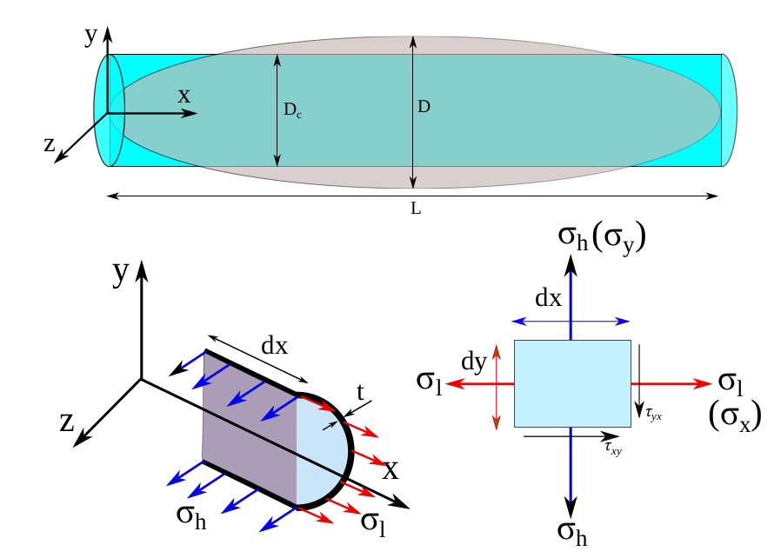
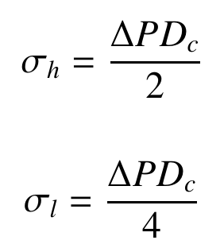
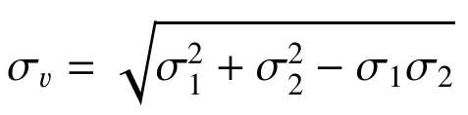
Von-Mises stresses

Slide 32
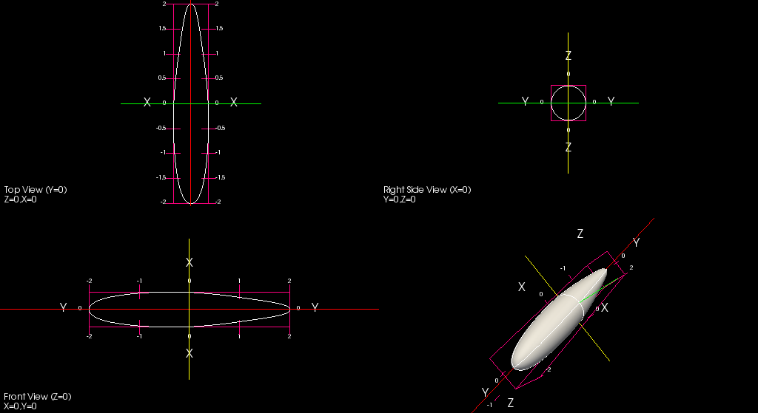
Axi-symmetric shape with minimum C_{DV}
Solution vecor = [0.40910 0.8 0.30428 0.61521 5.69420 1 ]

Slide 33
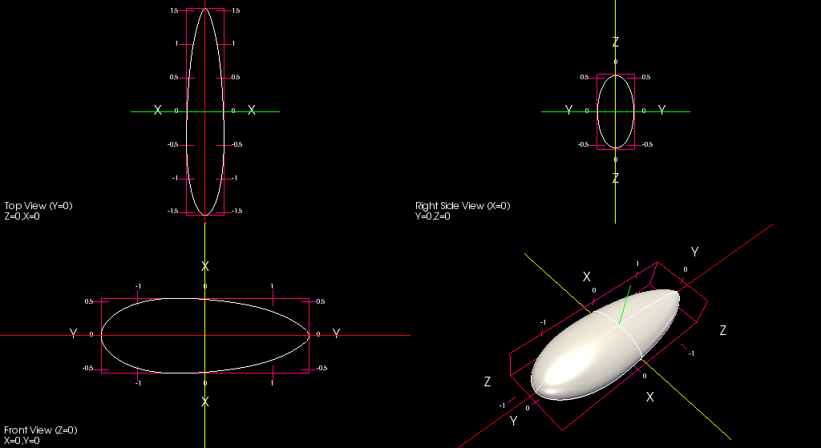
Non axi-symmetric shapes with minimum C_{DV}
Case A : Lower limit of Scale_{y} changed from 1 to 2
Solution vector = [0.37201 0.62891 0.15214 0.64283 5.53748 2]

Slide 34

Non axi-symmetric shapes with minimum C_{DV}
Case B : Lower limit of Scale_{y} changed from 1 to 2.5
Solution vector = [0.47998 0.74580 0.17931 0.66849 5.81668 2.58996]

Slide 35
Non axi-symmetric shapes with minimum σ_{v}
Solution vector = [0.5 0.8 0.5 0.55 6 3]

Slide 36
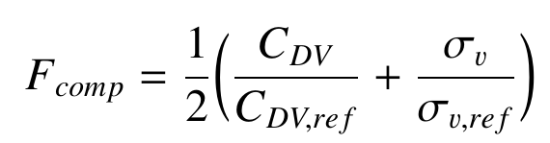
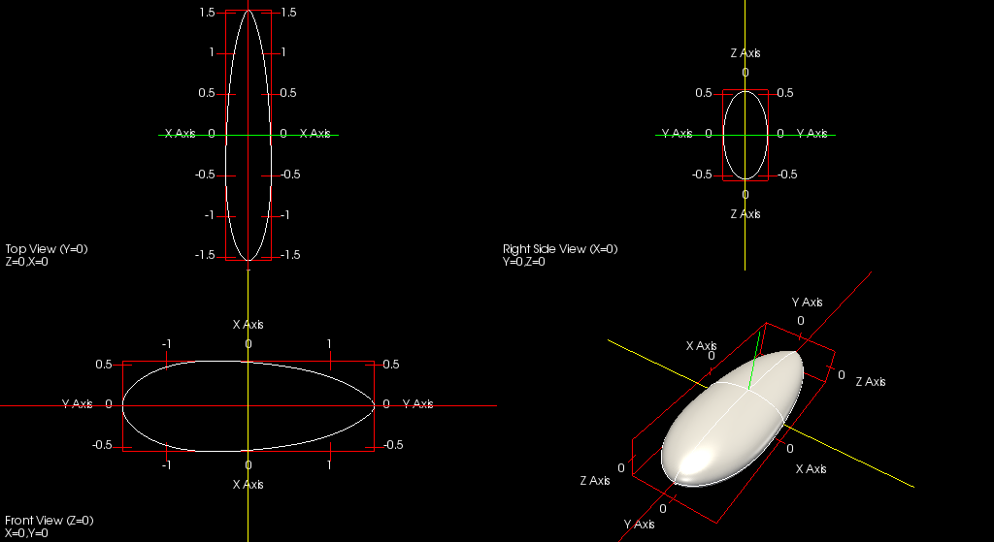
Composite objective function
Where, C_{DV,ref} , σ_{v,ref} are the values of these parameters corresponding to the reference shape. The values taken are 0.02064 and 415.29 respectively.
Solution vector = [0.37207 0.62949 0.15479 0.64237 5.63750 2.00000]

