Slide 1

Spam Detection using Machine Learning and Natural Language Processing
Project Guide : Dr . S. Prince Mary M.E., Ph.D.,
Team Members : 1) V. Sri Ganesh
reg : 38110623
2) V. Manideep Sitaram
reg : 38110624

Slide 2
Abstract
Today, spam has become a big trouble over the internet. Up to 2020, the statistic shown spam accounted for 47.8%of all e-mail messages, a significant jump over 45% recorded in 2019.
Spam which is also known as unsolicited bulk email has led to the increasing use of email as email provides the perfect ways to send the unwanted advertisement or junk newsgroup posting at no cost for the sender.
A lot of effort is being put into this by email service providers to prevent this due to unwanted increase in bandwidth and customer dissatisfaction.
This project aims at classifying an email as spam or not by analyzing the content using Natural Language Processing Techniques and comparing it previously recorded data using machine learning.

Slide 3
Literature Review
Author(s) | Year of Publication | Description | Pros | Cons
Abhila B, Mabel Nirmala Joseph, Delphin M | 2021 | Spam Detection in emails and texts using supervised machine learning algorithm | Usage of supervised models. Naïve bayes provides good accuracy. | Usage of only model results in overfitting of data No explicit pre-processing of emails/texts
Mansoor RAZA, Nathali Dilshani Jayasinghe, Muhana Magboul Ali Muslam | 2021 | A comprehensive review on email classification using machine learning algorithms | Extensive review of various algorithms Clear representation of results using visualization. | Grouping of algorithms into classes makes results inconclusive

Slide 4
Author(s) | Year of publication | Description | Pros | Cons
Tasnia Toma, Samia Hassan, Mohammad | 2021 | An analysis of supervised machine learning algorithms for spam detection | Uses multiple Algorithms in various categories Accuracies for each algorithm is above 90% | Relatively small dataset which may results in overfitting of data
Jaouhar Fattahi, Mohamed Mejri | 2021 | A Spam detector based on bimodal ensemble algorithm with natural language processing | Uses NLP for pre-processing of text Comparative analysis of various models using accuracies | Dataset contains only 700 instances of spam records which may not represent real world data.

Slide 5
Author(s) | Year of publication | Description | Pros | Cons
Md Khairul Islam, Md Al Amin, Md Rakibul Islam, Md Nosin Ibla Mahbub | 2021 | Spam Detection using comparative analysis and Spamming words extraction | Uses Natural language processing for text processing. Provides spamming words in visualisation. | Key words are generalised rather than extraction for each email.
Chirag bansal, brahmaleen sidhu | 2021 | Machine learning based hybrid approach for spam detection. | Uses both machine learning and AI classification. Uses TFIDF for frequency detection | Provides no specific procedure for text processing Model seems to be overfitted.

Slide 6
Existing Work
The existing system is completely operated by the email service provider by separating the mails into various categories but no system is perfect.
Some cases are reported on non-spam emails being categorized as spam and spam not being identified correctly.
Throughout this process the user has no way to determine if an email is spam or not in any way except diving into the mail and classifying it based on their knowledge
This method is not only a waste of valuable time but also prone to errors because spam is always changing and every user may not be aware of these changes so are the providers as they depend on user feedback.

Slide 7
Objectives
To study efficiency of various algorithms in spam detection.
To determine what concludes an email as spam using natural language processing through feature extraction.
To Classify emails into spam or not spam using machine learning models through ensemble approach.
To Provide key insights on what makes an email spam through entity extraction.

Slide 8
Proposed work
The proposed system is a standalone/web based application which the user can directly use to classify an email as spam or not.
The system classifies the email as spam or not using a dataset of emails containing thousands of emails categorized by users.
It cleans the user’s email using natural language processing techniques and then compares it other emails through various machine learning algorithms and classifies the email along with providing some key entities which are helpful in classifying it.
The main advantage of this system is that the user can provide a email and it cleans, compares, classifies by it self without making the user to go through it.

Slide 9

System Architecture
UI
text
Text Processing
vectors
ML Models
entities
predictions
Entities, prediction
output
Analysis
Final prediction

Slide 10

Work flow diagram
Dataset - 1
Dataset - 2
Final dataset
Data Cleaning
Text pre-processing
Feature vectors data
Dataset - 3
Training data
Testing data
Text pre-processing and vector conversion
User input
Feature vectors data
KNN
Used for results and analysis
Key entities
Logistic reg
Naïve Bayes
SVM
Random Forest
Majority Prediction
Predictions

Slide 11
System Requirements
Hardware Requirements
PC/Laptop
Ram – 8 Gig
Storage – 100-200 Mb
Software Requirements
OS – Windows 7 and above
Code Editor – Pycharm, VS Code, Built in IDE
Anaconda environment with packages nltk, numpy, pandas, sklearn, tkinter, nltk data.
Supported browser such as chrome, firefox, opera etc..

Slide 12
Modules
UI Module
Data Processing Module
Machine Learning Module

Slide 13
Module Description
UI Module
This Module contains all the functions related to UI(user interface).
The user interface of this application is designed using Tkinter library from python built-in packages.
The user inputs are acquired using the functions of this library and forwarded to data processing module for processing and conversion.
Finally the output from ML module is sent to this module and from this module to user in visual form.

Slide 14
Data Processing Module
The raw data undergoes several modifications in this module for further process.
Some of the main functions of this module includes
Data cleaning
Data merging of datasets
Text Processing using NLP
Conversion of text data into numerical data(feature vectors).
Splitting of data.
All the data processing is done using Pandas and NumPy libraries.
Text processing and text conversion is done using NLTK and scikit-learn libraries.

Slide 15
ML Module
This module is the main module of all three modules.
This modules performs everything related to machine learning and results analysis.
Some main functions of this module are
Training machine learning models.
Testing the model
Determining the respective parameter values for each model.
Key-word extraction.
Final output calculation
The output from this module is forwarded to UI for providing visual response to user

Slide 16
Implementation
1. Data Collection
Data plays an important role when it comes to prediction and classification, the more the data the more the accuracy will be.
The data used in this project is completely open-source and has been taken from various resources like Kaggle and UCI
For the purpose of accuracy and diversity in data multiple datasets are taken.
2 datasets containing approximately over 12000 mails and their labels are used for training and testing the application.
6000 spam mails are taken for generalisation of data and to increase the accuracy.

Slide 17
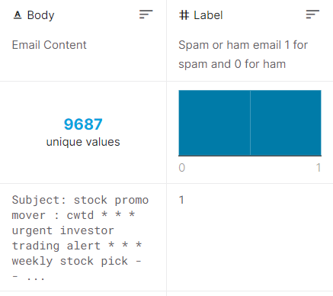
Data Description
Dataset : enronSpamSubset.
Source : Kaggle
Description : this dataset is part of a larger dataset called enron. This dataset contains a set of spam and non-spam emails with 0 for non spam and 1 for spam in label attribute.
Composition :
Unique values : 9687
Spam values : 5000
Non-spam values : 4687

Slide 18
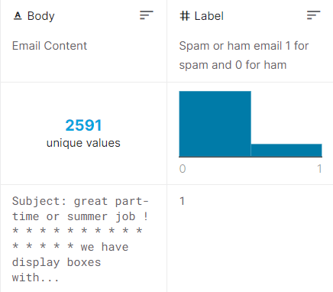
Data description
Dataset : lingspam.
Source : Kaggle
Description : This dataset is part of a larger dataset called Enron1 which contains emails classified as spam or ham(not-spam).
Composition :
Unique values : 2591
Spam values : 419
Non-spam values : 2172

Slide 19
2. Data Processing.
Overall data processing
Textual data processing
Overall Data Processing
Dataset cleaning
It includes tasks such as removal of outliers, null value removal, removal of unwanted features from data.
Dataset Merging
After data cleaning, the datasets are merged to form a single dataset containing only two features(text, label).
Data cleaning, Data Merging these procedures are completely done using Pandas library.

Slide 20
Textual Data Processing
Tag removal
Removing all kinds of tags and unknown characters from text using regular expressions through Regex library.
Sentencing, tokenization
Breaking down the text(email/SMS) into sentences and then into tokens(words).
This process is done using NLTK pre-processing library of python.
Stop word removal
Stop words such as of , a ,be , … are removed using stopwords NLTK library of python.
Lemmatization
Words are converted into their base forms using lemmatization and pos-tagging
This process gives key-words through entity extraction.
This process is done using chunking in regex and NLTK lemmatization.

Slide 21
Sentence formation
The lemmatized tokens are combined to form a sentence.
This sentence is essentially a sentence converted into its base form and removing stop words.
Then all the sentences are combined to form a text.
Feature vector formation
The texts are converted into feature vectors(numerical data) using the words present in all the texts combined
This process is done using countvectorization of NLTK library.
While the overall data processing is done only to datasets, the textual processing is done to both training data, testing data and also user input data.

Slide 22
3. Machine Learning Process
Data Splitting
The Data is split into training and testing datasets using sklearn Library functions.
80% of data is taken for training and remaining 20% is for testing.
Model Training
The machine learning models are fitted with the training data.
Model Testing
The predictions obtained from the models when given testing data are used calculate various metrics such as accuracy, precision, and f1 score.
Prediction
The user data is supplied to these trained models and the predictions are given to user post analysis.

Slide 23
Machine Learning models
Naive Bayes Classifier
Random Forest Classifier
Logistic Regression
KNN
SVM

Slide 24
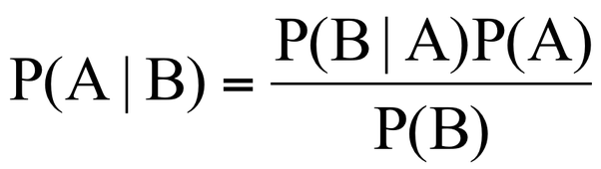
Naive Bayes Classifier
A Naive Bayes classifier is a probabilistic machine learning model that’s used for classification task. The crux of the classifier is based on the Bayes theorem
Bayes Theorem:
Bayes theorem determines the conditional probability of an event A given that event B has already occurred.
Using Bayes theorem, we can find the probability of A happening, given that B has occurred. Here, B is the evidence and A is the hypothesis. The assumption made here is that the predictors/features are independent. That is presence of one particular feature does not affect the other. Hence it is called naive.

Slide 25
Random Forest Classifier
Random Forest Classifier is Ensemble algorithim
Ensembled algorithms are those which combines more than one algorithms of same or different kind for classifying objects
Random forest classifier creates a set of decision trees from randomly selected subset of training set. It then aggregates the votes from different decision trees to decide the final class of the test object.
Random Forest Classifier works on principle Number of weak estimators when combined forms strong estimator

Slide 26
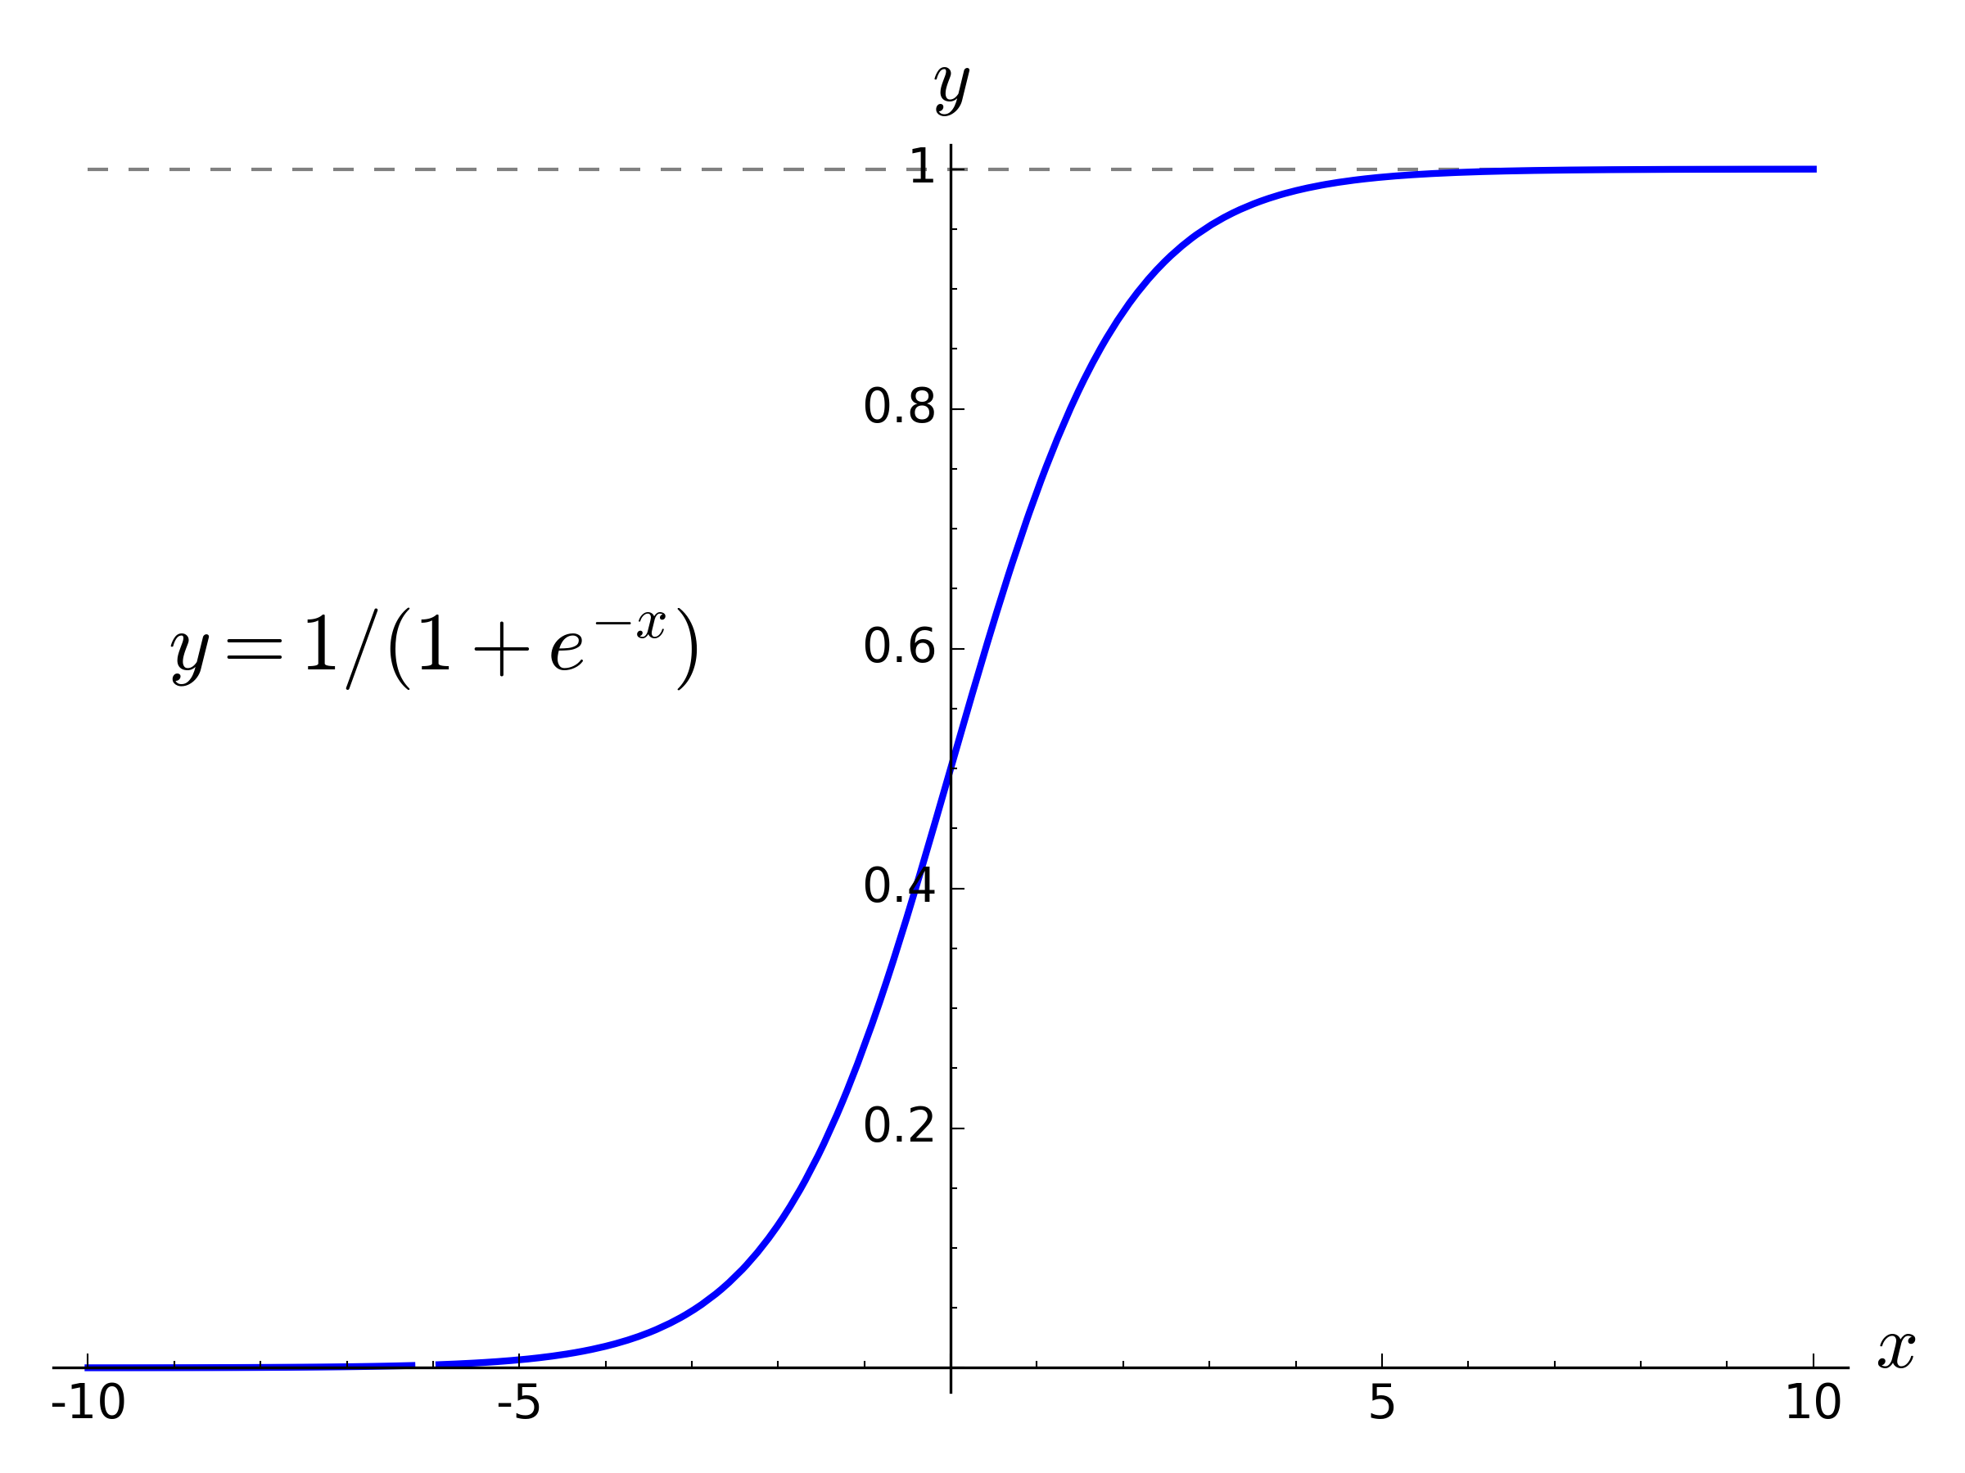
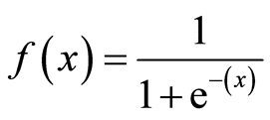
Logistic Regression
Logistic regression is basically a supervised classification algorithm.
In a classification problem, the target variable(or output), y, can take only discrete values for a given set of features(or inputs), X.
Logistic regression models the data using the sigmoid function.
The sigmoid function is a mathematical function having a characteristic “S” — shaped curve, which transforms the values between the range 0 and 1.
Sigmoid function mathematical equation is:

Slide 27

K Nearest Neighbour
K Nearest Neighbour is a simple algorithm that stores all the available cases and classifies the new data or case based on a similarity measure.
It is mostly used to classifies a data point based on how its neighbours are classified.
k’ in KNN is a parameter that refers to the number of nearest neighbours to include in the majority of the voting process.
k’ in KNN algorithm is based on feature similarity choosing the right value of K is a process called parameter tuning and is important for better accuracy
There are many distance methods used to find the distance between the two points.But the most popular one is Euclidean distance method

Slide 28
Support Vector Machines
A support vector machine (SVM) is a supervised machine learning model that uses classification algorithms for two-group classification problems
The objective of the support vector machine algorithm is to find a hyperplane in an N-dimensional space(N — the number of features) that distinctly classifies the data points.
Hyperplanes are decision boundaries that help classify the data points. Data points falling on either side of the hyperplane can be attributed to different classes
Support vectors are data points that are closer to the hyperplane and influence the position and orientation of the hyperplane

Slide 29
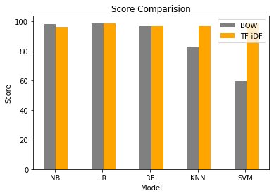
Results
Bag-of-Words vs TF-IDF
The models are tested with both the language models to determine which one is more efficient.
Model \ Language Model | Bag of Words (BoW) | TF-IDF
Naïve Bayes | 98.04 | 96.05
Logistic Regression | 98.53 | 98.80
Random Forest | 96.84 | 96.80
K-Nearest Neighbors | 83.15 | 96.61
Support Vector Machines | 59.41 | 98.82

Slide 30
a model is created by combining all the five models and TF-IDF language model.
Metric Model | Accuracy | Precision | F1 Score
Naïve Bayes | 96.0 | 99.2 | 95.2
Logistic Regression | 98.4 | 97.8 | 98.6
Random forest | 96.8 | 96.4 | 96.3
KNN | 96.6 | 96.9 | 96.0
SVM | 98.8 | 97.8 | 98.6
Proposed model | 99.0 | 98.5 | 98.6
RED - lower than the proposed model
GREEN - equal or higher.

Slide 31
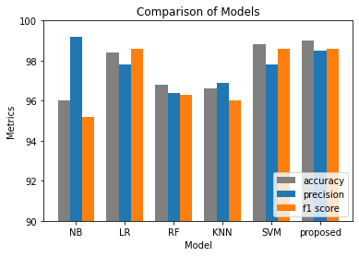

Slide 32
Conclusion
An application is created to classify an email as spam or not spam using machine learning and natural language processing techniques.
This application classifies the user provided text into spam or not-spam by comparing it to nearly 13000 texts through machine learning models.
TF-IDF language model is proved to be more efficient than Bag-of-Words model in classification.
The ensemble model created outperformed almost all the algorithms in every metric used.
This application enables the end-user to classify a text and get key-entities of that text without having to go through it.

Slide 33
Working Screenshots

Slide 34
References
M. RAZA, N. D. Jayasinghe and M. M. A. Muslam, "A Comprehensive Review on Email Spam Classification using Machine Learning Algorithms," 2021 International Conference on Information Networking (ICOIN), 2021, pp. 327-332, doi: 10.1109/ICOIN50884.2021.9334020.
A. B, D. P. M, K. M, M. N. Joseph and D. R, "Spam Detection System Using Supervised ML," 2021 International Conference on System, Computation, Automation and Networking (ICSCAN), 2021, pp. 1-5, doi: 10.1109/ICSCAN53069.2021.9526421.
M. K. Islam, M. A. Amin, M. R. Islam, M. N. I. Mahbub, M. I. H. Showrov and C. Kaushal, "Spam-Detection with Comparative Analysis and Spamming Words Extractions," 2021 9th International Conference on Reliability, Infocom Technologies and Optimization (Trends and Future Directions) (ICRITO), 2021, pp. 1-9, doi: 10.1109/ICRITO51393.2021.9596218.
C. Bansal and B. Sidhu, "Machine Learning based Hybrid Approach for Email Spam Detection," 2021 9th International Conference on Reliability, Infocom Technologies and Optimization (Trends and Future Directions) (ICRITO), 2021, pp. 1-4, doi: 10.1109/ICRITO51393.2021.9596149.
T. Toma, S. Hassan and M. Arifuzzaman, "An Analysis of Supervised Machine Learning Algorithms for Spam Email Detection," 2021 International Conference on Automation, Control and Mechatronics for Industry 4.0 (ACMI), 2021, pp. 1-5, doi: 10.1109/ACMI53878.2021.9528108.

