Slide 1

Final Review
Minor Project-2 Summer Semester-2024-25
Department of Electronics and Communication Engineering
Title: Segmentation & Classification Of Oral Cancer
Domain: Signal Processing
30/10/2024
Date:
Project Team Members
VTU 20901(Manideep.N)
VTU 19432(Rajesh kumar Reddy.K)
VTU 20948(Hayshitha.S)
Supervisor: Dr. A Ashwini
Assistant Professor / ECE

Slide 2
Content
Introduction
Objective
Proposed Methodology/Algorithm/Model
Literature survey
Results and Discussion
Work to be Carried-out
References

Slide 3
Motivation and Introduction/Justification of Title
The term oral cancer refers to malignant tumors of the mouth such as lips, tongue, cheeks, floor of mouth, hard and soft palate, sinuses and throat. Because it has a high morbidity and mortality rate, it is a major health issue.
Oral Cancer Segmentation : Segmenting the image into regions or segments is called segmentation, which aims to separate regions of interest, such as lesion areas from normal tissues. Precise splitting is essential
Treatment Planning: Tumor boundaries are established for accurate surgical removal.
Diagnosis: Helps pathologists in detecting and assessing how widespread the condition
Monitoring: Follow up on tumor growth over time or response to treatment.

Slide 4
Objective
Invent an Algorithm for Automated Segmentation: Make a program that can accurately divide oral cancer lesions from medical images by developing the algorithm using advanced methods like deep learning
Increase Classification Accuracy: Design a model that can recognize between malignant and benign oral lesions, compare traditional machine learning techniques with deep learning approaches.
Evaluate Algorithm Performance: Evaluation of segmentations and classifications will be based on metrics such as accuracy, precision, recall, F1-score, and Dice coefficient.
Design a User-Friendly Interface for Clinical Use
Integrate Multi-Modal Data for Improved Accuracy

Slide 5
Methodology/Technique
Oral Dataset
Data Preprocessing
&
Data Augmentation
Model Selection
(Custom CNN & VGG16)
Model Design (CONV2D,Maxpooling2D,Dense,Dropout,VGG16)
Result
(Oral Cancer ,Non-Oral Cancer)
Model Evaluation
(Accuracy,Metrics)

Slide 6
Literature Survey
S.No. | Title and Year of Publication | Methodology and Challenges Used
1 | Hussain, N., & Subramani, S. (2020). "Oral cancer segmentation and classification using deep learning | "Automated segmentation and classification of oral lesions using machine learning." Journal of Biomedical Informatics, 94, 103182.Patil, K., & Nagaraj, T. (2021). "Deep learning approaches for oral cancer detection and classification: A comprehensive review." Computers in Biology and Medicine, 133, 104389.
2 | Ariji et al. (2020) proposed a deep learning-based approach for segmentation of oral squamous cell carcinoma using CT images | They used a U-Net architecture with a batch size of 16 and trained the model for 50 epochs. They achieved a Dice coefficient of 0.85 and a Jaccard coefficient of 0.76 . Methodology: U-Net architecture, batch size of 16, 50 epochs Challenges: Limited dataset, class imbalance
3 | Panigrahi et al. (2019) developed a convolutional neural network (CNN) for segmentation of oral cancer images. | They used a dataset of 100 images and trained the model for 100 epochs. They reported an accuracy of 93.75% and a Dice coefficient of 0.83. Methodology: CNN architecture, dataset of 100 images, 100 epochs Challenges: Limited dataset, overfitting

Slide 7
Literature Survey
S.No. | Title and Year of Publication | Methodology and Challenges Used
4 | Ramalingam et al. (2020) used a pre-trained CNN for segmentation of oral squamous cell carcinoma images. | They fine-tuned the model on a dataset of 50 images and trained it for 20 epochs. They achieved an accuracy of 95.45% and a Dice coefficient of 0.87 . Methodology: Pre-trained CNN, fine-tuning, dataset of 50 images, 20 epochs Challenges: Limited dataset, transfer learning
5 | Kiruthika et al. (2020) developed a CNN for classification of oral cancer images | They used a dataset of 150 images and trained the model for 100 epochs. They reported an accuracy of 95.12% and a sensitivity of 96.15% . Methodology: CNN architecture, dataset of 150 images, 100 epochs Challenges: Limited dataset, overfitting

Slide 8
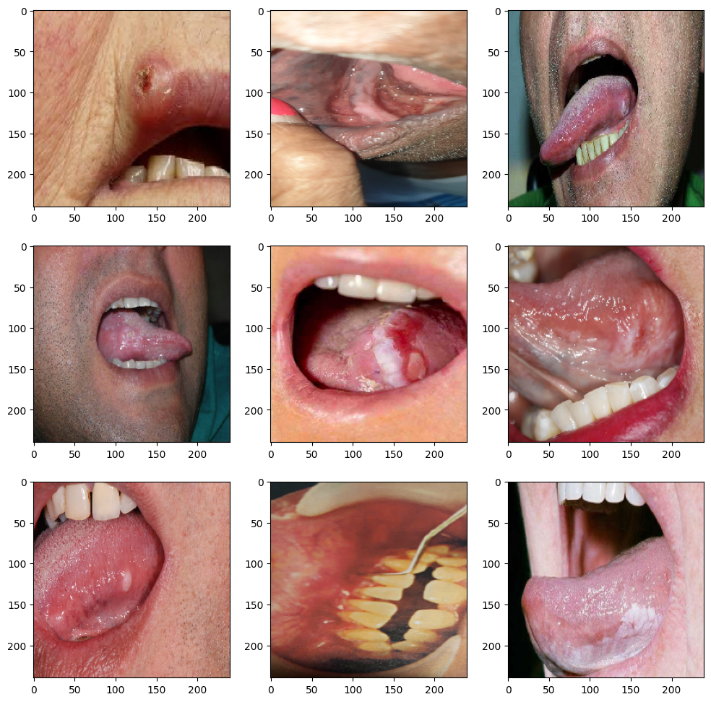
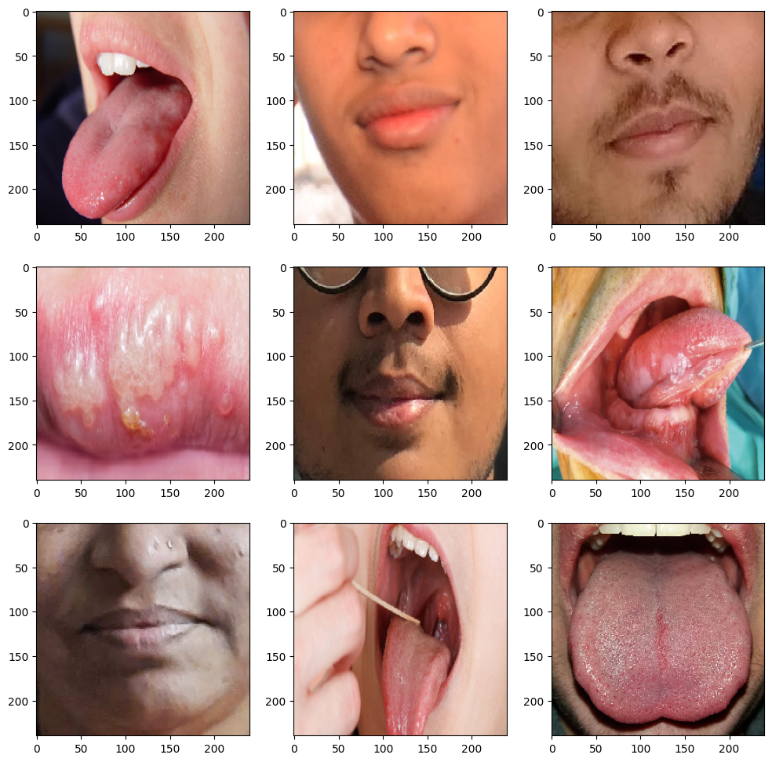
Oral cancer
Result And Discussion
Non-Cancer

Slide 9
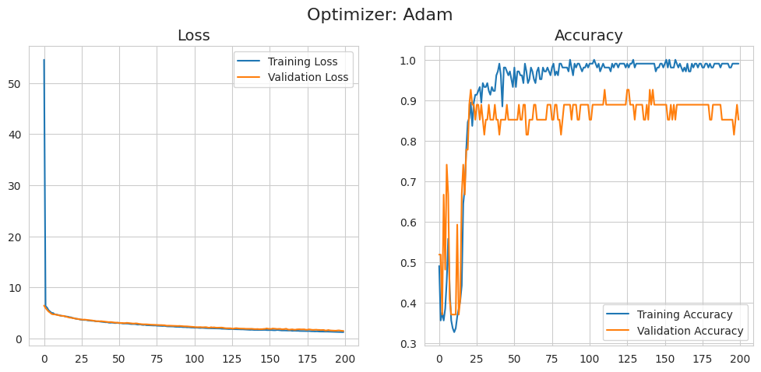
Training And Validation

Slide 10
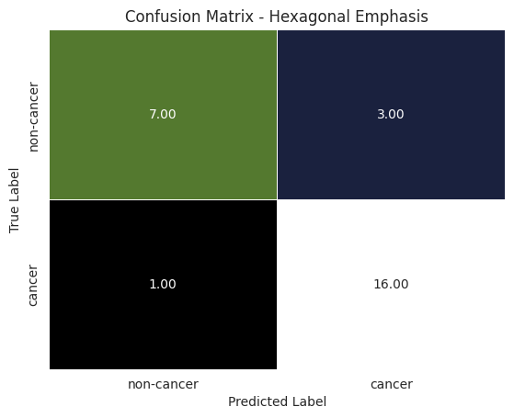
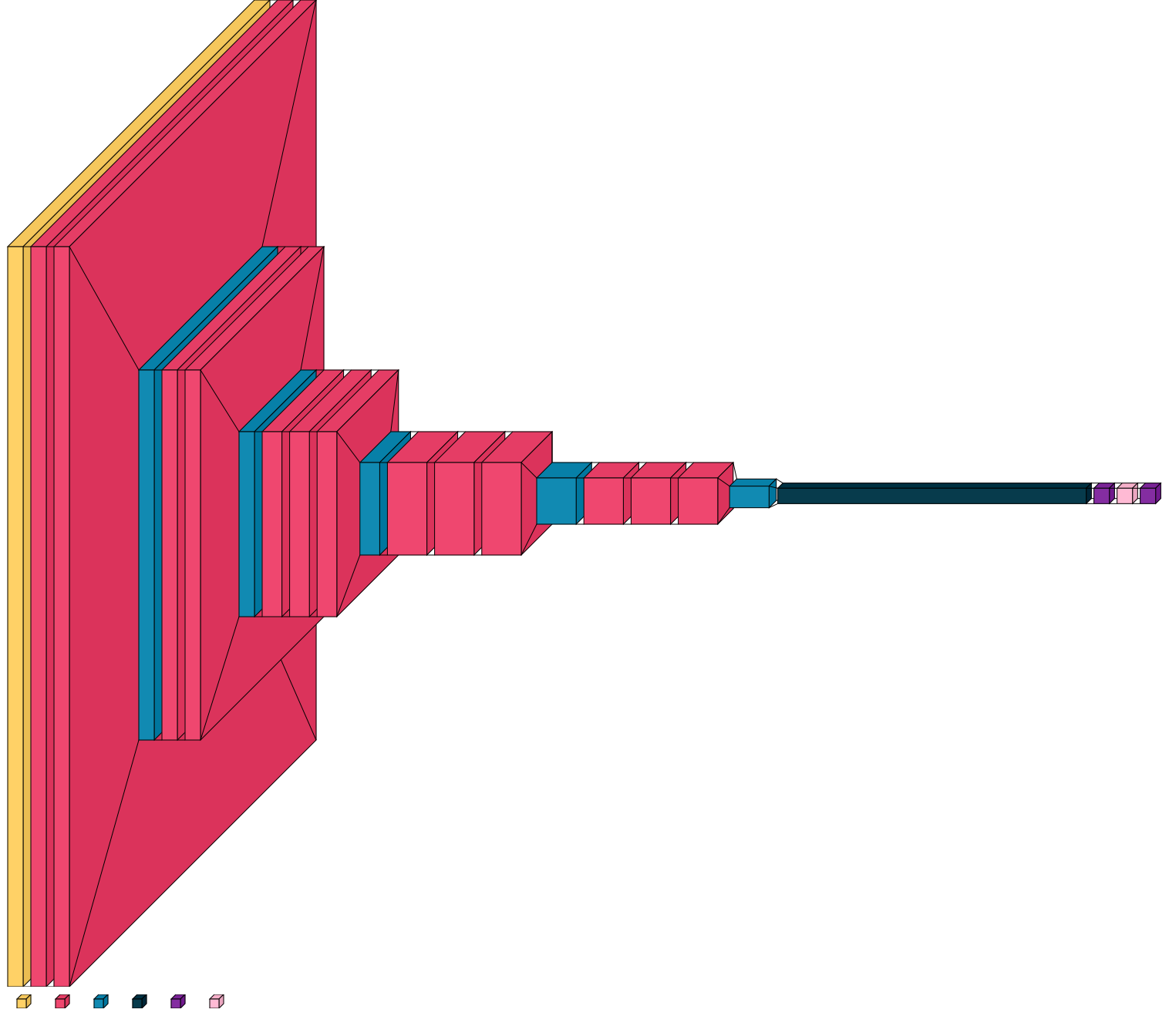
Confusion Matrix
Visual keras

Slide 11
Work to Carried
Implications for Future Work
Future studies could explore the integration of multi-modal data (e.g., clinical history, imaging data) to enhance the model's predictive power.
Continuous experimentation with various architectures and hyperparameters will help refine the model and increase its robustness.

Slide 12
Reference
Hussain, N., & Subramani, S. (2020). "Oral cancer segmentation and classification using deep learning techniques: A review." Oral Oncology, 104, 104653.
Acharya, A., & Ghosh, M. (2019). "Automated segmentation and classification of oral lesions using machine learning." Journal of Biomedical Informatics, 94, 103182.
Patil, K., & Nagaraj, T. (2021). "Deep learning approaches for oral cancer detection and classification: A comprehensive review." Computers in Biology and Medicine, 133, 104389.
Singh, D., & Mehra, R. (2022). "Multi-modal data fusion for oral cancer detection using machine learning." IEEE Access, 10, 5408-5421.
Gupta, S., & Sharma, A. (2018). "Segmentation and classification of oral cancer using hybrid algorithms." Journal of Medical Systems, 42(10), 183.
Chaudhary, K., & Srivastava, A. (2020). "Artificial intelligence in oral cancer diagnosis: Trends and future perspectives." Oral Diseases, 26(5), 1273-1285.

Slide 13


