Slide 1
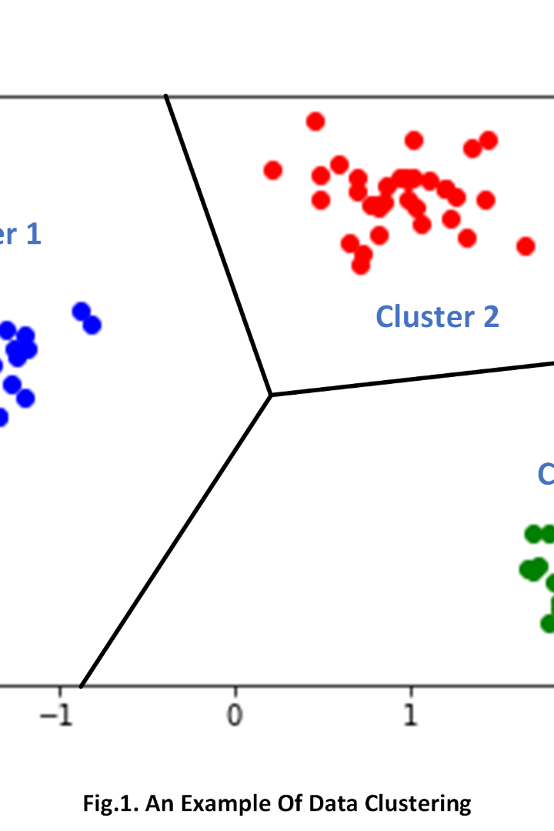
Clustering and its Types, Uses, and Examples in Machine Learning
Clustering is a fundamental concept in machine learning that involves grouping similar data points together. In this presentation, we will explore different clustering methods, their applications, and notable examples.
Manideep Guduru

Slide 2

Introduction
1
Definition of Clustering
Clustering is the process of dividing a set of data points into groups called clusters based on their similarity.
2
Importance of Clustering in Machine Learning
Clustering helps in data exploration, pattern recognition, and discovering hidden structures in datasets.

Slide 3
Types of Clustering
Partitioning Methods
Hierarchical Methods
Density-based Methods
Model-based Methods
Partitioning methods aim to divide the dataset into distinct non-overlapping clusters using iterative optimization techniques.
Hierarchical methods create clusters in a tree-like structure, allowing for both top-down and bottom-up approaches.
Density-based methods define clusters as high-density regions separated by low-density regions.
Model-based methods assume that the data is generated from a mixture of probability distributions and find the best fit for the data.

Slide 4
Uses of Clustering in Machine Learning
Customer Segmentation
Anomaly Detection
Clustering helps identify and group customers based on their behavior, preferences, and demographics for targeted marketing strategies.
Clustering can detect anomalous patterns or outliers in data, helping detect fraud, network intrusions, or system failures.
Image Recognition
Document Clustering
Clustering assists in classifying and organizing images based on visual similarities, aiding in tasks such as image search or recommendation systems.
Clustering text documents enables grouping of similar documents for topic modeling, document summarization, and information retrieval.

Slide 5
Examples of Clustering Algorithms
K-means Clustering
DBSCAN (Density-Based Spatial Clustering of Applications with Noise)
Mean Shift
Gaussian Mixture Models
Mean Shift identifies clusters by finding maxima of a density function and iteratively shifting points towards higher density regions.
K-means is a popular partitioning algorithm that aims to minimize the distance between data points within clusters and maximize the distance between clusters.
Gaussian Mixture Models represent the data as a mixture of Gaussian distributions, providing a probabilistic framework for clustering.
DBSCAN groups together data points that are closer to each other and separates data points that are in low-density regions.

Slide 6

Conclusion
1
Summary of Clustering and its Types
Clustering is a powerful technique in machine learning used to group similar data points together. It offers various methods like partitioning, hierarchical, density-based, and model-based.
2
Importance of Clustering in Machine Learning Applications
Clustering helps in data analysis, pattern recognition, and decision-making processes by revealing hidden structures and relationships within datasets.

