Slide 1
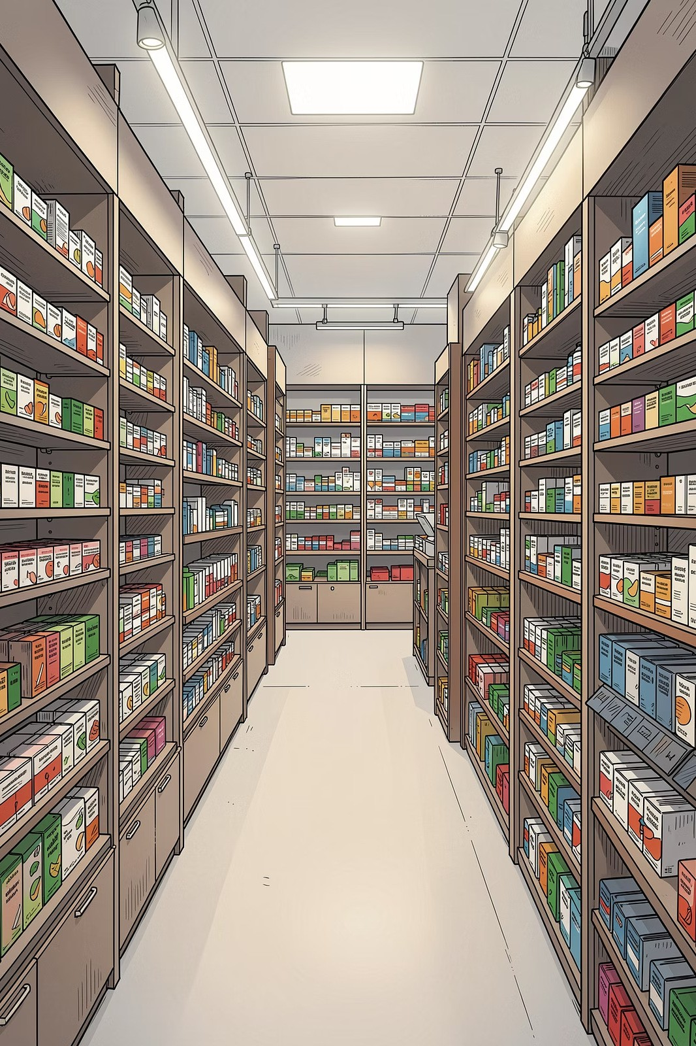
Pharmacy Inventory Dashboard

Slide 2

Introduction The Pharmacy Inventory Management System is a smart and efficient solution developed to manage medicine stock, sales, expiry tracking, and inventory operations in pharmacies. Traditional pharmacy management methods often rely on manual record maintenance, which can lead to stock errors, medicine wastage, and difficulties in tracking sales and expiry dates. The Pharmacy Inventory Management System is a smart and efficient solution developed to manage medicine stock, sales, expiry tracking, and inventory operations in pharmacies. Traditional pharmacy management methods often rely on manual record maintenance, which can lead to stock errors, medicine wastage, and difficulties in tracking sales and expiry dates.
.

Slide 3

Problem Statement Manual inventory management leads to human errors. Maintaining medicine records manually is time-consuming. Difficult to track medicine expiry dates. Expired medicines may cause financial loss and wastage. Lack of real-time stock monitoring. Frequent stock shortages and overstocking issues. Difficult to analyze sales and inventory performance. Poor inventory management affects pharmacy profitability.

Slide 4

Project Objectives Real-time stock monitoring Sales and revenue tracking Expiry medicine management Reduce medicine wastage Improve inventory accuracy Analyze pharmacy performance using dashboards Better decision-making using analytics Increase pharmacy profitability Save time and reduce manual work

Slide 5

Existing System
Pharmacies maintain records manually using paper or spreadsheets.
Inventory tracking is done without automation.
Medicine expiry dates are difficult to monitor.
Sales and stock updates take more time.
High chances of human errors in data entry.
Difficult to generate reports and business insights.
No real-time monitoring of stock and revenue.
Stock shortages and overstocking problems occur frequently.
Manual management reduces operational efficiency.

Slide 6
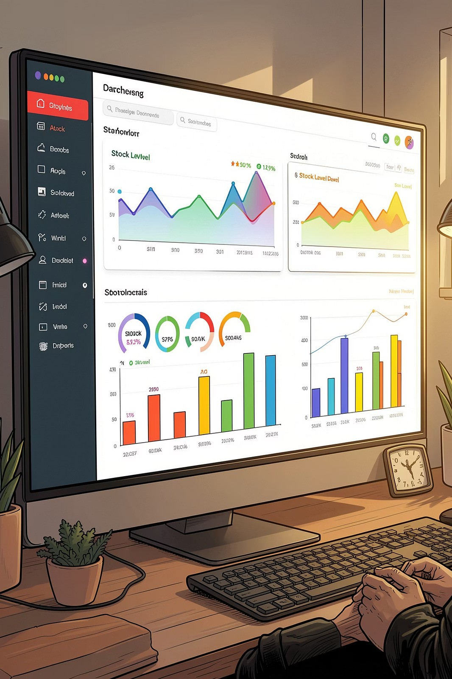
Proposed System A smart Pharmacy Inventory Management Dashboard is developed. Provides real-time monitoring of medicine stock and sales. Tracks expiry medicines and reduces wastage. Generates sales, revenue, and inventory reports automatically. Uses interactive dashboards for better visualization. Helps in faster and smarter decision-making. Improves inventory accuracy and operational efficiency. Reduces manual work and human errors. Enhances pharmacy profitability and customer service.

Slide 7


Technologies used
Python – Used for data processing and backend logic
Pandas – Used for data analysis and inventory management
NumPy – Used for numerical operations and calculations
Streamlit / Power BI – Used to create interactive dashboards
Matplotlib & Plotly – Used for charts and data visualization
Excel / CSV Dataset – Used for storing pharmacy inventory data
VS Code – Used for project development and testing

Slide 8

Features Real-time inventory monitoring Sales and revenue analysis Expiry medicine tracking Store-wise performance analysis Interactive charts and dashboards Top-selling medicine identification Category-wise inventory management Automated report generation

Slide 9
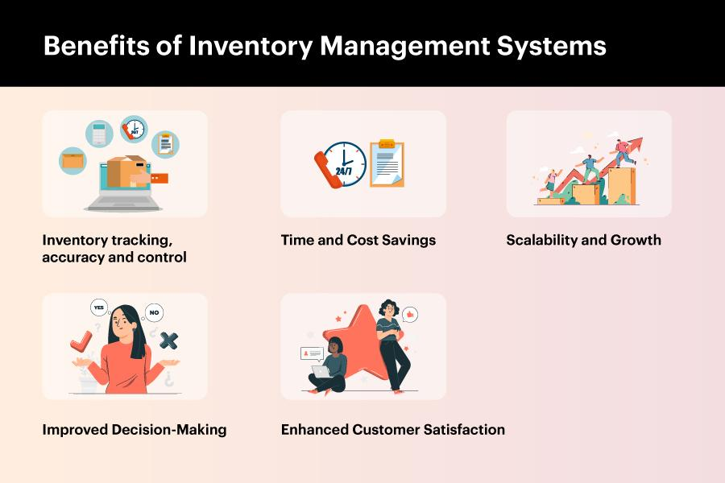
Advantages
Reduces manual work
Improves inventory accuracy
Saves time in stock management
Reduces medicine wastage
Helps in faster decision-making
Improves pharmacy efficiency
Increases profitability
Provides better customer service

Slide 10

Future Scope AI-based demand prediction Barcode and QR code integration Cloud database connectivity Mobile application support Automatic medicine reorder system Integration with hospital management systems Advanced analytics using Machine Learning Multi-store centralized management

Slide 11

Conclusion
The Pharmacy Inventory Management System is an efficient solution for managing medicine stock, sales, and expiry tracking. The dashboard provides real-time insights that help pharmacies improve inventory control, reduce wastage, and increase profitability. By automating inventory operations and using data analytics, the system improves accuracy, saves time, and supports smarter business decisions.ry Management System is an efficient and intelligent solution designed to simplify medicine stock management, billing, and inventory tracking in pharmacies and medical stores. This system helps reduce manual work, minimize human errors, and improve the overall accuracy of inventory operations. By providing real-time stock updates, expiry alerts, sales monitoring, and automated record maintenance, the system ensures smooth and reliable pharmacy management.

