Slide 1
BCSE403L · DIGITAL IMAGE PROCESSING
Image Restoration Using Spatial and Frequency Domain Filtering Techniques
MANIDEEP SAI CHINTHALA · 23BCE0737 · VELLORE INSTITUTE OF TECHNOLOGY, VELLORE
Notes:
Introduce the project as an interactive comparison of established image-restoration filters. The focus is how spatial and frequency-domain methods respond to different kinds of image damage.

Slide 2
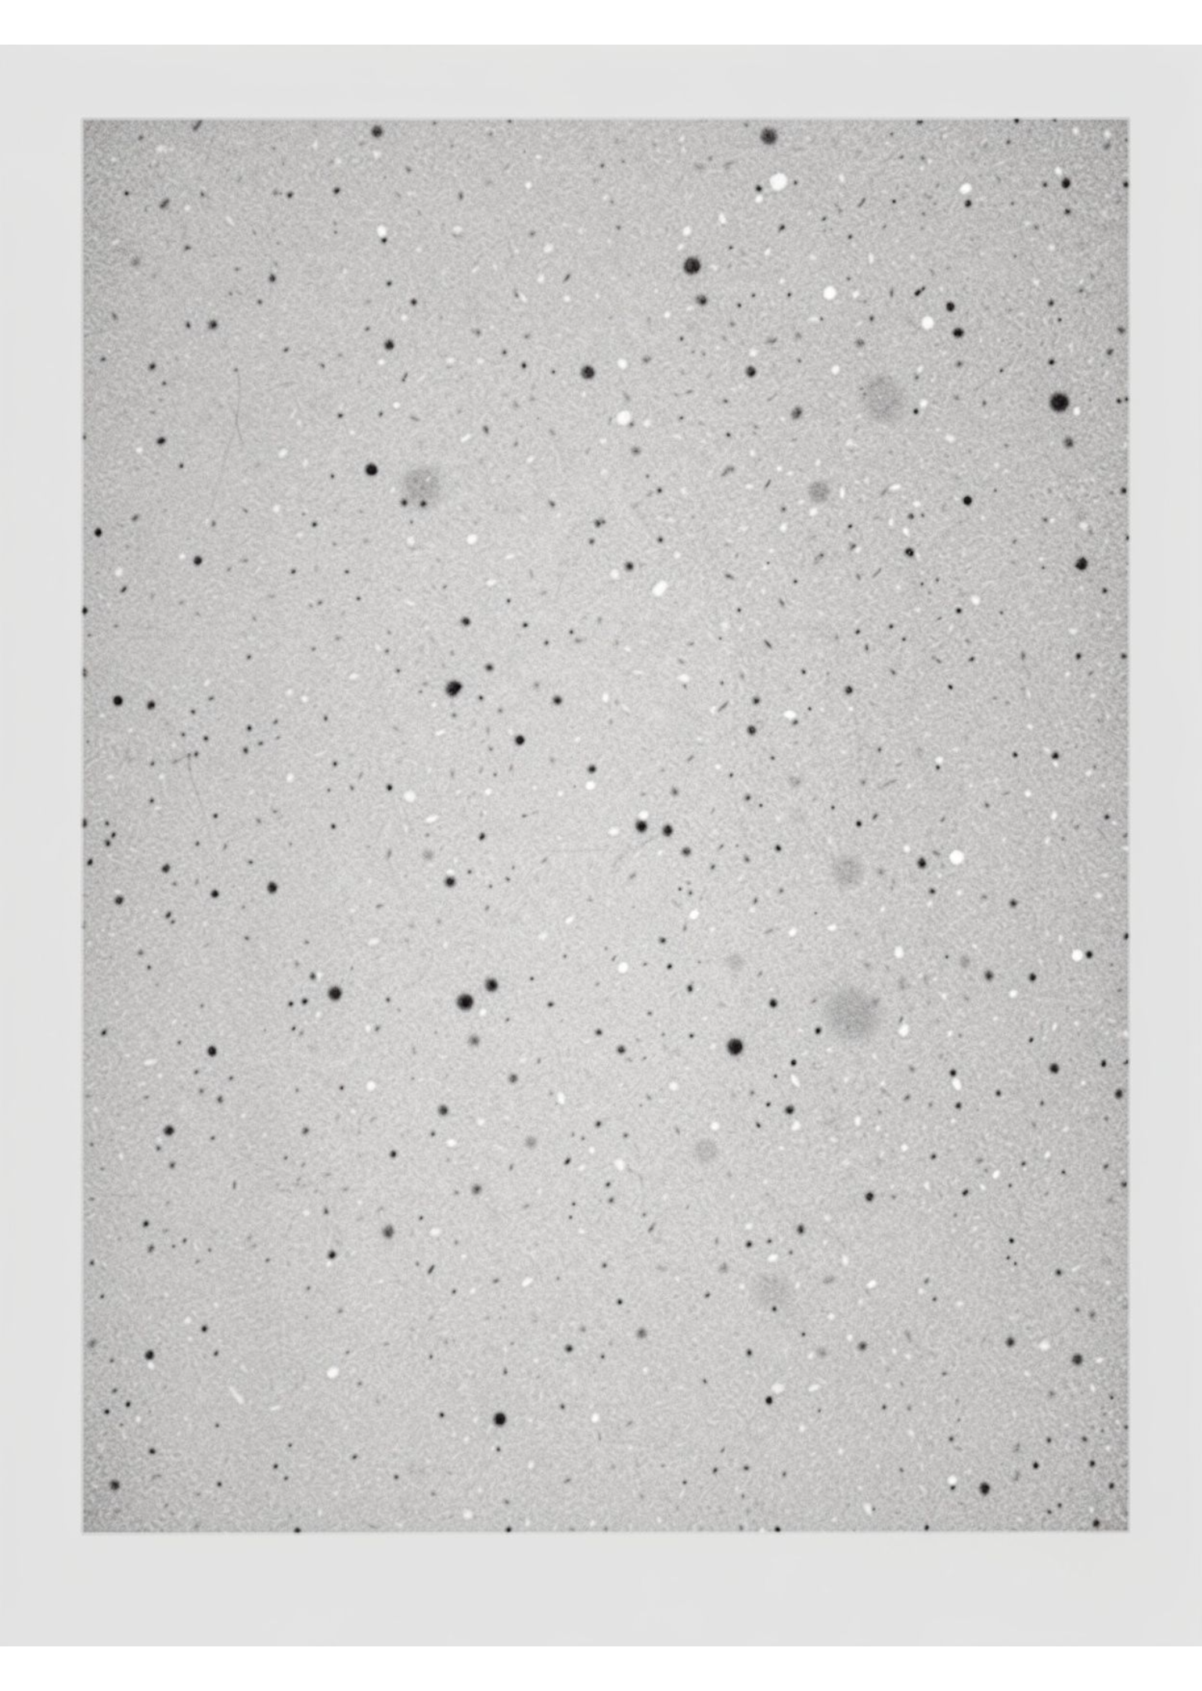

01 · PROBLEM SETUP
Restoration starts with a damaged image
Damage has a pattern
Images may be degraded by noise, blur, or both.
Restoration is comparative
Implement eight established filters and compare their performance.
The interface stays approachable
Keep the comparison interactive, controlled, and beginner-friendly.
Notes:
Begin with the input rather than the filter. Noise and blur create different restoration problems, so the project compares several established methods under controlled conditions instead of presenting one universal solution.

Slide 3
02 · RESTORATION PIPELINE
One pipeline, two restoration domains
The experiment changes the filter, not the comparison logic.
1
2
3
4
Original
Damage
Restore
Compare
Start with an original grayscale image.
Add salt-and-pepper noise, Gaussian noise, or blur.
Apply a selected restoration filter.
Compare the restored output and quality metrics.
SPATIAL DOMAIN
FREQUENCY DOMAIN
Spatial processing
Frequency processing
Works directly with neighbouring pixels.
Uses DFT/FFT, filtering, and inverse transform.
Notes:
Walk left to right through the common pipeline. The spatial and frequency-domain distinction is where the processing differs, while the input damage, selected method, output comparison, and quality review remain consistent.

Slide 4
03 · FILTER LIBRARY
Eight filters cover two complementary approaches
Choose a method by the damage it is designed to address.
Domain | Filter | Primary use
Spatial | Arithmetic mean | Smooths local variation
Spatial | Geometric mean | Multiplicative-noise smoothing
Spatial | Median | Impulse-noise removal
Spatial | Adaptive median | Variable impulse-noise suppression
Frequency | Inverse · Wiener | Deblurring and noise-aware recovery
Frequency | Gaussian low-pass | Gentle high-frequency smoothing
Frequency | Butterworth low-pass | Controlled frequency cutoff
Notes:
Point out the two groups. The four spatial filters operate on local neighbourhoods. The four frequency methods work through the transformed image representation, with inverse and Wiener aimed at deblurring and low-pass filters aimed at smoothing.

Slide 5
04 · IMPLEMENTATION
The implementation makes comparison repeatable
One offline HTML file
HTML, CSS, and JavaScript keep the tool portable.
Controlled workflow
Choose image → damage image → select filter and tune sliders → compare original, damaged, and restored outputs.
Preset experiments
Salt & Pepper Dust · Gaussian Grain · Optical Blur · Inverse Filter Failure
Notes:
Emphasize repeatability. The offline file lets a user change the image damage, filter choice, and slider settings while keeping the three-way comparison visible. The presets make common demonstrations easy to reproduce.

Slide 6
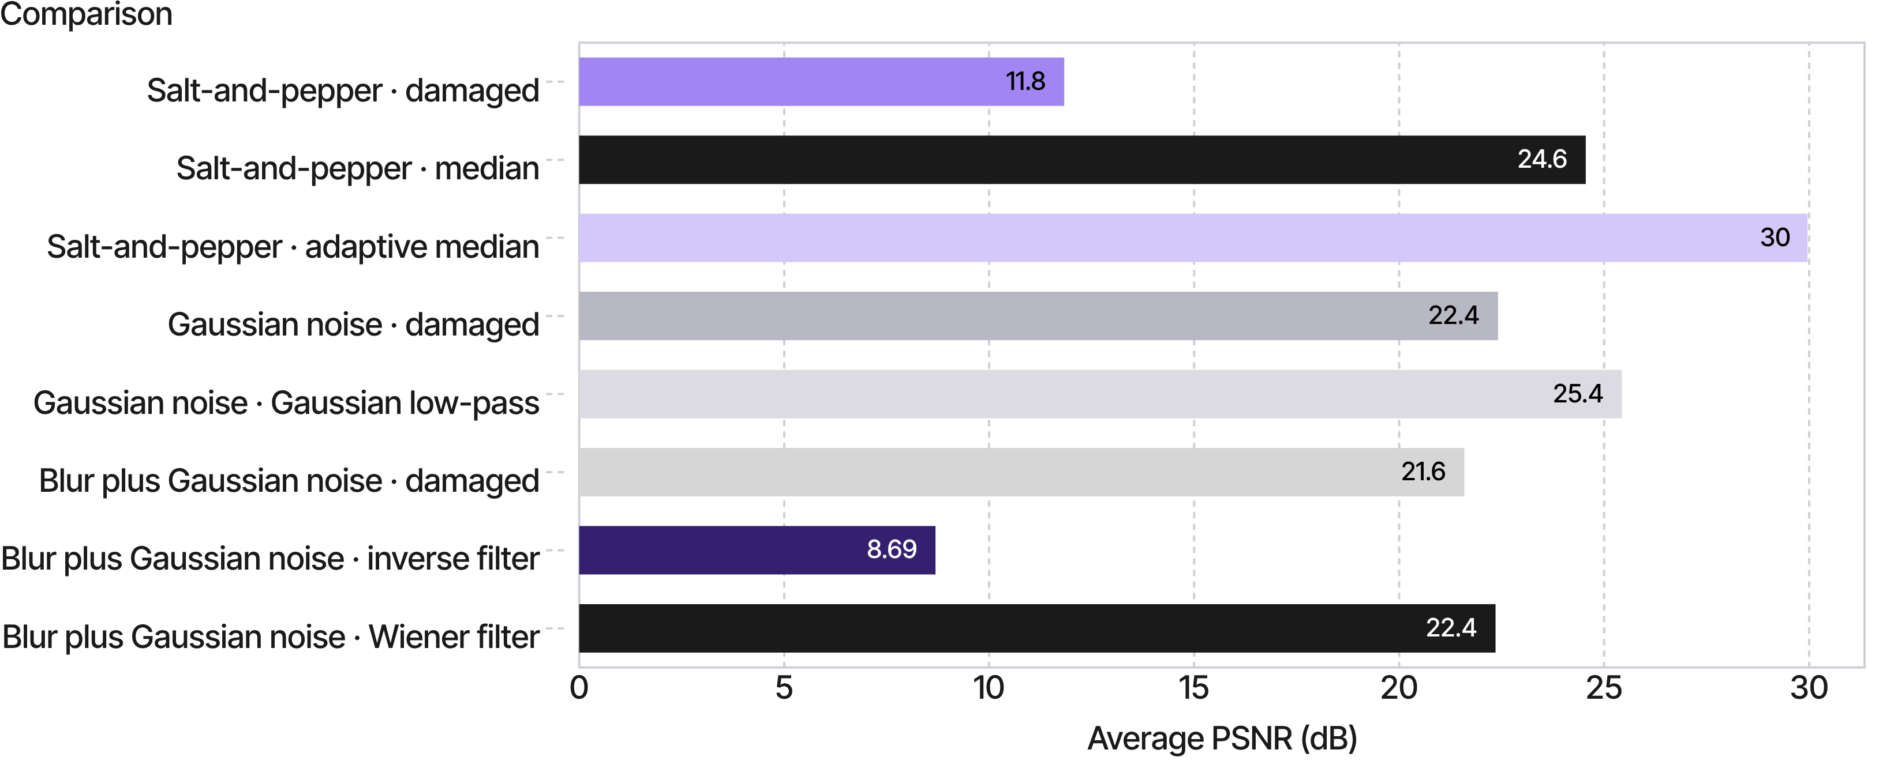
05 · EXPERIMENTAL RESULT
Adaptive median leads on impulse noise
Experimental averages over three sample images · higher PSNR generally indicates lower pixel error.
AVERAGE PSNR (DB), THREE SAMPLE IMAGES
Notes:
Use the chart to make three comparisons. Adaptive median reaches 29.96 dB under salt-and-pepper noise. Gaussian low-pass reaches 25.43 dB under Gaussian noise. Under blur plus Gaussian noise, Wiener reaches 22.35 dB while inverse filtering falls to 8.69 dB.

Slide 7
BLUR + GAUSSIAN NOISE
1
Blur response
06 · WHY THE GAP?
Some frequencies become weak.
Why Wiener outperforms inverse filtering with noise
2
Inverse division
Weak responses magnify noise.
Inverse filtering divides by the blur response. When that response is very small, the division can amplify noise instead of recovering the image.
3
Wiener control
Parameter K balances deblurring and suppression.
Takeaway: the best filter depends on the type of image damage.
8.69 DB · INVERSE
22.35 DB · WIENER
Notes:
Explain the mechanism rather than only reading the result. Inverse filtering assumes the blur response can be safely undone, but weak frequency responses make noise dominate. Wiener filtering introduces K to balance recovery against noise suppression, which explains the much stronger reported result.

Slide 8
07 · CONCLUSION
Reported results
Match the
filter to
the damage.
Adaptive median led for salt-and-pepper noise; Gaussian low-pass led for Gaussian noise; Wiener was more robust than inverse filtering for blur plus noise.
Limitations
Works only with grayscale images.
Uses known blur models to restore images.
Results may vary depending on the type and amount of noise.
Higher PSNR does not always mean better visual quality.
A CONTROLLED COMPARISON MAKES THE CHOICE VISIBLE.
Notes:
Close with the selection rule: match the filter to the damage. Then acknowledge the scope of the tests and the main next steps, before inviting questions.

