Slide 1
AadhaarGuard
A I - P O W E R E D F R A U D D E T E C T I O N
KOLLURI MANIDEEP
16 January, 2026

Slide 2
T H E C H A L L E N G E : D E T E C T I N G F R A U D A T S C A L E
Scale: Aadhaar processes millions of updates daily; manual verification covers less than 1%.
The Threat: Automated scripts create "Ghost IDs" and perform high-speed biometric identity theft.

Slide 3
The Gap: Rule-based systems miss complex, statistical anomalies.
The "Invisible" Fraud: Humans cannot spot distributed patterns across thousands of pincodes.
Latency: Current vigilance is reactive (post-audit); real-time prevention is missing.

Slide 4



H O W A A D H A A R G U A R D W O R K S
Automated Pipeline: Ingests Enrolment & Update data in real-time.
Contextual Intelligence: Calculates the "Normal" activity level for every District.
AI Engine: Uses Isolation Forest (Unsupervised Learning) to mathematically identify outliers.
Result: Flags suspicious Pincodes instantly without human intervention.

Slide 5
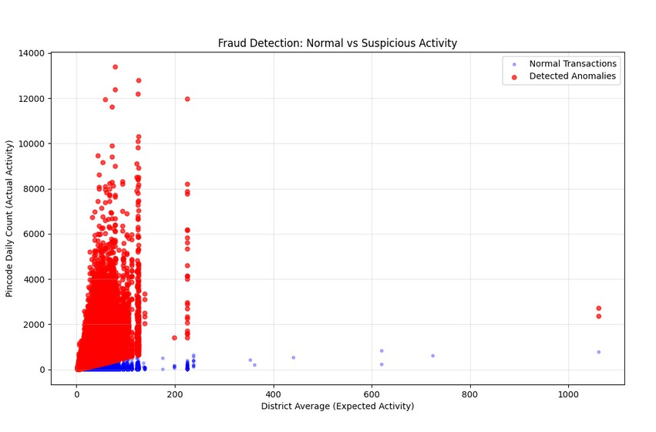
S E P A R A T I N G N O R M A L V S . S U S P I C I O U S A C T I V I T Y
Anomaly Detection Decision Boundary. The scatter plot visualizes the output of the Isolation Forest algorithm. The dense Blue Cluster represents 96% of normal Aadhaar centers operating within expected limits.
The Red Outliers represent the top 4% of high-risk pincodes deviating significantly (>5σ) from their district's demographic baseline, indicating potential bulk-update fraud.

Slide 6




R E A L - W O R L D I M P A C T
Big Number (Center): 84,516
Label for Number: Anomalies Detected
Analyzed 2 Million+ records in under 30 seconds. Identified a critical anomaly in South Delhi: A single center processed 13,381 updates/day (100x the district average).
Future Scope: Ready for Real-time API integration & Geospatial Heatmapping.

Slide 7
Thank you!
S E C U R I N G T H E F U T U R E O F D I G I T A L I D E N T I T Y , O N E A N O M A L Y A T A T I M E .
Kolluri Manideep manideepkolluri73@gmail.com https://github.com/Manideep136/AadhaarGuard 16 January, 2026

