Slide 1

CROP DISEASE DETECTION USING IMAGE CLASSIFICATION
Batch No : 23-A20
APPLICATION DEVELOPMENT –I
Name of Internal Guide
Mr . KDK AJAY
Assistant Professor
K.Manideep : 23N31A40456
K.Raj kumar : 23N31A40458
K.Anudeep : 23N31A40459
MRCET CAMPUS Department of Electronics & Communication Engineering

Slide 2
Contents
INTRODUCTION
ABSTRACT
LITERATURE REVIEW
PROPOSED METHOD BLOCK DIAGRAM
EXPLANATION
ALGORITHMS USED
SOFTWARE REQUIREMENTS
ADVANTAGES
RESULTS
CONCLUSION
REFERENCES
MRCET CAMPUS Department of Electronics & Communication Engineering

Slide 3
Introduction
Agriculture, is the foundation of global food security, faces the crop diseases, which cause yield losses and economic damage. The core problem is the reliance on traditional diagnosis a manual process that is slow, subjective, and often too late for effective intervention, leading to unavoidable crop loss. To solve this, our project, 'Crop Disease Detection Using Image Classification,' leverages Deep Learning (specifically CNNs) and image processing to build an automated, real-time diagnostic system. Our goal is to accurately and instantly classify diseases directly from leaf images, providing farmers with the precise, early information they need to minimize crop loss, enhance productivity, and secure food supply.
MRCET CAMPUS Department of Electronics & Communication Engineering

Slide 4
Abstract
This technology serves as a digital crop doctor that's available at any time enabling early disease detection before significant damage occurs. By catching problems early, farmers can reduce crop losses, minimize pesticide use, and improve their harvest quality. The system is designed to be user-friendly, making advanced agricultural technology accessible to farmers of all technical backgrounds . This approach modernizes traditional farming practices by bringing laboratory-level disease diagnosis directly to the field through simple image recognition technology.
MRCET CAMPUS Department of Electronics & Communication Engineering

Slide 5
Literature Review
SNO. | NAME OF AUTHOR | JOURNAL NAME | TITLE OF THE PAPER | TECHNOLOGY | DATASET
1 | Mohanty | Frontiers in Plant Science | Using Deep Learning for Image-Based Plant Disease Detection" | Deep Convolutional Neural Networks (CNNs) | PlantVillage Dataset (54,306 images of 14 crop species)
2 | Ahamed | International Journal of Computer Applications | "Plant Disease Detection using Image Processing" | K-means clustering, color-based segmentation, texture analysis | Publicly available plant image datasets
MRCET CAMPUS Department of Electronics & Communication Engineering

Slide 6


Proposed Method Block Diagram
Image
Image Preprocessing
Image Segmentation + Feature Extraction
crop
Leaf Images Dataset
Output
MRCET CAMPUS Department of Electronics & Communication Engineering

Slide 7
Proposed Method Explanation
1. Image capture
This is the input data for the system. This is the raw, unprocessed image of the crop.
2. Image Preprocessing
This step prepares the raw images for better analysis by removing noise and improving quality.
It also performs Resizing, Normalization.
The Goal is to improve model performance by feeding clean and standardized images into the model.
MRCET CAMPUS Department of Electronics & Communication Engineering

Slide 8
3. Leaf Images Dataset
A collection of leaf images (both healthy and diseased) stored in digital format.
Sources : PlantVillage dataset
Total Images : Over 54,000 images
Crops Covered: 12 crops including Potato, Apple, Grape, Corn , Pepper, etc.
Diseases Covered: 18 diseases such as Leaf Spot, Blight, Mildew, Rust, etc.
4. Image Segmentation and Feature Extraction
Segmentation: Divides the leaf image into different parts (e.g., healthy tissue vs. diseased region) to isolate the region of interest.
Feature Extraction : Identifies patterns and characteristics such as color , Texture, shapes
MRCET CAMPUS Department of Electronics & Communication Engineering

Slide 9
5. Classification
Uses a trained machine learning or deep learning model to classify the image as
Healthy
Diseased (e.g., bacterial, fungal)
Algorithms Used:
CNN (Convolutional Neural Network) It is a type of deep learning model specifically designed to process grid –like data such as images
It automatically detects patterns like edges , from the images
A CNN is made up of several types of layers, each with a specific job:
Layer 1 (Convolutional): Breaks down the image and looks for simple patterns like edges and colors.
MRCET CAMPUS Department of Electronics & Communication Engineering

Slide 10
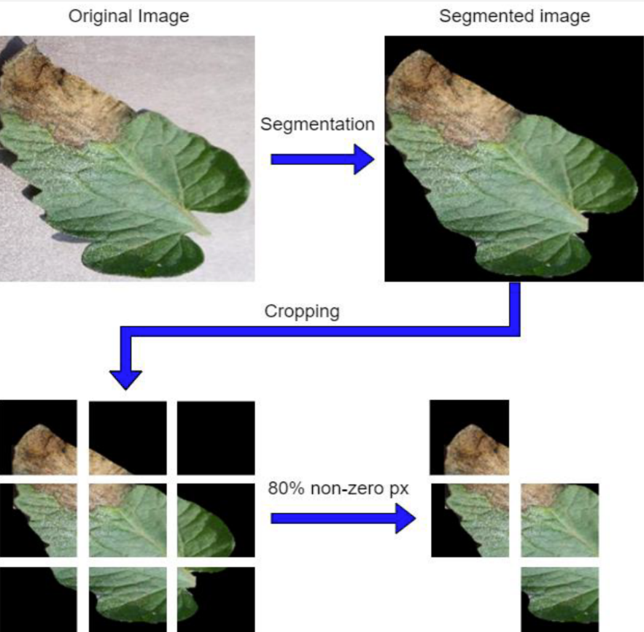
Layer 2 (Pooling): Shrinks the image to make it more manageable while keeping the most important patterns.
Layer 3 (More Convolutional and Pooling): Repeats the process, but this time it looks for more complex patterns like the specific shapes of disease spots.
Final Layer (Fully Connected): Uses all the detected patterns to make a .
final decision and classify the image.
MRCET CAMPUS Department of Electronics & Communication Engineering

Slide 11
SOFTWARE REQUIREMENTS
Programming Language:
Python: The industry standard for machine learning and data science due to its rich ecosystem of libraries.
Core Libraries :
TensorFlow : An open-source deep learning framework. provides a user-friendly, Environment that simplifies the process of building and training neural networks.
Streamlit: Essential for creating interactive web applications and user interfaces with
minimal code, enabling rapid deployment of machine learning models.
Development Environment
Google Colab &Jupyter Notebook: An interactive environment that allows you to write and run code, display visualizations, and document your work all in one place. It is perfect for this project as Google Colab offers free GPU access.
MRCET CAMPUS Department of Electronics & Communication Engineering

Slide 12
Advantages of Our System
Early and Accurate Detection
Increased Efficiency & Cost Savings
Reduced Pesticide Use
Accessibility :
making professional-level diagnostic tools accessible to farmers in remote
areas.
Empowers small-scale farmers who may not have access to agricultural experts.
MRCET CAMPUS Department of Electronics & Communication Engineering

Slide 13
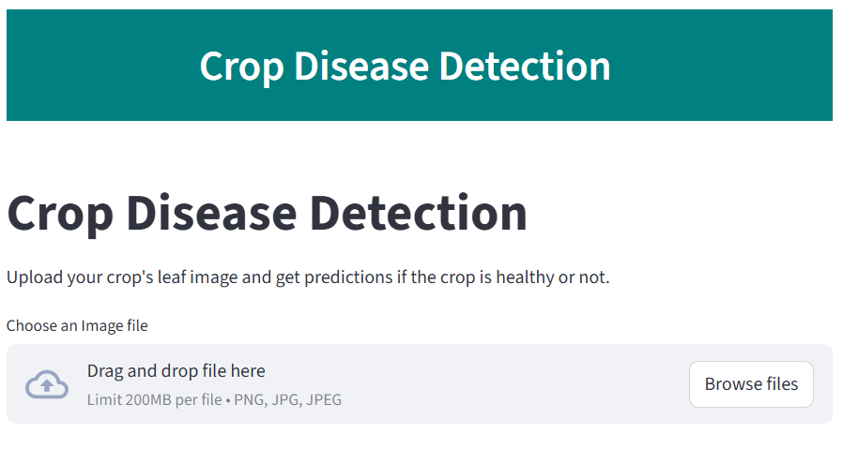
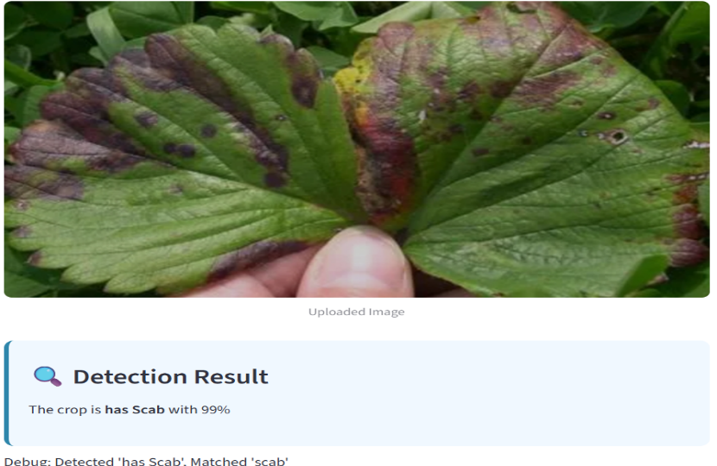
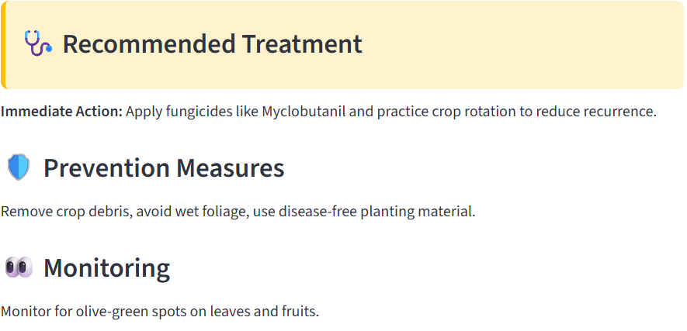
RESULTS
MRCET CAMPUS Department of Electronics & Communication Engineering

Slide 14
CONCLUSION
This project successfully tackles that gap, delivering a robust model that performs reliably in real-world agricultural settings, not just in the lab. This is our core contribution . On Crop disease detection using image classification has shown significant progress, moving from traditional machine learning to advanced deep learning methods. imbalanced data, and real-field adaptability remain. This project addresses the gap between lab accuracy and field performance, contributing to sustainable agriculture, reduced crop losses, and improved food security.
MRCET CAMPUS Department of Electronics & Communication Engineering

Slide 15
References
Journal of Agriculture and Food Science: Publishes papers on various agricultural technologies, including those related to crop health.
IEEE Access: A broad, multidisciplinary journal that frequently includes articles on computer vision and deep learning applications in real-world scenarios.
PlantVillage Dataset : http://www.Kaggle.com/datasets/abdallahalidev/plantvillage-dataset
MRCET CAMPUS Department of Electronics & Communication Engineering

Slide 16

MRCET CAMPUS Department of Electronics & Communication Engineering

Slide 17

MRCET CAMPUS Department of Electronics & Communication Engineering

