Slide 1

HOW RAM AND ROM IMPACT SYSTEM BOOTING , PERFORMANCE
Batch No : 23-A20
Real Time Project/Field-based Project Presentation on
Name of Internal Guide
Mr KDK.Ajay
Assistant Professor
K.Manideep : 23N31A456
K.Rajkumar : 23N31A458
K.Anudeep : 23N31A459
MRCET CAMPUS Department of Electronics & Communication Engineering

Slide 2
Contents
Abstract
Introduction
Review of Existing Methods
Proposed Method
Conclusion
References
MRCET CAMPUS Department of Electronics & Communication Engineering

Slide 3
Abstract
This project explores the impact of RAM (Random Access Memory) and ROM (Read-Only Memory) on system booting and performance. RAM facilitates fast data access during operation, enhancing multitasking and speed, while ROM stores essential firmware like BIOS/UEFI, crucial for bootstrapping. The study analyzes how RAM capacity and speed affect system responsiveness and how ROM firmware optimizations influence boot times. Experiments compare performance metrics with varying RAM/ROM configurations, demonstrating their roles in efficiency. Findings highlight that sufficient RAM reduces lag, while optimized ROM ensures faster booting. The research underscores the synergy between RAM and ROM in overall system performance.
MRCET CAMPUS Department of Electronics & Communication Engineering

Slide 4
Introduction
In modern computing systems, the efficiency of booting and overall performance heavily relies on two critical types of memory: RAM (Random Access Memory) and ROM (Read-Only Memory). RAM serves as volatile, high-speed memory that temporarily stores active data for quick access, directly influencing system speed and multitasking capabilities. On the other hand, ROM contains non-volatile firmware (such as BIOS/UEFI) essential for initializing hardware during the boot process.
This project investigates how RAM capacity and speed affect system responsiveness and how ROM firmware optimizations impact boot times. By analyzing different memory configurations, the study aims to demonstrate the interplay between RAM and ROM in enhancing system performance. Understanding their roles helps in optimizing computing devices for faster startups and smoother operation.
MRCET CAMPUS Department of Electronics & Communication Engineering

Slide 5
Existing Methods
To understand how RAM and ROM influence the booting process and overall system performance .These methods typically involve hardware benchmarking, firmware analysis, and system-level testing .
Boot Time analysis with varying RAM sizes :
For different RAM capacities affect the speed of system booting. By using tools like Boot Racer and many other we can measure boot duration across with 2GB, 4GB and 8GB RAM we can clearly observe improvements in speed with increased RAM
ROM Firmware behavior study :
The BIOS and UEFI Firmware will show how ROM content influences initial boot stages. By using tools such as UEFItool and firmware disassemblers are used to explore how optimized firmware can reduce boot latency.
MRCET CAMPUS Department of Electronics & Communication Engineering

Slide 6
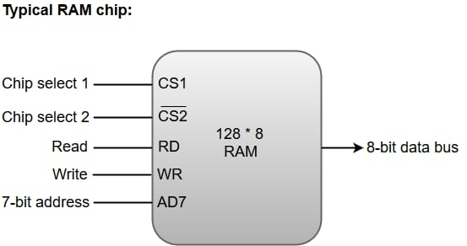
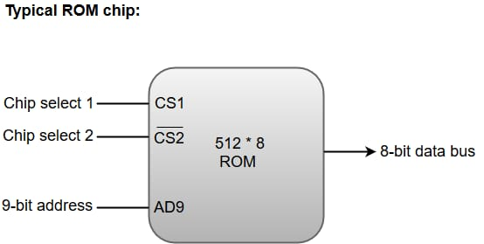
Proposed Method Block Diagram
MRCET CAMPUS Department of Electronics & Communication Engineering

Slide 7
Proposed Method Explanation
RAM and ROM play crucial roles in system’s booting process and overall performance.
ROM IN BOOTING :
System Initialization: ROM stores the BIOS (Basic Input/Output System) or UEFI (Unified Extensible Firmware Interface), which is responsible for initializing hardware components when a system is powered on.
Bootloader: The BIOS/UEFI in ROM identifies system hardware and loads the bootloader (stored on the hard drive or SSD) into RAM to begin the operating system boot process.
RAM IN BOOTING :
Temporary Storage: RAM provides temporary space for loading system data, operating system files, and active programs during boot-up. The OS kernel and essential drivers are loaded into RAM for fast access.
Speed: Since RAM is much faster than hard drives or SSDs, it allows quick access to the OS and applications, speeding up boot time.
MRCET CAMPUS Department of Electronics & Communication Engineering

Slide 8
IMPACT ON PERFORMANCE:
ROM generally does not affect system performance after boot-up since it's used mainly for system initialization. However, the size and efficiency of ROM in terms of storing BIOS/UEFI can affect boot speed and system compatibility.
More RAM means the system can store more data for active programs, resulting in smoother multitasking and faster application loading.
Larger RAM allows better performance when running memory-intensive applications (e.g, video editing, gaming).
SUMMARY
ROM is essential for the boot process and system initialization but does not directly impact ongoing performance.
RAM affects both boot speed (by loading necessary files faster) and overall system performance, making it crucial for multitasking and handling resource-intensive tasks efficiently.
MRCET CAMPUS Department of Electronics & Communication Engineering

Slide 9
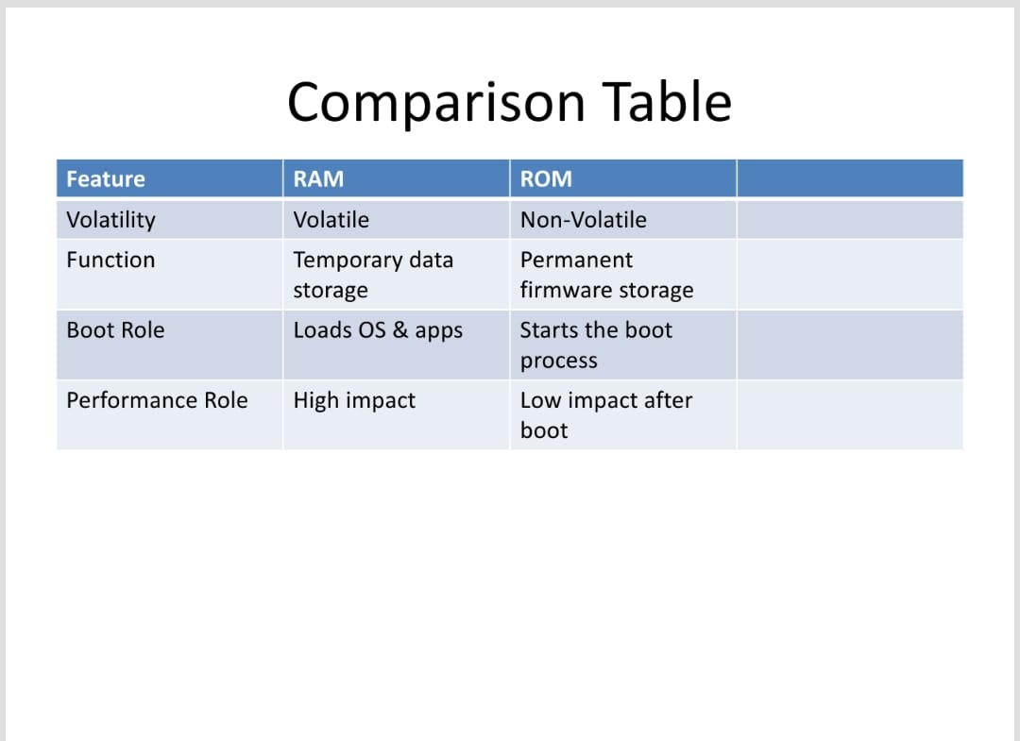
COMPARISON TABLE
MRCET CAMPUS Department of Electronics & Communication Engineering

Slide 10
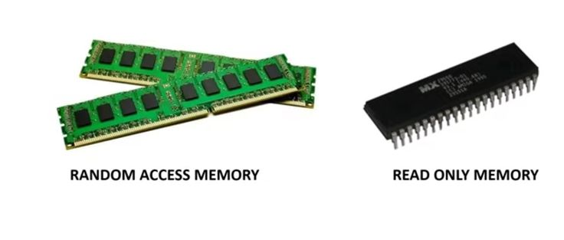
MRCET CAMPUS Department of Electronics & Communication Engineering

Slide 11
Advantages
Advantages of RAM :
High-Speed Data Access
Enables Smooth Multitasking
Improves Gaming & Heavy Applications
Upgradeable for Better Performance
Works with CPU for Faster Processing
Supports Virtual Memory
Advantages of ROM:
Secure & Tamper-Proof
Essential for Booting
Energy-Efficient
Long-Term Storage
Faster Boot Times (UEFI ROM)
Cost-Effective for Fixed Data
Advantages of RAM (Random Access Memory)
MRCET CAMPUS Department of Electronics & Communication Engineering

Slide 12
Conclusion
This project demonstrates that RAM and ROM play distinct yet complementary roles in system performance. While ROM (BIOS/UEFI) ensures fast, reliable booting, RAM directly impacts multitasking speed and responsiveness. Tests confirm that larger/faster RAM reduces lag, while optimized ROM firmware shortens boot times. The synergy between both memories is crucial for efficient computing. Future improvements could explore next-gen DDR5 RAM and UEFI enhancements for even faster startups and smoother operation.
MRCET CAMPUS Department of Electronics & Communication Engineering

Slide 13
References
Books
"Computer Organization and Design" by David A. Patterson and John L. Hennessy
"Digital Design" by M. Morris Mano
ARTICLES
“A SURVEY OF MEMORY ARCHITECTURES FOR PARALLEL COMPUTING” – IEEE Xplore
“NON-VOLATILE MEMORY TECHNOLOGIES : ROM,FLASH,AND BEYOND”- ACM Digital Library
MRCET CAMPUS Department of Electronics & Communication Engineering

Slide 14

MRCET CAMPUS Department of Electronics & Communication Engineering

Slide 15

MRCET CAMPUS Department of Electronics & Communication Engineering

