Slide 1
Mutual Fund Analytics Platform
Bluestock Fintech Pvt. Ltd. — Capstone Project
Data Analyst Internship | Cohort 2025
G. Manideep
github.com/Manideep685

Slide 2
Problem & Objective
The Problem
Our Objective
Investors lack easy access to fund analytics
Raw AMFI data is scattered across sources
No unified view of risk vs return metrics
Hard to compare 40+ schemes at once
Build end-to-end MF analytics platform
ETL pipeline from AMFI + mfapi.in data
SQLite star schema for structured queries
Interactive Power BI dashboard (4 pages)
Risk, performance and investor analytics

Slide 3
Data Sources
AMFI India
mfapi.in
NSE / BSE
40 real scheme codes
Fund master data
46,000+ daily NAV
Jan 2022 – May 2026
Benchmark indices
Nifty 50, Nifty 100
Dataset | Rows | Description
fund_master.csv | 40 | Scheme metadata — AMC, category, benchmark
nav_history.csv | 46,000+ | Daily NAV Jan 2022 – May 2026
investor_transactions.csv | 32,000+ | SIP / Lumpsum / Redemption records
benchmark_indices.csv | 8,050 | Nifty 50, Nifty 100, BSE SmallCap daily
scheme_performance.csv | 40 | Sharpe, Alpha, Beta, VaR, Max Drawdown

Slide 4
Data Architecture
Raw Data
CSVs + API
ETL
Pipeline
SQLite
Star Schema
EDA &
Analytics
Power BI
Dashboard
Star Schema — 5 Core Tables
dim_fund
fact_nav
fact_aum
fact_sip
fact_txn
scheme_code, name,
AMC, category
scheme_code, date,
nav_value
amc_name, quarter,
aum_crores
month, inflow_cr,
active_accounts
investor_id, amount,
txn_type
Tech Stack: Python 3.10 · Pandas · NumPy · SQLite · SQLAlchemy · Power BI · Git

Slide 5
EDA Highlights — Industry Overview
43.5
Total AUM
(₹ L Cr)
31K
SIP Inflows
(₹ Cr)
26.12
Total Folios
(Crore)
SIP inflows hit ₹31,002 Cr milestone in Dec 2025 — highest ever recorded by AMFI
40
Schemes
Tracked

Slide 6
EDA Highlights — Investor Demographics
31% of investors are under 30 years — strong young investor base
T30 cities account for 56% of transactions, B30 cities growing 19% YoY
SIP dominates at 68% of all transactions by volume
Maharashtra and Karnataka are top 2 states by investment value

Slide 7
Performance Metrics — Risk Analysis
0.85
Sharpe Ratio
Top fund avg
-23%
Max Drawdown
Small cap worst
0.92
Avg Beta
vs Nifty 50
0.18
Avg Alpha
Annualised

Slide 8
Performance Metrics — Fund Comparison
Key Finding: Folios grew 97% from 13.26 Cr to 26.12 Cr (Jan 2022 – Dec 2025). Mid cap and small cap funds delivered highest 3yr alpha. Liquid and gilt funds show lowest VaR confirming their defensive nature.

Slide 9
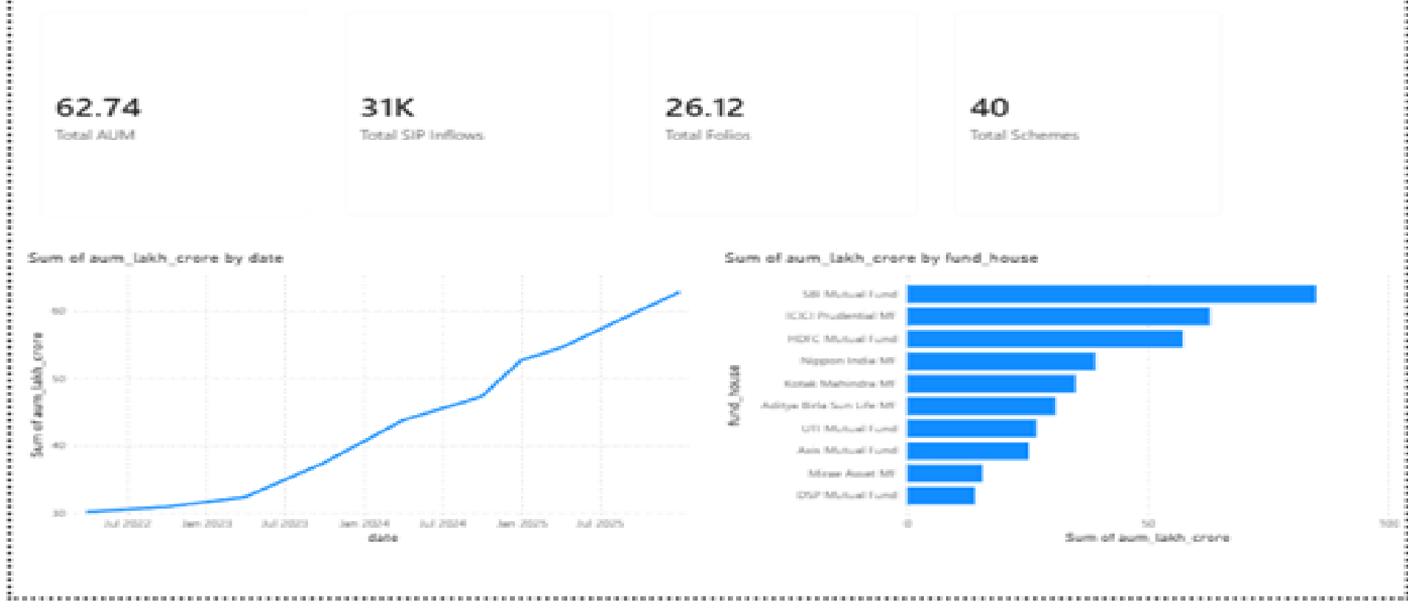
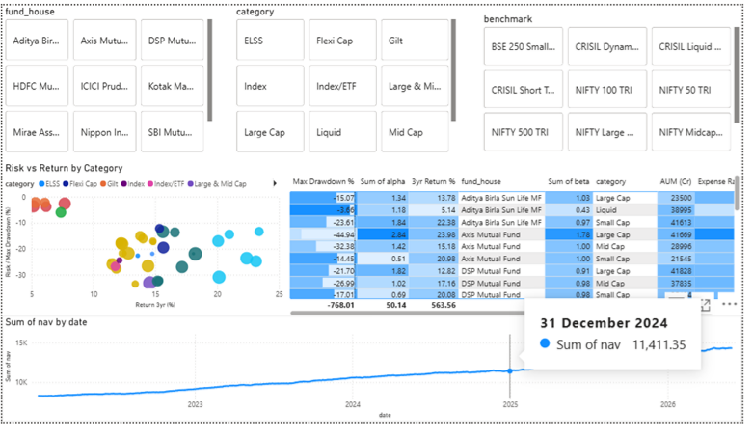
Power BI Dashboard — Pages 1 & 2
Screenshots from bluestock_mf_dashboard.pbix — built using Power BI Desktop | Data source: AMFI India & mfapi.in

Slide 10
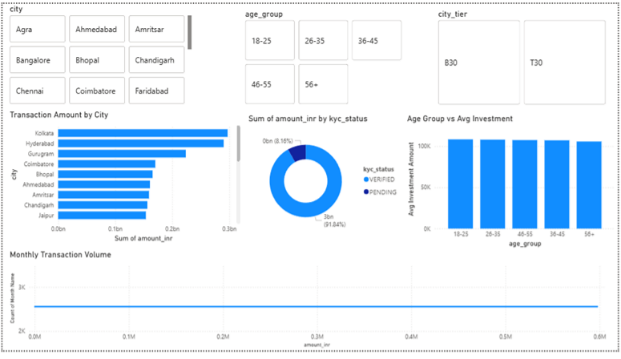
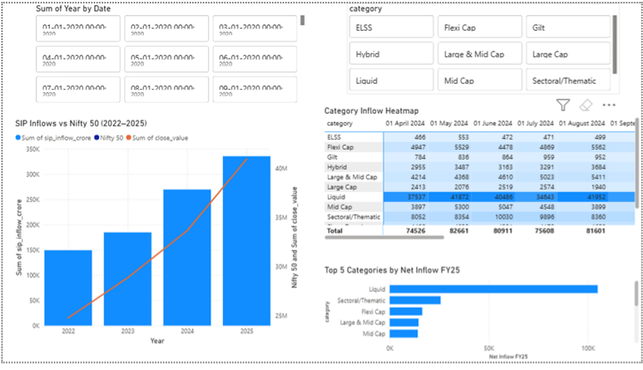
Power BI Dashboard — Pages 3 & 4
Dashboard built as part of Bluestock Fintech Data Analyst Internship Capstone

Slide 11
Key Findings
01
SIP Milestone
Industry SIP inflows hit ₹31,002 Cr in Dec 2025 — highest ever. Active SIP accounts crossed 10 Cr.
02
Folio Explosion
Total folios doubled from 13.26 Cr (Jan 2022) to 26.12 Cr (Dec 2025) — 97% growth in 3 years.
03
Risk-Return Insight
Mid cap and small cap funds delivered highest alpha but also highest VaR. Liquid funds safest.
04
Investor Profile
31% investors under 30. T30 cities lead at 56% but B30 cities growing 19% YoY — future growth engine.
05
SBI Dominance
SBI Mutual Fund leads industry AUM among top 10 AMCs. ICICI and HDFC follow closely.
06
SIP Continuity
Majority of investors maintain regular SIP gaps under 35 days showing strong investment discipline.

Slide 12
Thank You
Bluestock Fintech Pvt. Ltd. — Mutual Fund Analytics Platform
G. Manideep
Data Analyst Intern
github.com/Manideep685
GitHub Repo
Power BI Dashboard
Final Report

