Slide 1
MENTAL HEALTH PREDICTION
GROUP - 11
Manideep Annarapu
Sai Supraja Motamarri
Srujana Reddy Pininte

Slide 2
CONTENTS
PROBLEM STATEMENT
DATASET DESCRIPTION
PROPOSED MODEL
RESULT
DISCUSSION

Slide 3
PROBLEM STATEMENT
The title to the problem is Addressing the mental health prediction with Deep Learning
The main aim of this project is to build a model that uses deep learning and identify the mental health issues among the students, which includes depression, anxiety and panic attacks.
As there is growth in the concerns related to the mental health, there is still a lack of effective model that detects them in the early stages.
The main objective is to build the model that improves the accuracy of predictions and addressing the need for a clearer understanding of the factors contributing to mental health conditions.

Slide 4
DATASET DESCRIPTION
Here we used total of 3 datasets throughout our project and we have also used one more dataset that is the merged dataset of dataset-1 and datset-2.
DATASET-1 :
  Generally this dataset focuses on the mental health related attributes related to a student population, the variables are potentially correlated with the mental well being of the individuals in an education environment.
  The below are the attributes present in the dataset -1 :
  Choose your gender, Age, What is your course?, Your current year of Study, What is your CGPA? , Marital status, Do you have Depression?, Do you have Anxiety?, Do you have Panic attack?, Did you seek any specialist for a treatment? .
  In the deep learning model perspective :
    Number of Samples: 100
    Number of Features: 6
    Number of Unique Classes in the Predictor Column: 2
    Training Set Size: 80
    Testing Set Size: 20

Slide 5
DATASET DESCRIPTION
DATASET-2 :
  Generally this dataset focuses on the mental health related attributes and the life style factors related to a students, Features such as Age, Course, Gender, CGPA, Stress Level, and Anxiety Score suggest that this dataset aims to correlate these variables with mental health outcomes, specifically depression scores.
  The below are the attributes present in the dataset -2 :
  Sleep Quality, Physical Activity, Diet Quality, Social Support, Relationship Status, Substance Use, Counseling Service Use, Family History of mental health issues, Chronic Illness, Financial Stress, Involvement in Extracurricular Activities, Semester Credit Load, and Residence Type.
  The 'PredictorColumn' in Dataset 2 is the Depression Score, which is going to be the measure of mental health status.

Slide 6
DATASET DESCRIPTION
Merged Dataset :
  The main goal of merging the dataset 1 and dataset 2 is to get the more comprehensive view of the factors which are going to affect the mental health in students.
  Both the datasets are merged based on the common attribute of AGE.
  This combines the demographic and academic information from Dataset 1 with the lifestyle and mental health scores from Dataset 2.
DATASET – 3
  This dataset is about the world Happiness report.
  This dataset has the features like Overall rank', 'Country or region', 'Score', and various factors believed to contribute to happiness like 'GDP per capita', 'Social support', 'Healthy life expectancy', 'Freedom to make life choices', 'Generosity', and 'Perceptions of corruption’.
  The dataset encompasses 156 countries.

Slide 7
PROPOSED MODEL
CLASSIFICATION MODEL :
  This model is generally build to predict the categorical values or the columns, as we make a specific statement it is going to tell that whether a student is likely to have depression based on the features provided.
  The architecture of the classification model :
    Input layer : receives the scaled feature data
    Two hidden layers with having 64 and 32 neurons, respectively, using the ReLU (Rectified Linear Unit) activation function.
    An output layer with a single neuron using the sigmoid activation function, which is particularly suitable for the binary classification.
    The model uses the Adam optimizer and binary crossentropy as the loss function, and these are appropriate for the classification tasks.

Slide 8
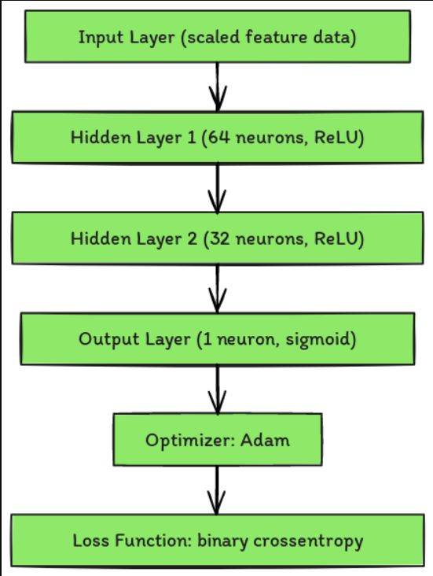
PROPOSED MODEL
CLASSIFICATION MODEL :

Slide 9
PROPOSED MODEL
REGRESSION MODEL :
  This model is build in a way to predict the continuous value or the outcome, which is the depression score in our project
  The architecture of the regression model :
    Input layer : receives the scaled feature data
    Two hidden layers with having 64 and 32 neurons, respectively, using the ReLU (Rectified Linear Unit) activation function.
    An output layer with a single neuron without the activation function, as this is the regression model it have to predict the continuous value. So no need of the activation function.
    For the regression model, the Adam optimizer is used along with mean squared error as the loss function, which is suitable for the regression.
The models were trained using the features from the merged dataset and it is trained over several epochs with the batch processing and validation splits to monitor the performance.

Slide 10
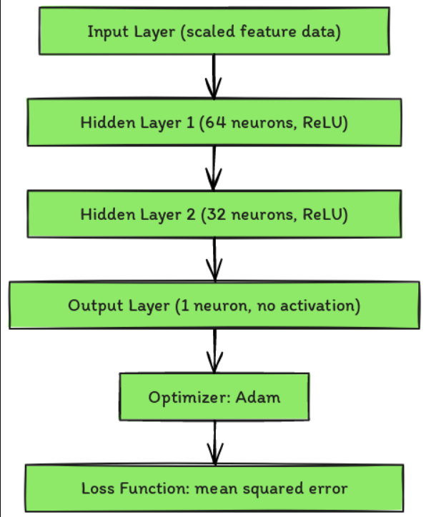
PROPOSED MODEL
REGRESSION MODEL :

Slide 11
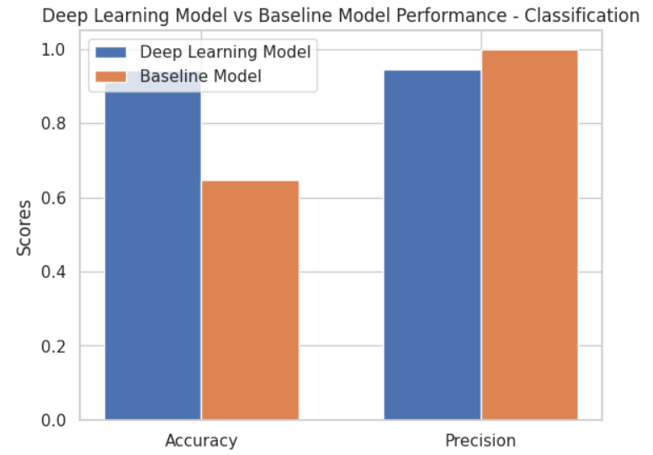
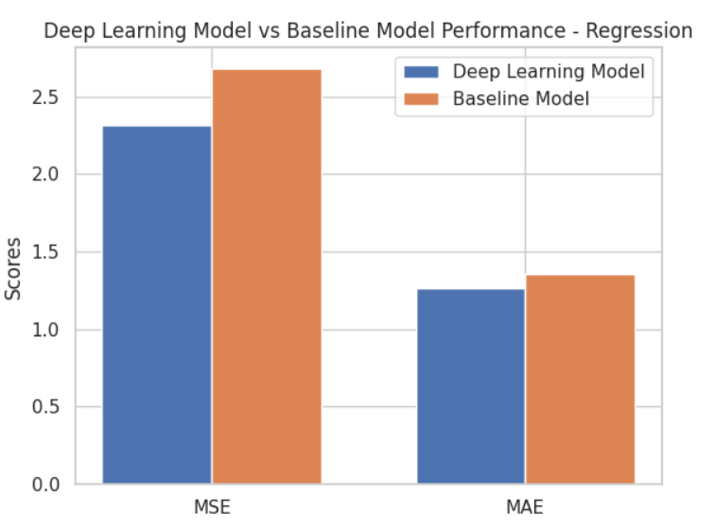
RESULT
The models performance were evaluated compared to the base line models using the metrics :
Accuracy and precision for the classification model
Mean squared error and Mean Absolute error for the regression tasks.

Slide 12
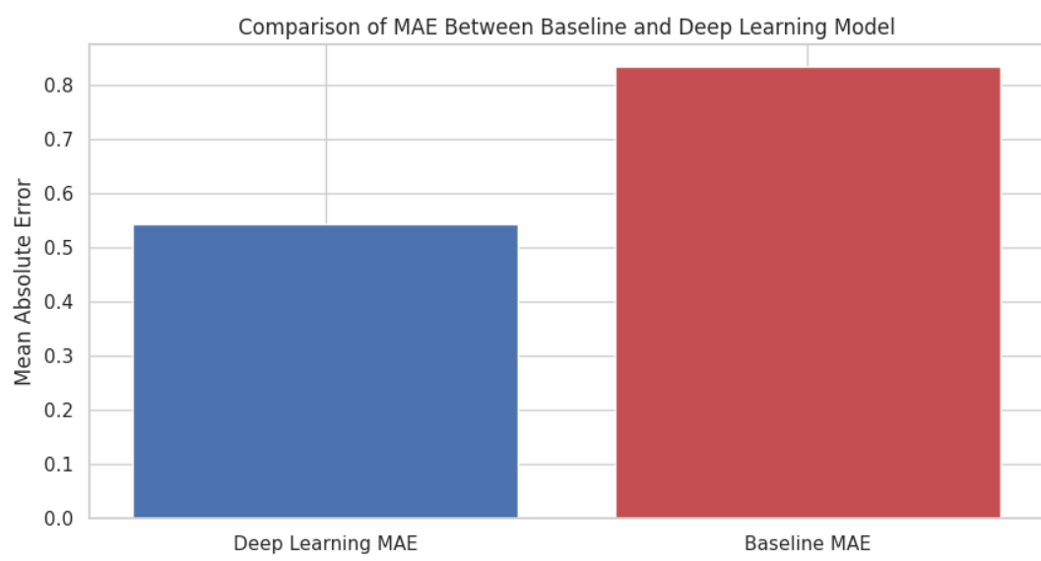
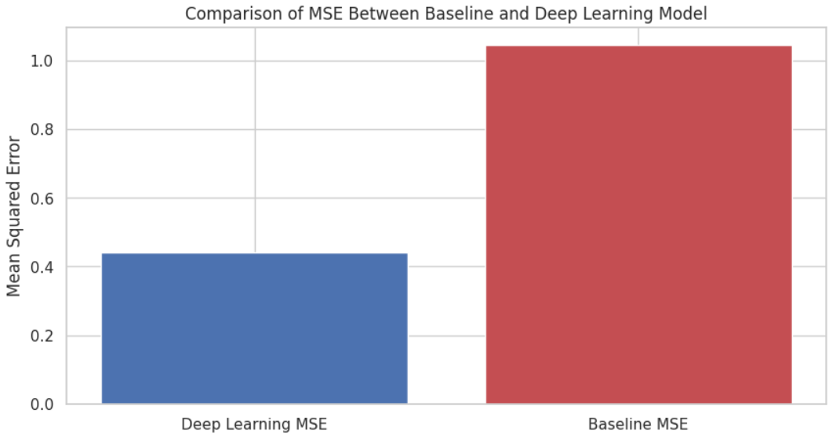
RESULT
The below are the model results with the dataset-3.

Slide 13
DISCUSSION
As we conclude this presentation, the main outcomes of this project is :
The model performance as we compared them with the baseline models in predicting the both the presence of depression (classification) and the depression score (regression).
This project understands the fact that, the data awareness and its adaptability and interpretability are some of the challenges in the mental health modelling.
The performance of the models also needs to be tested in broader and more varied populations

Slide 14


