Slide 1
Offline AI-Based Photo Categorizer using Flutter and Flask
Manideep Nunna
Department of CSE (AI & ML)
VIT-AP University

Slide 2
Problem Statement
- Managing thousands of images manually is time-consuming.
- Online photo sorters compromise privacy.
- Users need an offline intelligent categorizer that can auto-classify images securely.

Slide 3
Objectives
- Automatically categorize images into scenes (e.g., beach, office).
- Work offline without internet.
- Store images directly in phone memory.
- Simple and elegant user interface.
- Integrate Flutter (frontend) with Flask (backend).

Slide 4
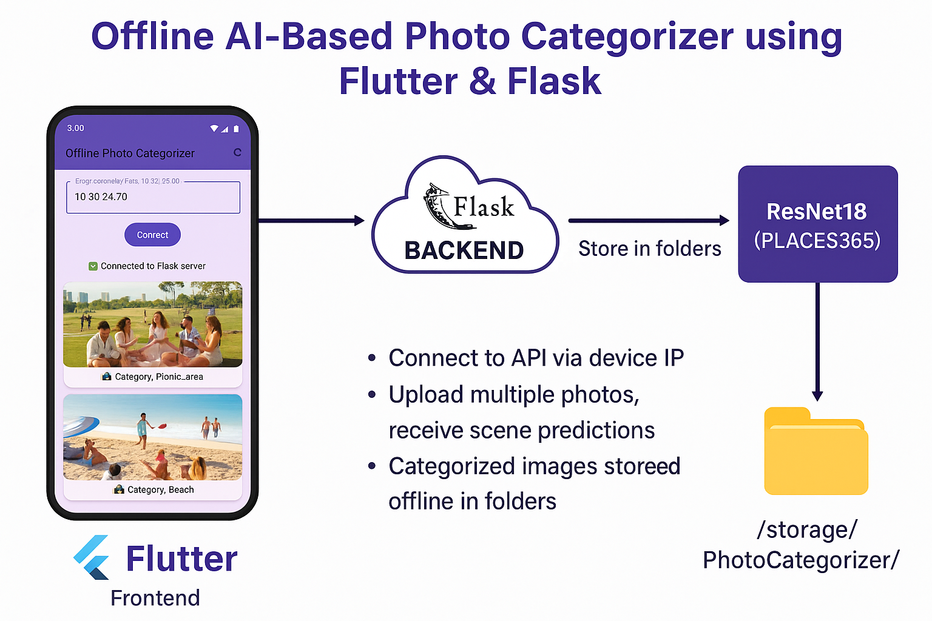

Slide 5
System Architecture
Flow: Flutter App → Flask API → AI Model (ResNet18) → Categorized Output
- Flutter sends images to Flask.
- Flask runs AI model and classifies scene.
- Response sent to app and stored locally on the phone.

Slide 6
Tools and Technologies
- Frontend: Flutter (Dart)
- Backend: Flask (Python)
- Model: ResNet18 trained on Places365
- Libraries: Torch, torchvision, Pillow, http
- IDE: VS Code, Android Studio

Slide 7
Implementation Steps
1. Integrated AI model (ResNet18) with Flask backend.
2. Built API endpoints for image upload.
3. Connected Flutter UI to Flask through local IP.
4. Implemented offline IP auto-connect.
5. Stored categorized images in phone folders.

Slide 8
Results - App Screenshots
Below are the working application results:
- App connected to Flask server successfully.
- Images categorized into 'Beach' and 'Picnic_area'.
- Images stored in phone folders.

Slide 9
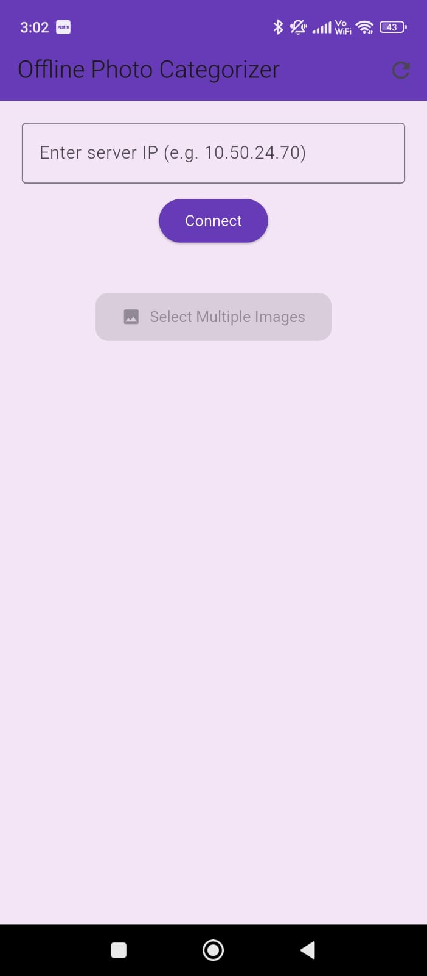
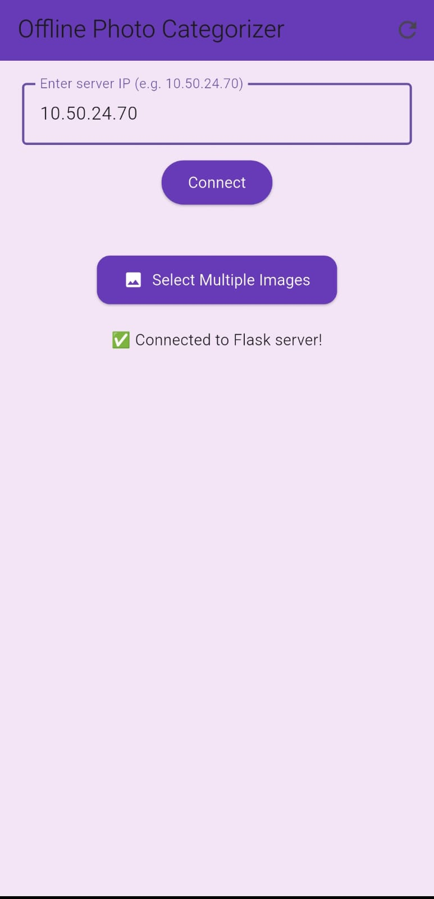
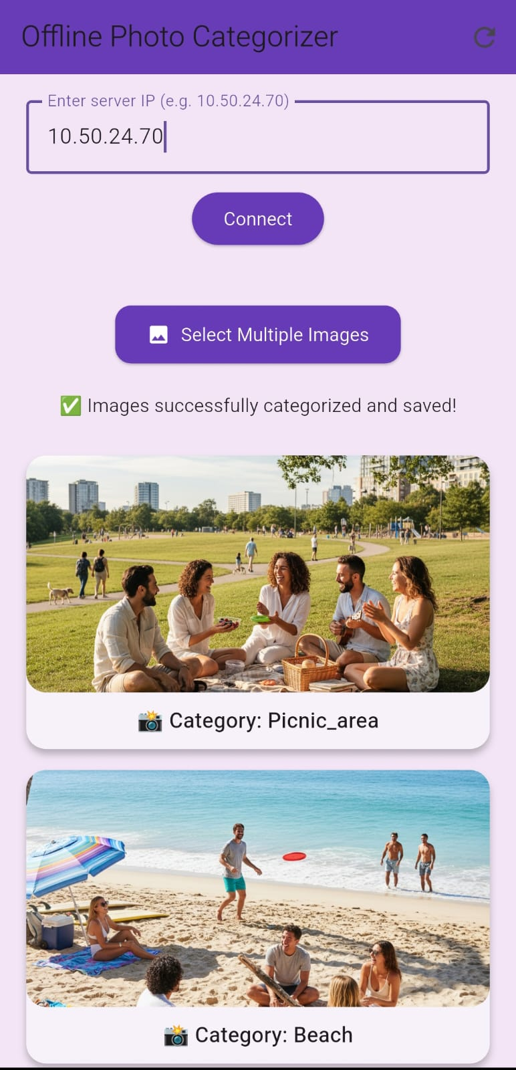

Slide 10
Categorized Folder Output
The categorized folders created in phone storage under:
/storage/emulated/0/Pictures/PhotoCategorizer/

Slide 11
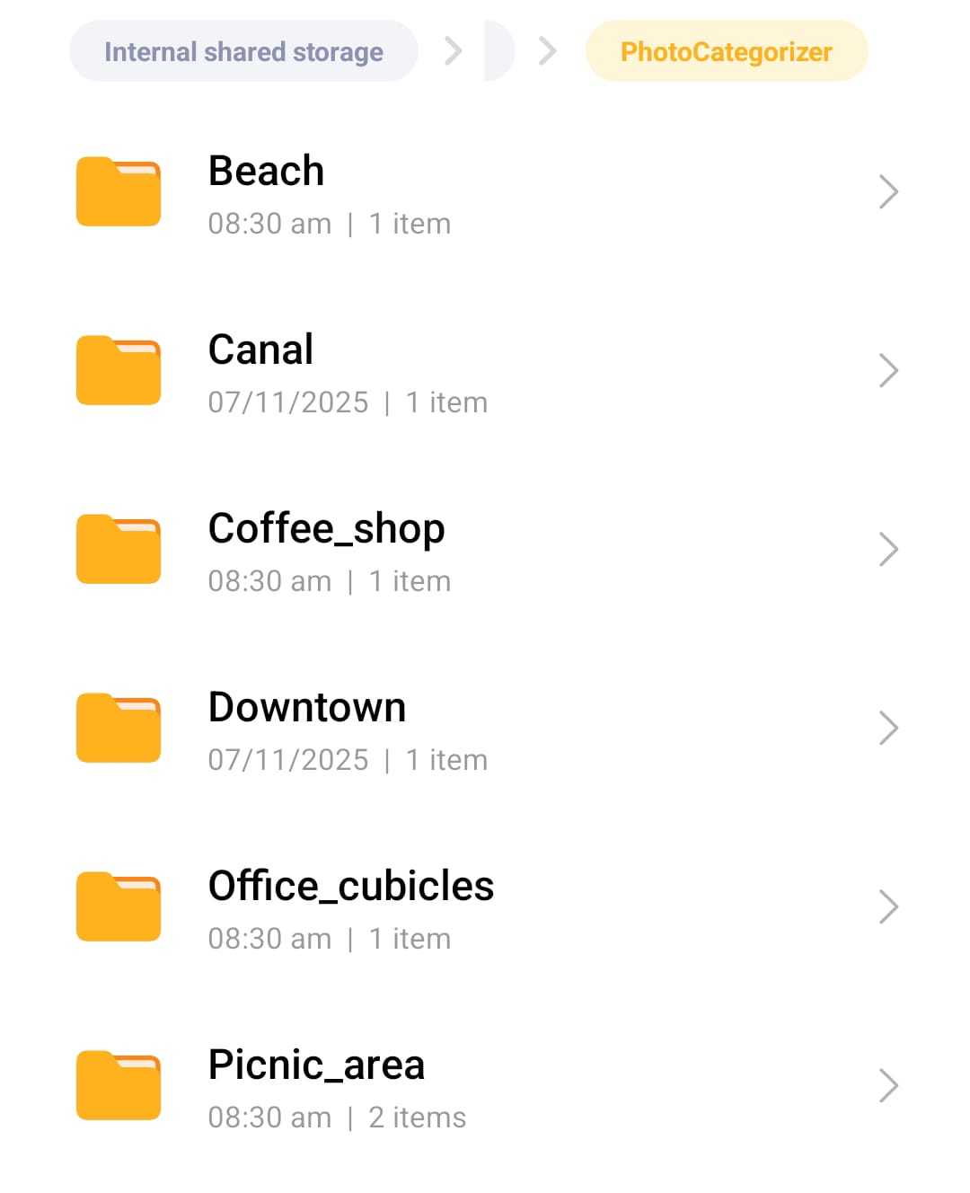

Slide 12
Novelty and Applications
- Offline AI: Works without internet or cloud.
- Privacy-preserving: No image leaves the device.
- Phone Integration: Results stored in user’s gallery.
- Applications: Smart gallery apps, photo management.

Slide 13
Conclusion
- Successfully achieved offline AI image categorization.
- Demonstrated real-time image classification and storage.
- Bridged Flutter frontend and Flask backend effectively.
- Ready for extension into full-fledged smart gallery apps.
Thank you!

