Slide 1
My AI Vision Project
Built by KONA VENKATA SAI GANA MANIDRA

Slide 2
What My AI Does
My AI guesses pictures like cats and airplanes using the CIFAR-10 dataset. I built two models: a CNN and MobileNetV2.

Slide 3
How I Made It
“Used Python and TensorFlow in Google Colab. Trained my AI with 50,000 pictures. Made charts to show progress.

Slide 4
My AI’s Results
“First AI accuracy: 69.14% . Smarter AI accuracy: 31.21%

Slide 5
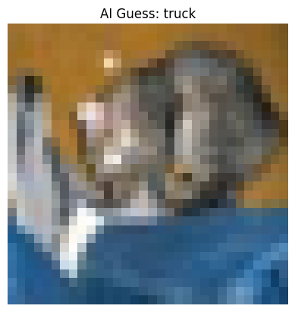
See It Work!
“My AI guessed a picture!

