Slide 1
ESSENTIALS OF ARTIFICIAL INTELLIGENCE - FINAL GROUP PROJECT
Diabetes Risk & Lifestyle Advisor
A Multi-Stage Decision Support System Combining Machine Learning, Fuzzy Logic & Expert Rules
STAGE 1: Neural Network (MLP) -> STAGE 2: Fuzzy Logic Engine -> STAGE 3: Rule-Based Advisor
[ Continuous Probability 0.0 - 1.0 ] [ Linguistic Category: Low/Mod/High/Severe ] [ 25+ Tailored Recommendations ]
Member 1
Overview & Dataset
* Problem Statement
* Diabetes Burden & Early Care
* Pima Indians Dataset
* Data Preprocessing Pipeline
Member 2
Architecture & NN
* 3-Stage Sequential Flow
* MLPClassifier Model Design
* Training & Hyperparameters
* Model Evaluation Metrics
Member 3
Fuzzy Logic & Rules
* Why Fuzzy Reasoning?
* 36 Combinatorial Rules
* Rule-Based Expert Advisor
* Streamlit Web Architecture
Member 4
Demo, Tests & Ethics
* Live System Walkthrough
* 10 Test Patient Profiles
* Limitations & Dataset Bias
* Ethical Safeguards & Summary
Essentials of AI - Group Project | Diabetes Risk & Lifestyle Advisor
Speaker: All Members
1 / 12

Slide 2
PROJECT MOTIVATION & SCOPE
Problem Statement & Project Goal
The Global Diabetes Challenge
* Massive Global Prevalence:
According to the International Diabetes Federation (IDF), over 537 million adults live with diabetes worldwide.
* Undiagnosed Burden (~50%):
Nearly half of all individuals with diabetes remain undiagnosed, delaying essential care until complications arise.
* Preventable with Timely Action:
Clinical studies prove early lifestyle intervention can reduce Type 2 diabetes risk by up to 58%.
* Limitations of Standard AI Tools:
Pure black-box classifiers output raw probabilities (e.g. 0.62) with zero actionable guidance, leaving users without practical lifestyle steps.
Our Hybrid AI Solution
* Chained 3-Stage Pipeline:
Integrates predictive machine learning, fuzzy inference, and expert decision rules into a cohesive clinical workflow.
* Nuanced Risk Categorization:
Instead of binary yes/no, fuzzy logic factors in BMI and physical activity to assess continuous real-world vulnerability.
* Personalized Lifestyle Action Plans:
The expert engine provides 25-30 tailored nutritional, fitness, and medical recommendations customized to individual vitals.
* Accessible & Educational:
Deployed as an interactive web dashboard with transparent disclaimers and immediate visual feedback.
Essentials of AI - Group Project | Diabetes Risk & Lifestyle Advisor
Speaker: Member 1
2 / 12

Slide 3
DATA ENGINEERING & PREPARATION
Pima Indians Diabetes Dataset & Preprocessing
Dataset Overview & Data Cleaning
* Origin & Scope:
National Institute of Diabetes and Digestive and Kidney Diseases (NIDDK), hosted on UCI Machine Learning Repository.
* Cohort Characteristics:
768 female patients of Pima Native American heritage, aged 21 and older. Target: Outcome (0 = Healthy, 1 = Diabetic).
* Biologically Impossible Zeros Imputation:
Features like Glucose, Blood Pressure, Skin Thickness, Insulin, and BMI had recorded values of 0 (physiologically invalid).
-> Handled by replacing 0 with NaN, then imputing with feature-specific column medians.
* Normalization & Splitting:
Applied StandardScaler normalization. Split using an 80/20 stratified split to preserve class distribution.
Clinical Features (8 Predictors)
1. Pregnancies: Total number of gestation cycles
2. Glucose: 2-hour plasma glucose concentration (mg/dL)
3. BloodPressure: Diastolic blood pressure (mm Hg)
4. SkinThickness: Triceps skinfold measurement (mm)
5. Insulin: 2-Hour serum insulin level (uU/mL)
6. BMI: Body Mass Index (weight in kg / (height in m)^2)
7. DiabetesPedigree: Genetic predisposition score
8. Age: Patient age in completed years
Essentials of AI - Group Project | Diabetes Risk & Lifestyle Advisor
Speaker: Member 1
3 / 12

Slide 4
MULTI-STAGE PIPELINE
System Architecture & End-to-End Pipeline
STAGE 1: NEURAL NETWORK
Model: MLPClassifier (scikit-learn)
* Takes 8 normalized vitals
* 2 Hidden Layers (16, 8 neurons)
* Output: Risk Probability (0.0 - 1.0)
STAGE 2: FUZZY LOGIC
Engine: scikit-fuzzy (skfuzzy)
* Combines Risk Prob + BMI + Activity
* 36 Expert Fuzzy Rules (Centroid)
* Output: Risk Category (0 - 100)
STAGE 3: RULE-BASED ENGINE
Advisor: Python Expert Rules
* 4 Risk Tiers (Low to Severe)
* 6 Patient Metric Modifiers
* Output: Tailored Advice + Disclaimer
Data-Driven Prediction
* Learns complex non-linear clinical interactions across 768 patient records.
* Provides fine-grained statistical calibration rather than arbitrary rules.
Nuanced Boundaries
* Handles gray areas (e.g. BMI 29.8 vs 30.1) using continuous membership curves.
* Balances raw ML risk with physical activity and lifestyle resilience.
Deterministic Actionability
* Translates risk numbers into clear, practical lifestyle guidelines.
* Guarantees consistent safety disclaimers and medical referrals when vitals spike.
Essentials of AI - Group Project | Diabetes Risk & Lifestyle Advisor
Speaker: Member 2
4 / 12

Slide 5
STAGE 1: PREDICTIVE MODELING
Neural Network Model Architecture & Training
Model Specifications (MLPClassifier)
* Model Framework:
scikit-learn MLPClassifier (Multi-Layer Perceptron)
* Network Topology:
- Input Layer: 8 neurons (standardized clinical features)
- Hidden Layer 1: 16 neurons with ReLU activation
- Hidden Layer 2: 8 neurons with ReLU activation
- Output Layer: Single probability score via logistic function
* Optimization & Training:
- Solver: Adam (Adaptive Moment Estimation)
- Max Iterations: 500 epochs (early convergence)
- Reproducibility: Fixed random_state=42
* Continuous Probability Output:
Invokes model.predict_proba(X)[0][1] to generate continuous risk (0.0 to 1.0) rather than coarse 0/1 binary labels.
Pipeline Integration & Reliability
* Preprocessing Guarantee:
Input patient features are scaled using the pre-fit StandardScaler (scaler.pkl) before inference, preventing feature distortion.
* Model Persistence (joblib):
- Trained weights saved as model.pkl
- Fitted scaler saved as scaler.pkl
* Self-Healing Auto-Training:
If model.pkl or scaler.pkl are absent when the web app initializes, nn_model.py automatically triggers training on diabetes.csv seamlessly.
* Evaluation Metrics:
Monitored Accuracy, Precision, Recall, F1 Score, and Confusion Matrix during training to ensure balanced clinical sensitivity.
Essentials of AI - Group Project | Diabetes Risk & Lifestyle Advisor
Speaker: Member 2
5 / 12

Slide 6
STAGE 2: APPROXIMATE REASONING
Fuzzy Logic Engine & Nuanced Categorization
Why Fuzzy Logic & Input Variables
* Solving the Crisp Boundary Problem:
Real-world risk isn't black or white. A patient with BMI 29.9 and another with 30.1 are virtually identical clinically. Fuzzy logic enables continuous degrees of membership.
* 3 Antecedent Variables (Inputs):
1. Risk Probability (0.0 to 1.0): [Low, Medium, High]
2. BMI (0 to 60 kg/m2): [Underweight, Normal, Overweight, Obese]
3. Activity Level (0 to 10 scale): [Sedentary, Moderate, Active]
* 1 Consequent Variable (Output):
Risk Category Score (0 to 100):
- Low: Score <= 25 | - Moderate: Score 25 to 50
- High: Score 50 to 75 | - Severe: Score > 75
36 Rules & Computational Robustness
* 36 Combinatorial Rules:
Covers all combinations (3 risk levels x 4 BMI categories x 3 activity tiers = 36 rules) to guarantee complete rule coverage.
* Membership Geometry:
Uses trapezoidal functions (trapmf) for extreme boundaries and triangular functions (trimf) with overlaps for intermediate zones.
* Centroid Defuzzification:
Computes the center of gravity of the aggregated fuzzy output set for a smooth continuous risk score.
* Production Safeguards:
- Input Clamping: Prevents out-of-universe exceptions.
- Cached singleton control system for sub-millisecond execution.
- Linear fallback mechanism if zero rules trigger.
Essentials of AI - Group Project | Diabetes Risk & Lifestyle Advisor
Speaker: Member 3
6 / 12

Slide 7
STAGE 3: ACTIONABLE ADVICE
Rule-Based Expert Engine & Personalization
4-Tier Baseline Recommendations
* Mandatory Disclaimer First:
Every output begins with an explicit medical disclaimer stating the educational nature of the tool.
* Tier 1: Low Risk (4 Base Guidelines):
Maintain balanced lifestyle, routine annual checkup, hydration, nutritious whole-food diet.
* Tier 2: Moderate Risk (4 Proactive Guidelines):
Schedule fasting plasma glucose test, achieve 150 min/wk moderate exercise, cut refined carbs, track BMI.
* Tier 3: High Risk (5 Urgent Guidelines):
Consult physician within 2 weeks, begin daily glucose logs, adopt low-GI diet, structured daily workouts.
* Tier 4: Severe Risk (5 Critical Guidelines):
Immediate clinical evaluation, mandatory daily logs, medical dietitian meal plan, assess clinical therapy.
6 Dynamic Clinical Modifiers
* Blood Glucose:
Additional alerts if Glucose > 140 mg/dL (prediabetes threshold) or > 180 mg/dL (acute hyperglycemia).
* Body Mass Index (BMI):
Custom guidance for Underweight (< 18.5), Obese (> 30), and Severely Obese (> 35).
* Blood Pressure (BP):
Cardiovascular warnings if diastolic BP > 90 or > 100 mm Hg.
* Insulin & Age Milestones:
Hyperinsulinemia alerts (> 200 uU/mL) + specialized screening schedules for patients aged > 45 and > 60.
* Family Genetic History (Pedigree):
Increased screening urgency if pedigree score > 0.5 or > 0.8.
* Total: 25-30 contextually assembled clinical directives.
Essentials of AI - Group Project | Diabetes Risk & Lifestyle Advisor
Speaker: Member 3
7 / 12

Slide 8
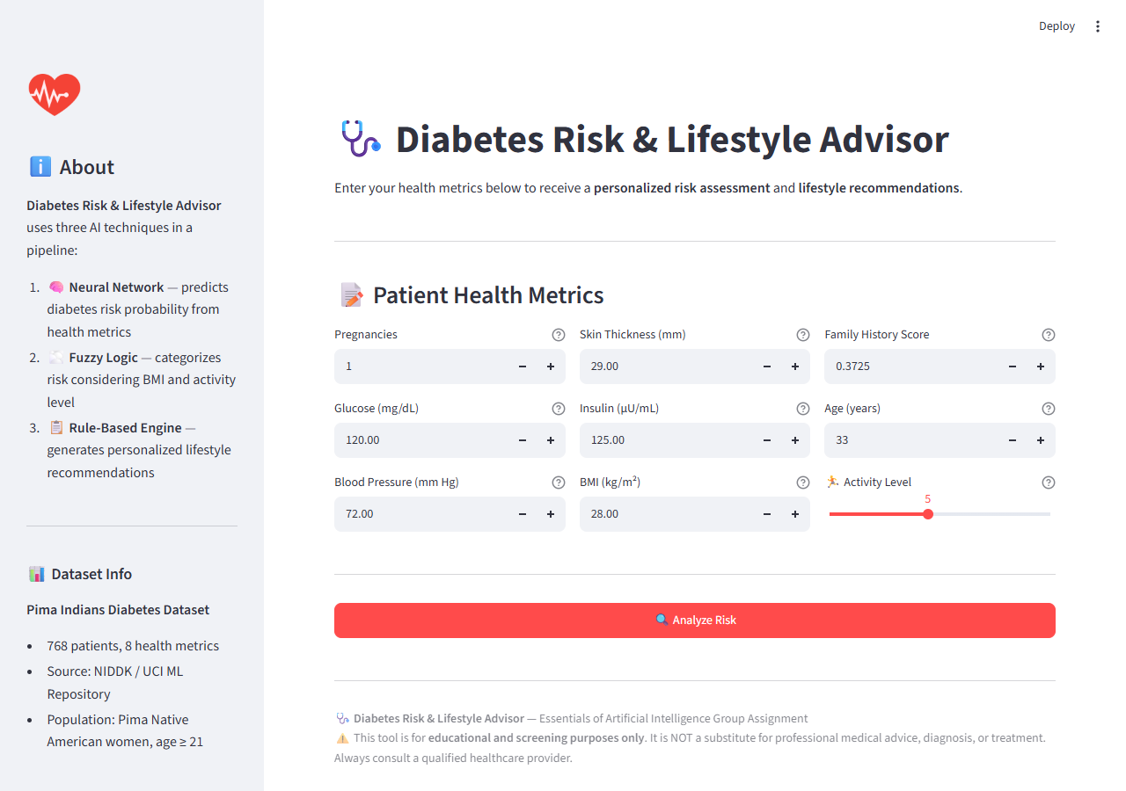
USER EXPERIENCE & IMPLEMENTATION
Interactive Web Dashboard & Tech Stack
Dashboard Capabilities
* Responsive 3-Column Input Grid:
Clean entry fields for all 9 health vitals with tooltips and slider for activity level.
* Informative Sidebar Panel:
Provides pipeline explanation, dataset details, demographic caveats, and project disclaimer.
* Asynchronous Execution Indicator:
Visual spinners show pipeline execution across NN, Fuzzy Logic, and Rule evaluation.
* Technology Stack:
- Streamlit (v1.28+) : Web UI & reactivity
- scikit-learn : MLP neural network
- scikit-fuzzy : Fuzzy logic control systems
- pandas & numpy : Tabular data handling
- joblib : Scaler & weight serialization
Essentials of AI - Group Project | Diabetes Risk & Lifestyle Advisor
Speaker: Member 3
8 / 12

Slide 9
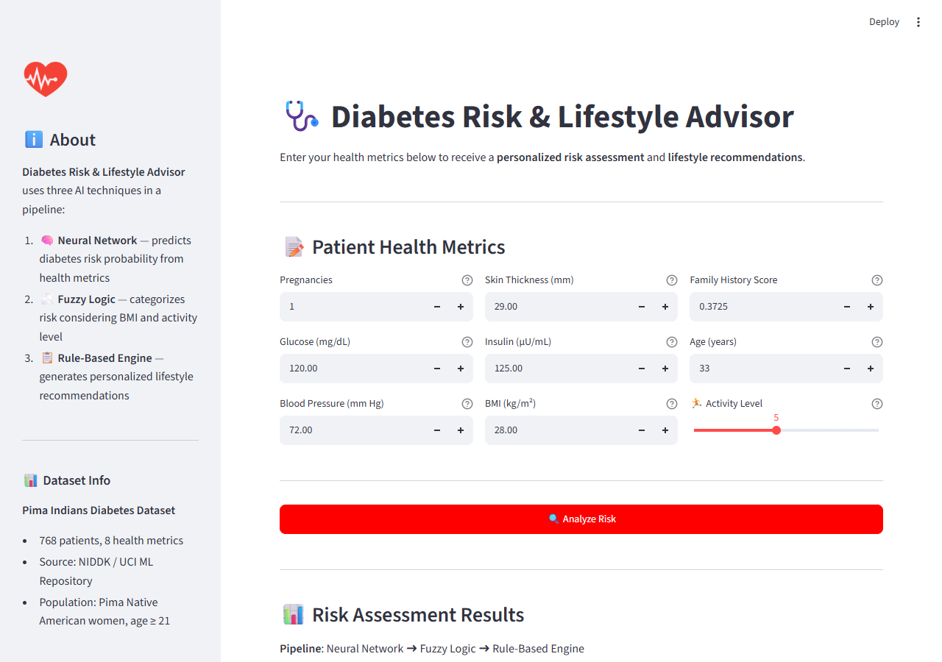
SYSTEM IN ACTION
Live Demonstration & Output Synthesis
Sample Patient Assessment
* Patient Vitals Input:
- Age: 33 | Pregnancies: 1 | Glucose: 120 mg/dL
- Blood Pressure: 72 mm Hg | Skin Thickness: 29 mm
- Insulin: 125 uU/mL | BMI: 28.0 | Activity: 5/10
* Pipeline Execution Trace:
1. Neural Network: 38.4% continuous probability
2. Fuzzy Logic: Synthesizes probability + BMI 28 + moderate activity -> Category Score 46.2 (Moderate Risk)
3. Rules Advisor: Generates 8 targeted guidelines
* Rich UI Results Presentation:
- Color-coded badges (Green/Yellow/Red/Dark Red)
- Category icons: Fitness, Diet, Clinical
- Expandable JSON debug inspectability
Essentials of AI - Group Project | Diabetes Risk & Lifestyle Advisor
Speaker: Member 4
9 / 12

Slide 10
VERIFICATION & QUALITY ASSURANCE
Testing Suite & Pipeline Validation
10 Clinical Test Profiles (test_pipeline.py)
* Healthy Young Woman (Age 22, BMI 21.5) -> Low Risk [Passed]
* Average Middle-Aged (Age 45, BMI 26.5) -> Moderate [Passed]
* Overweight Sedentary (BMI 32, Act 1/10) -> Moderate [Passed]
* High-Risk Elderly (Age 65, Gluc 155) -> High Risk [Passed]
* Borderline Profiles A & B (Cutoff tests) -> Smooth curve [Passed]
* Active + Family History (Pedigree 1.2) -> Controlled [Passed]
* Extreme High Risk (Gluc 198, BMI 42) -> Severe Risk [Passed]
* Young Underweight (BMI 17.5) -> Low Risk [Passed]
* Isolated Hypertension (BP 105, Gluc 95) -> Targeted BP [Passed]
Validation Assertions & Rigor
* Neural Network Bounds Assertion:
Probability strictly verified within [0.0, 1.0] across all profiles with no NaN or infinite results.
* Fuzzy Engine Completeness Assertion:
Asserts category key exists in {'Low', 'Moderate', 'High', 'Severe'} and score is within [0, 100]. Confirms zero runtime crashes from edge metrics.
* Rule Safety Invariant Assertion:
Verifies list contains >= 2 recommendations and the first item strictly matches the required medical disclaimer.
* Clinical Coherence:
Verified that extreme risk profiles reliably elevate to High/Severe, and healthy profiles remain at Low.
Essentials of AI - Group Project | Diabetes Risk & Lifestyle Advisor
Speaker: Member 4
10 / 12

Slide 11
RESPONSIBLE AI PRINCIPLES
Limitations & Ethical Considerations
Identified Project Limitations
* Demographic & Geographic Bias:
The Pima Indians dataset comprises solely adult females of Pima heritage from a historical study. Findings may not generalize accurately across male, pediatric, or diverse ethnic cohorts.
* Limited Clinical Biomarkers:
The model relies on 8 basic metrics. Real clinical diagnoses evaluate HbA1c, continuous glucose telemetry, lipid panels, and comprehensive dietary histories.
* Sample Volume Limitations:
768 records is relatively small for deep generalization, necessitating lightweight architectures to prevent overfitting.
Proactive Ethical Safeguards
* Educational Screening Tool Framing:
System explicitly self-identifies as an educational screener, never as a diagnostic authority. Disclaimers are displayed prominently.
* Privacy by Design:
No patient data, identifiers, or prediction logs are saved to disk or transmitted to third-party APIs. Processing runs entirely in local ephemeral session memory.
* Asymmetric Risk Mitigation:
High and Severe tiers mandate professional medical consultation within defined timeframes (e.g. 2 weeks or immediate).
* Explainable Decision Logic:
Users can trace exactly how their vitals produced their risk category.
Essentials of AI - Group Project | Diabetes Risk & Lifestyle Advisor
Speaker: Member 4
11 / 12

Slide 12
WRAP-UP & SUBMISSION
Conclusion, Future Work & Deliverables
Key Project Achievements
* Working Hybrid AI System:
Successfully chained a neural network (continuous risk), fuzzy logic (linguistic reasoning), and expert rules (custom lifestyle recommendations).
* Interactive Web Interface:
Deployed a polished Streamlit dashboard with real-time risk classification and inspectable pipeline outputs.
* Rigorous Automated Validation:
Validated on 10 synthetic patient profiles with 100% assertion pass rates across all individual stages.
* Responsible Healthcare AI:
Built with medical disclaimers, input validation, and privacy-preserving ephemeral computation.
Future Roadmap & Submission Checklist
* Future Technical Roadmap:
- Retrain on diverse multi-ethnic datasets (NHANES, UK Biobank)
- Integrate wearable sensors (Fitbit, Apple Watch) for real-time telemetry
- Explore deep tabular architectures (TabNet, XGBoost)
- Multi-language localization for global accessibility
* Submission Deliverables (Due Oct 9th):
- Recorded presentation video with presenter view visible
- Presentation slide deck (PPTX & HTML format)
- GitHub repository containing clean code, tests & documentation
- LMS video & repository submission link
Thank You! Questions & Viva Discussion Welcome.
Essentials of AI - Group Project | Diabetes Risk & Lifestyle Advisor
Speaker: All Members
12 / 12

