Slide 1
LangChain
5/21/2023

Slide 2
What It Does
data-aware: can reference user’s data
LLM wrappers (components)
prompt templates
indexes for retrieval
agentic: can take actions such as sending emails
customizable chains
assembled components to solve tasks

Slide 3
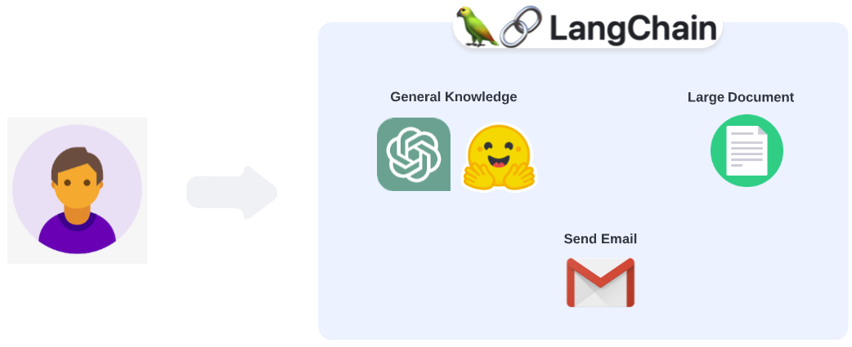
How It Works

Slide 4
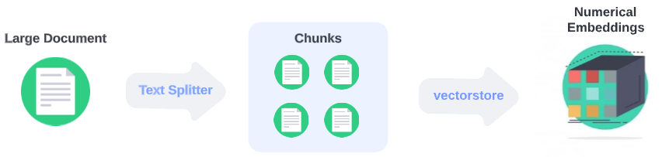
Data-aware
splits document into chunks
turns chunks into embeddings

Slide 5
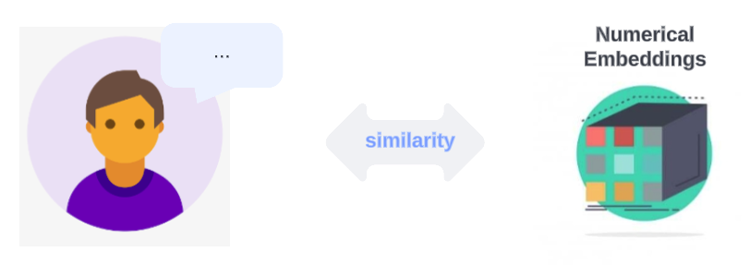
Retrieval
similarity search on user’s input vs embeddings of the document chunks → fetches relevant chunks

Slide 6
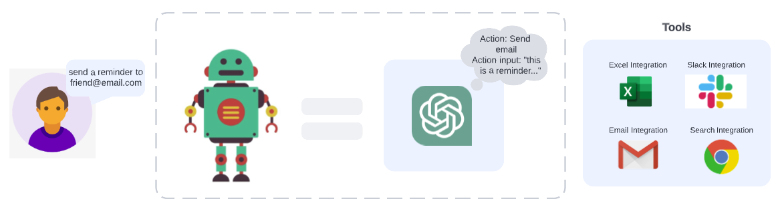
Agentic
Agent = wrapper around a language model that derives decision making
user input
outputs: action + action input
Tools = functions that let the agent interact with the environment
define the actions the agent can take

Slide 7
Agentic
Specify the following:
LLM
tools
AgentType (a string that references a support agent class)
conversational
reAct_description
self_ask_with_search

Slide 8
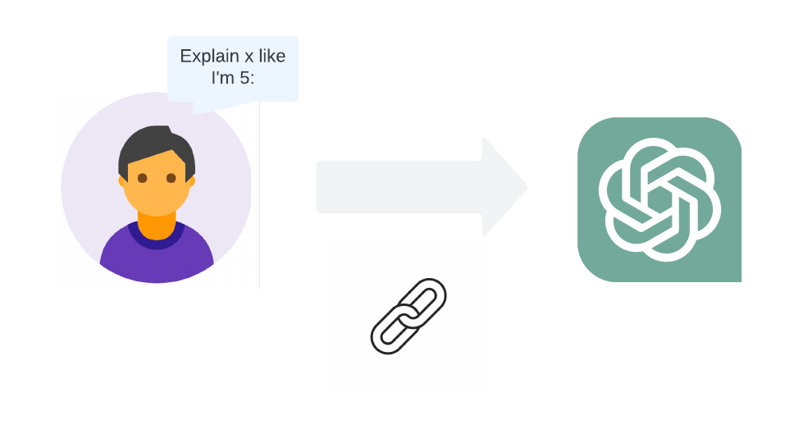
Chains
Consist of links run in predetermined order to create a single application:
Primitives
Prompts
Models
Functions

Slide 9
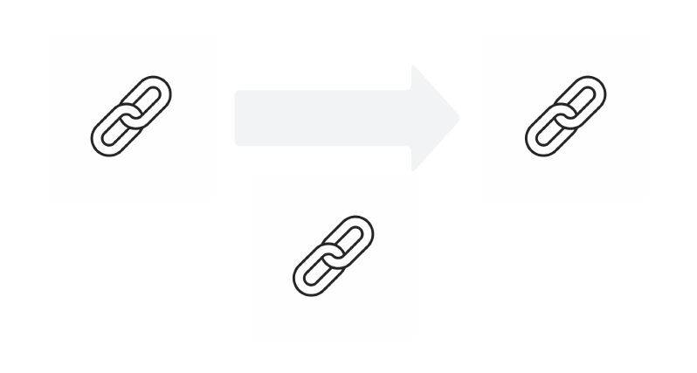
Chains
Consist of links run in predetermined order to create a single application:
Primitives
Prompts
Models
Functions
Chains

Slide 10
Chains
LLMChain
LLMMath
SequentialChain
Index-related chains

