Slide 1
Gorilla
LLM connected with Massive APIs

Slide 2
Gorilla contributions
LLaMa-based model that performs better than GPT-4 on writing API calls (fewer hallucinations). It can adapt to test-time document changes when combined with a document retriever.
APIBench for model evaluation: a comprehensive dataset consisting of HuggingFace, TorchHub, and TensorHub APIs
Retrieval aware training paradigm: incorporates document retrieval into the fine-tuning and inference pipelines so Gorilla can leverage up-to-date documentation

Slide 3
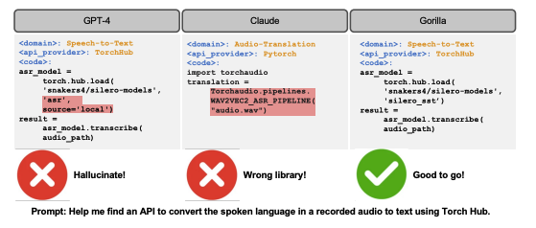
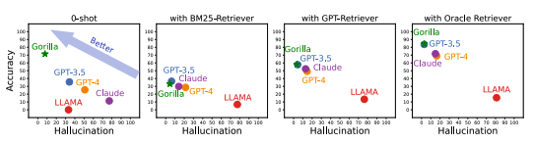
Gorilla vs SOTA

Slide 4
APIBench Dataset
recorded model cards for HuggingFace’s Model Hub, Pytorch Hub, TensorFlow Hub.
filtered out models with poor documentation
925 from HuggingFace, 95 from Pytorch Hub, 626 from TensorFlow Hub
converted API calls into json object with fields: {domain, framework, functionality, api_name, api_call, api_arguments, environment_requirements, example_code, performance, and description.}

Slide 5
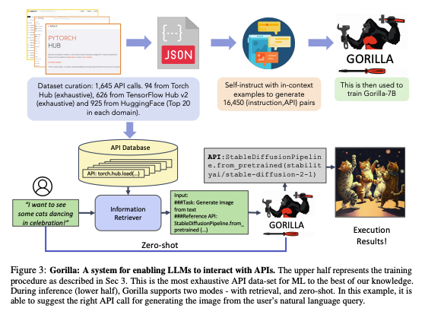
Gorilla-training & usage

Slide 6
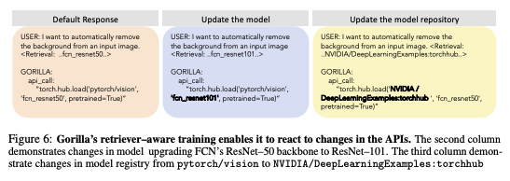
Training with Retriever
"Use this API documentation for reference: " appended to the user prompt
enables adaptation to changes in API documentation

Slide 7
Relevance to AF Survey
this is another one of the LLM-based agents that uses LLM as the controller and calls other models

