Slide 1


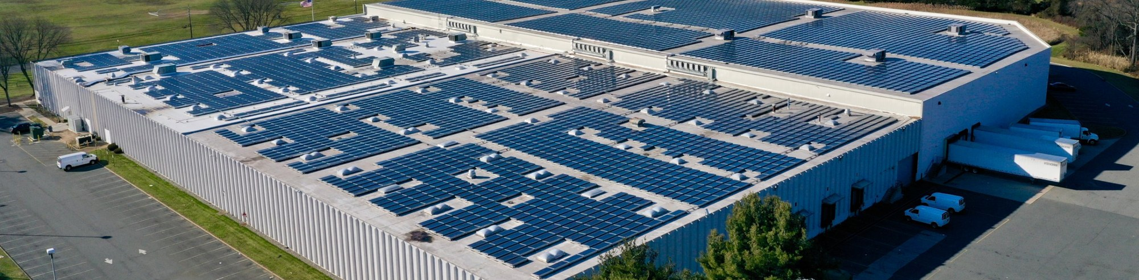
SOLAR & BATTERY OPPORTUNITY
Rooftop and Excess Land Income
Kurv formerly Bridge Investment Group portfolio screen
$194.4M
ILLUSTRATIVE INCREMENTAL ASSET VALUE
$11,665,000 portfolio annual income ÷ 6.0% cap rate
Potential roof lease (solar) and ground lease (BESS) revenue without upfront owner CAPEX
PORTFOLIO AT A GLANCE
PROJECTED PORTFOLIO ANNUAL INCOME
31
13.71M
2
$11.7M
properties modeled
sq ft GLA
states
Solar $8.6M
BESS $3.1M
TOP 7 PROPERTIES BY ANNUAL VALUE | GLA (SF) | SOLAR | BESS | ANNUAL TOTAL
Kurv Somerset · NJ | 1,243,982 | $1,197,000 | $100,000 | $1,297,000
Kurv Perth Amboy II · NJ | 1,094,676 | $1,053,500 | $100,000 | $1,153,500
Kurv Bridge Point 78 Phase II · NJ | 1,235,513 | $757,000 | $100,000 | $857,000
Kurv Melrose Park · IL | 1,557,680 | $613,500 | $100,000 | $713,500
Kurv McCook · IL | 1,193,232 | $470,000 | $100,000 | $570,000
Kurv Perth Amboy III · NJ | 471,231 | $453,500 | $100,000 | $553,500
Kurv Fountain Square · IL | 965,751 | $380,500 | $100,000 | $480,500
PORTFOLIO TOTAL (ALL 31 PROPERTIES) | 13,711,249 | $8,565,000 | $3,100,000 | $11,665,000
CAP-RATE SENSITIVITY
Portfolio asset value
CAP RATE | ASSET VALUE
5.00% | $233.3M
5.50% | $212.1M
6.00% | $194.4M
6.50% | $179.5M
7.00% | $166.6M
KEY ASSUMPTIONS
25-year term · 2% annual escalations · BESS $100K/year per eligible site
NEXT STEPS
Validate site feasibility, interconnection and lease terms
Contact Adam Simensky | Adam.Simensky@SolarKal.com for the property-level analysis
Preliminary screening estimates for discussion purposes only. Solar values reflect midpoint estimates from SolarKal's current market model, with system size estimated at one kW per 100 sq ft of building GLA; usable roof area is subject to site confirmation. BESS assumes $100,000/year for each of the 31 sites identified as eligible, over a 25-year term with no replacement cost modeled. Asset value is annual roof or ground lease rent divided by a 6.0% cap rate. Actual economics depend on site conditions, interconnection, market rules, incentives, lease structure and final diligence.

