Slide 1
MDM SaaS
Multi-Tenant Apple Device Management Platform
Product Demo
✦ Enrollment & Device Management
✦ Platform SSO with Microsoft Entra ID
✦ Software Distribution & Self-Service Portal
✦ USB Policy, Gatekeeper & Compliance
✦ JIT Admin Access with Auto-Revoke
Built with FastAPI · PostgreSQL · Apple APNs · Next.js

Slide 2
The Problem We Solve
Managing macOS devices at scale — without the complexity of enterprise MDM tools
❌ Traditional Pain Points
✅ Our Solution
• High cost
• Affordable SaaS
Legacy MDM tools (Jamf, Kandji) cost $6–15/device/month
Multi-tenant — one server, many customers
• Complex setup
• 5-minute setup
Requires dedicated IT staff and weeks of onboarding
Docker Compose → enroll device in minutes
• No PSSO
• Native PSSO
Most tools don't support macOS Platform SSO with Entra ID
Built-in Entra ID Platform SSO with Secure Enclave
• No agent control
• Management Agent
Can't run custom scripts or manage admin access remotely
Pure-bash agent — installs apps, elevates access
• Siloed workflows
• Unified platform
Software requests, access, compliance in separate tools
Device mgmt + software + compliance + access in one

Slide 3
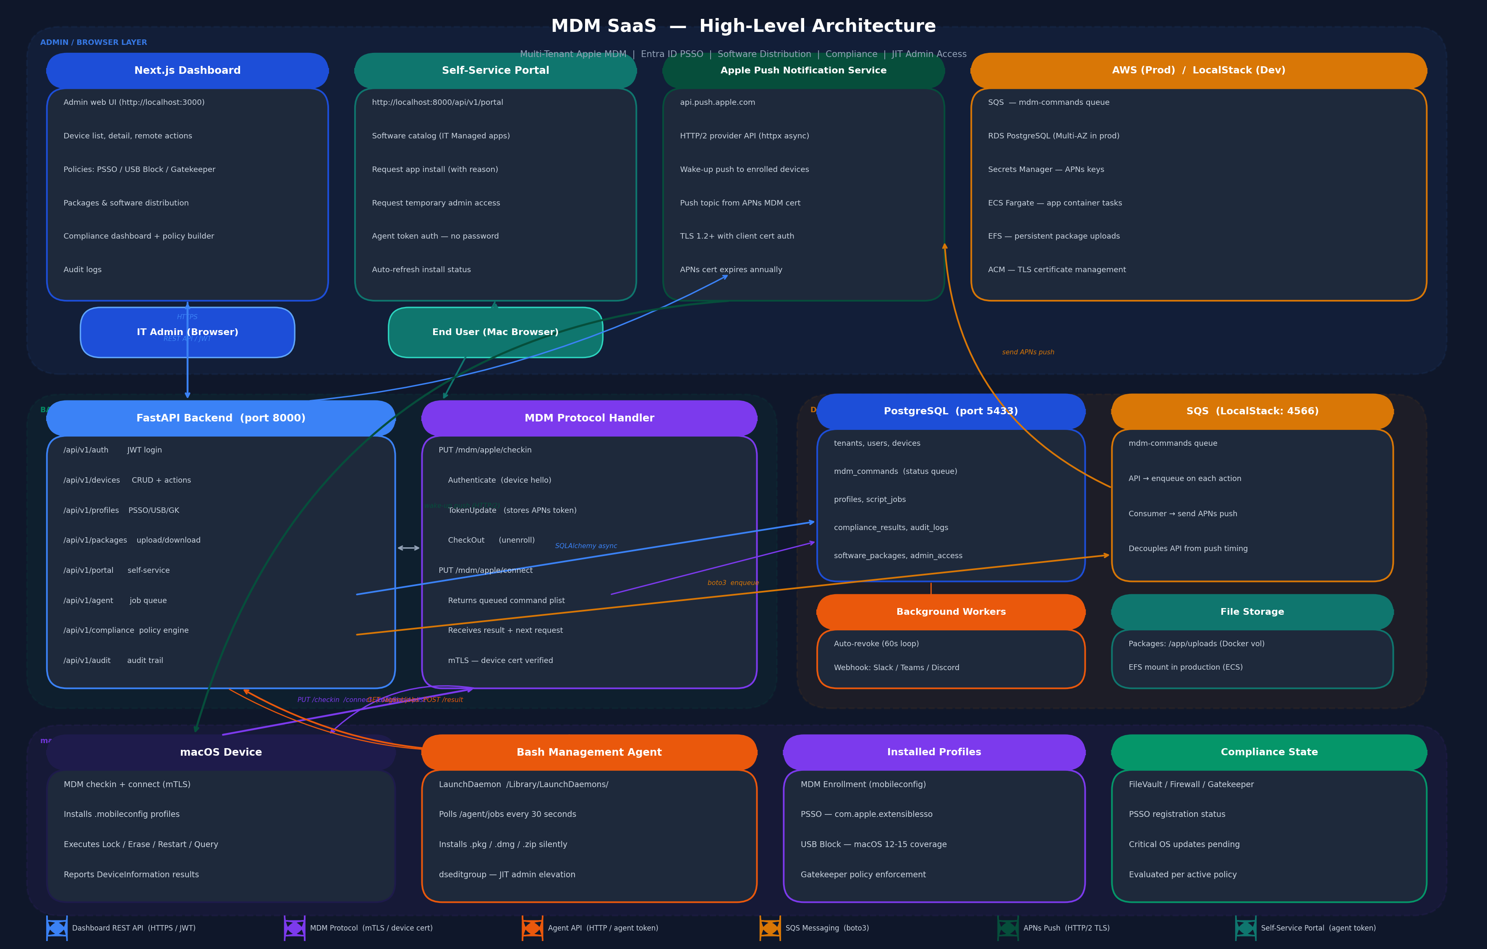
High-Level Architecture
End-to-end platform showing all components and their interactions

Slide 4
Platform Architecture
How it all fits together
Next.js Dashboard
FastAPI Backend
PostgreSQL
Apple APNs
• Admin web UI
• REST API /api/v1/
• Tenants & devices
• Wake-up push
• Device management
• MDM protocol /mdm/
• Commands queue
• HTTP/2 provider API
• Policy controls
• JWT + mTLS auth
• Compliance results
• Per-device push
• Audit logs
• Async/await
• Audit trail
• Instant delivery
macOS Device
Bash Agent
AWS SQS
Self-Service Portal
• MDM protocol
• LaunchDaemon service
• Command queue
• Software catalog
• Checkin + Connect
• Polls for jobs
• LocalStack (dev)
• App requests
• Profile install
• Installs software
• Async processing
• Admin access req.
• Command execute
• Reports results
• Reliable delivery
• Token-authenticated
Command Flow:
Admin action → FastAPI queues command in PostgreSQL → SQS message sent → APNs wake-up push to device → Device calls /mdm/apple/connect → Server returns command plist → Device executes → Result stored in DB

Slide 5
Device Enrollment
Zero-touch enrollment with signed .mobileconfig profiles
1
2
3
4
5
Generate Token
Share URL
Install Profile
Authenticate
Enrolled
Admin creates enrollment token in dashboard. Choose platform (macOS), reusable or single-use, expiry time.
Enrollment URL shared with user. Open in Safari on the Mac — no agent pre-installed needed.
Signed .mobileconfig downloaded. macOS prompts user to install the MDM enrollment profile.
Device sends Authenticate + TokenUpdate to /mdm/apple/checkin. Server stores APNs push token.
Device appears in dashboard as 'enrolled'. APNs push, serial, OS version, model all captured.
→
→
→
→
After enrollment: device receives APNs push within seconds for any remote action

Slide 6
Device Management
Full remote control over enrolled macOS devices
🔒 Lock Device
🗑️ Erase Device
🔄 Restart
🔍 Query Info
✓ Send PIN + message
✓ Full wipe + reinstall
✓ Graceful restart
✓ Serial, model, OS
✓ Immediate via APNs
✓ Configurable PIN
✓ Queued via APNs
✓ FileVault, Firewall
✓ Device shows lock screen
✓ CheckOutWhenRemoved
✓ Useful after profile install
✓ Supervised status
✓ Audit logged
✓ Irreversible action
✓ Instant delivery
✓ Updates available
👥 Device Users
📦 Patch Management
🛡️ Compliance
📋 Audit Logs
✓ List local users
✓ Installed app inventory
✓ Policy evaluation
✓ All admin actions
✓ Admin / standard role
✓ Available OS updates
✓ Pass / Fail / Unknown
✓ Actor email + IP
✓ Secure Token status
✓ Critical update count
✓ Per-device report
✓ Resource + changes
✓ Last login time
✓ Remote install
✓ Fleet dashboard
✓ Export as CSV

Slide 7
Platform SSO — Microsoft Entra ID
Passwordless macOS login with corporate credentials
What is PSSO?
Profile Payload (mobileconfig)
→ macOS 13+ native Single Sign-On framework
PayloadType:
com.apple.extensiblesso
→ Login to Mac using Microsoft Entra ID credentials
ExtensionIdentifier:
com.microsoft.CompanyPortalMac
→ Secure Enclave key — no password stored on disk
TeamIdentifier:
UBF8T346G9
→ Seamless SSO to all Microsoft 365 / Azure apps
Type:
Credential
→ Requires Microsoft Company Portal installed
AuthenticationMethod:
UserSecureEnclaveKey
→ Delivered via com.apple.extensiblesso MDM profile
EnableCreateUserAtLogin:
true
RegistrationToken:
<from Entra portal>
→ Registration token from Entra automates device join
AdministratorGroups:
["IT Admins"]
Push to all enrolled devices in one click from the Policies page

Slide 8
Platform SSO — New Joiner Onboarding
PSSO auto-pushed on enrollment — zero admin effort
Onboarding Flow
Auth Methods & Compatibility
→ PSSO profile auto-pushed on enrollment — zero admin effort
→ Secure Enclave Key (recommended)
→ New joiner installs Company Portal → registers with Entra ID
Hardware-bound, T2 / M1 / M2 / M3 chip
→ Login window authenticates against Microsoft Entra ID
→ Password mode — Entra password synced locally
→ New local macOS account created automatically at first login
Works on VMs (UTM, Parallels)
→ All Microsoft apps (Teams, Outlook, Office) SSO automatically
→ Tested: macOS 15.1 Sequoia (UTM VM)
→ No Intune license required — works with any MDM
→ Tested: macOS 26.2 Tahoe beta (Physical Mac)
No Intune license required — PSSO works with any MDM via com.apple.extensiblesso payload

Slide 9
Device Lifecycle
From enrollment through wipe and redeployment — fully automated
Enrolled
Wiped
Spare
Re-Enrolled
✓ MDM commands active
✓ EraseDevice command sent
✓ CheckOut received
✓ Fresh enrollment
✓ Compliance evaluated
✓ Status → wiped immediately
✓ Status → spare
✓ New push token registered
✓ PSSO auto-pushed
→
✓ Push tokens cleared
→
✓ Available for redeployment
→
✓ PSSO auto-pushed again
✓ APNs push token stored
✓ Audit log entry created
✓ Token cleared, ready to re-enroll
✓ New joiner ready in minutes
PSSO is automatically re-pushed on every re-enrollment — no admin action required

Slide 10
Software Distribution
Upload once, deploy to any device via self-service portal
1. Upload Package
2. Portal Catalog
3. Admin Approval
4. Agent Installs
✓ Admin uploads .pkg/.dmg/.zip
✓ Appears in self-service portal
✓ Request appears in dashboard
✓ Agent picks up job in 30s
✓ Up to 4 GB supported
✓ User sees 'IT Managed' apps
✓ Admin reviews + approves
✓ Runs installer silently
✓ Stored securely on server
✓ One-click install request
✓ Or set auto-approve
✓ Reports exit code + output
✓ Versioning & description
→
✓ Token-authenticated access
→
✓ Audit logged
→
✓ Status: installing → done
Management Agent — pure bash LaunchDaemon, no Python or Xcode required. Bootstrap: curl -sSLG -d auth=<token> <url> | sudo bash

Slide 11
USB Block Policy
Block or allow external storage — fleet-wide or per device
How It Works
Fleet Push (All Devices)
• macOS 12–13
Policies page → USB Block → Push to All Queues InstallProfile for every enrolled device simultaneously. APNs push wakes each device instantly.
com.apple.systemuiserver with mount-controls. Denies harddisk-external, disk-image, DVD, CD, BD.
• macOS 14+
com.apple.security.diskaccess with DenyExternalStorage: true. Full enforcement on supervised devices.
• Both payloads sent together
Single profile push covers all macOS versions automatically.
Per-Device Control
• Deterministic identifier
Device Detail page → Block USB / Remove USB Block Block: InstallProfile queued for that device only. Remove: RemoveProfile with deterministic identifier — works reliably every time.
com.mdmsaas.usb.block.profile.{tenant_id} — ensures RemoveProfile always finds the right profile.
• Removal disallowed
Profile cannot be removed by user — only via MDM RemoveProfile command.
Requires supervised device for silent enforcement. Unsupervised: macOS shows user-dismissable warning dialog.

Slide 12
JIT Admin Access
Temporary, audited admin elevation — auto-revoked on expiry
Request
Approve
Elevate
Auto-Revoke
User opens self-service portal on their Mac. Selects their account, enters a reason and duration (1–24h). Request sent to admin dashboard.
Admin reviews request in dashboard. Approves with optional duration override. revoke_at timestamp set in database.
Management agent picks up dseditgroup job. Adds user to 'admin' group on macOS. User is now local admin for the duration.
Background worker checks every 60 seconds. When revoke_at ≤ now: removes from admin group. Webhook notification sent (Slack/Teams/Discord).
→
→
→
Security principles: Least privilege • Time-bound access • Full audit trail • No persistent admin accounts

Slide 13
Compliance Engine
Policy-based compliance evaluation across your entire fleet
Policy Rules
Device Status
Supported Frameworks
☑ FileVault encryption enabled
✅ Compliant
CIS macOS Benchmark
All rules passing
Center for Internet Security hardening
☑ Firewall enabled
❌ Non-Compliant
NIST 800-53
One or more rules failing
Federal security controls
☑ Gatekeeper enforced
❓ Unknown
Not yet evaluated
PCI DSS v4
☑ PSSO registered
Payment card industry standard
Fleet Dashboard
☑ Screen lock configured
ISO 27001
→ Total enrolled devices
Information security management
☑ Max check-in age (hours)
→ # Compliant
Custom
☑ Critical updates threshold
→ # Non-compliant
Define your own policy rules
→ # Unknown
→ Active policies list

Slide 14
Tested On & Compatibility
Real-world testing results for PSSO and MDM enrollment
Platform / Feature
Test Scenario
Result
macOS 15.1 Sequoia (UTM VM)
Password PSSO auth
✓ PASS
macOS 26.2 Tahoe beta (Physical MacBook Pro)
Secure Enclave Key PSSO auth
✓ PASS
Microsoft Entra ID PSSO
No Intune license required
✓ PASS
Browser SSO
Safari, Microsoft 365
✓ PASS
MDM Enrollment
Safari enrollment profile install
✓ PASS
Remote Wipe (EraseDevice)
Status → wiped, tokens cleared
✓ PASS
All tests performed with Microsoft Company Portal (free from Mac App Store)

Slide 15
Multi-Tenancy & Security
Built for SaaS — complete isolation between customers
Tenant Isolation
Authentication
Profile Security
✓ Every DB query: WHERE tenant_id = :id
✓ Dashboard: JWT Bearer tokens
✓ Profiles signed with CMS PKCS#7
✓ tenant_id from JWT, never from URL params
✓ MDM endpoints: mTLS device certificates
✓ SHA-256 signature, DER encoded
✓ MDM endpoints: UDID → tenant_id lookup
✓ Agent: per-device agent tokens
✓ macOS verifies signature on install
✓ No cross-tenant data leakage possible
✓ Portal: per-device tokens (no JWT)
✓ CA cert embedded in signature bag
Audit Trail
Secrets Management
Network Security
✓ All admin actions logged
✓ APNs certs via AWS Secrets Manager
✓ HTTPS everywhere (Caddy / ALB)
✓ Actor email + IP address
✓ JWT key in environment variable
✓ APNs: TLS 1.2+ to api.push.apple.com
✓ Resource type + changes (JSONB)
✓ DB password never in code
✓ MDM commands: device cert verified
✓ Filterable by action + resource type
✓ LocalStack for dev (no AWS needed)
✓ No raw plist bodies in logs (PII)

Slide 16
Live Demo Walkthrough
End-to-end demonstration of key capabilities
Step 1: Enroll a Device
Step 2: Remote Actions
Step 3: Push PSSO Profile
Generate enrollment token → Open URL in Safari on Mac → Install profile → Device appears enrolled
Query device info → View serial/OS/model → Lock device with PIN → View command status in real time
Policies → Platform SSO → Configure Entra tenant → Push to all devices → Verify profile on Mac
Step 4: Software Request
Step 5: USB Block
Step 6: JIT Admin Access
Install agent via bootstrap URL → Open self-service portal → Request Zoom/Firefox → Approve → Auto-installs
Device page → Block USB → Plug in USB stick → Blocked! → Remove USB Block → USB works again
Portal → Request admin access (2h) → Approve in dashboard → Elevated → Auto-revoked after timeout
Total demo time: ~15 minutes | All features running live on real macOS device

Slide 17
MDM SaaS
One platform to manage, secure, and support every Mac in your organisation.
Enrollment
Remote Actions
PSSO / Entra ID
Software Distribution
USB Policy
Compliance
JIT Admin Access
Audit Logs
Built with FastAPI · PostgreSQL · Next.js · Apple APNs · AWS ECS
Thank You

