Slide 1


Algorithm-2
K-Nearest Neighbors (KNN)

Slide 2
K-Nearest Neighbors (KNN) Analysis CKD Dataset
Introduction to KNN
Dataset Overview
K-Nearest Neighbors (KNN) is a supervised machine learning algorithm.
It classifies data points based on the majority class of their nearest neighbors.
Used for both classification and regression tasks.
Here, KNN is applied to analyze the CKD dataset.
Dataset: CKD (Chronic Kidney Disease)
Contains attributes related to kidney disease diagnosis.
Data used to train the KNN algorithm to predict outcomes.

Slide 3
K-Nearest Neighbors (KNN): Methodology and Implementation
Methodology
Implementation
KNN uses the distance between data points to find the k-nearest neighbors to a new data point, and predicts its class based on the majority class of its neighbors.
KNN is implemented by calculating the distance between data points and identifying the nearest neighbors based on a chosen metric, such as Euclidean distance.

Slide 4
WORK FLOW
1. Load and preprocesses the dataset
2. Split the data into training and test sets
3. Train the KNN Model
4. Evaluate the model with accuracy and confusion matrix
5. Plot the accuracy for varying k values

Slide 5
KNN Model Implementation
1. Data Preprocessing:
- Handled missing values.
- Scaled the features for uniformity.
-Normalizes the data using Standard Scaler.
2. Model Training:
- Split data into 70% training and 30% testing sets.
- Trained the model using different 'k' values.
3. Model Evaluation:
- Computes the accuracy score.
- Displays a confusion matrix.

Slide 6
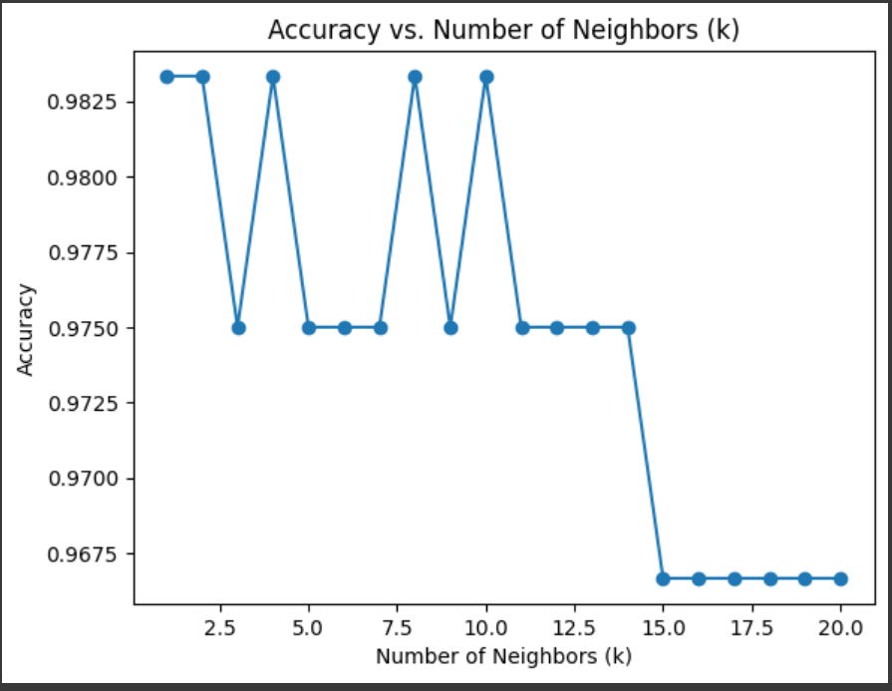
Accuracy vs. Number of Neighbors (k)
The accuracy of the model was evaluated for different values of k (number of neighbors)
Observations:
-The accuracy fluctuates for small values of k, peaking at k=1,5,9,11 .
-Beyond k=15, the accuracy drops significantly.
-Optimal k value appears to be 1 or 9 for highest accuracy .

Slide 7
Comparison of Model Performance Metrics
Accuracy
Precision
The proportion of correctly classified instances.
(TP+TN)
(TP+TN+FP+FN)
The proportion of true positives among predicted positives.
TP
(TP+FP)
Accuracy =
Precision =
Recall (Sensitivity)
F1-score
The proportion of true positives among actual positives.
TP
(FN+TP)
The harmonic mean of precision and recall.
2*Precision*Recall
Precision + Recall
F1-score =
Recall =

Slide 8
Comparison of Model Performance Metrics
Accuracy
Precision
The proportion of correctly classified instances.
(TP+TN)
(TP+TN+FP+FN)
The proportion of true positives among predicted positives.
TP
(TP+FP)
Accuracy =
Precision =
Recall (Sensitivity)
F1-score
The proportion of true positives among actual positives.
TP
(FN+TP)
The harmonic mean of precision and recall.
2*Precision*Recall
Precision + Recall
F1-score =
Recall =

Slide 9
Comparison of Model Performance Metrics
Accuracy
Precision
The proportion of correctly classified instances.
(TP+TN)
(TP+TN+FP+FN)
The proportion of true positives among predicted positives.
TP
(TP+FP)
Accuracy =
Precision =
Recall (Sensitivity)
F1-score
The proportion of true positives among actual positives.
TP
(FN+TP)
The harmonic mean of precision and recall.
2*Precision*Recall
Precision + Recall
F1-score =
Recall =

Slide 10
Comparison of Model Performance Metrics
Accuracy
Precision
The proportion of correctly classified instances.
(TP+TN)
(TP+TN+FP+FN)
The proportion of true positives among predicted positives.
TP
(TP+FP)
Accuracy =
Precision =
Recall (Sensitivity)
F1-score
The proportion of true positives among actual positives.
TP
(FN+TP)
The harmonic mean of precision and recall.
2*Precision*Recall
Precision + Recall
F1-score =
Recall =

Slide 11
Comparison of Model Performance Metrics
Accuracy
Precision
The proportion of correctly classified instances.
(TP+TN)
(TP+TN+FP+FN)
The proportion of true positives among predicted positives.
TP
(TP+FP)
Accuracy =
Precision =
Recall (Sensitivity)
F1-score
The proportion of true positives among actual positives.
TP
(FN+TP)
The harmonic mean of precision and recall.
2*Precision*Recall
Precision + Recall
F1-score =
Recall =

Slide 12
Comparison of Model Performance Metrics
Accuracy
Precision
The proportion of correctly classified instances.
(TP+TN)
(TP+TN+FP+FN)
The proportion of true positives among predicted positives.
TP
(TP+FP)
Accuracy =
Precision =
Recall (Sensitivity)
F1-score
The proportion of true positives among actual positives.
TP
(FN+TP)
The harmonic mean of precision and recall.
2*Precision*Recall
Precision + Recall
F1-score =
Recall =

