Slide 1
IOT Development Project
Environmental Monitoring

Slide 2
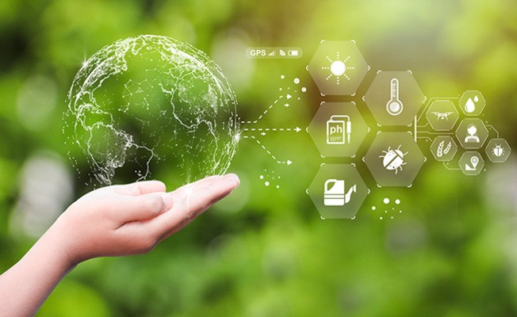
Introduction
Advancing Environmental Monitoring through IoT technology is crucial for sustainable development. This project aims to leverage the power of IoT to collect real-time data on air quality, water pollution, and climate conditions. By integrating environmental sensors with IoT devices, we can obtain accurate and timely information to make informed decisions for preserving our planet.

Slide 3
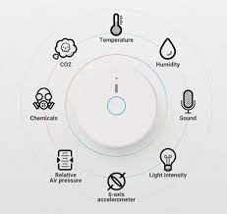
Environmental Sensors
High-quality sensors are the foundation of effective environmental monitoring. These sensors can measure various parameters such as temperature, humidity, CO2 levels, and particulate matter. By deploying these sensors in strategic locations, we can gather precise data that helps us understand the environmental impact of human activities.

Slide 4
New technology in Environmental monitoring
Sensor Technology: Areas of Application
Next-generation sensors are transforming air quality monitoring, enabling accurate and real-time detection of pollutants, aiding in the prevention of respiratory diseases, and improving overall environmental health

Slide 5

Challenges and Solutions
Implementing an IoT-based environmental monitoring project comes with challenges.
Some of these include data security, scalability, and sensor calibration.
However, these challenges can be overcome through encryption, cloud-based infrastructure, and regular maintenance. By addressing these concerns, we can ensure the reliability and longevity of the IoT system.

Slide 6
Conclusion
Real-time data
Gain valuable insights
New technology used
conservation and technological innovation go hand in hand

