Slide 1

ENHANCING BANKING EFFICIENCY WITH A DEEP LEARNING-BASED APPOINTMENT MANAGEMENT SYSTEM
TEAM MEMBERS:
GUIDE NAME:
CB2308-P.ATHITHYA
CB2335-M.MANIKANDAN
CB2345-M.RIYASH
Mrs.N.G.GAYATHRI,M.E.,
ASSISTANT PROFESSOR,CSBS

Slide 2
ABSTRACT
The Appointment Management System for Banks using Deep Learning is designed to streamline customer scheduling and significantly reduce waiting time in banking services. This system allows customers to conveniently book appointments in advance for services such as account opening, loan processing, and customer support. By leveraging deep learning techniques, the system analyzes historical data to accurately predict peak hours, customer flow patterns, and service durations. This enables intelligent scheduling and efficient resource allocation within the bank.
The system helps minimize overcrowding, optimize staff utilization, and improve overall operational efficiency. Additionally, it provides real-time updates, secure data handling, and adaptive decision-making capabilities. By enhancing both customer experience and service management, the system contributes to a more efficient, reliable, and user-friendly banking environment.

Slide 3
INTRODUCTION
Efficient Banking Services:
The system helps banks manage customer appointments effectively, reducing long queues and improving overall service quality. By organizing customer visits in advance, it ensures a smooth and structured banking experience.
Smart Scheduling:
Deep learning techniques analyze historical data and customer patterns to accurately predict peak hours and service demand. This enables efficient allocation of time slots and better planning of banking operations.
Customer Convenience:
Customers can easily book, modify, or cancel appointments through an online platform. This flexibility enhances user experience and eliminates the need for long waiting times at the bank.

Slide 4
PROBLEM STATEMENT
Traditional banking systems face several challenges such as long waiting times, overcrowding, inefficient staff allocation, and the lack of effective scheduling mechanisms. Manual appointment handling or walk-in systems often result in customer dissatisfaction and poor service management.
Although some digital solutions exist, they lack advanced predictive capabilities and fail to adapt to dynamic customer demand and varying service patterns. These systems are not capable of accurately forecasting peak hours or optimizing appointment schedules in real time.
Therefore, there is a need for an intelligent Appointment Management System for Banks using Deep Learning. By leveraging deep learning techniques, the system can analyze historical data, predict customer flow, estimate service duration, and optimize scheduling. This will help reduce waiting time, improve resource utilization, and enhance overall customer satisfaction.

Slide 5
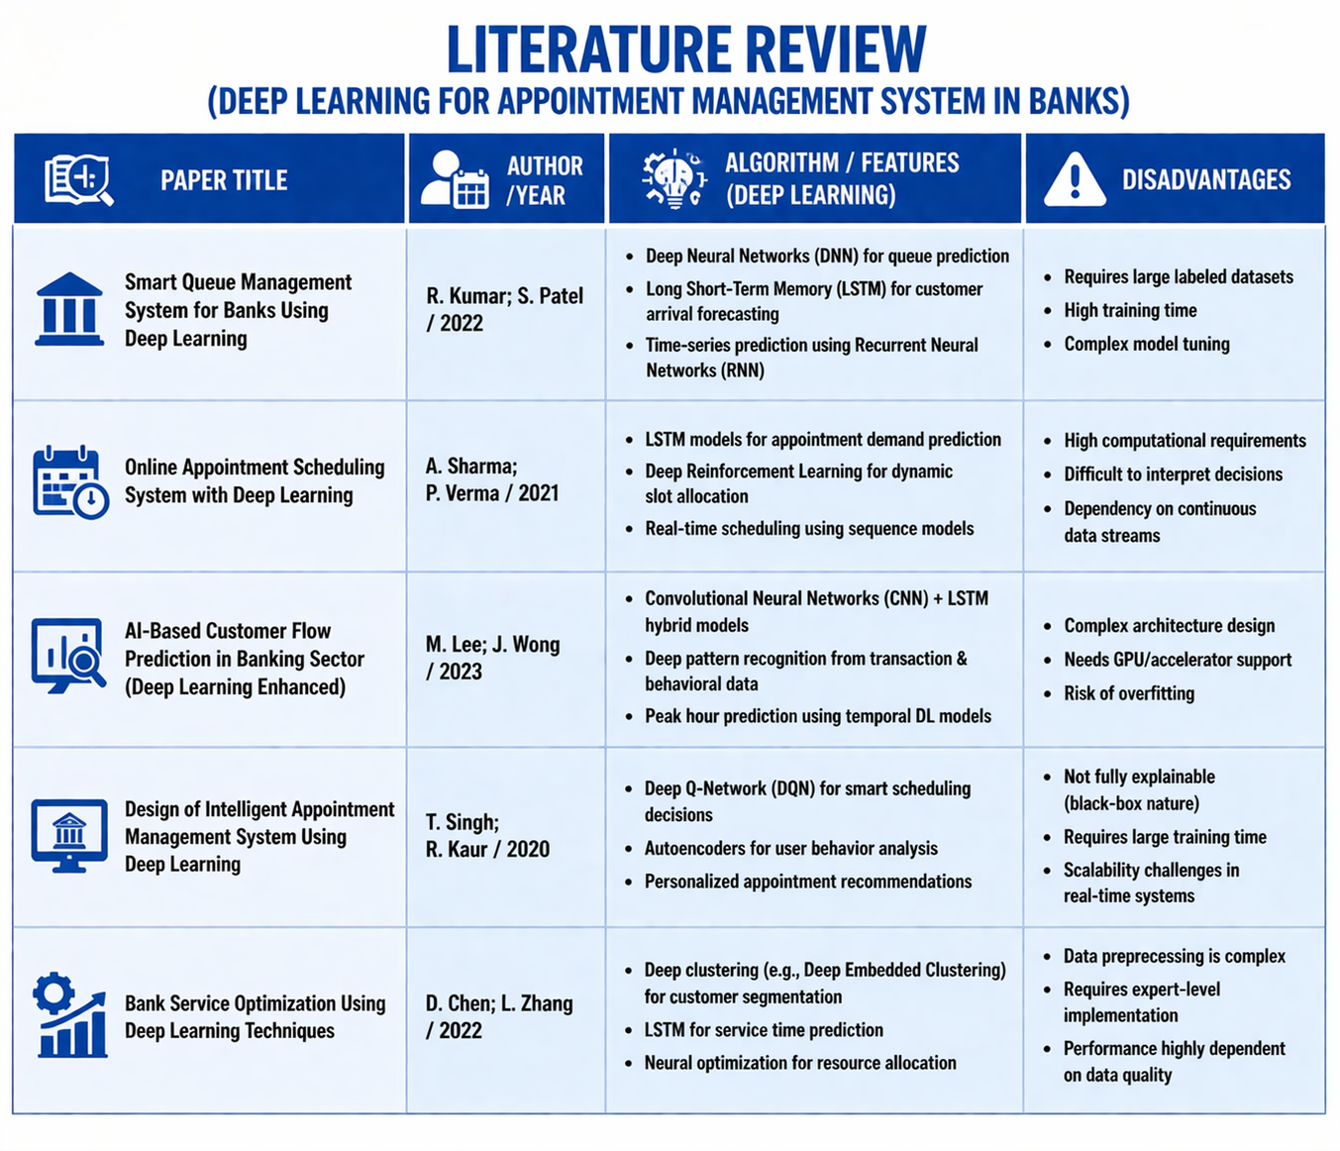

Slide 6
EXISTING SYSTEM
Manual Token System:
In many banks, customer handling is still based on manual token or walk-in systems. Customers must wait in long queues without prior scheduling, leading to overcrowding and increased waiting times. This approach lacks efficiency, proper time management, and does not provide any predictive capability for handling customer flow.
Basic Digital Appointment Systems:
Some banks have adopted simple online appointment booking systems. While these systems allow customers to schedule visits, they operate on fixed time slots without considering real-time demand or historical patterns. These systems do not use advanced analytics and often fail to prevent peak-hour congestion.
Lack of Intelligent Prediction:
Existing systems do not incorporate deep learning or advanced predictive techniques. As a result, they are unable to forecast customer inflow, estimate service duration, or dynamically adjust scheduling. This leads to inefficient staff allocation and underutilization of resources during non-peak hours.

Slide 7
DISADVANTAGE OF EXISTING
SYSTEM
1.No prediction of customer flow
2.Increased waiting time
3.Poor resource utilization
4.No real-time updates
5.Limited scalability
6.No personalized services

Slide 8
PROPOSED SYSTEM
Online Appointment Booking:
Customers can schedule appointments easily based on available time slots through an online platform.
Deep Learning Integration:
Deep learning models analyze historical data to predict peak hours, customer arrival patterns, and service duration more accurately.
Smart Queue Management:
The system optimizes appointment schedules to reduce waiting time and manage customer flow efficiently.
Secure Data Storage:
Ensures safe and reliable handling of customer data with proper security mechanisms.

Slide 9
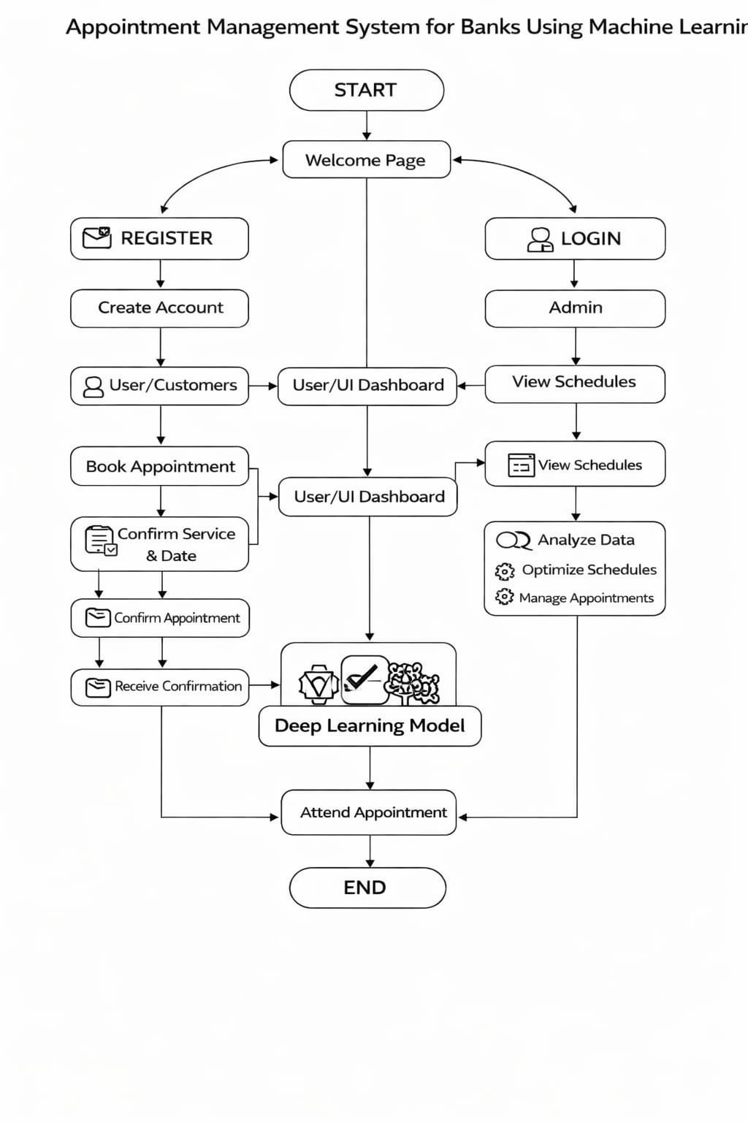
SYSTEM ARCHITECTURE

Slide 10
MODULES
1.Register
2.Log in
3.Book Appointment
4.Modify Appointment
5.Cancel Appointment
6.Admin Dashboard
7.Log out

Slide 11
REGISTER
Objective:
Allows users to create an account for booking and managing bank appointments with enhanced security using Deep Learning.
Name:
Collects user name for identification and personalization.
Email / Mobile Number:
Used for OTP verification and notifications.Deep Learning helps detect fake or duplicate registrations.
Password:
Ensures secure access with strong validation. Deep Learning detects unusual registration behavior.

Slide 12
LOG IN
Authentication:
Users enter their registered email or mobile number along with password to access the bank appointment system securely.
User Verification:
The system verifies credentials using secure validation methods and may include OTP or multi-factor authentication for added security.
Access to Services:
After successful login, users can view available banking services, book appointments, check status, or modify existing bookings.
Quick Navigation:
The login module provides a fast and user-friendly interface, enabling smooth access to all appointment-related features without complexity.

Slide 13
BOOK APPOINTEMENT
Service Selection
Users select banking services such as account opening, loan inquiry, fund transfer, or customer support based on their requirements. The system provides a user-friendly interface that allows customers to choose the appropriate service quickly and accurately.
Date and Time Selection
Customers choose a convenient date and time slot for their appointment. The system displays available slots, enabling users to schedule appointments according to their preferences and availability.
Availability Check
The system verifies the availability of the selected time slot in real time to prevent double booking and scheduling conflicts. Deep Learning techniques further enhance this process by forecasting customer demand patterns and optimizing slot allocation for improved efficiency.

Slide 14
MODIFY APPOINTMENT
View Existing Appointment:
Users can view their previously booked appointments with details such as service type, date, and time.
Update Details:
Customers can modify the appointment date, time, or selected banking service as needed.
Availability Check:
The system checks the availability of the newly selected time slot to prevent conflicts or double bookings.

Slide 15
CANCEL APPOINTMENT
View Existing Appointment:
Users can view their previously booked appointments along with details such as service type, date, and time.
Select Appointment to Cancel:
Customers choose the appointment they wish to cancel from their schedule.
Availability Update:
Once an appointment is canceled, the system updates the slot availability in real time.
Confirmation:
After cancellation, users receive a confirmation notification acknowledging the action. Deep Learning enhances this by sending smart alerts.

Slide 16
ADMIN DASHBOARD
Select Appointment:
Admins can select specific appointments for monitoring or management. Deep Learning assists by highlighting important or high-priority appointments using predictive analysis.
Cancellation Process:
The system allows admins to cancel appointments when required with proper confirmation. Deep Learning supports this by identifying patterns of frequent cancellations and suggesting preventive actions.
Update Availability:
Once an appointment is canceled, the time slot becomes available for other users. Deep Learning optimizes slot utilization by predicting demand and reallocating availability efficiently.

Slide 17
LOG OUT
Session Termination:
Allows users to securely exit the system by ending their current session. Deep Learning monitors session behavior to ensure safe and valid logout activities.
Data Security:
Ensures that user information and appointment details are protected after logout. Deep Learning enhances security by detecting unusual access patterns and preventing unauthorized usage.
Clear Session Data:
Removes temporary data to prevent misuse, especially on shared devices. Deep Learning ensures sensitive data is properly cleared based on usage patterns and risk levels.

Slide 18
CONCLUSION
The Appointment Management System for Banks using Deep Learning provides an innovative and efficient solution for modern banking operations. By integrating advanced deep learning algorithms with intelligent appointment scheduling, the system effectively minimizes customer waiting time and improves overall service quality. It enables banks to predict customer arrival patterns, manage appointments efficiently, and allocate staff resources based on demand.
The system enhances customer satisfaction by providing a seamless and convenient booking experience while reducing overcrowding in bank branches. It also improves operational efficiency by automating appointment management tasks, reducing manual errors, and ensuring better utilization of available resources.

Slide 19
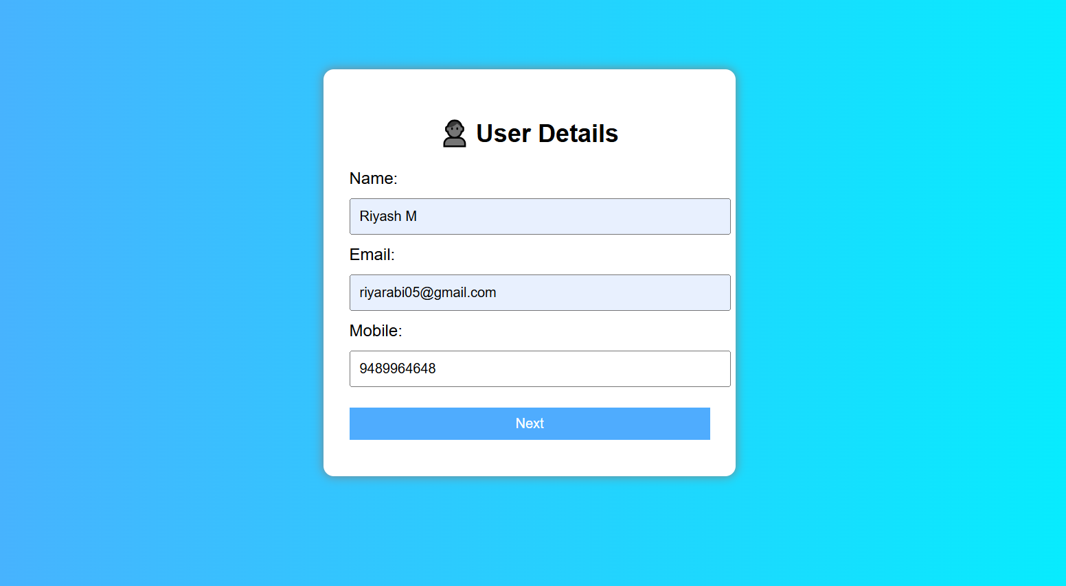
OUTPUT SCREENSHOTS
USER DETAILS

Slide 20
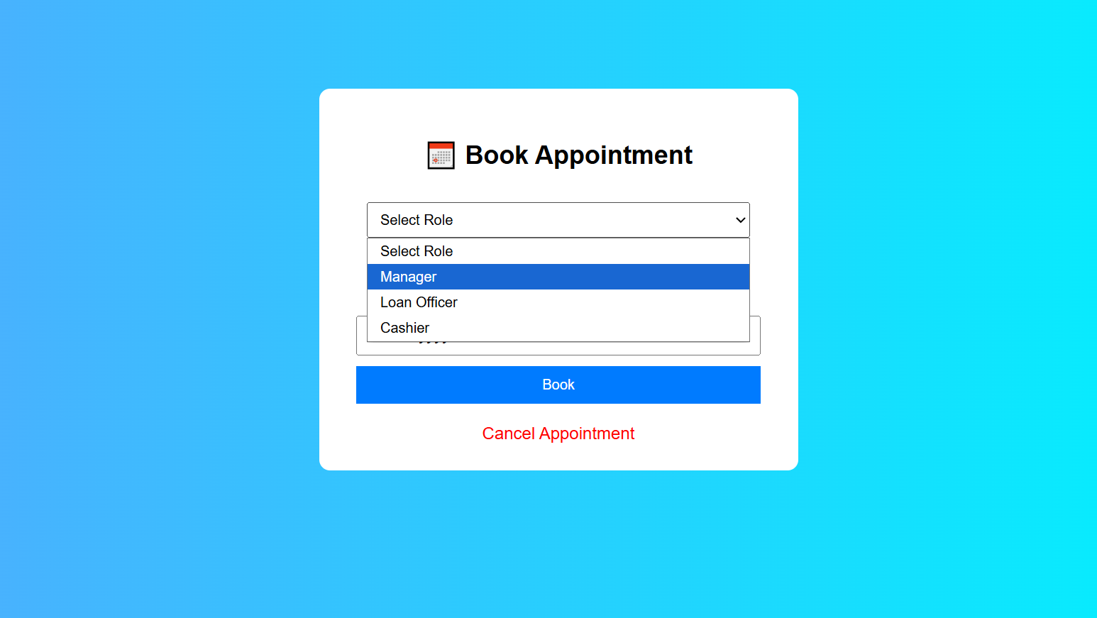
BOOK APPOINTMENT

Slide 21
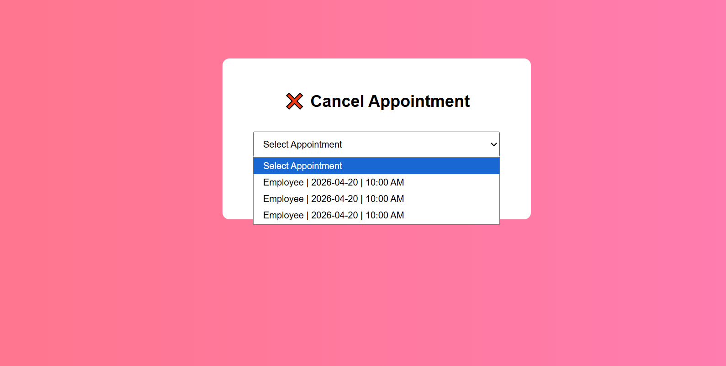
CANCEL APPOINTMENT

Slide 22
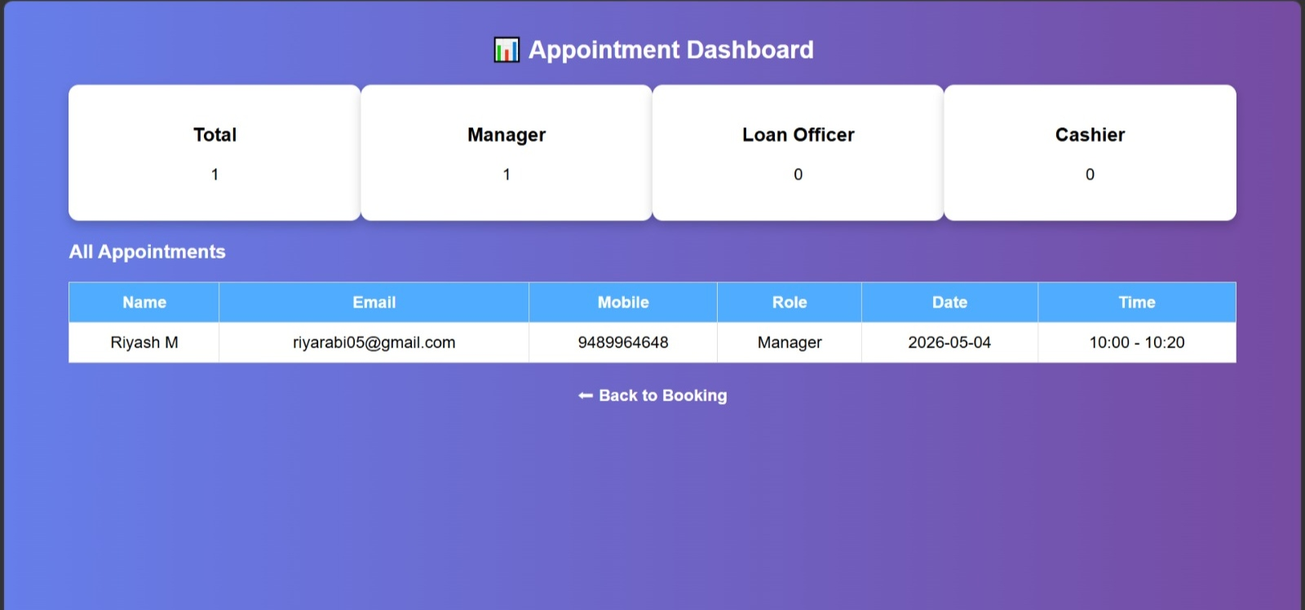
APPOINTMENT DASHBOARD

Slide 23
REFERENCE
[1] M. Jena and S. Dehuri, ‘‘DecisionTree for classification and regres-sion: A state-of-the art review,’’ Informatica, vol. 44, no. 4, pp. 405–420,Dec. 2020.
[2] R. Sharma, S. Gupta, and P. Garg, ‘‘Model for predicting cardiac health using deep learning classifier,’’ in Proc. 5th Int. Conf. Comput.Intell.Commun. Technol. (CCICT), Jul. 2022, pp. 25–30.
[3] F. Rustam, A. A. Reshi, A. Mehmood, S. Ullah, B.-W. On, W. Aslam,and G. S. Choi, ‘‘COVID-19 future forecasting using supervised machine learning models,’’ IEEE Access, vol. 8, pp. 101489–101499, 2020.
[4] J. Qin, L. Chen, Y. Liu, C. Liu, C. Feng, and B. Chen,‘‘A machine learning methodology for diagnosing chronic kidney disease,’’ IEEE Access, vol. 8,pp. 20991–21002, 2020.

Slide 24
THANK YOU

