Slide 1
Why Regression?
📊 Predict numbers
🏠 Prices
💰 Revenue

Slide 2
The Challenge
⚠️ Messy data
❌ Missing values
🔀 Noise

Slide 3
The Solution
📐 Learn patterns
🔍 Find relationships
📊 Predict output

Slide 4
Models
📏 Linear
📐 Multiple
🎯 SVM
🌳 Tree
🌲 Forest

Slide 5
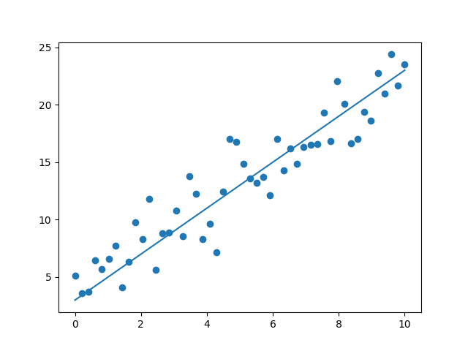
Linear Regression
Straight line model
Fast & simple
Best for linear trends

Slide 6
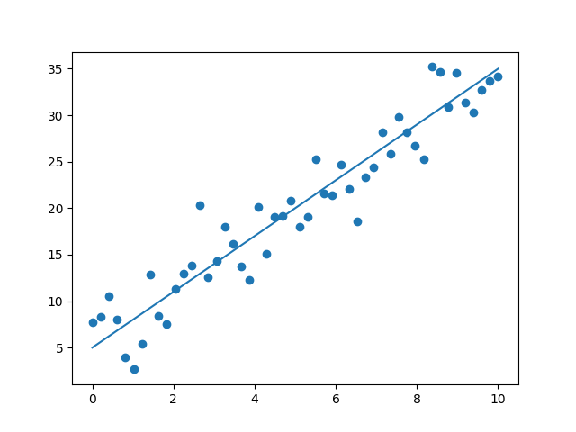
Multiple Linear Regression
Uses multiple features
More realistic
Still linear

Slide 7
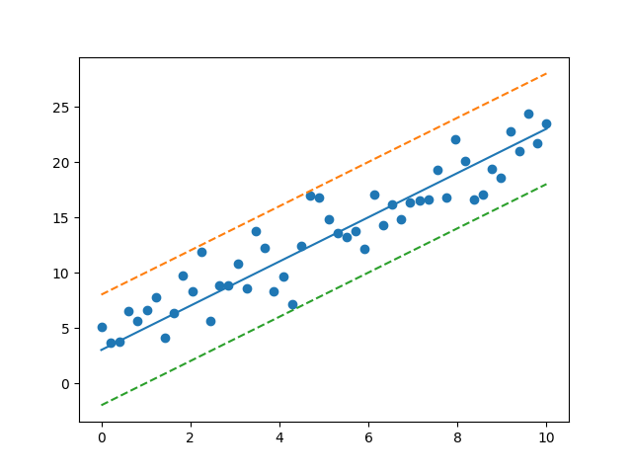
SVM Regression
Uses margin
Robust to outliers
Handles complex data

Slide 8
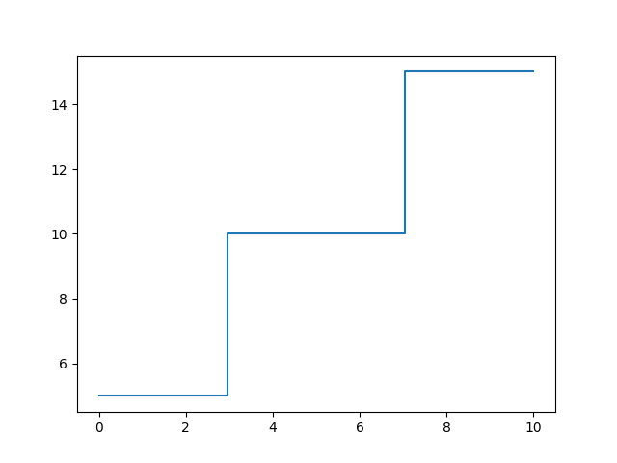
Decision Tree
Rule-based splits
Easy to understand
Non-linear model

Slide 9
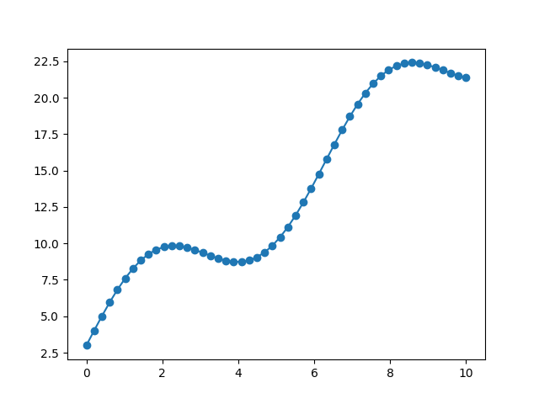
Random Forest
Many trees combined
High accuracy
Reduces overfitting

Slide 10
Preprocessing
🧹 Clean
🧩 Missing values
⚖️ Scaling

Slide 11
Optimization
🔍 Grid Search
🎯 Best model

Slide 12
Post Processing
📊 Visualize
📤 Output
💼 Insights

Slide 13
Pipeline
📥 Data → 🧹 → 🤖 → 🎯 → 📊

