Slide 1
Java Database Connectivity (JDBC)
Campus Mind 2011

Slide 2
Objectives
Overview of JDBC technology
JDBC drivers
Basic steps in using JDBC
Using Statement, PreparedStatement and CallableStatement
Retrieving data from a ResultSet
Handling SQL exceptions
Submitting multiple statements as a transaction
Good JDBC programming practices.

Slide 3

What is a database?
A database is a container that holds tables and other SQL structures related to that table.
They’re everywhere
Student info
Bank Account
Credit card
Library Card
Employee

Slide 4
What is a table?
A table is the structure inside your database that contains data, organized in columns and rows.
Columns are like your instance variables, correspond to attributes of the class.
Row contains all the information about one object in your table.
Columns
PRODUCT TABLE
PROD_ID | PROD_NAME | PROD_QTY | PROD_PRICE
100 | Dell Laptop | 100 | 45000.55
101 | Logitech Mouse | 500 | 250.33
102 | Samsung LCD Monitor | 333 | 7500.44
ROWS
Notes:
Each row is a product instance.

Slide 5
JDBC
JDBC (Java Database Connectivity) provides a standard library for accessing relational databases.
API standardizes
Way to establish connection to database.
Approach to instate queries.
API does not standardize SQL syntax
JDBC classes are in java.sql package.

Slide 6
JDBC
JDBC standardizes
Mechanism for connecting to the Database
Syntax for sending SQL queries
The data structure of query result (table)
JDBC does not standardize
SQL syntax ( JDBC is not embedded SQL)
Dialects
Extensions like OODBMS

Slide 7
JDBC Drivers
JDBC Drivers are required to access a database from Java application.
Different databases require different drivers.
Drivers may be supplied by database vendors or a third party.
When Java program issues SQL commands, the driver forwards them to the database.
Java application
JDBC Driver
Database Server
Database Tables

Slide 8
JDBC Driver types
JDBC drivers are divided into four types or levels:
Type 1 Driver - JDBC-ODBC bridge
Type 2 Driver - Native-API Driver specification
Type 3 Driver - Network-Protocol Driver
Type 4 Driver - Native-Protocol Driver

Slide 9
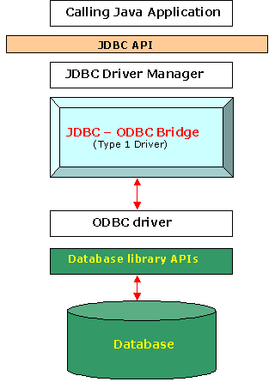
Type 1 Driver - JDBC-ODBC bridge
The driver converts JDBC method calls into ODBC (Open Database Connectivity) function calls.
Sun (Oracle) provides a JDBC-ODBC Bridge driver -> “sun.jdbc.odbc.JdbcOdbcDriver”.
Advantages
Easy to connect.
Disadvantages
Performance overhead since every call has to go through the jdbc –odbc bridge and to the ODBC driver, then to the native db connectivity interface.
The ODBC driver needs to be installed on the client machine.
Compared to other driver types it's slow.

Slide 10
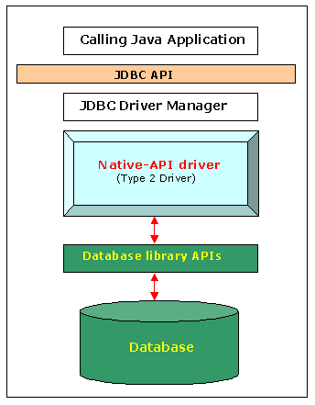
Type 2 Driver - Native-API Driver specification
Type 2 Drivers uses drivers provided by database vendors. These drivers are known as client-side libraries of the database.
The Driver is compiled to be used with the particular operating system.
Disadvantages
Not all the databases have a client side library
This driver is platform dependent

Slide 11
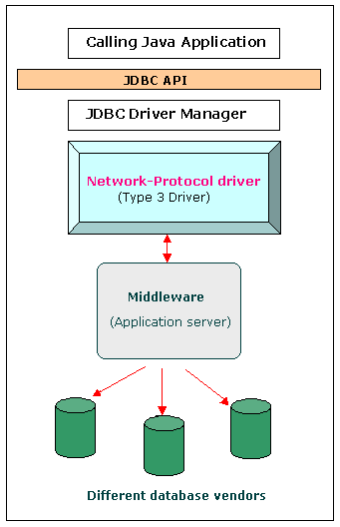
Type 3 Driver - Network-Protocol Driver
Type 3 driver makes use of a middle tier between the calling programs and the database. The middle-tier converts JDBC calls into vendor-specific database protocol.
Advantages
No need for Database vendor libraries in client machine.
Disadvantages
An extra layer added between client and database.

Slide 12
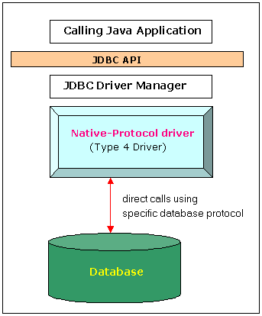
Type 4 Driver - Native-Protocol Driver
The Type 4 driver written completely in Java, is also known as Pure Java Driver.
This database driver implementation that converts JDBC calls directly into a vendor-specific database protocol. Therefore it is called a THIN driver.
Advantages:
Type 4 drivers are Platform independent

Slide 13
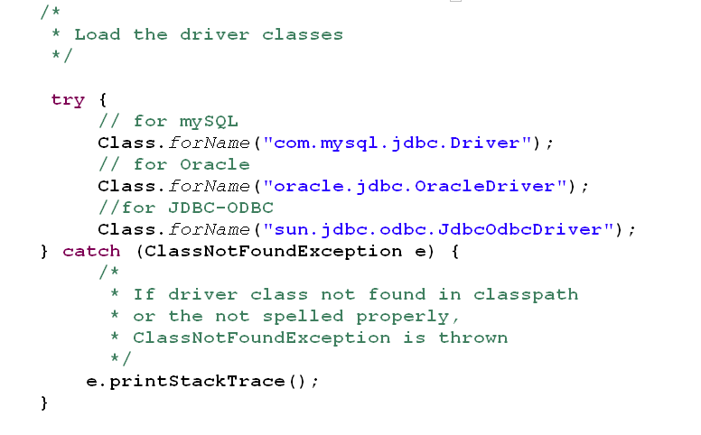
Steps in using JDBC
Step 1 : Load the Driver
Add the Database specific jar file to classpath and load the driver class
Notes:
Database specific jar files
for mySQL : mysql-connector-java-5.1.7-bin.jar
for Oracle : classes12.jar or ojdbc.jar
for ODBC: rt.jar ( bundled with JDK )
Refer: Here’s an example to show you how to connect to MySQL database via JDBC driver. http://goo.gl/ujZK3

Slide 14
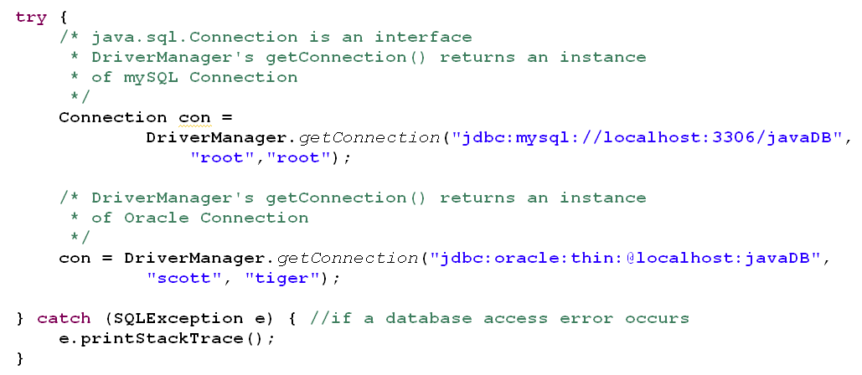
Step 2: Establish a database connection.
The getConnection( ) method of DriverManager attempts to select an appropriate driver from the set of registered JDBC drivers and attempts to establish a connection to the given database URL
Notes:
getConnection
public static Connection getConnection(String url, String user, String password) throws SQLException
Parameters: url - a database url of the form jdbc:subprotocol:subname
user - the database user on whose behalf the connection is being made
password - the user's password

Slide 15
Step 3: Send SQL statements
The java.sql package provides 3 interfaces for sending SQL statements
Statement
Represents the base statements interface.
In terms of efficiency, it is suitable to use Statement only when we know that we will not need to execute the SQL query multiple times
PreparedStatement
Also know as precomplied or parameterized statements are more efficient for multiple executions.
Supports only “IN” parameters.
CallableStatement.
This interface is used for executing the SQL stored procedures
Supports “IN”, “OUT” and “INOUT” parameters.
Notes:
JDBC & Statement - The “Statement” interface is used to execute a simple SQL statement with no parameters. For create, insert, update or delete statement, uses “Statement.executeUpdate(sql)“; select query, uses “Statement.executeQuery(sql)“.
JDBC & PreparedStatement - The “PreparedStatement” interface is extended “Statement”, with extra feature to send a pre-compiled SQL statement with parameters. For create, insert, update or delete statement, uses “PreparedStatement.executeUpdate(sql)“; select query, uses “PreparedStatement.executeQuery(sql)“.
JDBC & Stored Procedure - JDBC CallableStatement and Stored Procedure, IN, OUT, CURSOR examples.

Slide 16
java.sql.Statement interface
Some important methods:
int executeUpdate(String sql) Executes the given SQL statement, which may be an INSERT, UPDATE, or DELETE statement.
Returns the row count.
int executeUpdate(String sql, int autoGeneratedKeys) Similar to previous method but signals the driver that the auto-generated keys produced by this Statement object should be made available for retrieval.
Returns the row count.
ResultSet executeQuery(String sql) Executes the given SQL statement, which returns a single ResultSet object
ResultSet getGeneratedKeys() Retrieves any auto-generated keys created as a result of executing this Statement object.

Slide 17
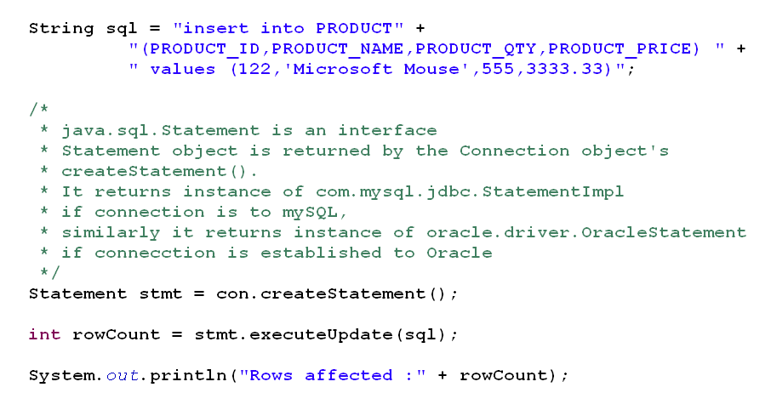
Code Snippet: using Statement interface

Slide 18
Example
Code Example:
Refer: StatementExample.java
Illustrates basic steps required to interact with database
Illustrates how to use executeUpdate() of java.sql.Statement.
Table used for this example is PRODUCT
SQL Script:
create table PRODUCT
(PRODUCT_ID int PRIMARY_KEY AUTO INCREMENT,
PRODUCT_NAME varchar(50) unique not null,
PRODUCT_QTY int,
PRODUCT_PRICE double);

Slide 19
java.sql.PreparedStatement interface
PreparedStatement extends java.sql.Statement interface.
A SQL statement is precompiled and stored in a PreparedStatement object. This object can then be used to efficiently execute this statement multiple times.
PreparedStatement takes “IN” parameter.
In the following example of setting a parameter, con represents an active connection:
PreparedStatement pstmt =
con.prepareStatement
("UPDATE EMPLOYEES SET SALARY = ? WHERE ID = ?");
pstmt.setBigDecimal(1, 153833.00);
pstmt.setInt(2, 100);
Notes:
Each “?” is an IN PARAMETER in PreparedStatment.
Values for IN parameter are set using setXXX() before the statement is executed, where XXX is a data type.

Slide 20
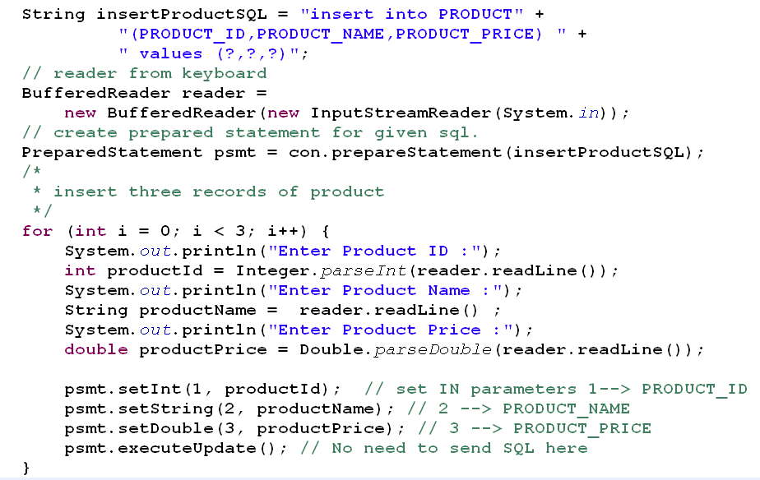
Code Snippet: java.sql.PreparedStatement interface
Notes:
Once an object of type java.sql.PreparedStatement is precompiled, for every iteration you need to set “IN” parameters and execute.
If java.sql.Statement was used instead of java.sql.PreparedStatement, then for every Iteration “SQL” needs to be formed and executed.

Slide 21
Example
Code Example:
Refer: PreparedStatementExample.java
Illustrates how to use PreparedStatement
Table used for this example is PRODUCT
SQL Script:
create table PRODUCT
(PRODUCT_ID int PRIMARY_KEY AUTO INCREMENT,
PRODUCT_NAME varchar(50) unique not null,
PRODUCT_QTY int,
PRODUCT_PRICE double);

Slide 22
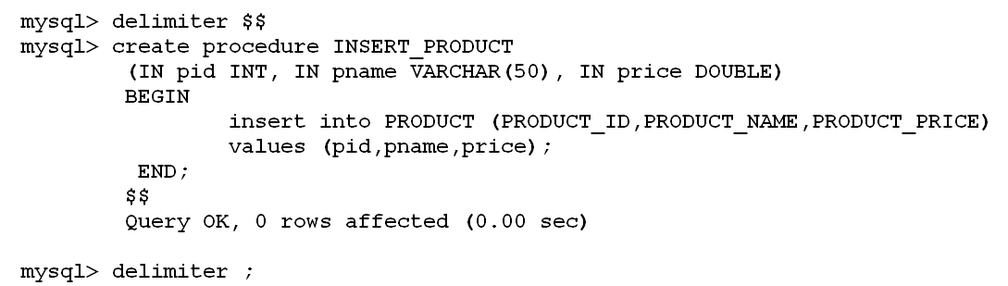
Stored Procedures.
Stored Procedure: A stored procedure is a subroutine available to applications accessing a relational database system.
Uses are :
Extensive or complex processing that requires the execution of several SQL statements
centralize logic for different applications.
Example of how to create a stored procedure in mySQL.
Notes:
Need to change the delimiter to anything other than “;” before creating stored procedure.
Set the delimiter back to “;” after creating stored procedure.

Slide 23
java.sql.Callable interface
This interface is used to execute SQL stored procedures.
Usage Syntax:
{?= call <procedure-name>[<arg1>,<arg2>, ...]}
{call <procedure-name>[<arg1>,<arg2>, ...]}
IN parameter values are set using the set methods inherited from PreparedStatement.
OUT parameters must be registered prior to executing the stored procedure; their values are retrieved after execution via the get methods

Slide 24
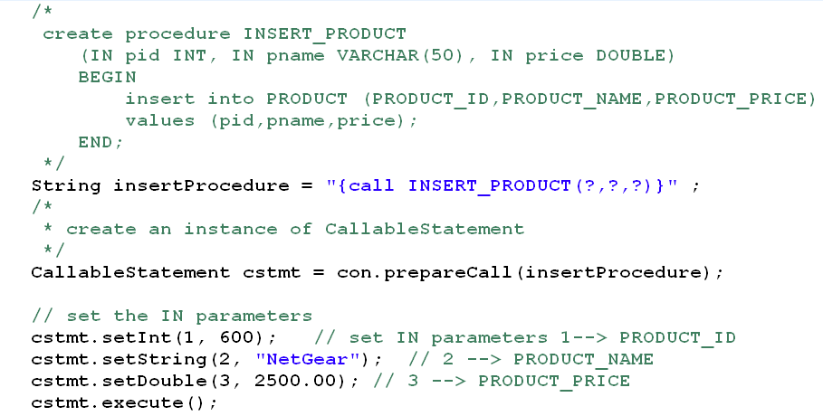
Code Snippet: using CallableStatement
Notes:
Remember creating Procedures vary for each database.

Slide 25
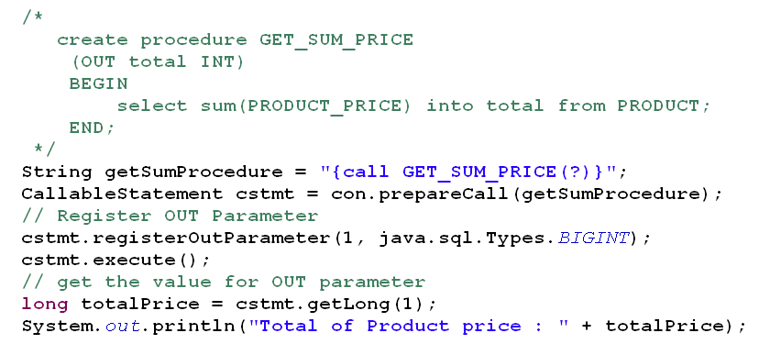
Code Snippet: using CallableStatement OUT parameter

Slide 26
Example
Code Example:
Refer: CallableStatementExample.java
Illustrates how to call stored procedures and to set “IN” parameters , register “OUT” parameters
Create the following stored procedures required by this example to check “IN” and “OUT” parameters .
create procedure INSERT_PRODUCT
(IN pid INT, IN pname VARCHAR(50), IN price DOUBLE)
BEGIN
insert into PRODUCT (PRODUCT_ID,PRODUCT_NAME,PRODUCT_PRICE)
values (pid,pname,price);
END;
create procedure GET_SUM_PRICE (OUT total INT)
BEGIN
select sum(PRODUCT_PRICE) into total from PRODUCT;
END;

Slide 27
ResultSet
ResultSet is a table of data representing a database result set, which is usually generated by executing a statement that queries the database.
A ResultSet object maintains a cursor pointing to its current row of data. Initially the cursor is positioned before the first row.
The boolean next( ) method moves the cursor to the next row, and because it returns false when there are no more rows in ResultSet Object.
ResultSet
PROD_ID | PROD_NAME | PROD_QTY | PROD_PRICE
100 | Dell Laptop | 100 | 45000.55
101 | Logitech Mouse | 500 | 250.33
102 | Samsung LCD Monitor | 333 | 7500.44
next( )
Notes:
ResultSet Direction:
ResultSet has the capability of setting the direction in which you want to process the results: FETCH_FORWARD, FETCH_REVERSE
Initially find the direction by using ResultSet.getFetchDirection();
and then set the direction accordingly ResultSet.setFetchDirection(FETCH_REVERSE);
Close ResultSet when finished:
Close ResultSet object as soon as you finish working with ResultSet object even though Statement object closes the ResultSet object implicitly when it closes, closing ResultSet explicitly gives chance to garbage collector to recollect memory as early as possible because ResultSet object may occupy lot of memory depending on query.
Optimization with SQL Query:
Statement stmt = connection.createStatement();
ResultSet rs = stmt.executeQuery("select * from employee where name=‘Banu Prakash’");
The returned result set contains all the columns data.
You may not need all the column data and want only salary for Banu Prakash.
The better query is "select salary from employee where name=‘Banu Prakash’"
It returns the required data and reduces unnecessary data retrieval.
Refer RowSet Tutorial: http://java.sun.com/developer/Books/JDBCTutorial/chapter5.html

Slide 28
ResultSet methods
Some important getXXX( ) methods or ResultSet
SQL data type | Java Type | Get Method
CHAR | String | getString( )
VARCHAR | String | getString( )
BIT | Boolean | getBoolean( )
TINYINT | Byte | getByte()
INTEGER | Integer | getInt()
DOUBLE | Double | getDouble()
DATE | java.sql.Date | getDate()

Slide 29
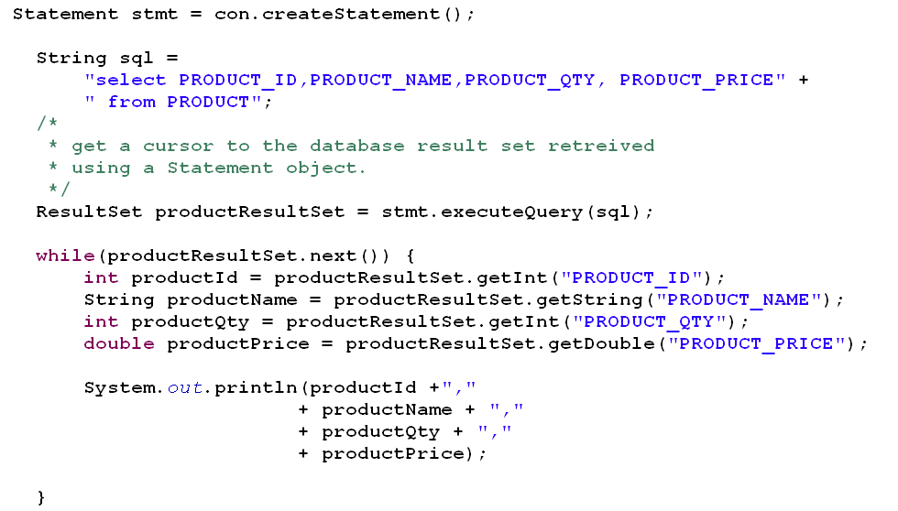
Code Snippet : using ResultSet
Notes:
ResultSet methods :
getXXX( int columnNumber) // You can specify column numbers instead of column names.
Example: to get product_id you can use : int productId = productResultSet.getInt(1);
Remember in table it is “1” based index and not “0” based.

Slide 30
Example
Code Example:
Refer: ResultSetExample.java
Illustrates how to traverse through the retrieved results from database

Slide 31
Retrieving Automatically Generated Keys
JDBC 3.0's auto generated keys feature provides a way to retrieve values from columns that are part of an index or have a default value assigned.
mySQL supports the auto increment feature, which allows users to create columns in tables for which the database system automatically assigns increasing integer values.
create table PRODUCT
( PRODUCT_ID int PRIMARY KEY AUTO_INCREMENT,
PRODUCT_NAME varchar(50) unique not null,
PRODUCT_QTY int,
PRODUCT_PRICE double );
Statement.getGeneratedKeys( ) can be called to retrieve the value of such a column.

Slide 32
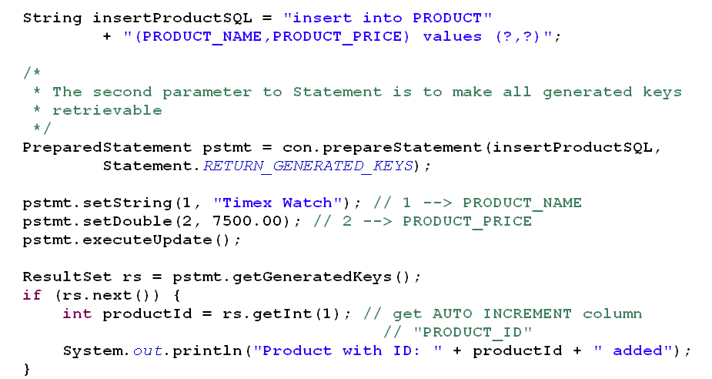
Code Snippet: Auto generated keys.
Notes:
Refer : AutoGeneratedKeysExample.java for complete working code.

Slide 33
Transaction
A transaction is a set of one or more statements that is executed as a unit, so either all of the statements are executed, or none of the statements is executed.
Example: Assume you need to transfer funds between two accounts 230 and 500, it involve two updates
Withdraw
Update Account set balance = balance – amount where acc_no = 230.
Deposit
Update Account set balance = balance + amount where acc_no = 500.
Both these statements has to execute or none.
Notes:
Refer : JDBC Transaction example - http://goo.gl/iE6ta

Slide 34
JDBC Transaction
Disable Auto-Commit mode.
con.setAutoCommit(false);
Commit transaction.
After the auto-commit mode is disabled, no SQL statements are committed until you call the method commit() explicitly.
Rollback transaction.
calling the method rollback() terminates a transaction and returns any values that were modified to their previous values.

Slide 35
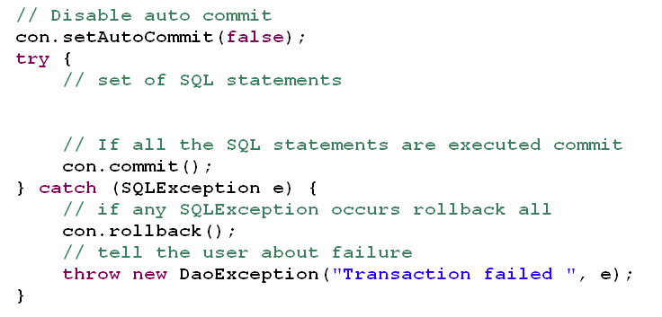
Code Snippet: JDBC transaction

Slide 36
Example :Complete DAO
Code Example: ShoppingExample.zip
Code contains complete java project
Illustrates database application using DAO pattern.
Steps
Create database
Run sql’s provided in shopDB.sql
Modify “database.properties” as applicable
Execute Client.java
Things to observe
Modularity
Exception funneling
Program to interface
Association between entity classes
Transaction
Inserting Order and all line items should be a single transaction
Using java.sql.Date
Add reporting functionality to this application
List Orders placed between two dates.
It should also display item details

Slide 37
Core JDBC Best Practices.
Always close Statements, ResultSet, and Connection:
This practice involves always closing JDBC objects in a finally block to avoid resource limitations found in many databases.
Consolidate formation of SQL statement strings:
This practice involves placing the SQL statement text in a field that is declared static final to reduce string processing as well as make SQL statements easy to identify and read.
Use Date, Time, and Timestamp objects for temporal fields (avoid using strings):
This practice eliminates conversion overhead in the database and often the application.
Always specify a column list with a select statement (avoid "select *") and with an insert statement:
This practice insulates your code against tuning activities of database administrators.

Slide 38
Other JDBC Best practices
Query Fetch Size for Large Result Sets
The fetch size is the number of rows physically retrieved from the database at one time by the JDBC driver as you scroll through a query ResultSet with next().
For example, you set the query fetch size to 100. When you retrieve the first row, the JDBC driver retrieves the first 100 rows (or all of them if fewer than 100 rows satisfy the query).
When you retrieve the second row, the JDBC driver merely returns the row from local memory - it doesn't have to retrieve that row from the database.
This feature improves performance by reducing the number of calls to the database.
Performance increases vary depending upon the speed of the network and also the fetch size should be based on your JVM heap memory setting

Slide 39
Other JDBC Best practices.
Connection Pooling
Connection pooling provides a way for database connections to be established separately before your application needs them. They are used and reused throughout the lifetime of application.
It eliminates the latency involved in creating a connection and closing those resources.
Batch Updates
Consider an baking application, if you are transferring funds between two accounts it involves. Two updates on accounts and one insert into transaction table. All these statements can be treated as a batch and submitted to database for processing as a batch.
Refer : http://goo.gl/nCLsQ
Stored Procedures
Check how many network transmissions will be saved by calling a stored procedure.
Stored procedures are not portable. Also not all databases support stored procedures.

Slide 40
Quiz!
Some quiz questions to reinforce the classroom learning

Slide 41
Quiz questions
How do you load database drivers?
Which of the following supports IN parameters?
Connection
Statement
PreparedStatement
CallableStatement.
What is the return type of executeUpdate( ) and what does it represent?
Which method of Statement should be used to invoke “SELECT” SQL statements?

Slide 42
Quiz questions
When do you use CallableStatement?
Do we need to call commit after executing “INSERT”, “DELETE” or “UPDATE” sql statements from java.
State True or False:
ResultSet can be used to read information from a single table only.

Slide 43
JDBC Metadata
DatabaseMetaData can be
Used to Discover database schema and catalog information.
Discover database users, tables, views, and stored procedures.
Understand and analyze the result sets returned by SQL queries.
Find out the table, view, or column privileges.
Determine the signature of a specific stored procedure in the database.
Identify the primary/foreign keys for a given table.
ResultSetMetadata can be used to
Get information about types and properties of columns in a ResultSet object.

Slide 44
Some methods of DatabaseMetaData.
Method Name | Description
getSchemas() | Schemas provide a logical classification of database objects (tables, views, aliases, stored procedures, user-defined types, and triggers) in an RDBMS.
getTables(catalog, schema, tableNames, columnNames) | Returns table names for all tables matching tableNames and all columns matching columnNames.
getColumns(catalog, schema, tableNames,columnNames) | Returns table column names for all tables matching tableNames and all columns matching columnNames.
getURL() | Gets the name of the URL you are connected to.
getDriverName() | Gets the name of the database driver you are connected to.
Refer : http://goo.gl/Cz5F9

Slide 45
Some important methods of ResultSetMetaData
Method Name | Description
String getColumnLabel(int column) | Gets the designated column's suggested title for use in printouts and displays
String getColumnName(int column) | Get the designated column's name.
int getColumnType(int column) | Retrieves the designated column's SQL type.
boolean isAutoIncrement(int column) | Indicates whether the designated column is automatically numbered, thus read-only
int getColumnCount() | Returns the number of columns in this ResultSet object.
Refer: http://goo.gl/BbsN1

Slide 46
Explore More!!
Never let your curiosity die!

Slide 47
Advanced Topic
Using JDBC Updateable ResultSet
http://goo.gl/PFeET
How to traverse back word's using ResultSet
http://goo.gl/PFeET
RowSet
How to view results in disconnected mode
http://goo.gl/23b3P
Explore how to connect to database using JDBC:ODBC driver.
Check if it supports concurrent access.

Slide 48
References
Contains the reference that will supplement the self learning and will be needed for completing the assignments & practice questions

Slide 49
References
JDBC Tutorial
http://java.sun.com/developer/Books/JDBCTutorial/
Core J2EE Patterns - Data Access Object
http://java.sun.com/blueprints/corej2eepatterns/Patterns/DataAccessObject.html
Isolation Levels and Concurrency
http://db.apache.org/derby/manuals/develop/develop71.html
JDBC Code Examples
http://goo.gl/n70cI

