Slide 1

Manikandan Selvaganesan
Software Engineer @ Cisco

Slide 2




There to here .
1
3
2
4
B.E (CSE), a lot of facts to add too.
Software Engineer, Co-Maintainer of three components in Gluster
Open source enthusiast,
Intern at Red Hat , security tester(hobby)
Software Engineer II

Slide 3

GlusterFS - Quota
Scalable Network(Distributed) File System
No dedicated Metadata servers
User space file system
More features – Replication, Snapshot, Tiering, Quota, Geo-replication

Slide 4

Quota
Noun
a limited or fixed number or amount of people or things, in particular

Slide 5


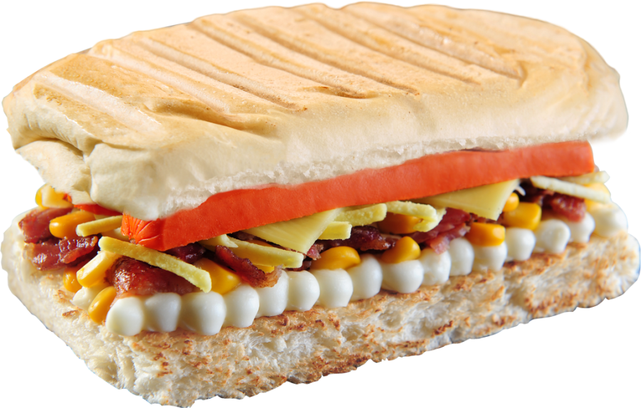
Is limit really important?
People/Process
Resource
We now know what happens when there is no limit
Of course, yes!

Slide 6



Day to day - College
Global Storage
Student
Faculties

Slide 7

Inode Quota
Restricts based on the count
Exam attempts for a student
OTP/Password retries
Number of movie tickets for one person
Anywhere where one needs to restrict based on count

Slide 8
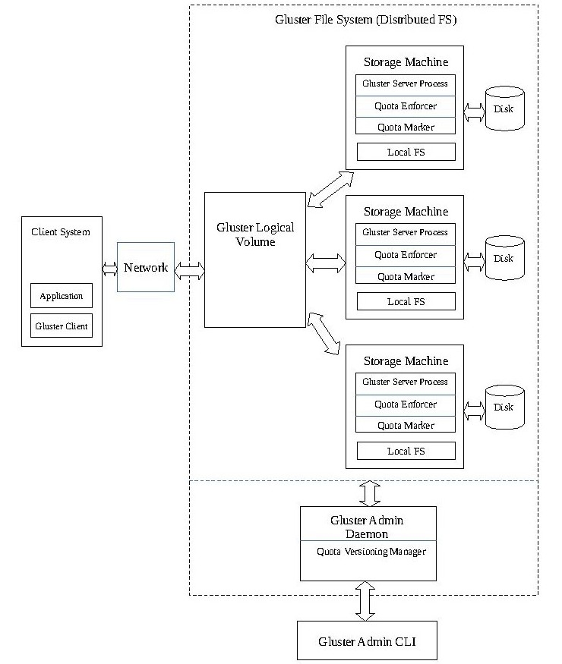
Architecture Overview

Slide 9
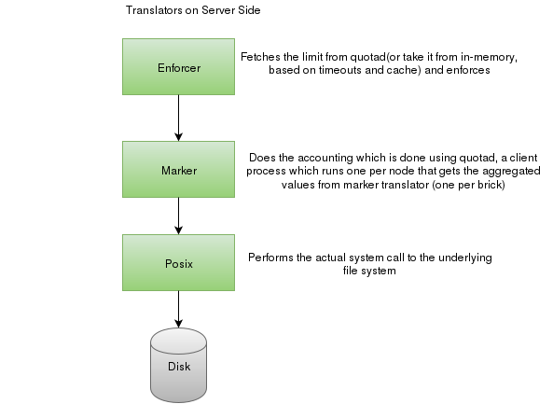
An insight

Slide 10


Slide 11

Challenges
Do not break the existing features
How to store limits and differentiate - Quota.conf
Upgrade scenario – from 3.6 to 3.7/later
Setting the correct inode context and healing the extended attributes – root, differentiate between quota/inode-quota

Slide 12

Code walkthrough
Keywords:
Translators,
Graph,
Winding,
Unwinding.
Will just go through: Xlators/features/quota/*
Soft limit logger method
One fop – rename
Basic functions

Slide 13
Simple examples

Slide 14
A bit harder – rename algorithm
1) Set inodelk on src-parent.
2) Lookup contribution to src-parent on src-inode. We need to save the contribution info for use at step-8.
3) Wind rename.
4) Remove xattr on src-loc.
5) Remove contribution node corresponding to src-parent from the in-memory
list.

Slide 15
Rename algorithm – continues…
6) unwind rename
7) release inodelk on src-parent
8) Initiate mq_reduce_parent_size_txn on src-parent to remove contribution of src-inode to src-parent.
9) Initiate mq_reduce_parent_size_txn on dst-parent if dst-inode exists.
10) create contribution xattr to dst-parent on src-inode.
To read more visit: https://docs.google.com/document/d/1O4s6w-gom6p-2Q8n-6g41M_L9J8C8qpF4Ry86SJSl9c/edit

Slide 16

Demo
No worries, I will be done soon ☺

Slide 17
To know more ->
Gluster docs – http://gluster.readthedocs.io/en/latest/
My Code contributions to GlusterFS – http://review.gluster.org/#/q/owner:%22Manikandan+Selvaganesh%22
GitHub Profile - https://github.com/Manikandan-Selvaganesh/
Blog - https://manikandanselvaganesh.wordpress.com/
GlusterFS Quota IEEE Paper - http://www.slideshare.net/ManikandanSelvaganes/aninsightaboutglusterfsanditsenforcementtechniques

Slide 18
Some more interesting projects!!
Enhancement of quota crawling process - http://review.gluster.org/#/c/13897/
SELinux implementation for GlusterFS - http://review.gluster.org/#/c/13762/
Web crawlers - https://github.com/Manikandan-Selvaganesh/web-crawler
Data structures optimization test on Search Engine
Quota versioning implementation - http://review.gluster.org/#/c/12386/
…........!!!!!

Slide 19
Thank You!

