Slide 1
Ansible

Slide 2
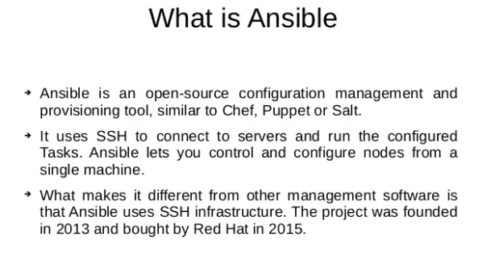

Slide 3


Slide 4
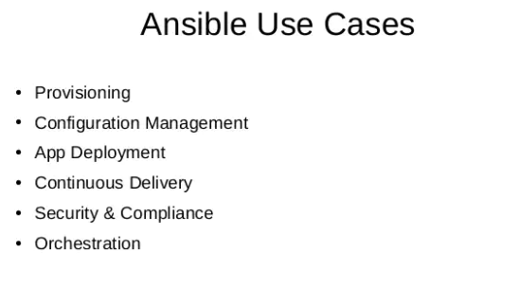

Slide 5
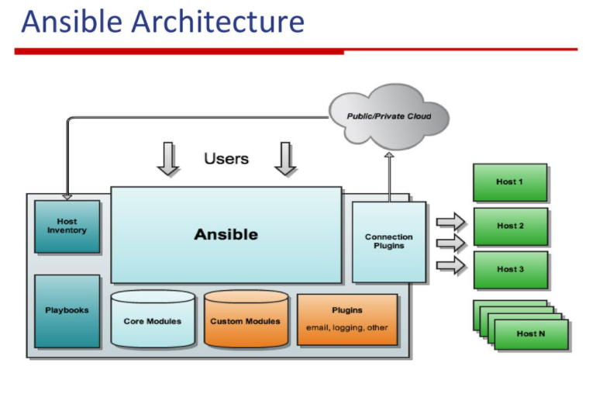

Slide 6
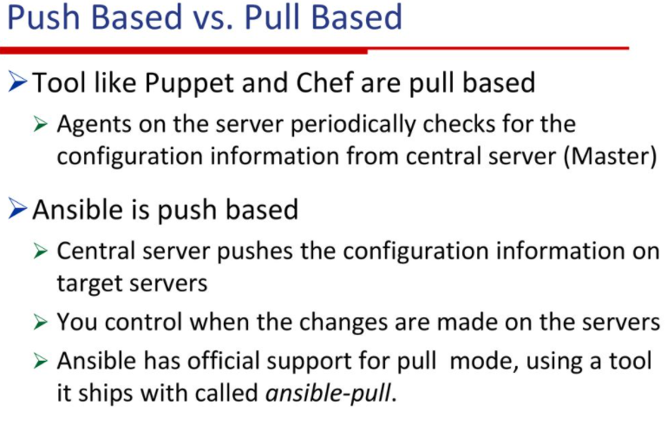

Slide 7
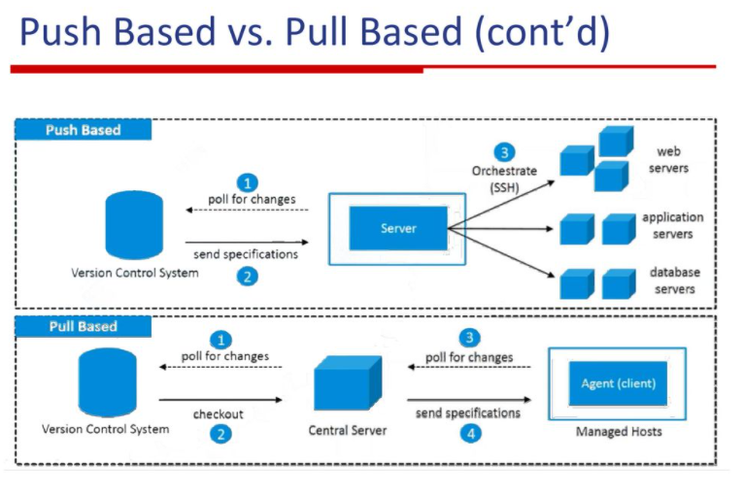

Slide 8
Ansible concepts
Control node
Managed nodes
Inventory
Collections
Modules
Tasks
Playbooks

Slide 9
Ansible concepts
Control node
Any machine with Ansible installed. You can run Ansible commands and playbooks by invoking the ansible or ansible-playbook command from any control node. You can use any computer that has a Python installation as a control node - laptops, shared desktops, and servers can all run Ansible. However, you cannot use a Windows machine as a control node. You can have multiple control nodes.
Managed nodes
The network devices (and/or servers) you manage with Ansible. Managed nodes are also sometimes called “hosts”. Ansible is not installed on managed nodes.

Slide 10
Ansible concepts
Inventory
A list of managed nodes. An inventory file is also sometimes called a “hostfile”. Your inventory can specify information like IP address for each managed node. An inventory can also organize managed nodes, creating and nesting groups for easier scaling.
Collections
Collections are a distribution format for Ansible content that can include playbooks, roles, modules, and plugins. You can install and use collections through Ansible Galaxy.

Slide 11
Ansible concepts
Modules
The units of code Ansible executes. Each module has a particular use, from administering users on a specific type of database to managing VLAN interfaces on a specific type of network device. You can invoke a single module with a task, or invoke several different modules in a playbook.
Tasks
The units of action in Ansible. You can execute a single task once with an ad hoc command.
Playbooks
Ordered lists of tasks, saved so you can run those tasks in that order repeatedly. Playbooks can include variables as well as tasks. Playbooks are written in YAML and are easy to read, write, share and understand.

Slide 12
Installing ansible
Ansible Installation steps in Amazon Linux2
Pre-requisites : Installation of Python3.8
amazon-linux-extras | grep -i python
sudo amazon-linux-extras enable python3.8
sudo yum install python3.8
cd /usr/bin
sudo rm -f python3
sudo ln -s python3.8 python3
Installing pip and ansible
curl https://bootstrap.pypa.io/get-pip.py -o get-pip.py
$ sudo python3 get-pip.py
$ sudo python3 -m pip install ansible
Reference : https://docs.ansible.com/ansible/latest/installation_guide/intro_installation.html

Slide 13
Ansible Configuration file
The configuration file (ansible.cfg)
Changes can be made and used in a configuration file which will be searched for in the following order:
ANSIBLE_CONFIG (environment variable if set)
ansible.cfg (in the current directory)
~/.ansible.cfg (in the home directory)
/etc/ansible/ansible.cfg
Ansible will process the above list and use the first file found, all others are ignored
For more Details : Refer to this link
https://docs.ansible.com/ansible/latest/reference_appendices/config.html#ansible-configuration-settings

Slide 14
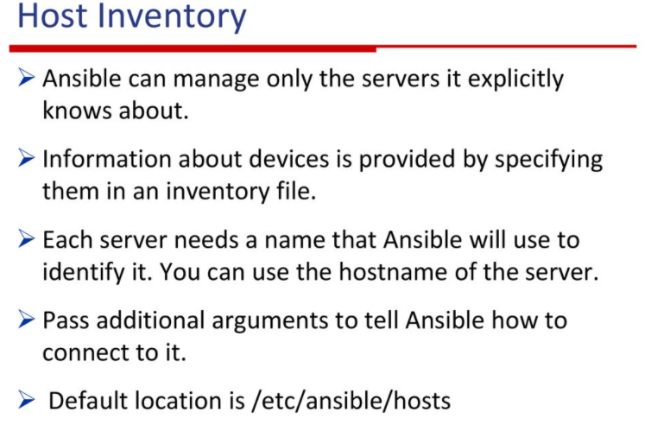

Slide 15
Inventory
mail.example.com
[webservers]
foo.example.com
bar.example.com
[dbservers]
one.example.com
two.example.com
three.example.com
all:
hosts:
mail.example.com:
children:
webservers:
hosts:
foo.example.com:
bar.example.com:
dbservers:
hosts:
one.example.com:
two.example.com:
three.example.com:

Slide 16
Inventory (Groups)
all:
hosts:
mail.example.com:
children:
webservers:
hosts:
foo.example.com:
bar.example.com:
dbservers:
hosts:
one.example.com:
two.example.com:
three.example.com:
east:
hosts:
foo.example.com:
one.example.com:
two.example.com:
west:
hosts:
bar.example.com:
three.example.com:
prod:
hosts:
foo.example.com:
one.example.com:
two.example.com:
test:
hosts:
bar.example.com:
two default groups: all and ungrouped
Multiple groups

Slide 17
Inventory (Range of hosts)
If you have a lot of hosts with a similar pattern, you can add them as a range rather than listing each hostname separately:
In INI:
[webservers]
www[01:50].example.com
In YAML:
...
webservers:
hosts:
www[01:50].example.com:
You can specify a stride (increments between sequence numbers) when defining a numeric range of hosts:
In INI:
[webservers]
www[01:50:2].example.com
In YAML:
...
webservers:
hosts:
www[01:50:2].example.com:

Slide 18
Inventory (Range of hosts)
For numeric patterns, leading zeros can be included or removed, as desired. Ranges are inclusive. You can also define alphabetic ranges:
In YAML:
...
databases:
hosts:
db-[a:f].example.com
In INI:
[databases]
db-[a:f].example.com

Slide 19
Inventory (groups of groups)
If all hosts in a group share a variable value, you can apply that variable to an entire group at once. In INI:
[atlanta]
host1
host2
[raleigh]
host2
host3
[southeast: children]
atlanta
raleigh
[usa:children]
southeast
northeast
southwest
Northwest
[southeast:vars]
some_server=foo.southeast.example.com
halon_system_timeout=30
self_destruct_countdown=60
escape_pods=2
In YAML:
...
all:
children:
usa:
children:
southeast:
children:
atlanta:
hosts:
host1:
host2:
raleigh:
hosts:
host2:
host3:
vars:
some_server: foo.southeast.example.com
halon_system_timeout: 30
self_destruct_countdown: 60
escape_pods: 2
northeast:
northwest:
southwest:

Slide 20
Inventory (Adding variables and alias)
You can store variable values that relate to a specific host or group in inventory. To start with, you may add variables directly to the hosts and groups in your main inventory file.
In INI
[atlanta]
host1 http_port=80 maxRequestsPerChild=808
host2 http_port=303 maxRequestsPerChild=909
In YAML:
...
atlanta:
hosts:
host1:
http_port: 80
maxRequestsPerChild: 808
host2:
http_port: 303
maxRequestsPerChild: 909
You can also define aliases in your inventory:
jumper ansible_port=5555 ansible_host=192.0.2.50
In YAML:
...
hosts:
jumper:
ansible_port: 5555
ansible_host: 192.0.2.50

Slide 21
Inventory (behavioral inventory parameters)
ansible_connection: Connection type to the host. This can be the name of any of ansible’s connection plugins. SSH protocol types are smart, ssh or paramiko(python module).
General for all connections:
ansible_host : The name of the host to connect to, if different from the alias you wish to give to it.
ansible_port: The connection port number, if not the default (22 for ssh)
ansible_user:The user name to use when connecting to the host
ansible_password :The password to use to authenticate to the host (never store this variable in plain text; always use a vault. See Keep vaulted variables safely visible)

Slide 22
Inventory (behavioral inventory parameters)
Privilege escalation
ansible_become : Equivalent to ansible_sudo or ansible_su, allows to force privilege escalation
ansible_become_method: Allows to set privilege escalation method
ansible_become_user: Equivalent to ansible_sudo_user or ansible_su_user, allows to set the user you become through privilege escalation
ansible_become_password: Equivalent to ansible_sudo_password or ansible_su_password, allows you to set the privilege escalation password (never store this variable in plain text; always use a vault)

Slide 23
Ansible adhoc commands
Why use ad hoc commands?
ad hoc commands are great for tasks you repeat rarely. For example, if you want to power off all the machines in your lab, you could execute a quick one-liner in Ansible without writing a playbook
ansible [pattern] -m [module] -a "[module options]"

Slide 24
Ansible adhoc commands
Common patterns
This table lists common patterns for targeting inventory hosts and groups.
Description | Pattern(s) | Targets
All hosts | all (or *)
One host | host1
Multiple hosts | host1:host2 (or host1,host2)
One group | webservers
Multiple groups | webservers:dbservers | all hosts in webservers plus all hosts in dbservers
Excluding groups | webservers:!atlanta | all hosts in webservers except those in atlanta
Intersection of groups | webservers:&staging | any hosts in webservers that are also in stagin

Slide 25
Ansible Modules
Modules (also referred to as “task plugins” or “library plugins”) are discrete units of code that can be used from the command line or in a playbook task. Ansible executes each module, usually on the remote managed node, and collects return values
ansible webservers -m service -a "name=httpd state=started"
ansible webservers -m ping
ansible webservers -m command -a "/sbin/reboot -t now“
Reference Documentation
https://docs.ansible.com/ansible/latest/collections/ansible/builtin/index.html#plugins-in-ansible-builtin

