Slide 1
Ansible

Slide 2
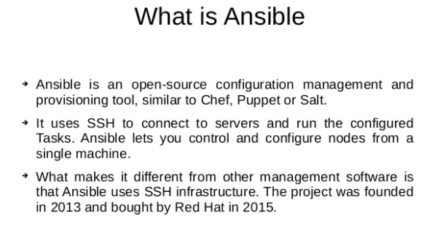

Slide 3


Slide 4
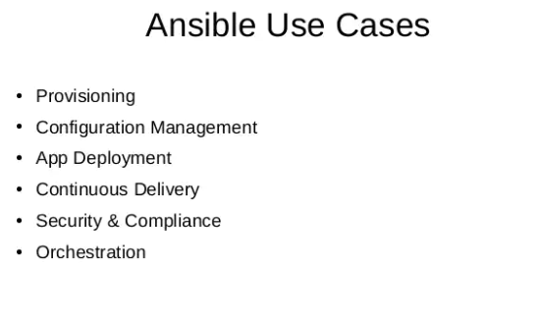

Slide 5
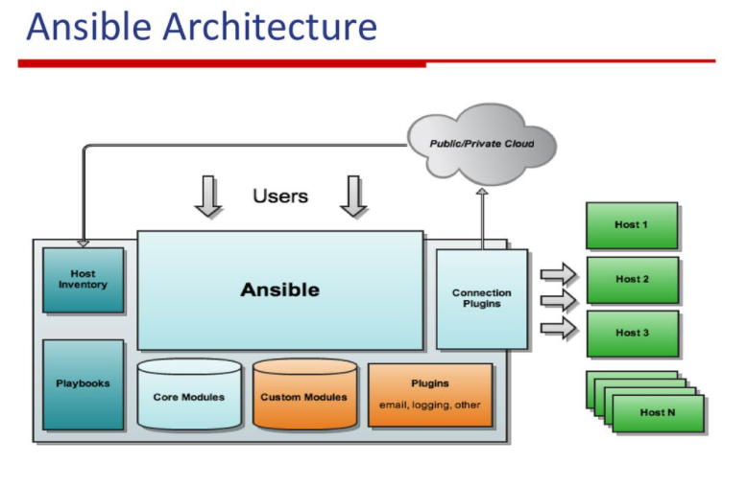

Slide 6
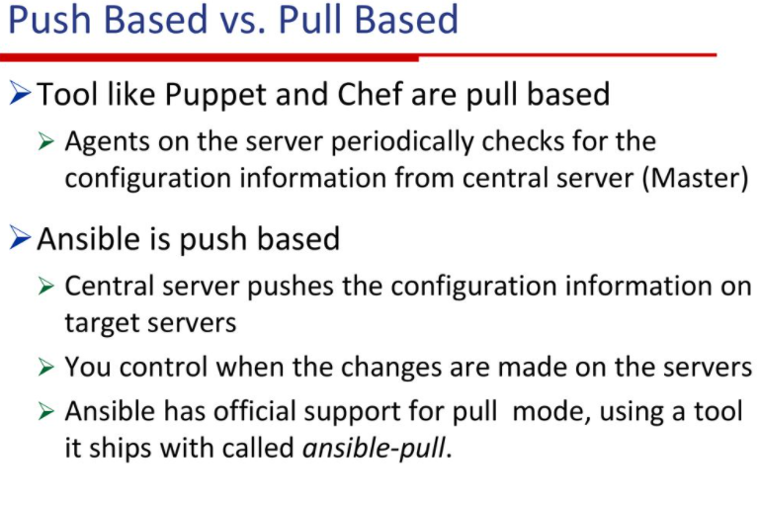

Slide 7
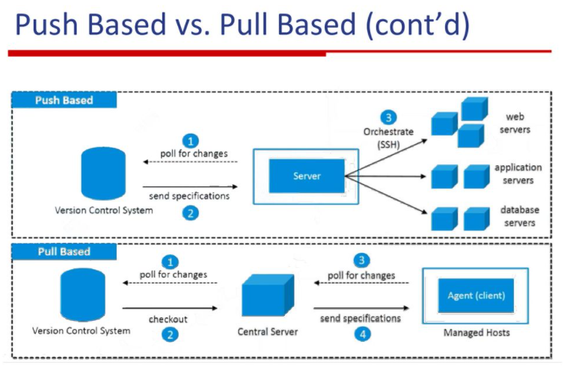

Slide 8
Ansible concepts
Control node
Managed nodes
Inventory
Collections
Modules
Tasks
Playbooks

Slide 9
Ansible concepts
Control node
Any machine with Ansible installed. You can run Ansible commands and playbooks by invoking the ansible or ansible-playbook command from any control node. You can use any computer that has a Python installation as a control node - laptops, shared desktops, and servers can all run Ansible. However, you cannot use a Windows machine as a control node. You can have multiple control nodes.
Managed nodes
The network devices (and/or servers) you manage with Ansible. Managed nodes are also sometimes called “hosts”. Ansible is not installed on managed nodes.

Slide 10
Ansible concepts
Inventory
A list of managed nodes. An inventory file is also sometimes called a “hostfile”. Your inventory can specify information like IP address for each managed node. An inventory can also organize managed nodes, creating and nesting groups for easier scaling.
Collections
Collections are a distribution format for Ansible content that can include playbooks, roles, modules, and plugins. You can install and use collections through Ansible Galaxy.

Slide 11
Ansible concepts
Modules
The units of code Ansible executes. Each module has a particular use, from administering users on a specific type of database to managing VLAN interfaces on a specific type of network device. You can invoke a single module with a task, or invoke several different modules in a playbook.
Tasks
The units of action in Ansible. You can execute a single task once with an ad hoc command.
Playbooks
Ordered lists of tasks, saved so you can run those tasks in that order repeatedly. Playbooks can include variables as well as tasks. Playbooks are written in YAML and are easy to read, write, share and understand.

Slide 12
Installing ansible
Ansible Installation steps in Amazon Linux2
Pre-requisites : Installation of Python3.8
amazon-linux-extras | grep -i python
sudo amazon-linux-extras enable python3.8
sudo yum install python3.8
cd /usr/bin
sudo rm -f python3
sudo ln -s python3.8 python3
Installing pip and ansible
curl https://bootstrap.pypa.io/get-pip.py -o get-pip.py
$ sudo python3 get-pip.py
$ sudo python3 -m pip install ansible
Reference : https://docs.ansible.com/ansible/latest/installation_guide/intro_installation.html

Slide 13
Ansible Configuration file
The configuration file (ansible.cfg)
Changes can be made and used in a configuration file which will be searched for in the following order:
ANSIBLE_CONFIG (environment variable if set)
ansible.cfg (in the current directory)
~/.ansible.cfg (in the home directory)
/etc/ansible/ansible.cfg
Ansible will process the above list and use the first file found, all others are ignored
For more Details : Refer to this link
https://docs.ansible.com/ansible/latest/reference_appendices/config.html#ansible-configuration-settings

Slide 14
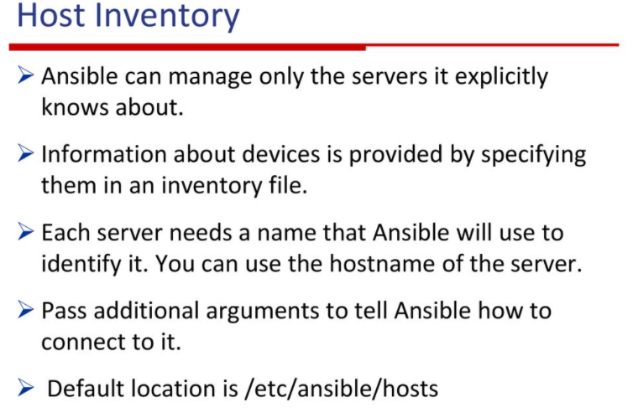

Slide 15
Inventory
mail.example.com
[webservers]
foo.example.com
bar.example.com
[dbservers]
one.example.com
two.example.com
three.example.com
all:
hosts:
mail.example.com:
children:
webservers:
hosts:
foo.example.com:
bar.example.com:
dbservers:
hosts:
one.example.com:
two.example.com:
three.example.com:

Slide 16
Inventory (Groups)
all:
hosts:
mail.example.com:
children:
webservers:
hosts:
foo.example.com:
bar.example.com:
dbservers:
hosts:
one.example.com:
two.example.com:
three.example.com:
east:
hosts:
foo.example.com:
one.example.com:
two.example.com:
west:
hosts:
bar.example.com:
three.example.com:
prod:
hosts:
foo.example.com:
one.example.com:
two.example.com:
test:
hosts:
bar.example.com:
two default groups: all and ungrouped
Multiple groups

Slide 17
Inventory (Range of hosts)
If you have a lot of hosts with a similar pattern, you can add them as a range rather than listing each hostname separately:
In INI:
[webservers]
www[01:50].example.com
In YAML:
...
webservers:
hosts:
www[01:50].example.com:
You can specify a stride (increments between sequence numbers) when defining a numeric range of hosts:
In INI:
[webservers]
www[01:50:2].example.com
In YAML:
...
webservers:
hosts:
www[01:50:2].example.com:

Slide 18
Inventory (Range of hosts)
For numeric patterns, leading zeros can be included or removed, as desired. Ranges are inclusive. You can also define alphabetic ranges:
In YAML:
...
databases:
hosts:
db-[a:f].example.com
In INI:
[databases]
db-[a:f].example.com

Slide 19
Inventory (groups of groups)
If all hosts in a group share a variable value, you can apply that variable to an entire group at once. In INI:
[atlanta]
host1
host2
[raleigh]
host2
host3
[southeast: children]
atlanta
raleigh
[usa:children]
southeast
northeast
southwest
Northwest
[southeast:vars]
some_server=foo.southeast.example.com
halon_system_timeout=30
self_destruct_countdown=60
escape_pods=2
In YAML:
...
all:
children:
usa:
children:
southeast:
children:
atlanta:
hosts:
host1:
host2:
raleigh:
hosts:
host2:
host3:
vars:
some_server: foo.southeast.example.com
halon_system_timeout: 30
self_destruct_countdown: 60
escape_pods: 2
northeast:
northwest:
southwest:

Slide 20
Inventory (Adding variables and alias)
You can store variable values that relate to a specific host or group in inventory. To start with, you may add variables directly to the hosts and groups in your main inventory file.
In INI
[atlanta]
host1 http_port=80 maxRequestsPerChild=808
host2 http_port=303 maxRequestsPerChild=909
In YAML:
...
atlanta:
hosts:
host1:
http_port: 80
maxRequestsPerChild: 808
host2:
http_port: 303
maxRequestsPerChild: 909
You can also define aliases in your inventory:
jumper ansible_port=5555 ansible_host=192.0.2.50
In YAML:
...
hosts:
jumper:
ansible_port: 5555
ansible_host: 192.0.2.50

Slide 21
Inventory (behavioral inventory parameters)
ansible_connection: Connection type to the host. This can be the name of any of ansible’s connection plugins. SSH protocol types are smart, ssh or paramiko(python module).
General for all connections:
ansible_host : The name of the host to connect to, if different from the alias you wish to give to it.
ansible_port: The connection port number, if not the default (22 for ssh)
ansible_user:The user name to use when connecting to the host
ansible_password :The password to use to authenticate to the host (never store this variable in plain text; always use a vault. See Keep vaulted variables safely visible)

Slide 22
Inventory (behavioral inventory parameters)
Privilege escalation
ansible_become : Equivalent to ansible_sudo or ansible_su, allows to force privilege escalation
ansible_become_method: Allows to set privilege escalation method
ansible_become_user: Equivalent to ansible_sudo_user or ansible_su_user, allows to set the user you become through privilege escalation
ansible_become_password: Equivalent to ansible_sudo_password or ansible_su_password, allows you to set the privilege escalation password (never store this variable in plain text; always use a vault)

Slide 23
Ansible adhoc commands
Why use ad hoc commands?
ad hoc commands are great for tasks you repeat rarely. For example, if you want to power off all the machines in your lab, you could execute a quick one-liner in Ansible without writing a playbook
ansible [pattern] -m [module] -a "[module options]"

Slide 24
Ansible adhoc commands
Common patterns
This table lists common patterns for targeting inventory hosts and groups.
Description | Pattern(s) | Targets
All hosts | all (or *)
One host | host1
Multiple hosts | host1:host2 (or host1,host2)
One group | webservers
Multiple groups | webservers:dbservers | all hosts in webservers plus all hosts in dbservers
Excluding groups | webservers:!atlanta | all hosts in webservers except those in atlanta
Intersection of groups | webservers:&staging | any hosts in webservers that are also in stagin

Slide 25
Ansible Modules
Modules (also referred to as “task plugins” or “library plugins”) are discrete units of code that can be used from the command line or in a playbook task. Ansible executes each module, usually on the remote managed node, and collects return values
ansible webservers -m service -a "name=httpd state=started"
ansible webservers -m ping
ansible webservers -m command -a "/sbin/reboot -t now“
Reference Documentation
https://docs.ansible.com/ansible/latest/collections/ansible/builtin/index.html#plugins-in-ansible-builtin
Example adhoc commands
https://www.middlewareinventory.com/blog/ansible-ad-hoc-commands/#ex1

Slide 26
YAML Basics
A list
All members of a list are lines beginning at the same indentation level starting with a "- " (a dash and a space):
---
# A list of tasty fruits
- Apple
- Orange
- Strawberry
- Mango
...

Slide 27
YAML Basics
A dictionary
A dictionary is represented in a simple key: value form (the colon must be followed by a space):
# An employee record
martin:
name: Martin D'vloper
job: Developer
skill: Elite

Slide 28
YAML Basics
A complex structure with list of dictionaries, dictionaries whose values are list or a mix of both
# Employee records
- martin:
name: Martin D'vloper
job: Developer
skills:
- python
- perl
- pascal
- tabitha:
name: Tabitha Bitumen
job: Developer
skills:
- lisp
- fortran
- erlang

Slide 29
YAML Basics
Values can span multiple lines using | or >
Spanning multiple lines using a “Literal Block Scalar” | will include the newlines and any trailing spaces.
Using a “Folded Block Scalar” > will fold newlines to spaces
include_newlines: |
exactly as you see
will appear these three
lines of poetry
fold_newlines: >
this is really a
single line of text
despite appearances

Slide 30
YAML Basics
An example with all
---
# An employee record
name: Martin D'vloper
job: Developer
skill: Elite
employed: True
foods:
- Apple
- Orange
- Strawberry
- Mango
languages:
perl: Elite
python: Elite
pascal: Lame
education: |
4 GCSEs
3 A-Levels
BSc in the Internet of Things

Slide 31
Ansible Playbooks
Ansible Playbooks offer a repeatable, re-usable, simple configuration management and multi-machine deployment system, one that is well suited to deploying complex applications.
Playbooks can:
declare configurations
orchestrate steps of any manual ordered process, on multiple sets of machines, in a defined order
launch tasks synchronously or asynchronously
A playbook is composed of one or more ‘plays’ in an ordered list.
The terms ‘playbook’ and ‘play’ are sports analogies. Each play executes part of the overall goal of the playbook, running one or more tasks
Each task calls an Ansible module.

Slide 32
Ansible Playbooks
Play1
---
- name: Update web servers
hosts: webservers
remote_user: root
tasks:
- name: Ensure apache is at the latest version
ansible.builtin.yum:
name: httpd
state: latest
- name: Write the apache config file
ansible.builtin.template:
src: /src/httpd.j2
dest: /etc/httpd.conf
Play 2
---
- name: Update db servers
hosts: databases
remote_user: root
tasks:
- name: Ensure postgresql is at the latest version
ansible.builtin.yum:
name: postgresql
state: latest
- name: Ensure that postgresql is started
ansible.builtin.service:
name: postgresql
state: started

Slide 33
Ansible Variables
A variable name can only include letters, numbers, and underscores.
Python keywords or playbook keywords are not valid variable names.
A variable name cannot begin with a number.
Variable names can begin with an underscore.
Valid variable names | Not valid
foo | *foo, Python keywords such as async and lambda
foo_env | playbook keywords such as environment
foo_port | foo-port, foo port, foo.port
foo5, _foo | 5foo, 12

Slide 34
Ansible Variables
Defining simple variables
remote_install_path: /opt/my_app_config
Referencing simple variables
ansible.builtin.template:
src: foo.cfg.j2
dest: '{{ remote_install_path }}/foo.cfg'

Slide 35
Ansible Variables
List Variables
region:
- northeast
- southeast
- midwest
Referencing list variables
region: "{{ region[0] }}"
Dictionary Variables
foo:
field1: one
field2: two
Referencing Dictionary variables
{{foo['field1’]}}
{{foo.field1}}

Slide 36
Ansible Variables
Registering variables
Registered variables are stored in memory. You cannot cache registered variables for use in future plays. Registered variables are only valid on the host for the rest of the current playbook run.
- hosts: web_servers
tasks:
- name: Run a shell command and register its output as a variable
ansible.builtin.shell: /usr/bin/foo
register: foo_result
ignore_errors: true
- name: Run a shell command using output of the previous task
ansible.builtin.shell: /usr/bin/bar
when: foo_result.rc == 5

Slide 37
Ansible Variables
Where to set variables
Defining variables in inventory
Defining variables in a play
- hosts: webservers
vars:
http_port: 80
Defining variables in included files and roles
---
- hosts: all
remote_user: root
vars:
favcolor: blue
vars_files:
- /vars/external_vars.yml
tasks:
- name: This is just a placeholder
ansible.builtin.command: /bin/echo foo
Defining variables at runtime
ansible-playbook release.yml --extra-vars "version=1.23.45 other_variable=foo"

Slide 38
Ansible Variables
Understanding variable precedence
command line values (for example, -u my_user, these are not variables)
role defaults (defined in role/defaults/main.yml)
inventory file or script group vars
inventory group_vars/all
playbook group_vars/all
inventory group_vars/*
playbook group_vars/*
inventory file or script host vars
inventory host_vars/*
playbook host_vars/*
host facts / cached set_facts
play vars
play vars_prompt
play vars_files
role vars (defined in role/vars/main.yml)
block vars (only for tasks in block)
task vars (only for the task)
include_vars
set_facts / registered vars
role (and include_role) params
include params
extra vars (for example, -e "user=my_user")(always win precedence)

Slide 39
Ansible Conditions
Basic conditionals with when
tasks:
- name: Configure SELinux to start mysql on any port
ansible.posix.seboolean:
name: mysql_connect_any
state: true
persistent: yes
when: ansible_selinux.status == "enabled“
Conditionals based on ansible_facts
tasks:
- name: Shut down CentOS 6 and Debian 7 systems
ansible.builtin.command: /sbin/shutdown -t now
when: (ansible_facts['distribution'] == "CentOS" and ansible_facts['distribution_major_version'] == "6") or
(ansible_facts['distribution'] == "Debian" and ansible_facts['distribution_major_version'] == "7")

Slide 40
Ansible Loops
Iterating over a simple list
- name: Add several users
ansible.builtin.user:
name: "{{ item }}"
state: present
groups: "wheel"
loop:
- testuser1
- testuser2
Other loop options
with_list
with_items
with_indexed_items
with_flattened
with_together
with_dict
with_sequence
with_subelements
with_nested/with_cartesian
with_random_choice
---
name: users
vars:
users:
- testuser1
- testuser2
tasks:
- name: Add several users
ansible.builtin.user:
name: "{{ item }}"
state: present
groups: "wheel"
with_list : {{ users }}

Slide 41
Ansible Blocks
Blocks create logical groups of tasks. Blocks also offer ways to handle task errors, similar to exception handling in many programming languages.
Grouping tasks with blocks
tasks:
- name: Install, configure, and start Apache
block:
- name: Install httpd and memcached
ansible.builtin.yum:
name:
- httpd
- memcached
state: present
- name: Apply the foo config template
ansible.builtin.template:
src: templates/src.j2
dest: /etc/foo.conf
- name: Start service bar and enable it
ansible.builtin.service:
name: bar
state: started
enabled: True
when: ansible_facts['distribution'] == 'CentOS'
become: true
become_user: root
ignore_errors:

Slide 42
Ansible Jinja2 Templates
Jinja2 is a powerful and easy to use python-based templating engine that comes in handy in an IT environment with multiple servers where configurations vary every other time
A Jinja2 template file is a text file that contains variables that get evaluated and replaced by actual values upon runtime or code execution.
In a Jinja2 template file, you will find the following tags:
{{ }} : These double curly braces are the widely used tags in a template file and they are used for embedding variables and ultimately printing their value during code execution. For example, a simple syntax using the double curly braces is as shown: The {{ webserver }} is running on {{ nginx-version }}
{% %} : These are mostly used for control statements such as loops and if-else statements.
{# #} : These denote comments that describe a task.
:

Slide 43
Ansible Error handling in playbooks
Ignoring failed commands
- name: Do not count this as a failure
ansible.builtin.command: /bin/false
ignore_errors: yes
Ignoring unreachable host errors
- name: This executes, fails, and the failure is ignored
ansible.builtin.command: /bin/true
ignore_unreachable: yes
- name: This executes, fails, and ends the play for this host
ansible.builtin.command: /bin/true

Slide 44
Ansible Error handling in playbooks
Defining failure
- name: Fail task when the command error output prints FAILED
ansible.builtin.command: /usr/bin/example-command -x -y -z
register: command_result
failed_when: "'FAILED' in command_result.stderr“
Defining “changed”
tasks:
- name: Report 'changed' when the return code is not equal to 2
ansible.builtin.shell: /usr/bin/billybass --mode="take me to the river"
register: bass_result
changed_when: "bass_result.rc != 2"
- name: This will never report 'changed' status
ansible.builtin.shell: wall 'beep'
changed_when: False

Slide 45
Ansible Vault
Ansible Vault encrypts variables and files so you can protect sensitive content such as passwords or keys rather than leaving it visible as plaintext in playbooks or roles
Encrypting content with Ansible Vault
 | Encrypted Variables | Encrypted files
How much is encrypted? | Variables within a plaintext file | The entire file
When is it decrypted? | On demand, only when needed | Whenever loaded or referenced
What can be encrypted? | Only variables | Any structured data file

Slide 46
Ansible Vault
Encrypting individual variables with Ansible Vault
ansible-vault encrypt_string <password_source> '<string_to_encrypt>' --name '<string_name_of_variable>’
ansible-vault encrypt_string --vault-password-file a_password_file 'foobar' --name 'the_secret'
The command above creates this content:
the_secret: !vault |
$ANSIBLE_VAULT;1.1;AES256
62313365396662343061393464336163383764373764613633653634306231386433626436623361
6134333665353966363534333632666535333761666131620a663537646436643839616531643561
63396265333966386166373632626539326166353965363262633030333630313338646335303630
3438626666666137650a353638643435666633633964366338633066623234616432373231333331
6564
ansible-vault encrypt_string --vault-id dev@a_password_file --stdin-name 'new_user_password'

Slide 47
Ansible Vault
Encrypting files with Ansible Vault
Ansible Vault can encrypt any structured data file used by Ansible, including:
group variables files from inventory
host variables files from inventory
variables files passed to ansible-playbook with -e file.yml or -e @file.json
variables files loaded by include_vars or vars_files
variables files in roles
defaults files in roles
tasks files
handlers files
binary files or other arbitrary files

