Slide 1
Employee Data Analysis using Excel
STUDENT NAME: Manikandan.S
REGISTER NO: 312203698
DEPARTMENT: 3rd B.COM (COMPUTER APLLICATION)
COLLEGE: HINDUSTAN ARTS AND SCIENCE COLLEGE

Slide 2
PROJECT TITLE
Employee Performance Analysis using Excel

Slide 3


AGENDA
Problem Statement
Project Overview
End Users
Our Solution and Proposition
Dataset Description
Modelling Approach
Results and Discussion
Conclusion
3/21/2024 Annual Review

Slide 4

PROBLEM STATEMENT
To Analyse the performance of the employee with current employee rating given in the Employee data set.

Slide 5

PROJECT OVERVIEW
.
"Employee Performance Analysis" project aims to evaluate employee performance using current ratings in the employee dataset. The project will:
- Analyze rating distribution and trends
- Identify top-performing and underperforming employees
- Correlate ratings with demographic and job-related factors

Slide 6

WHO ARE THE END USERS?
Human Resource Manager
Supervisors
Employees
Data Analysts
Executive leadership

Slide 7

OUR SOLUTION AND ITS VALUE PROPOSITION
Conditonal Formatting - To Highlight the Blanks cells and change the font colour of the cell .
Sort & Filter - Remove the BlankValues.
Pivot Table - Performance Analysis from the Company through Current Employee Rating.
Formulas - IFS (To get the Feedback of Rating )
Graphs- (Area Chart ) - FINAL REPORT on Employee Performance

Slide 8
Dataset Description
Employee Performance Dataset - IBM Edunet Portal.
Features - 29
Employee status - Text values
Employee type - Text values
Location code - Numerical values
Job function description - Text values
Gender code - Text values
Performance score - Text values
Current employee rating - Numerical values
Feedback - Text values

Slide 9

THE "WOW" IN OUR SOLUTION
New Formula Used : IFS
To Find out the Feedback for Performance of Employees by Analysing the Current Employee Rating
3/21/2024 Annual Review
9

Slide 10
MODELLING
Dataset Collection - Employee Performance Dataset
Dataset Preparation - Deleting Blanks, Filtering and Removing Blank data in the Dataset.
Using IFS formula to attain the Feedback for Job Performace through Current Employee Rating (1,2,3,4,5) (Good & Bad)
Insert Pivot Table to Summarize the Dataset on Employee Performance based on Gender Code , Current Employee Rating , and Feedback of Performance .
Data Visualization using Area Chart to represent the Performnce of the Employee.
Result and Discussion
Final Report
10

Slide 11
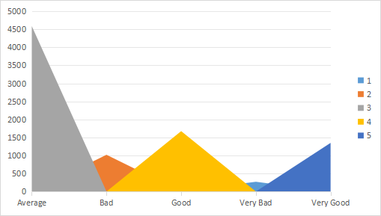
RESULTS
11

Slide 12
SETTING CLEAR GOALS AND EXPECTATIONS
Establishing specific, measurable, achievable, relevant, and time-bound (SMART) goals helps employees understand what is expected of the formance to rewards, promotions, or disciplinary actions motivates employees to excel.

Slide 13
Conclusion
The employee performance analysis reveals valuable insights into current ratings, strengths, and weaknesses. The study highlights high-performing employees in specific job functions and locations, and identifies areas for improvement in feedback and performance scores. Additionally, correlations are found between employee type, gender, and performance ratings. These findings can inform data-driven HR decisions and targeted interventions to enhance employee performance and overall organizational success.

