Slide 1
Elasticsearch
Version 1.0

Slide 2
Elasticsearch -Content
Introduction
Basic concepts
Architecture
API Conventions
Document APIs
Search APIs
Aggregations
Index APIs
Query DSL
Analysis

Slide 3
Elasticsearch –Introduction
Elasticsearch is a highly scalable open-source full-text search and analytics engine. It allows you to store, search, and analyze big volumes of data quickly and in near real time.
Written in JAVA
Elasticsearch is scalable up to petabytes of structured and unstructured data.
Elasticsearch uses denormalization to improve the search performance.

Slide 4
Elasticsearch –Basic Concepts
NODE:
It refers to a single running instance of Elasticsearch. Single physical and virtual server accommodates multiple nodes depending upon the capabilities of their physical resources like RAM, storage and processing power.
CLUSTER:
It is a collection of one or more nodes. Cluster provides collective indexing and search capabilities across all the nodes for entire data.
INDEX:
It is a collection of different type of documents and document properties. Index also uses the concept of shards to improve the performance.
DOCUMENT:
It is a collection of fields in a specific manner defined in JSON format. Every document belongs to a type and resides inside an index. Every document is associated with a unique identifier, called the UID.

Slide 5
Elasticsearch –Basic Concepts
Shard:
An Index can be divided into multiple pieces called shards.
It allows you to distribute and parallelize operations across shards (potentially on multiple nodes) thus increasing performance/throughput
Replicas:
It provides high availability in case a shard/node fails. For this reason, it is important to note that a replica shard is never allocated on the same node as the original/primary shard that it was copied from.

Slide 6
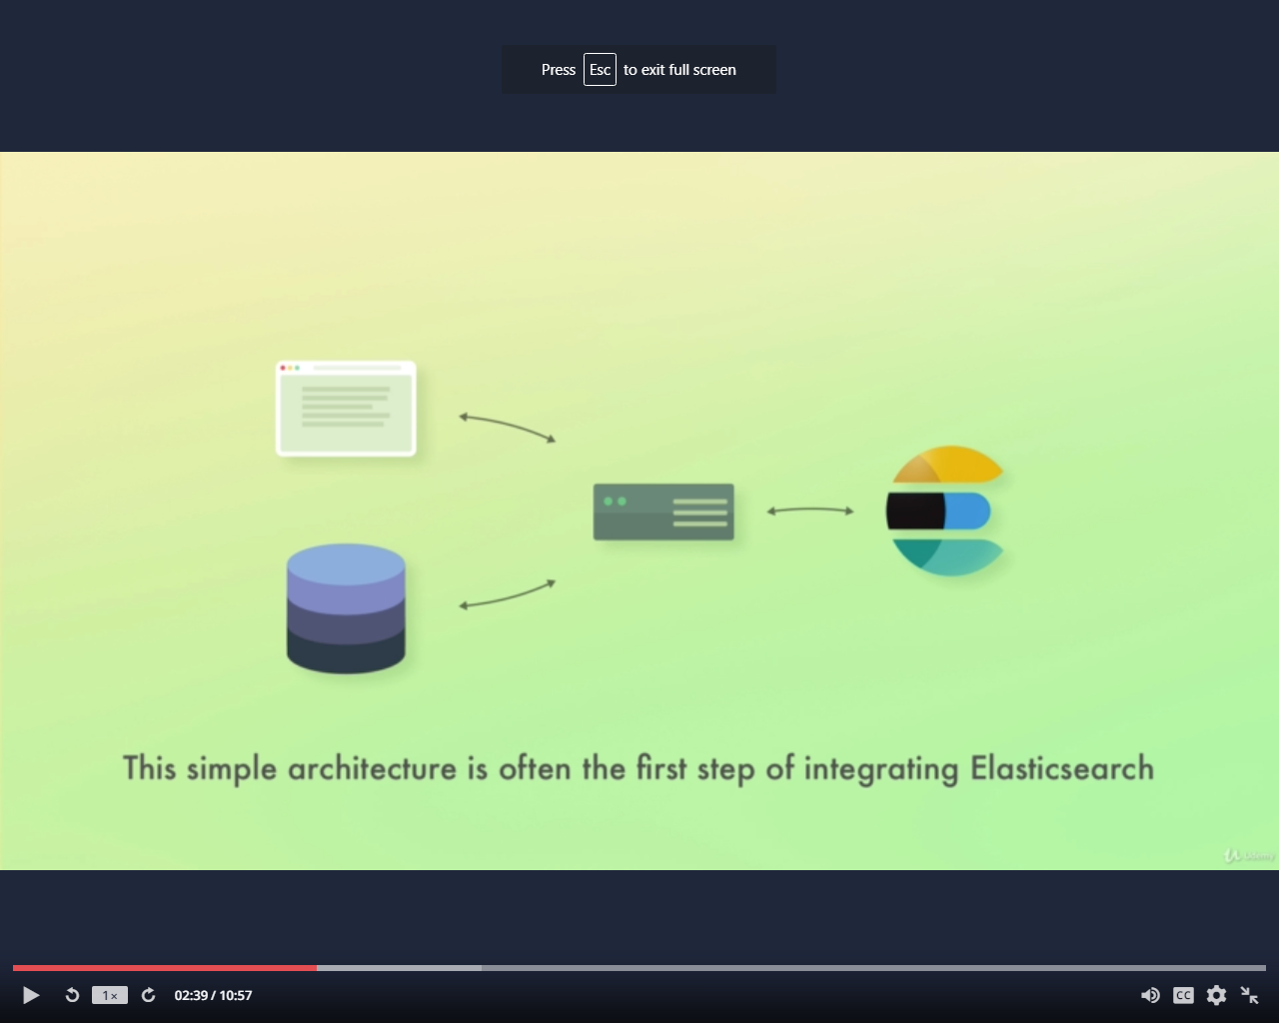
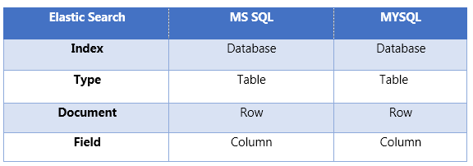
Elasticsearch –Architecture
Application
Server
Elastic Search
Database

Slide 7
Elasticsearch –API Conventions
Elasticsearch provides a REST API, which is accessed by JSON over HTTP.
Multiple Indices:
Most of the operations, mainly searching and other operations, in APIs are for one or more than one indices. Many different notations are used to perform operations in multiple indices.
URL query string parameters:
allow_no_indices
POST http://localhost:9200/schools_pri*/_search?allow_no_indices = true
expand_wildcards (+,*)
POST http://localhost:9200/school*/_close

Slide 8
Elasticsearch –API Conventions
Date math support in index names:
Date math index name resolution enables you to search a range of time-series indices, rather than searching all of your time-series indices and filtering the results. Limiting the number of indices that are searched reduces the load on the cluster and improves execution performance.
A date math index name takes the following form:
<static_name{date_math_expr{date_format|time_zone}}>
http://localhost:9200/<accountdetail-{now-2d{YYYY.MM.dd|utc}}>/_search
Expression | Resolves to
<accountdetail-{now-d}> | accountdetail-2017.12.29
<accountdetail-{now-M}> | accountdetail-2017.11.30
<accountdetail-{now{YYYY.MM}}> | accountdetail-2017.12

Slide 9
Elasticsearch –Document APIs
Index API:
It helps to add or updates the JSON document in an index when a request is made to that respective index with specific mapping.
Automatic Index Creation:
When a request is made to add JSON object to a particular index and if that index does not exist then this API automatically creates that index and also the underlying mapping for that particular JSON object.
Operation type:
The operation type is used to force a create operation, this helps to avoid the overwriting of existing document.
POST http://localhost:9200/tutorials/chapter/1?op_type = create

Slide 10
Elasticsearch –Document APIs
Automatic ID generation:
When ID is not specified in index operation, then Elasticsearch automatically generates id for that document.
Get API:
The get API allows to get a typed JSON document from the index based on its id.
GET twitter/_doc/0
Delete API:
The delete API allows to delete a typed JSON document from a specific index based on its id.
DELETE /twitter/_doc/1
Update API:
Script is used for performing this operation and versioning is used to make sure that no updates have happened during the get and re-index.
PUT test/_doc/1

Slide 11
Elasticsearch –Search APIs
This API is used to search content in Elasticsearch. Either a user can search by sending a get request with query string as a parameter or a query in the message body of post request. Mainly all the search APIS are multi-index.
Multi-Index :
Elasticsearch allows us to search for the documents present in all the indices or in some specific indices. For example, if we need to search all the documents with a name that contains central.
GET http://localhost:9200/_search?q = name:central
URI Search:
A search request can be executed purely using a URI(Uniform Resource Identifier) by providing request parameters.
GET http://localhost:9200/_ twitter/_search?q=user:kimchy

Slide 12
Elasticsearch –Aggregations
This framework collects all the data selected by the search query. This framework consists of many building blocks, which help in building complex summaries of the data.
Metrics Aggregations:
These aggregations help in computing matrices from the field’s values of the aggregated documents and sometime some values can be generated from scripts.
Numeric matrices are either single-valued like avg aggregation or multi-valued like stats.
Avg Aggregation:
This aggregation is used to get the average of any numeric field present in the aggregated documents
POST /exams/_search?size=0
{
"aggs" : {
"avg_grade" : { "avg" : { "field" : "grade" } }
}
}

Slide 13
Elasticsearch –Aggregations
Cardinality Aggregations:
A single-value metrics aggregation that calculates an approximate count of distinct values. Values can be extracted either from specific fields in the document or generated by a script.
Extended Stats Aggregations:
A multi-value metrics aggregation that computes stats over numeric values extracted from the aggregated documents.
Max Aggregations:
A single-value metrics aggregation that keeps track and returns the maximum value among the numeric values extracted from the aggregated documents.
{
"aggs" : {
"fees_stats" : { "extended_stats" : { "field" : "fees" } }
}
}

Slide 14
Elasticsearch –Aggregations
Min Aggregations:
A single-value metrics aggregation that keeps track and returns the minimum value among numeric values extracted from the aggregated documents. These values can be extracted either from specific numeric fields in the documents, or be generated by a provided script.
Stats Aggregations:
A multi-value metrics aggregation that computes stats over numeric values extracted from the aggregated documents. These values can be extracted either from specific numeric fields in the documents, or be generated by a provided script.
The stats that are returned consist of: min, max, sum, count and avg.

Slide 15
Elasticsearch –Index APIs
These APIs are responsible for managing all the aspects of index like settings, aliases, mappings, index templates.
Create Index:
The Create Index API is used to manually create an index in Elasticsearch. All documents in Elasticsearch are stored inside of one index or another.
Delete Index:
This API helps you to delete any index. You just need to pass a delete request with the URL of that particular Index.
Get Index: This API can be called by just sending get request to one or more than one indices. This returns the information about index.

Slide 16
Elasticsearch - Query DSL
Elasticsearch provides a full Query DSL (Domain Specific Language) based on JSON to define queries. Think of the Query DSL as an AST (Abstract Syntax Tree) of queries, consisting of two types of clauses:
Leaf query clauses:
Leaf query clauses look for a particular value in a particular field, such as the match, term or rangequeries. These queries can be used by themselves.
Compound query clauses:
These queries are a combination of leaf query clauses and other compound queries to extract the desired information.
Query clauses behave differently depending on whether they are used in query context or filter context.

Slide 17
Query DSL -Full Text Queries
The high-level full text queries are usually used for running full text queries on full text fields like the body of an email. They understand how the field being queried is analyzed and will apply each field’s analyzer (or search analyzer) to the query string before executing.
Match query:
This Match queries accept text/numeric/dates, analyzes them, and constructs a query.
GET /_search
{
"query": {
"match" : {
"message" : {
"query" : "this is a test",
"operator" : "and"
}
}
}
}

Slide 18
Query DSL -Full Text Queries
Multi Match query:
This query matches a text or phrase with more than one field.
Query String query:
This query uses query parser and query string keyword.
GET /_search
{
"query": {
"multi_match" : { "query": "this is a test",
"fields": [ "subject", "message" ]
}
}
}
GET /_search
{
"query": {
"query_string" : { "default_field" : "content",
"query" : "this AND that OR thus"
}
}
}

Slide 19
Query DSL - Term Level Queries
Term Level Queries:
These queries mainly deal with structured data like numbers, dates and strings. The term query finds documents that contain the exact term specified in the inverted index.
Range query:
This query is used to find the objects having values between the ranges of values. For this, we need to use operators like −
gte − greater than equal to
gt − greater-than
lte − less-than equal to
lt − less-than
POST _search
{
"query": { "term" : { "user" : "Kimchy" }
}
}
GET _search
{
"query": {
"range" : {
"date" : {
"gte" : "now-1d/d",
"lt" : "now/d"
}
}
}
}

Slide 20
Query DSL - Term Level Queries
Exists query − If a certain field has non null value.
Missing query − This is completely opposite to exists query, this query searches for objects without specific fields or fields having null value.
Wildcard or regexp query − This query uses regular expressions to find patterns in the objects
Compound Queries:
These queries are a collection of different queries merged with each other by using Boolean operators like and, or, not or for different indices or having function calls etc.

Slide 21
Query DSL - Joining query
Joining query:
These queries are used where more than one mapping or document is included
Nested query:
Documents may contain fields of type nested. These fields are used to index arrays of objects, where each object can be queried (with the nested query) as an independent document.
has_child and has_parent queries:
These queries are used to retrieve child or parent of the document, which got match in the query.
Geo Queries:
These queries deal with geo locations and geo points. These queries help to find out schools or any other geographical object near to any location.

Slide 22
Elasticsearch - Mapping
Mapping is the outline of the documents stored in an index. It defines the data type like geo_point or string and format of the fields present in the documents and rules to control the mapping of dynamically added fields .
A mapping type has:
Meta-fields:
Meta-fields are used to customize how a document’s metadata associated is treated. Examples of meta-fields include the document’s _index, _type, _id, and _source fields.
Fields or properties:
A mapping type contains a list of fields or properties pertinent to the document.

Slide 23
Elasticsearch -Field Data Types
Field Data Types:
Elasticsearch supports a number of different datatypes for the fields in a document. The following data types are used to store fields in Elasticsearch.
Core Data Types:
These are the basic data types supported by almost all the systems like integer, long, double, short, byte, double, float, string, date, Boolean and binary.
Complex Data Types
These data types are a combination of core data types. Like array, JSON object and nested data type.

Slide 24
Elasticsearch - Analysis
Analysis is the process of converting text, like the body of any email, into tokens or terms which are added to the inverted index for searching. Analysis is performed by an analyzer which can be either a built-in analyzer or a custom analyzer defined per index.
Index time Analyzer:
For instance, at index time the built-in English analyzer will first convert the sentence:
"The QUICK brown foxes jumped over the lazy dog!"
into distinct tokens. It will then lowercase each token, remove frequent stop words ("the") and reduce the terms to their word stems (foxes → fox, jumped → jump, lazy → lazi). In the end, the following terms will be added to the inverted index:
[ quick, brown, fox, jump, over, lazi, dog ]

Slide 25
Elasticsearch - Anatomy of an analyzer
Character Filters:
These filters process the text before tokenizers. Character filters look for special characters or html tags or specified pattern and then either delete then or change them to appropriate words like ‘&’ to and, delete html markup tags.
Tokenizers:
A tokenizer receives a stream of characters, breaks it up into individual tokens (usually individual words), and outputs a stream of tokens. For instance, a whitespace tokenizer breaks text into tokens whenever it sees any whitespace. It would convert the text "Quick brown fox!" into the terms [Quick, brown, fox!].
POST _analyze
{
"tokenizer": "whitespace",
"text": "The 2 QUICK Brown-Foxes jumped over the lazy dog's bone."
}
[ The, 2, QUICK, Brown-Foxes, jumped, over, the, lazy, dog's, bone. ]

Slide 26
Thank you

