Slide 1
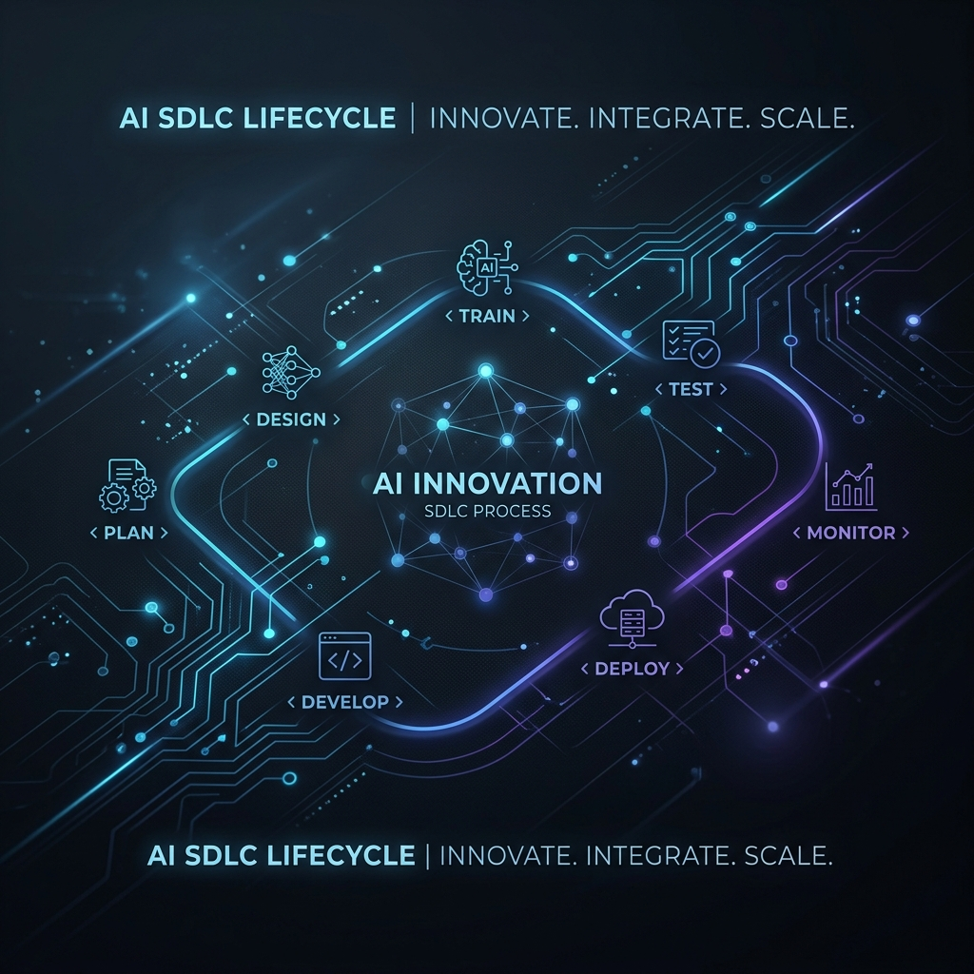
AI-Augmented Software Development Lifecycle (SDLC) Engine
Automating Efficiency from Requirements to Production
Presenter: [Your Name]
Company: Prodapt (Internship 2026)

Slide 2
The Problem Statement (The 'Why')
Current SDLC Challenges:
Ambiguity: Vague requirements lead to 40% of project rework.
Bottlenecks: Manual code reviews slow down the 'Lead Time to Production'.
Gaps: Inconsistent test coverage and missing traceability.
Risk: Blind deployments lead to production incidents and developer burnout.
TL Quote: "There is a critical need for intelligent automation that catches errors before they reach production."

Slide 3
The Solution: AI-SDLC Platform
Vision: A unified platform that 'Augments' human intelligence.
Core: 8 specialized AI modules running on a high-performance stack.
Stack: FastAPI (Backend) + React (Frontend).
Goal: Zero-friction development with 100% traceability.

Slide 4
System Architecture
Frontend: React 18 with Glassmorphism Design System
Backend: FastAPI for asynchronous AI orchestration
Knowledge: RAG Engine with FAISS Vector Store
Connectivity: Event-driven Webhooks (GitHub / Jira)
AI Engine: OpenAI GPT-4o (Structured Output API)

Slide 5
Module 1: Requirements Analyzer
Detects ambiguities in natural language
Automatically drafts Gherkin User Stories
Calculates a Completeness Score (0-100)
Value: Replaces vague talk with testable requirements.

Slide 6
Module 2: AI Code Reviewer
Security-first architectural review
Provides 'Before vs. After' code diffs with fixes
Checks for missing unit tests
Value: Shields production from security flaws.

Slide 7
Module 3: Smart Test Generator
Generates full pytest / jest files automatically
Covers edge cases (null values, boundary limits)
Value: Ensures high-quality coverage without manual overhead.

Slide 8
Module 4: Deployment Risk Scorer
Calculates a 0-100 risk score based on change signals
Generates Rollback Plan and Monitoring Checklist
Value: Minimizes downtime and deployment anxiety.

Slide 9
Module 5: Traceability Engine
Maps: Requirement → Story → Commit → Test → Deployment
Visually traces the 'Chain of Custody'
Value: Simplifies audits and ensures business alignment.

Slide 10
Module 6: Multi-Agent Bug Fixer
Collaborative workflow: Analyst → Researcher → Fixer → QA
Automated root cause analysis from bug reports
Value: Slashes 'Mean Time To Repair' (MTTR) by 70%.

Slide 11
Module 7: Integrations & RAG
Live GitHub and Jira Webhook data streams
Codebase indexing for context-aware AI decisions
Value: Unified source of truth for the entire SDLC.

Slide 12
Module 8: AI System Architect
Converts natural language into live Mermaid.js diagrams
Automates architectural documentation and visualization
Value: Bridges the gap between business logic and technical design.

Slide 13
Future Roadmap
Phase 4: Autonomous Pull Request Creation & Management
Phase 5: Self-Healing Production (Auto-rollback on metric drift)
Phase 6: Multi-Repo Cross-Project Intelligence

Slide 14
Conclusion / Q&A
Summary: Moving from manual to AI-Augmented SDLC
"Technology is best when it empowers developers to focus on creativity while AI handles the complexity."

