Slide 1
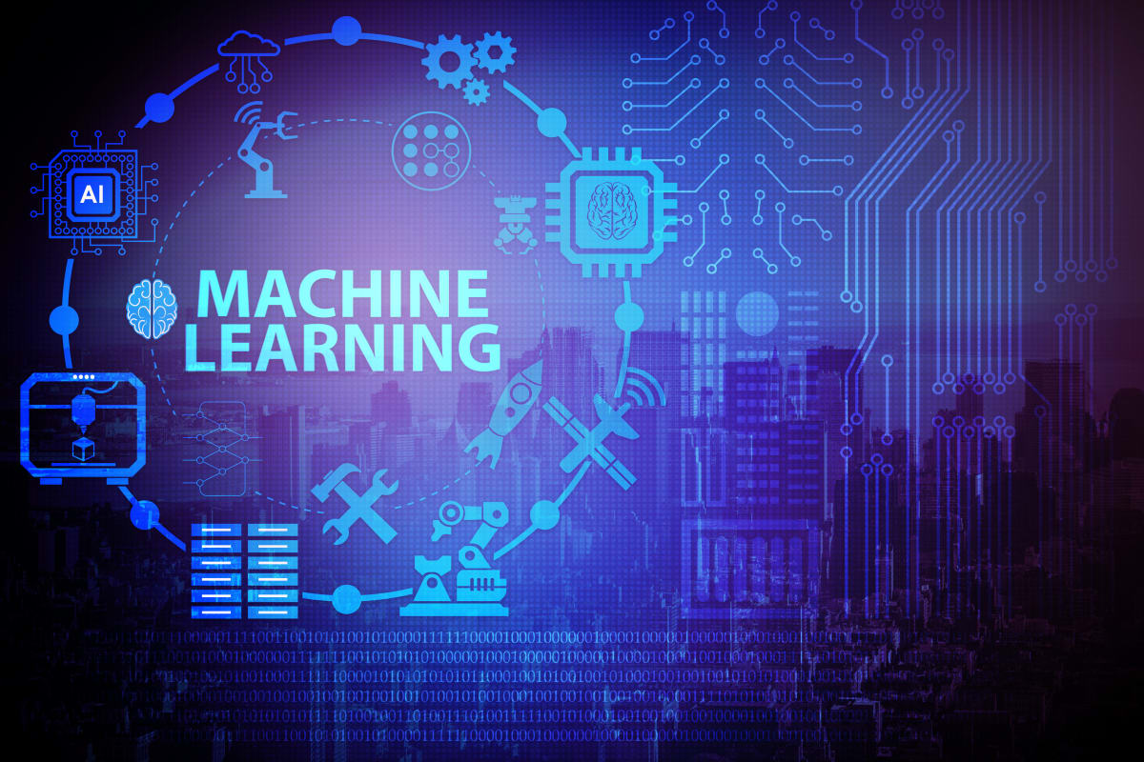

Slide 2
Outline
History of Machine Learning.
What is Machine Learning.
Why Machine Learning.
Learning System Model.
Training and Testing.
Performance.
Algorithms.
Machine Learning Structure.
Application.
Conclusion.

Slide 3
History of ml
The name machine learning was coined in 1959 by Arthur Samuel Tom M. Mitchell provided a widely quoted, more formal definition of the algorithms studied in the machine learning field.
A computer program is said to learn from experience E with respect to some class of tasks T and performance measure P if its performance at tasks in T , as measured by P, improves with experience E.
Alan Turing’s proposal in his paper “Computing Machinery and Intelligence", in which the question “Can machine think?” is replaced with question “Can machines do what we(as thinking entities) can do?”.

Slide 4
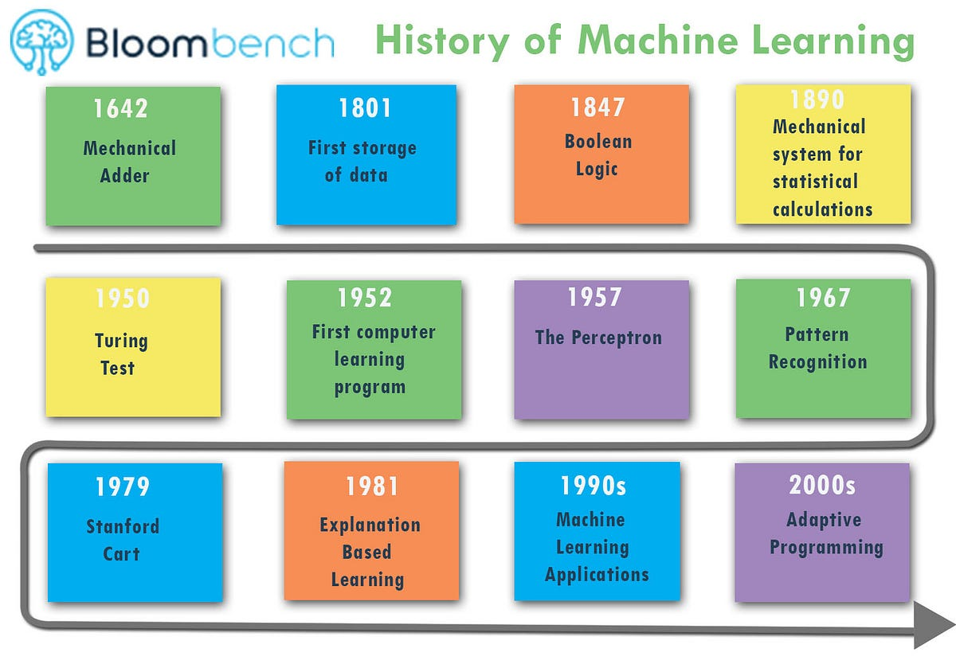
Contd.

Slide 5
What is ml
A branch of Artificial intelligence, concerned with the design and development of algorithms that allow computers to evolve behaviors based on empirical data.
As intelligence requires knowledge, it is necessary for the computers to acquire knowledge.
Machine learning refers to a system capable of the autonomous acquisition and integration of knowledge.

Slide 6
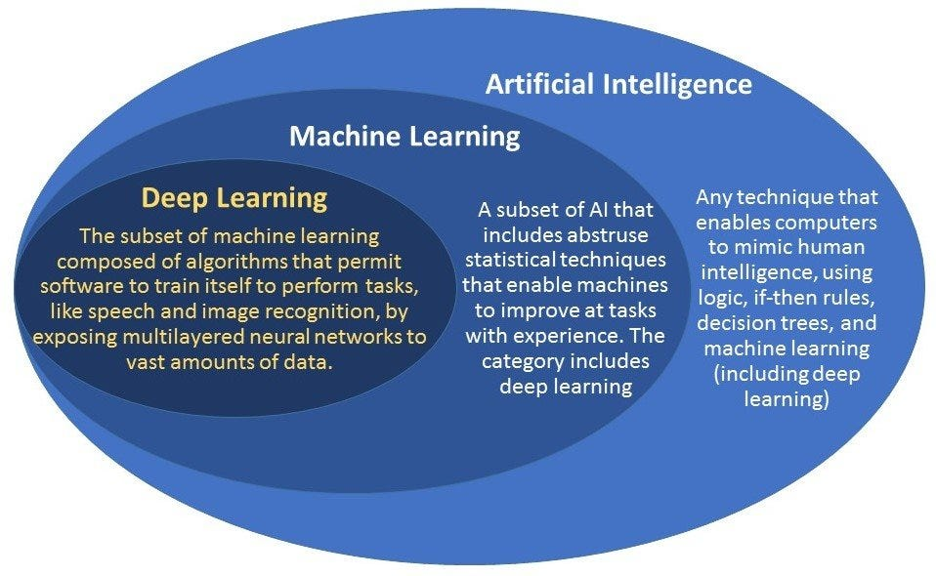
Contd.

Slide 7
Why ml
No human experts.
Industrial/manufacturing control.
Mass spectrometer analysis, drug design, astronomic discovery.
Black-box human expertise.
Face/handwriting/speech recognition.
Driving a car , flying a plane.
Rapidly changing phenomena.
Credit scoring, financial modeling.
Diagnosis, fraud detection.
Need for customization/personalization.
Personalized news reader.
Movie / book recommendation.

Slide 8
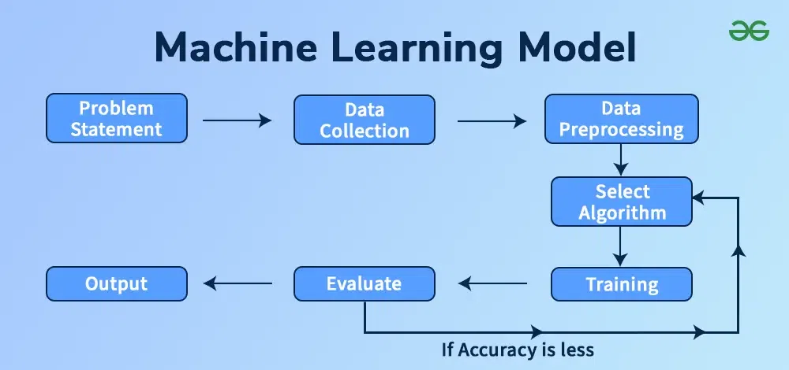
Learning system model

Slide 9
Training and testing
Training Set:
The model is built (or trained) on this data.
It contains both the input features and the target labels.
The model learns patterns and relationships in the data by adjusting internal parameters to minimize error.
Test Set:
Once the model is trained, it's evaluated on the test set.
The test set contains data the model has never seen before, helping to assess how well the model generalizes to unseen data.
It helps to check if the model is overfitting or underfitting.

Slide 10
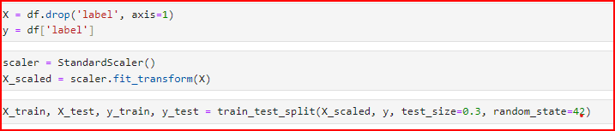
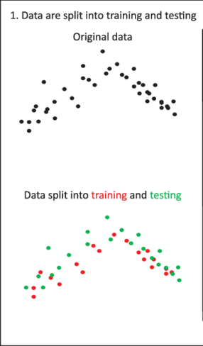

Slide 11
performance
There are several factors affecting the performance.
Type of training provided.
The form and extent of any initial background knowledge.
The type of feedback provided.
The learning algorithms used.
Two important factors:
Modeling.
Optimization.

Slide 12
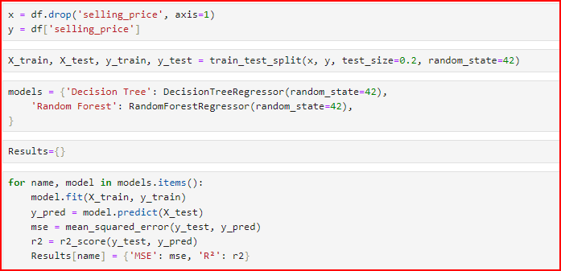

Regressor Data

Slide 13
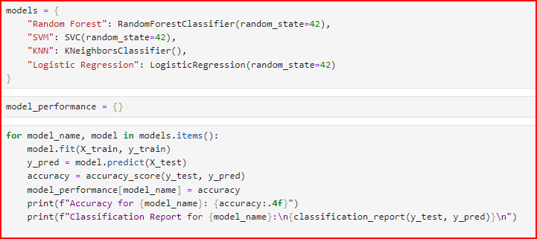
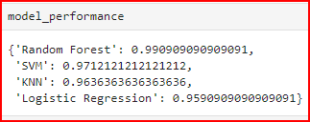
Classifier Data

Slide 14
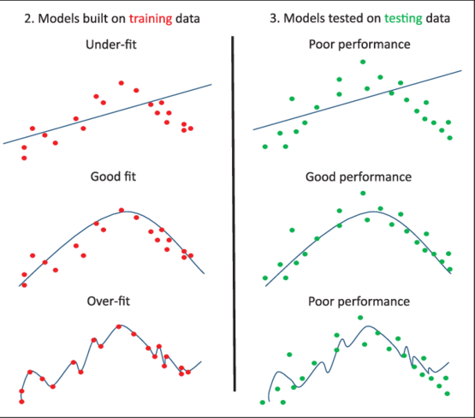

Slide 15
algorithm
The success of machine learning system also depends on the algorithms.
The algorithms control the search to find and build the knowledge structures.
The learning algorithms should extract useful information from training.

Slide 16
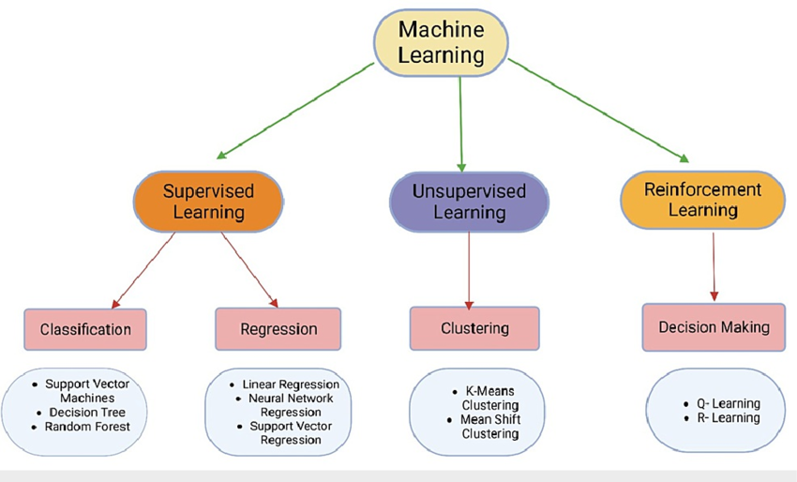
Type of algorithm in ml

Slide 17
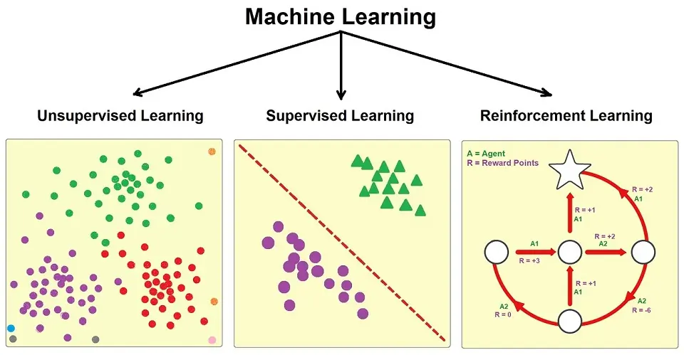
Contd.

Slide 18
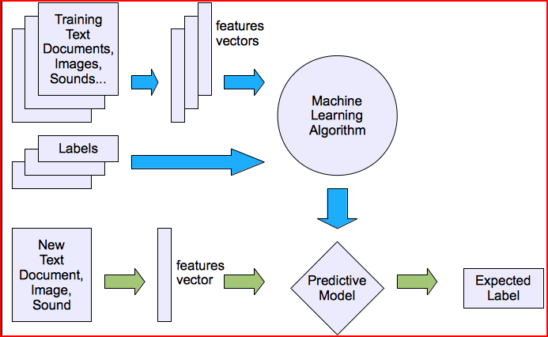
Machine learning structures
Supervised learning

Slide 19
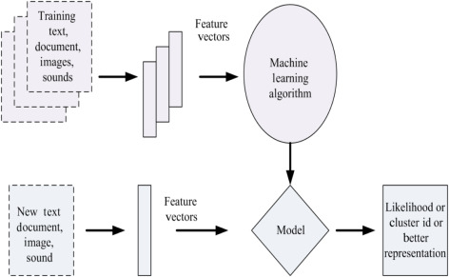
contd
Unsupervised learning

Slide 20
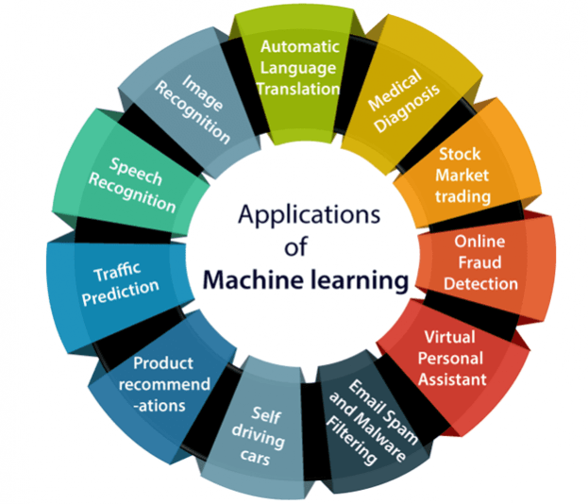
application

Slide 21
conclusion
We have a simple overview of some techniques and algorithms in machine learning . Furthermore , there are more and more techniques apply machine learning as a solution. In the future, machine learning will play an important rule in our daily life.

Slide 22
Thank you

