Slide 1
Introduction to Node.js

Slide 2
Table of Contents:
What is node?
What so special about node.js
Why Node.js
Node Architecture
How node works?
Installing Node
Creating First App
REPL

Slide 3
What is Node.js?

Slide 4
Node.js
Node or Node.js:
Is a open source and cross platform runtime environment.
Is used to run javascript code outside of a browser.
Is used to build backend services, also called API’s or Application Programming Interfaces.
Is used to create services sitting on the server or in the cloud to store data, send emails, push notifications, and so on.

Slide 5
Often used to build back-end services
WEB APP
BACK-END SERVICE
MOBILE APP

Slide 6
What so special about node
Highly scalable
Data intensive (process large volume of data)
Real time
These above three points adds extra power to the back-end services that are used by our client applications.

Slide 7
Why node.js?
It is easy to get started
Used for building a model of a system (Prototyping)
Used for agile development
Using Node.js we can build super fast back-end services
Node.js back-end services can be built faster with fewer people.

Slide 8
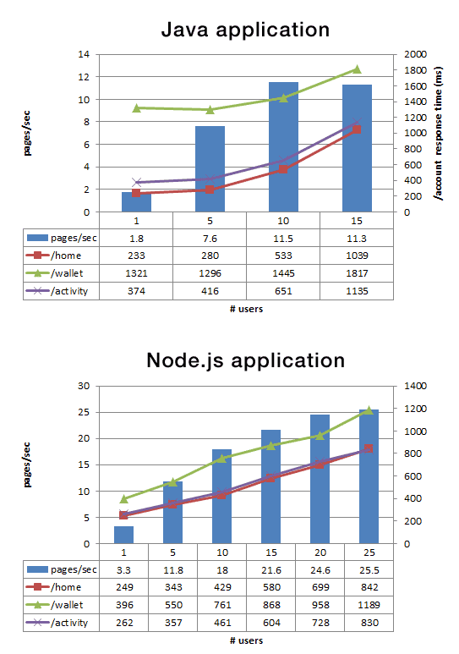
Node App
With fewer people - built fast
Less lines of code
Less files
Double the rate of request per second
35% faster response time

Slide 9
Other reasons for using node.js
JavaScript everywhere
Cleaner and more consistent codebase
Large ecosystem of open-source libs

Slide 10
Node Architecture

Slide 11
Runtime environment
Earlier only JavaScript is used to build applications that will run inside the browser.
Every browser has their own JavaScript engine.
JavaScript Engine - converts our code into code that a computer can understand.
JavaScript code can given different output in different browser because each browser has their own engine.

Slide 12



Varieties of Engine
Chakra
SpiderMonkey
V8

Slide 13
JacaScript – Runtime Environment
Node.js is a JavaScript runtime, uses V8 engine.
JavaScript runtime has several components as follows,
Memory Heap
Execution/Call Stack
Web APIs Container
Callback Queue
Even Loop

Slide 14
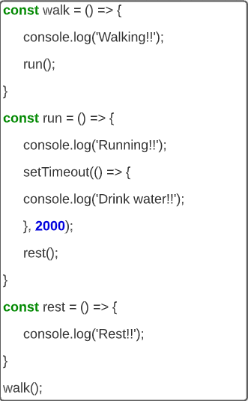
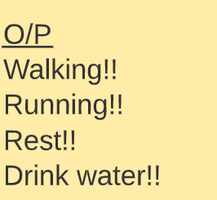
JacaScript – Runtime Environment

Slide 15
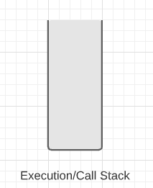
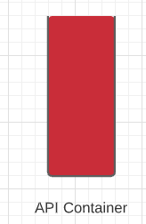
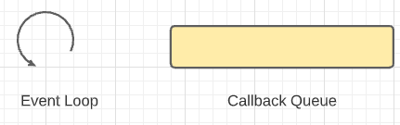
JacaScript – Runtime Environment

Slide 16
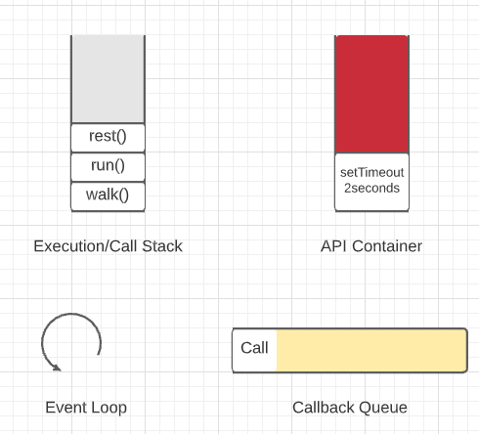
JacaScript – Runtime Environment

Slide 17
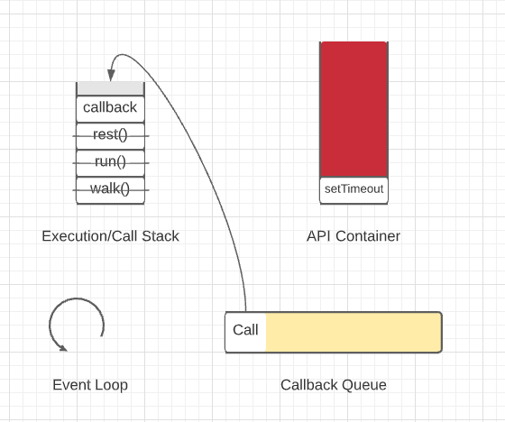
JacaScript – Runtime Environment

Slide 18
How Node.js works?

Slide 19
Model used by Node.js
Node uses an event-driven non-blocking I/O model.
Input/Output (I/O) model refers to,
Input/output operations
Reading/writing files
Making api calls
There are two types of I/O models,
Blocking i/o model
Non-blocking i/o model

Slide 20
I/o Modle types
Blocking I/O model – Subsequent code will be blocked from execution by the code comes before. Code inside the execution stack is NOT executed simultaneously.
Non-Blocking I/O model – Code will not be blocked from execution by the code comes before. JavaScript follows non-blocking I/O model.

Slide 21
Installing Node

Slide 22
Environment Setup: Windows
In the search bar, type Command Prompt. Click on the first search result to open. Alternatively, press Win+R. In the Run window that pops up, type cmd in the Open text field and click on OK.
Check node.js is installed or not by typing ‘node –v’ command in Command Prompt.
Press Enter

Slide 23
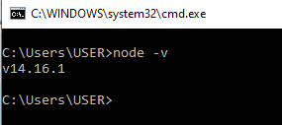
Environment Setup: Windows
If you see any version, then Node.js is already installed on your machine.

Slide 24

Environment Setup: Windows
If you get below message then, we need to install node.js from this link ‘https://nodejs.org/en/download/’

Slide 25
Environment Setup: MacOS
Press Cmd+Space to open Spotlight Search, and type Terminal. Click on the first search result to open it.
Check node.js is installed or not by typing ‘node –v’ command in terminal.
Press Enter

Slide 26

Environment Setup: MacOS
If you see any version, then Node.js is already installed on your machine.

Slide 27

Environment Setup: MacOS
If you get below message then, we need to install node.js from this link ‘https://nodejs.org/en/download/’

Slide 28
Runtime environment
Node.js in JavaScript runtime uses V8 engine
JavaScript runtime has several components as follows,
Memory heap
Execution/Call stack
Web APIs container
Callback queue
Even loop

Slide 29
Creating first app

Slide 30
Creating first app
Open Command prompt and create a new folder using the following cmd ‘mkdir firstapp’. (mkdir - make directory)
Then navigate to this newly created folder using the following cmd ‘cd firstapp’. (cd - change directory)
The above two commands are same for all the OS you will be running

Slide 31

Creating first app
Then, open this folder in VS Code or Visual Studio Code, which is a powerful code Editor, using the cmd ‘code .’

Slide 32
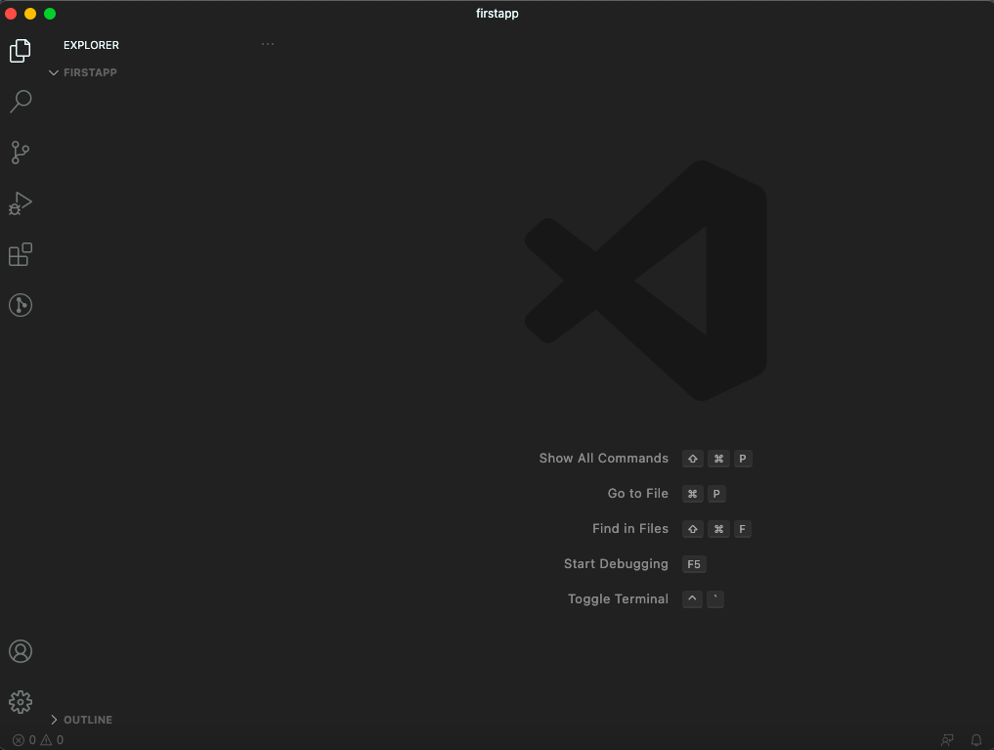
Creating first app
VS code editor
Use any editor that you prefer like Sublime, Atom, etc.

Slide 33
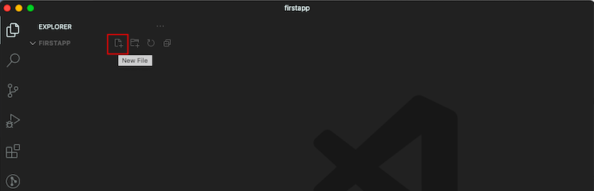
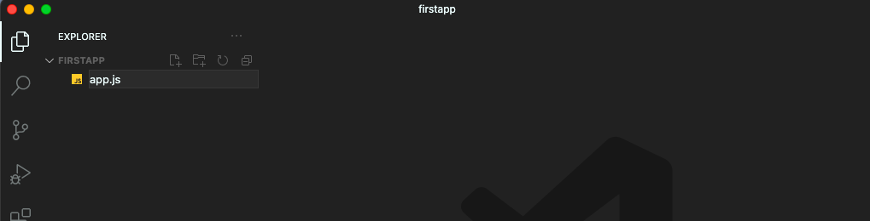
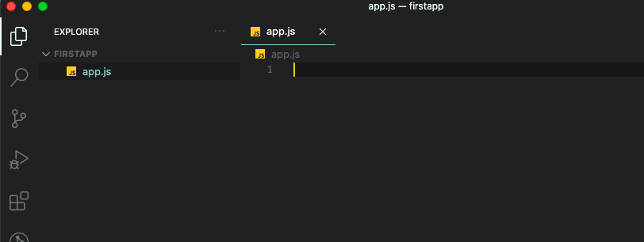
Creating first app
Add a new file inside this folder and name it as ‘app.js’
Write a JavaScript function in this file, that simply logs the message on the console

Slide 34
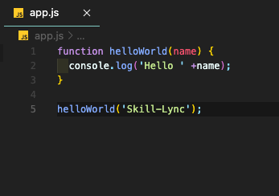
Creating first App
Terminal execute code
Go back to terminal and execute this code
Run node and pass file name as an argument
‘node app.js’ - Node includes chrome’s V8 engin and this app.js will be given to V8 for execution

Slide 35
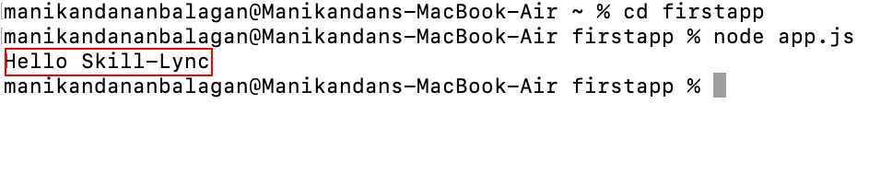
Creating first App
¸

Slide 36
REPL

Slide 37
REPL
REPL is a language shell, which is an interactive computer programming environment
REPL stand for
R - Read input from user
E - Evaluate input and return result
P - Print/display result
L - Loop previous 3 commands until termination

Slide 38
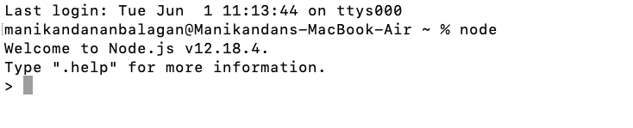
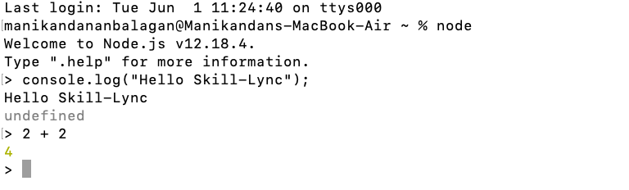
REPL
Below is the sample code that we can execute in REPL
environment like print message and execute expressions

Slide 39
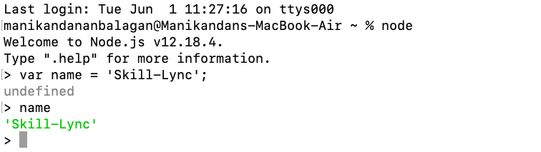
REPL
Apart from printing messages and executing expressions, we can also store values in REPL environment

Slide 40
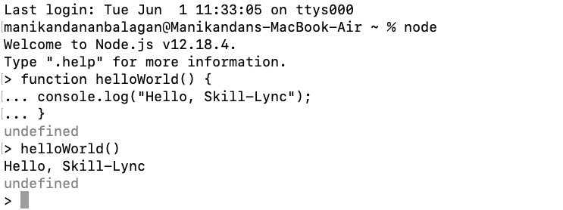
REPL
You can also write functions in REPL environment, press ‘shift + enter’ in order to consider the whole function as a multiline expression

Slide 41
Thank you

