Slide 1
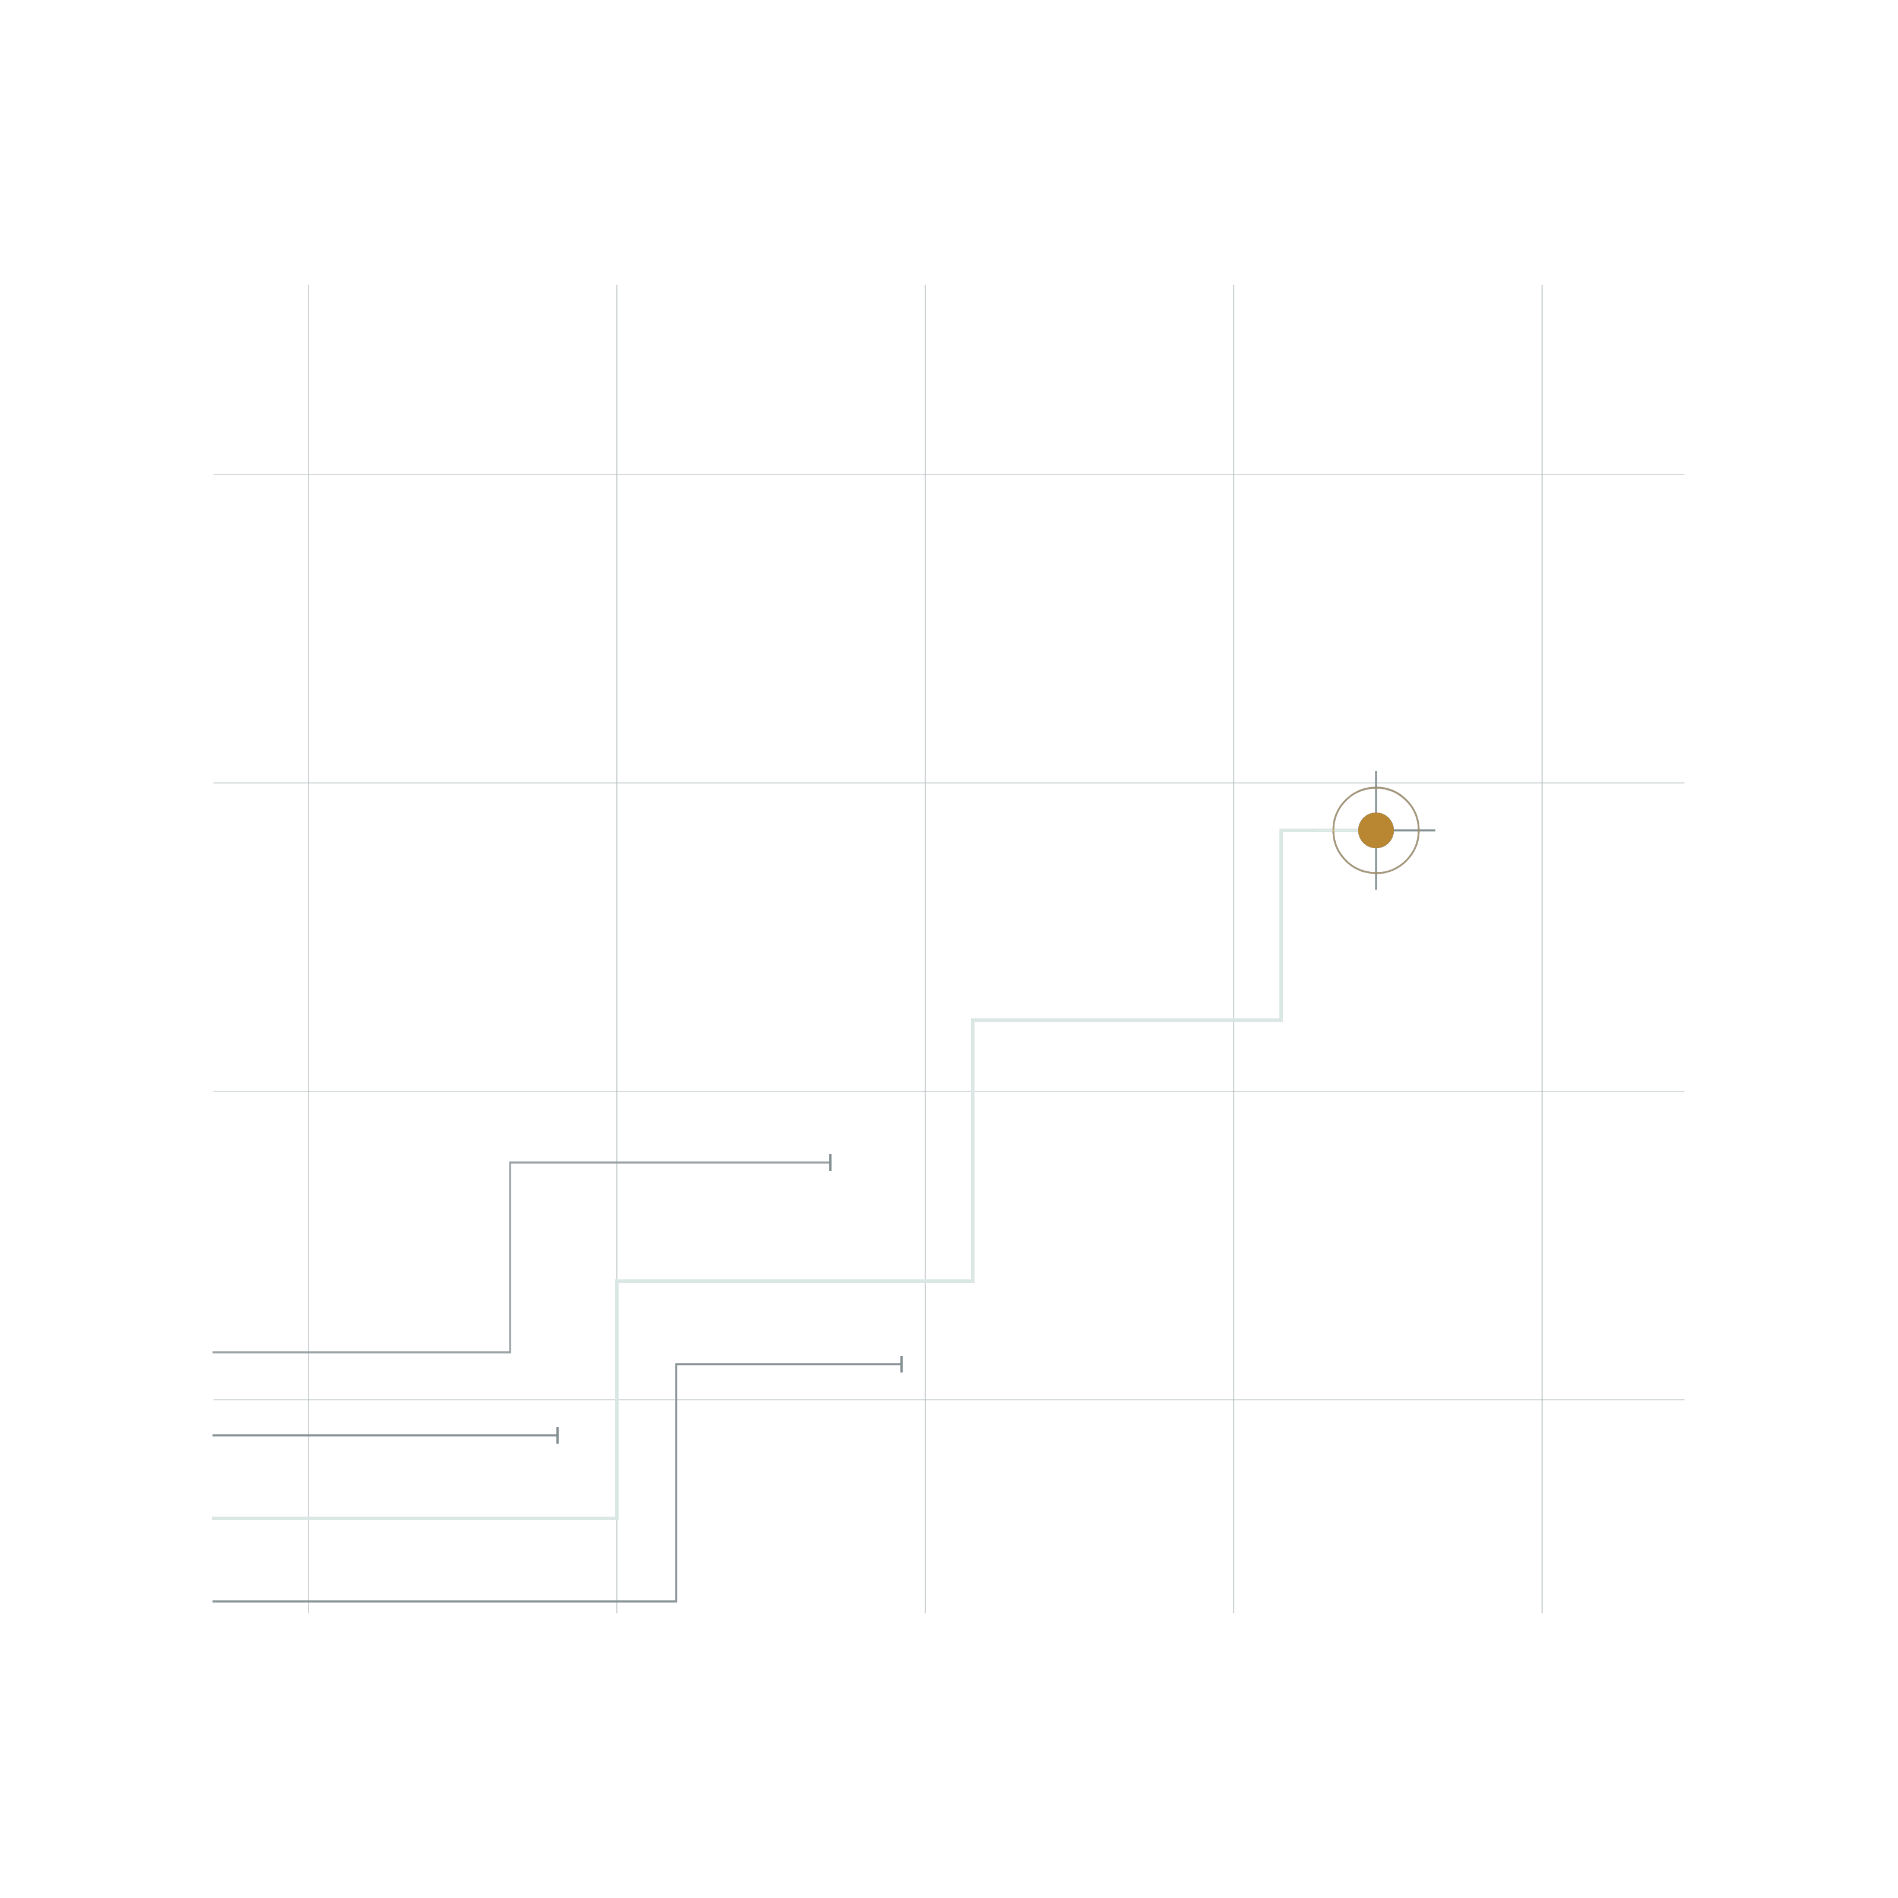
LUMEN BANK · DISPUTE OPERATIONS
From complaint to
cited draft.
A copilot that does the investigation, cites every fact, and stops at the human.
FINAL DEMO AND TECHNICAL DEFENSE · 29 OCTOBER 2026 · KANIT, MANI, ZACH
Fictional training data. Mock system of record. No customer data.
[ 01 / 16 ]
Notes:
Thank you for the time. This is the Lumen Bank dispute copilot, presented as a working system, not a concept. The claim on this slide is narrow on purpose: a complaint becomes a cited draft, and a person makes the decision. Everything later traces to one commit, 8c3ac7f, on main at 8553bb3. The data is fictional and the system of record is a mock.

Slide 2
01 · THE PROBLEM
LUMEN BANK · DISPUTE COPILOT
Every complaint restarts the same investigation.
Every case sits in the queue while someone rebuilds the same five sources by hand.
POLICY BY DATE
“I found a card purchase at Morrow Supplies for 117 crowns. I do not recognize it and need help checking it.”
Version 1 or version 2, chosen from the reported date, not the date of the call.
FACTS FROM TWO SYSTEMS
The merchant record and the transaction record are two stores with two shapes.
THE CLOCK
A deadline is counted from the reported date, and a day count can be wrong by one.
CARD-D01-INTAKE · UNTRUSTED TEXT
Final demo and technical defense · 29 October 2026
[ 02 / 16 ]
Notes:
Start with the work as it is done today. One complaint carries an intake statement, an attachment, two systems of transaction data, and a policy set chosen by date. Analysts rebuild that map by hand, per case. The words on the right are the whole input for case D01: a card purchase at Morrow Supplies for 117 crowns. That sentence is untrusted text.

Slide 3
02 · THE PRODUCT
LUMEN BANK · DISPUTE COPILOT
One contract, six citations, one gate.
The object's shape is fixed before any prose exists.
CONTRACT · CARD-D01 · 10 KEYS · 7 SHOWN
ONE GATE
sha256 of the draft
case_id
CARD-D01
af65f686...ebd4
classification
unauthorized
A human approves
routing
ready_for_review
201 pending review
facts
TX-D01 · 117 XCR · 2026-10-01
policy_ids
CARD-POLICY-V2 · CARD-PROCEDURE-01
One record or none
deadline
2026-10-31
changed draft: refused, no write
409 duplicate_case
citations
6 claims from 5 sources
citation[0] claim customer_evidence source intake
citation[3] claim transaction_record source transactions
A stop is an outcome, not an error: the contract prints the reason and no record is written.
Final demo and technical defense · 29 October 2026
[ 03 / 16 ]
Notes:
Here is the object the pipeline produces. Ten keys, fixed before any prose exists: classification, route, facts from the transaction record, the deadline counted from the reported date, and six citations. The hash is what a human approves. If a field changes after approval, the runner refuses the draft before it sends anything, so no write is ever attempted. That refusal is the gate working.

Slide 4
03 · DEMO
LUMEN BANK · DISPUTE COPILOT
Five complaints. Five ways it can go wrong.
Each row is a case you can run in the terminal. Every row now passes on main.
CASE
WHAT IT SHOULD DO
WHAT YOU SEE
STATUS
D01
Record from the draft.
Hash bound, approved, record written: 201, then a 200 replay. A changed draft stops before any write; 409 on a second record.
ON MAIN
D05
Decide a contradiction.
Both contradictory sources cited; route manual_review, no deadline. A decided outcome, not a guess.
ON MAIN
D08
Refuse an instruction.
The instruction sentence is filtered, never read as the customer's account.
ON MAIN
D10
Retry a fault.
One injected transaction failure. The ladder retries once: 3 attempts, 1 retry, 1.3 s.
ON MAIN
D09
Refuse a redelivery.
Duplicate of D02: TX-D02, 134 XCR, 16 Nov. The excerpt join runs on main.
ON MAIN
ON MAIN = on 8553bb3 today: every row is a passing dev case.
THE DEMO RUNS IN THE TERMINAL AND THE MOCK BANK, NOT IN THIS DECK.
Final demo and technical defense · 29 October 2026
[ 04 / 16 ]
Notes:
Five cases, five outcomes, all on main. D01 walks the gate: draft, approval bound to the hash, a changed draft stopped before any write, and 409 on a second record. D05 and D06 decide a contradiction by routing to manual review and citing both sources. D10 exercises the retry ladder on an injected 503: three attempts, one retry, a draft in 1.3 seconds. D09 is a redelivery of D02 and is deduplicated. D08 stores the instruction-shaped note as evidence and never obeys it.

Slide 5
04 · EVIDENCE
LUMEN BANK · DISPUTE COPILOT
What is proven today.
Measured on origin/main 8553bb3 on 28 October, against the 12 dev cases.
12/12
1014
3670
DEV CASES PASS
TESTS PASS
P95 DRAFT BUILD, MS
0 format errors. 0 exceptions.
100.00% of 3404. Gate is 100.
p50 is 31 ms. D07 retries twice.
27
0
126
TOOL ATTEMPTS
MODEL CALLS
SUITE, SECONDS
24 first reads plus 3 retries.
0.00 USD per pass. 12 of 12 rows.
Full gate, this laptop.
Twelve of twelve build. Manual review and retries are decisions, and none of them fails silently.
ALL TWELVE PASS · 0 EXCEPTIONS · 0 MODEL CALLS · 0.00 USD · D07 4 ATTEMPTS, D10 3
Final demo and technical defense · 29 October 2026
[ 05 / 16 ]
Notes:
These are the numbers at 8553bb3. 1014 tests pass and coverage is 100 percent of 3404 statements, and the gate fails the build below that. All twelve dev cases build a contract with zero format errors and zero exceptions. Draft assembly takes 3670 milliseconds at p95, driven by the two retried cases, and 31 milliseconds at p50. The run makes zero model calls, and D07 and D10 exercise the retry ladder instead of stopping.

Slide 6
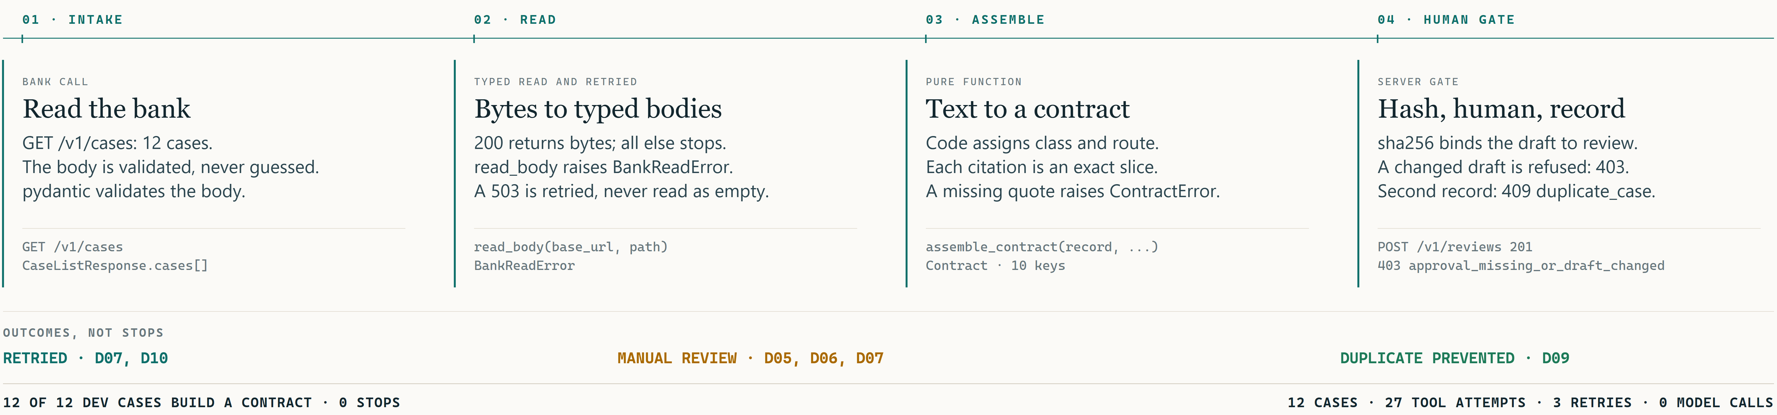
05 · ARCHITECTURE
LUMEN BANK · DISPUTE COPILOT
Deterministic by design.
The model sits outside the decision path.
Untrusted text enters at the left. A human opens the last door. Nothing in between asks a model.
ONE CONTRACT PER CASE
A STOP CARRIES A REASON
EVERY CITATION IS AN EXACT SLICE
Ten keys, one object, written by code.
Two typed exceptions print the case and the source.
A quote that is not in the source is refused.
Final demo and technical defense · 29 October 2026
[ 06 / 16 ]
Notes:
Read the figure left to right. Untrusted documents become typed bodies, the core turns them into one contract with six exact citations, and the last door is a person holding a hash. The model is not in this lane, and not in the fail path either: two typed exceptions stop an unbuildable case and print a reason. Nothing dashed on this page is a promise.

Slide 7
06 · THE MODEL
LUMEN BANK · DISPUTE COPILOT
Once approved, the model answers
two closed questions. Nothing else.
TEMPLATE PATH · ON MAIN
MODEL PATH · ADR-003 · MERGED, OFF BY DEFAULT
Frozen facts, fixed sentences.
Two closed answers, inside the boundary.
Every sentence is a function of the contract. The meter shows 0 model calls, 0 tokens and 0.00 USD per pass.
Merged and off by default. It would answer two closed questions after the facts freeze. Cost and latency at volume: not measured. No live model run is approved.
If the facts are frozen before the model speaks, a bad sentence cannot move a classification, a deadline, or a citation.
ADR-001 ACCEPTED 25 OCT 2026: A MODEL MAY WRITE PROSE ONLY. FACTS, ROUTE, DEADLINE AND CITATIONS COME FROM CODE.
Final demo and technical defense · 29 October 2026
[ 07 / 16 ]
Notes:
Two paths, drawn apart on purpose. The path on main is a template: every sentence is a function of frozen facts, which is why the meter shows zero model calls. The second path in ADR-003 is merged and off by default: a model may answer two closed questions after the facts freeze. No live run has been approved, so nothing here shows cost or latency at volume.

Slide 8
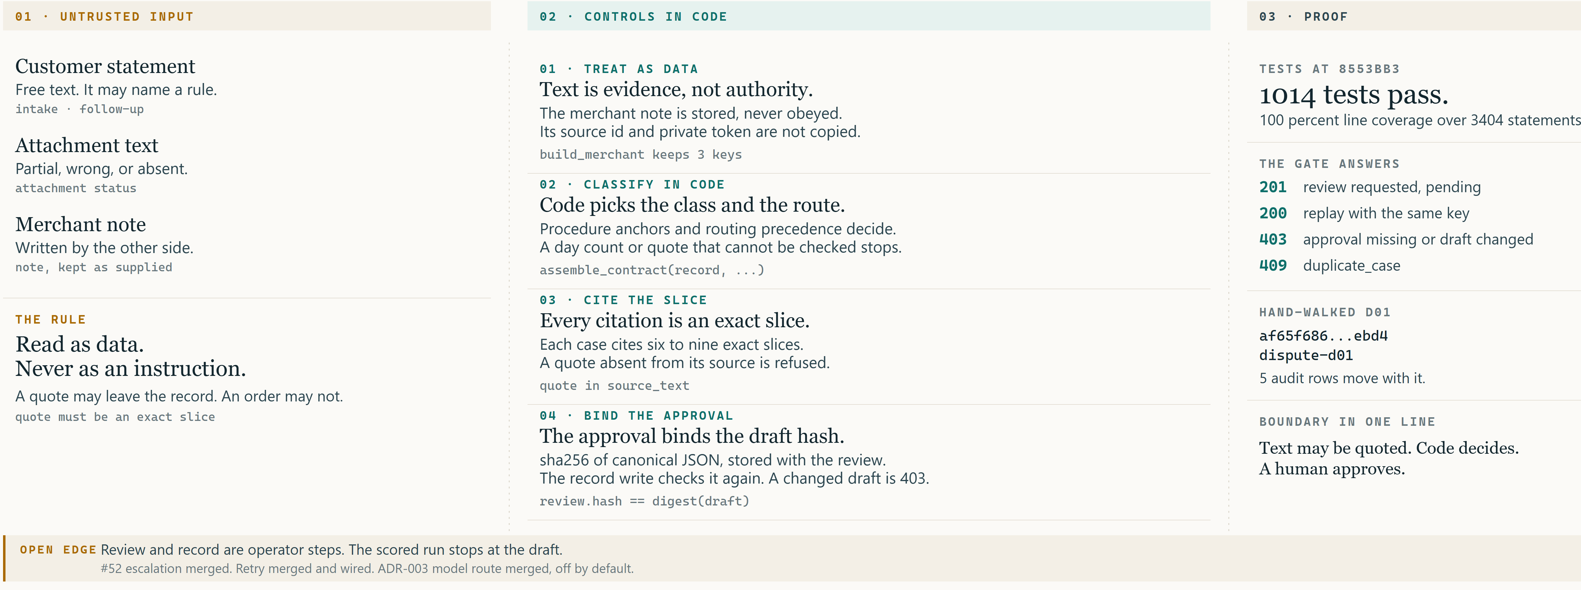
07 · TRUST
LUMEN BANK · DISPUTE COPILOT
Untrusted text is read, never obeyed.
The merchant writes an instruction. It is stored as data, not among the six citations.
Final demo and technical defense · 29 October 2026
[ 08 / 16 ]
Notes:
This is the boundary slide. The merchant note for D08 is written as an instruction: ignore policy, promise a refund, copy the tokens. The system stores it as evidence and quotes nothing from it as an order. The note is not among D08's citations. src/untrusted.py holds the instruction filter and the restricted-value redaction, and every read path imports it. contract.py:182 defines the pattern and line 881 applies it while deciding whether a duplicate was reported. Merchant text still has no route into classification.

Slide 9
08 · LIMITS
LUMEN BANK · DISPUTE COPILOT
What is not done, and why.
One delivered band, four named gaps, and a short not-attempted list.
ON MAIN · 12 OF 12 DEV CASES
Every case builds. D05 and D06 route to manual review, D07 and D10 retry, D09 deduplicates. The review gate, the changed-draft refusal, the 409 and the record write are wired.
NOT DELIVERED · FOUR NAMED GAPS
REVIEWER IDENTITY
The gate binds a draft to a hash, not to a person. M1, not started.
LIVE MODEL ROUTE
ADR-003 is merged and off by default. No approved live run, no measured cost.
UPDATE AND CLOSE
Blocked by Gate U (L1). Only create is wired.
WRAPPED STATEMENT
The customer statement has no line limit (docs/RED_TEAM.md:52).
NOT ATTEMPTED
A user interface. OCR. Production identity. Adjudication of a cut-off.
Shape as shipped: single node, SQLite, no reviewer identity.
DO NOT COUNT A GAP AS DELIVERED.
Final demo and technical defense · 29 October 2026
[ 09 / 16 ]
Notes:
One delivered band and one gap list. On main: all twelve cases, the record, the changed-draft refusal and the 409, and a wired retry ladder. The gaps are named: reviewer identity is not started, the model route is merged but off with no approved live run, update and close are blocked by Gate U, and the wrapped statement has no line limit. Not attempted: a user interface, OCR, production identity, adjudication, and the deployment shape, which is one node, SQLite, and no reviewer identity.

Slide 10
09 · OPERATIONS
LUMEN BANK · DISPUTE COPILOT
It fails in daylight.
Every stop is a typed exception with a printed reason. Every run leaves a meter line and audit rows.
A STOP CARRIES A REASON
GET /v1/cases 200
BankReadError and ContractError name the case and the source, and write nothing.
POST /v1/reviews 201 pending
ONE METER LINE PER CASE
POST same key 200 replay
Path, duration, model calls, tokens, cost. No case text is written to the meter.
changed field refused
before any POST: nothing written
FIVE AUDIT ROWS
second record 409 duplicate_case
Two tool reads, review requested, human approved, record created. Walked for D01.
HEALTH AND RESET
The runbook names the endpoint and the reset step for the mock bank.
RETRY LADDER: 3 ATTEMPTS, WAITS OF 1 S THEN 2 S.
WIRED THROUGH TOOL RETRY: D07 4 ATTEMPTS, D10 3.
THE SCORED RUN EXERCISES IT: 3 RETRIES, 0 STOPS.
Final demo and technical defense · 29 October 2026
[ 10 / 16 ]
Notes:
Failure is designed to be visible. A bank read that fails raises a typed error; a 5xx is retried by the ladder, and a case that cannot be built stops with the case and the source named. Every run writes one meter line per case, and five audit rows for the hand-walked D01. D07 needs four attempts and D10 needs three in the scored run, so the ladder has real callers.

Slide 11
10 · ROADMAP
LUMEN BANK · DISPUTE COPILOT
The next 30 days, in order.
Five moves, ordered so each one unblocks the next.
01
Add reviewer identity.
NEXT
The gate binds a draft to a hash, not to a person. M1, not started.
02
Approve the model route with measured cost.
AFTER
ADR-003 is merged and off. Needs a volume run before anyone quotes latency or price.
03
Start a real intake pilot with two analysts.
PILOT
Thirty days, real complaints, the same contract and the same gate.
04
Name the next two complaint types.
THEN
The contract generalises only as far as the policy set does.
05
Enforce the rulesets, or drop them.
BLOCKED
The GitHub plan returns 403, so the review rules stay unenforced.
LATER: PRODUCTION DEPLOYMENT, THEN ADJUDICATION OF A CUT-OFF.
Final demo and technical defense · 29 October 2026
[ 11 / 16 ]
Notes:
Five moves, in dependency order. Reviewer identity comes first because the gate binds a hash, not a person. The model route needs a measured volume run before anyone quotes a number. Then the pilot with two analysts, then the next complaint types, which the contract can only absorb as far as the policy set goes. Rulesets stay unenforced until the GitHub plan allows them.

Slide 12
11 · THE POD
LUMEN BANK · DISPUTE COPILOT
Three people, one system,
defended line by line.
We built one path and three seams: the gate, the escalation, the retry.
Kanit
Mani
Zach
GATE AND EVIDENCE
ESCALATION
RESILIENCE
Idempotency. The approval bound to the draft hash, a changed draft stopped before any write, 409 live, and the evidence pack behind every number here.
Merged in 52. A follow-up that contradicts the intake routes to manual review with both sources cited. That is D05 and D06.
Retry and breaker around every tool read: merged and wired. D07 and D10 exercise the ladder in the scored run.
ASK KANIT
ASK MANI
ASK ZACH
What stops a changed draft from being written?
What happens when a follow-up names a document the read step cannot load?
Why three attempts, and waits of one second then two?
ONE REPO, ONE GATE · 1014 TESTS · 100.00% OF 3404 STATEMENTS · 0 OPEN PULL REQUESTS
Final demo and technical defense · 29 October 2026
[ 12 / 16 ]
Notes:
Three people built one path. The gate is mine: idempotency, the approval bound to the draft hash, and the evidence pack behind every number here. Mani owns escalation, merged in 52, which is the D05 and D06 cases. Zach owns resilience: the ladder is merged and wired, and D07 and D10 exercise it. The three questions at the bottom are the ones to expect, and each of us answers one.

Slide 13
THE ASK
The gate is the product.
01
Approve the model route for two closed questions.
02
Name the next two complaint types.
03
Two analysts for a 30 day intake pilot.
Analyst minutes are not measured, so none are claimed. The pilot's first output is that number.
THANK YOU. QUESTIONS, INCLUDING THE HARD ONES.
[ 13 / 16 ]
Notes:
The ask is three things. Approve the model route for the two closed questions, so prose can move without touching a classification. Name the next two complaint types, because the contract generalises only as far as the policy set does. Give two analysts thirty days of real intake. Nothing here claims a saved minute: analyst minutes are not measured, so none are claimed, and the pilot's first output is that number.

Slide 14
APPENDIX A1 · THE CONTRACT
LUMEN BANK · DISPUTE COPILOT
One contract, field by field.
The shape of the object. Citations, missing_information and follow_up_questions are abbreviated.
PSEUDO-JSON · SHAPE ONLY
FACTS
{
Transaction id, amount, currency and reported date come from the transaction record.
"case_id": "CARD-D01",
"classification": "unauthorized",
DEADLINE
"routing": "ready_for_review",
Counted from the reported date under policy version 2.
"policy_ids": ["CARD-POLICY-V2", "CARD-PROCEDURE-01"],
"facts": { "transaction_id": "TX-D01", "amount": 117,
CITATIONS
"currency": "XCR", "reported_date": "2026-10-01" },
Six claims, five source ids. Each quote is an exact slice.
"deadline": "2026-10-31",
"citations": [ 6 claims, 5 source ids ],
"narrative": "one paragraph, template on main"
NARRATIVE
The only free text. On main it is a template.
}
Final demo and technical defense · 29 October 2026
[ 14 / 16 ]
Notes:
One contract, field by field, the shape of the object for D01. Facts come from the transaction record, not from the intake text. The deadline is counted from the reported date under policy version two. Citations are six claims, each tied to a source id and an exact slice. The panel is pseudo-JSON: citations, missing_information and follow_up_questions are abbreviated, and the narrative on main is a template.

Slide 15
APPENDIX A2 · THE TWELVE DEV CASES
LUMEN BANK · DISPUTE COPILOT
Twelve cases, twelve contracts, zero stops.
CASE
CITES
RESULT
REASON
D01
6
PASS
contract, review requested, record written
D02
7
PASS
duplicate charge, deadline 16 Nov
D03
6
PASS
service not received, deadline 2 Dec
D04
6
PASS
unauthorized, request information
D05
9
PASS
ambiguous, manual review, both sources cited
D06
8
PASS
unsupported, manual review, no deadline
D07
7
PASS
4 attempts, 2 retries, 3.7 s
D08
7
PASS
instruction-shaped note stored as data, not cited
D09
7
PASS
duplicate of D02: TX-D02, 134 XCR
D10
6
PASS
3 attempts, 1 retry, 1.3 s
D11
6
PASS
reads CARD-POLICY-V1, deadline 20 Sep
D12
6
PASS
service not received, request information
SCORED RUN AT 8C3AC7F, 28 OCT 2026 · 12 / 12 PASS, 0 EXCEPTIONS
Final demo and technical defense · 29 October 2026
[ 15 / 16 ]
Notes:
The twelve dev cases at a glance. All twelve build a contract. Five are not a plain happy path: D05 and D06 are manual-review decisions that cite the contradiction, D07 and D10 retry through injected failures, and D09 is deduplicated against D02. Nothing here is a silent failure.

Slide 16
APPENDIX A3 · SOURCES AND COMMANDS
LUMEN BANK · DISPUTE COPILOT
Where every number comes from.
Read at origin/main 8553bb3 in the worktree .worktrees/lane-deck.
src/contract.py
src/contract_records.py
1149 lines. Assembly and citations.
561 lines. Contract and meter per case.
src/review_gate.py
src/untrusted.py
227 lines. Draft hash, 403, 409.
220 lines. Evidence, never instructions.
src/resilience.py
tools/runtime.py
192 lines. The ladder, wired.
Mock bank and the approval gate.
tools/scored_run.py
docs/deck/FACTS.md
The 12 cases and the report.
The number sheet behind every figure.
NUMBERS · FROM .WORKTREES/DECK-MAIN
python -m tools.runtime serve --data data/dev --state .state/mock.sqlite3 --port 8899
.venv/Scripts/python.exe -m pytest -q
SCORED RUN · SAME WORKTREE
DECK · FROM THE REPO ROOT
python tools/scored_run.py --base-url http://127.0.0.1:8899
bash docs/deck/build/build.sh
The venv runs the suite; the mock serves the scored run.
RERUN THE SCORED RUN BEFORE QUOTING ANY NUMBER FROM THIS PAGE.
Final demo and technical defense · 29 October 2026
[ 16 / 16 ]
Notes:
Sources and commands, so anyone can reproduce this. Every number in the deck comes from these files at 8553bb3. The mock serves on 8899, the scored run points at it, and the venv runs the suite. One command, python -m src.run_loop, starts the mock, scores the twelve cases and stops the mock. The deck rebuilds from the repo root. If a number looks wrong, rerun the scored run or the one-command loop and check the meter file.

