Slide 1
SmartMove AI
AI-Powered Road Hazard Detection & Smart City Safety Platform
Team Leader: Vasantharaj G
Team Members:
1.Manikandan Prabhu B
2.Gokul Anand A
3.Vasantharaj G
Tata Centre for AI & ML Hackathon Centre of Excellence in AI, NIT Tiruchirappalli 31 July – 1 August 2026
Team name: SmartMove
Team ID:H26SCT09
College Name: Madras Institute of Technology, Chrompet, Chennai-600044
!

Slide 2
Problem Statement
THE PROBLEM
OUR VISION
Road hazards cause accidents and vehicle damage before drivers can react. Road accidents frequently occur in accident-prone zones due to limited visibility, high traffic density, overspeeding, and the lack of timely hazard warnings. Drivers entering these high-risk areas often remain unaware of nearby vehicles or emerging dangers until it is too late.
SmartMove AI: A transportation intelligence platform.
Monitor vehicles in real time using GPS telemetry.
Detect vehicles entering accident-prone zones.
Generate instant safety and emergency alerts.
Visualize live vehicle status through an interactive dashboard.
2

Slide 3
Existing Solution & Gaps
Existing
Solution
Flaw
Existing traffic systems mainly respond after an incident rather than preventing it. An intelligent, real-time cooperative system is needed to monitor vehicles in accident-prone zones, predict potential collisions, and issue instant alerts to improve road safety.
Existing road safety systems are reactive, responding only after an incident occurs.
Accident-prone zones have a higher risk due to poor visibility, overspeeding, and heavy traffic.
Drivers often lack real-time awareness of nearby vehicles and potential hazards.
The absence of vehicle-to-vehicle cooperation delays timely risk detection and warnings.
A real-time AI-based cooperative system is needed to predict collision risks and provide instant safety alerts before accidents occur.
2

Slide 4
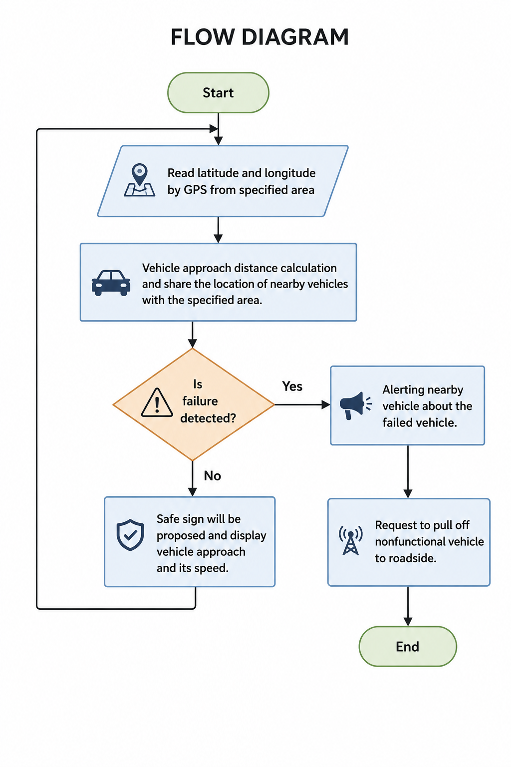





ARCHITECTURE OVERVIEW
Vehicle Simulator
MQTT Broker
FastAPI Backend
AI Risk Analysis
Dashboard

Slide 5
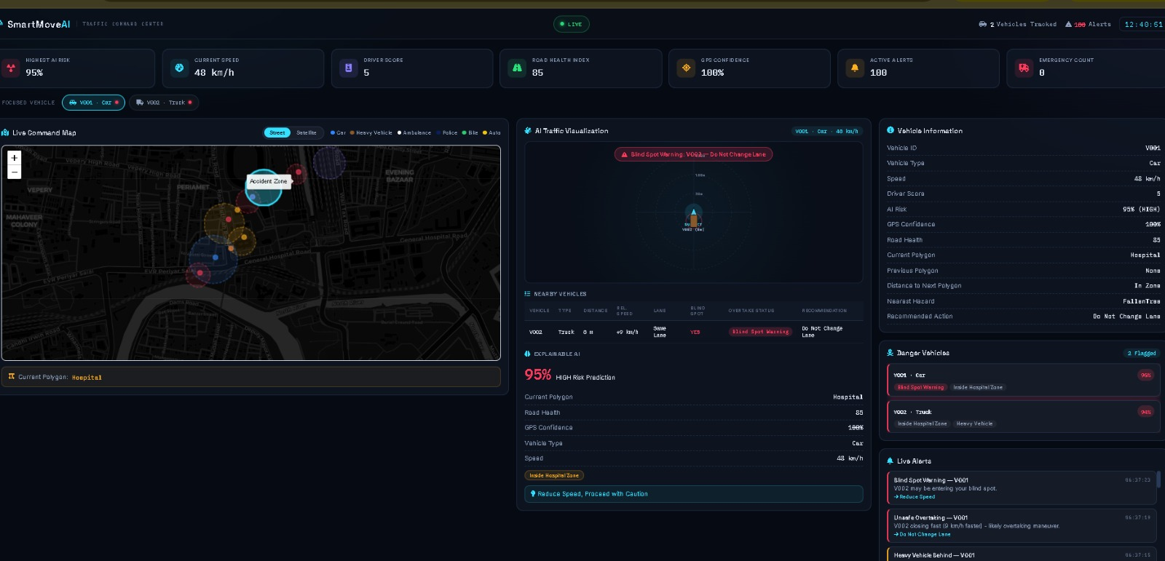

Implementation Progress
So far, we have completed the vehicle simulator, MQTT communication, Redis database integration, and FastAPI backend APIs. The dashboard frontend is partially completed, while nearby vehicle alerts and emergency alert display are still in progress.

