Slide 1
IBM University Engagement Project Submission
“Exploring the Power of Agentic AI with IBM Granite and LangFlow”

Slide 2

Project Tile – SONICSCOPE
Domain of Project – Electronics and Telecommunications Engineering:
Student Name | Recent Passport Photo | Email ID | Mobile number [WhatsApp]
Manikandan Prabhu B |  | bmanikandanprabhu.ece@gmail.com | 7358834577

Slide 3
Problem Statement -
Problem Statement : Audio Signal Processing Assistant Agent
The Challenge
Designing and debugging audio circuits like preamps, filters and amplifiers is hard for students and engineers. Problems such as hum, hiss, distortion and oscillation have many possible causes, and finding the right one takes experience. Information on grounding, filter design and noise elimination is scattered across forums, datasheets and textbooks. Calculating filter component values by hand is slow, and the results don’t always match standard parts. Beginners often can’t tell why an amplifier produces noise or how to reduce distortion in an op-amp circuit. They need quick, clear and reliable guidance.
The Objective
.Build an AI-powered Audio Signal Processing Assistant Agent that helps users design and debug audio circuits. It must use IBM Granite on IBM Cloud Lite services, which is mandatory for this problem statement. The solution should:
Answer audio engineering questions: Handle queries like “Why is my audio amplifier producing noise?” or “How do I reduce distortion in my op-amp circuit?” with clear explanations, relevant equations and practical advice.
Give filter design suggestions: Calculate the missing resistor or capacitor value for RC low-pass and high-pass filters from a target cutoff frequency, and recommend the nearest standard E12 capacitor so the design can be built with real parts.
Provide grounding tips: Explain techniques such as star grounding, ground loop isolation, balanced connections and proper shielding.
Offer noise elimination techniques: Diagnose common problems (hum, buzz, hiss, distortion, pops and oscillation) and give structured output: possible causes, how to identify the real cause, and step-by-step solutions.
Stay reliable and secure: Use IBM Cloud Lite and IBM Granite, keep credentials out of the code, avoid invented measurements, and show a clear error if the AI service is unavailable.

Slide 4
Proposed Solution -
Proposed Solution: Sonicscope is a web-based assistant that helps students and engineers design and debug audio circuits. It is powered by the IBM Granite model through IBM watsonx.ai on IBM Cloud Lite. Instead of searching many unreliable sources, the user gets answers, calculations and diagnoses in one place, in simple language.
The system has three modules:
AI Audio Engineering Assistant: A chat interface where users ask audio circuit questions. Each question goes to IBM Granite with a system prompt that sets the model up as an audio electronics engineer and educator. It covers op-amp circuits, amplifiers, filters (low-pass, high-pass, band-pass, notch), preamplifiers, grounding, noise elimination and audio DSP concepts. If a question is unrelated to audio electronics, the assistant politely declines and redirects the user, which keeps answers focused. One-click example questions help first-time users get started.
RC Filter Calculator: The user selects low-pass or high-pass and enters a cutoff frequency plus either a resistance or a capacitance. The tool computes the missing value using fc = 1 / (2π × R × C). It then finds the nearest standard E12 capacitor and recalculates the actual cutoff frequency with that part. The result is shown with the formula and a plain-language explanation, so users understand what the numbers mean.
Audio Noise Troubleshooter: The user describes the problem in plain words, for example “constant 50 Hz hum from my speakers”. A rule-based engine scores the description against known noise patterns and returns the best match. The output has the noise type, possible causes, identification steps to confirm the root cause, solutions, and a short summary. If nothing matches, it falls back to general troubleshooting guidance. The guidance is built on established audio engineering practice.

Slide 5
Technology Used
IBM Granite (ibm/granite-4-h-small): The model for natural language understanding and for generating audio engineering answers. It was checked as available through the live watsonx.ai API.
IBM watsonx.ai: Hosts and serves the Granite model through its chat completions endpoint.
IBM Cloud Lite: Provides the free account, the IAM API key authentication, and the watsonx.ai project. This meets the mandatory IBM Cloud Lite requirement.
FastAPI and Uvicorn (Python): The backend and REST API layer. FastAPI also generates interactive API docs automatically.
Pydantic: Validates every user input (length limits, positive numbers, allowed filter types) before any processing.
httpx: Makes the async calls to IBM IAM and watsonx.ai.
HTML5, CSS3 and vanilla JavaScript: A lightweight single-page frontend with three tabs, a chat view and result cards.
python-dotenv: Loads the IBM credentials from a .env file so they are never hardcoded.

Slide 6
FLOW
User Input (Chat Input): The web interface where users type questions, enter filter values (cutoff frequency plus R or C), or describe a noise problem. Questions are limited to 2000 characters and noise descriptions to 1000.
IBM watsonx.ai Agent: The FastAPI backend gets an IBM IAM token from the API key. It then sends the question, with the audio-engineering system prompt, to Granite through watsonx.ai. This produces the explanations and recommendations.
IBM Granite model: ibm/granite-4-h-small. It runs with greedy decoding, up to 800 new tokens and a repetition penalty of 1.1. This gives consistent, focused and reasonably fast answers.
Chat Output: Displays the Granite answer in the chat, the filter result card (R, C, standard E12 value, actual cutoff, formula and explanation), and the noise diagnosis (type, causes, identification steps, solutions and summary).
File component: The project doesn’t have one. It stores no user data or logs. The E12 capacitor list and the noise pattern knowledge base are built into the Python code. I’d skip this item, or say the domain knowledge is embedded in the backend modules.
Other components:
  FastAPI/Uvicorn backend with CORS enabled
  Pydantic validation
  RC Filter Calculator engine
  Rule-based Noise Troubleshooter engine
  /health endpoint that reports whether credentials are configured
  httpx client
  python-dotenv for configuration
  HTML/CSS/JS frontend

Slide 7

Role of Agentic AI in the solution
Role of Agentic AI in SonicScope
IBM Granite acts as an on-demand audio electronics mentor, understanding questions in everyday language and providing clear explanations, relevant equations, calculations and practical troubleshooting steps. The agent goes beyond simply generating answers by coordinating with specialized tools, including an exact calculator for filter design and a diagnostic engine for identifying potential noise-related problems.
The system follows a tool-assisted approach where the AI interprets the user's requirements, determines which tools are needed and combines their results into a meaningful response. This allows users to receive both conceptual explanations and precise engineering results within a single interface.
Importantly, numerical results are calculated using predefined engineering formulas rather than relying on AI-generated estimates, ensuring accuracy, consistency and repeatability.
IBM Granite is primarily responsible for language understanding, reasoning and guiding the user, while the specialized tools handle computation and diagnosis.
The assistant is designed to remain focused on audio electronics and signal processing. It also follows a transparent error-handling approach: if the IBM watsonx.ai service is unavailable, the system displays a clear error message instead of generating fabricated responses or inventing circuit measurements.
Through this combination of AI reasoning, deterministic engineering tools and reliable error handling, SonicScope functions as an intelligent, interactive and always-available audio lab mentor.

Slide 8
Novelty and Uniqueness
Language model plus exact tools, so numbers never come from the model. Open-ended questions go to IBM Granite. Filter values are computed by deterministic code using fc = 1 / (2π × R × C), and noise diagnosis comes from a fixed knowledge base. Numeric answers are therefore repeatable and can’t be hallucinated. Many audio chatbots let the model guess component values.
Filter results you can build. The calculator doesn’t stop at the ideal value. It snaps to the nearest standard capacitor from an E12-based list and recalculates the cutoff you will actually get with that part. It can solve for either R or C, and if you give both it returns the real cutoff. This closes the gap between the textbook value and what’s in a parts bin.
Diagnosis that teaches a debugging method. Each result follows the same order: possible causes, then identification steps to confirm which cause it is, then solutions. Most answers jump straight to fixes. Here the user is guided to confirm the root cause first (for example, unplugging devices one at a time to test for a ground loop).
Covers the problem statement’s three asks in one tool. The assistant combines Q&A (amplifier noise, op-amp distortion), filter design suggestions, and grounding and noise elimination tips. They sit in one tabbed app instead of separate calculators and forum searches.
Domain-restricted and honest by design. The system prompt limits Granite to audio electronics and signal processing, and it redirects off-topic questions. If IBM’s service fails, the app shows a clear error and never fakes an answer. Credentials come only from .env, and all inputs are validated before use.
Built on the mandated IBM stack. It uses IBM Cloud Lite (IAM authentication) and IBM Granite through watsonx.ai. The model ID was checked against the live API as available for chat. The app is lightweight (FastAPI plus plain HTML/JS), needs no database and runs locally.

Slide 9
Git Hub Link
LINK : ManikandanPrabhu13/sonicscope-audio-signal-processing: An intelligent platform for audio signal analysis and processing, combining core digital signal processing concepts with modern software engineering and AI capabilities.
·
·
·

Slide 10
Future Scope
Phase 1 – Core Enhancements
Expand noise troubleshooting capabilities.
Introduce advanced filter calculations.
Enhance keyword matching and diagnosis accuracy.
Phase 2 – AI Enhancements
4. Integrate IBM Granite for personalized explanations.
5. Implement RAG using trusted technical documents.
6. Add conversational memory for contextual interactions.
Phase 3 – Advanced Features
7. Enable circuit schematic and image analysis.
8. Integrate audio signal and noise analysis.
9. Support saving and exporting diagnostic reports.
Phase 4 – Deployment
10. Deploy the application on IBM Cloud for wider accessibility.
·
·
·

Slide 11
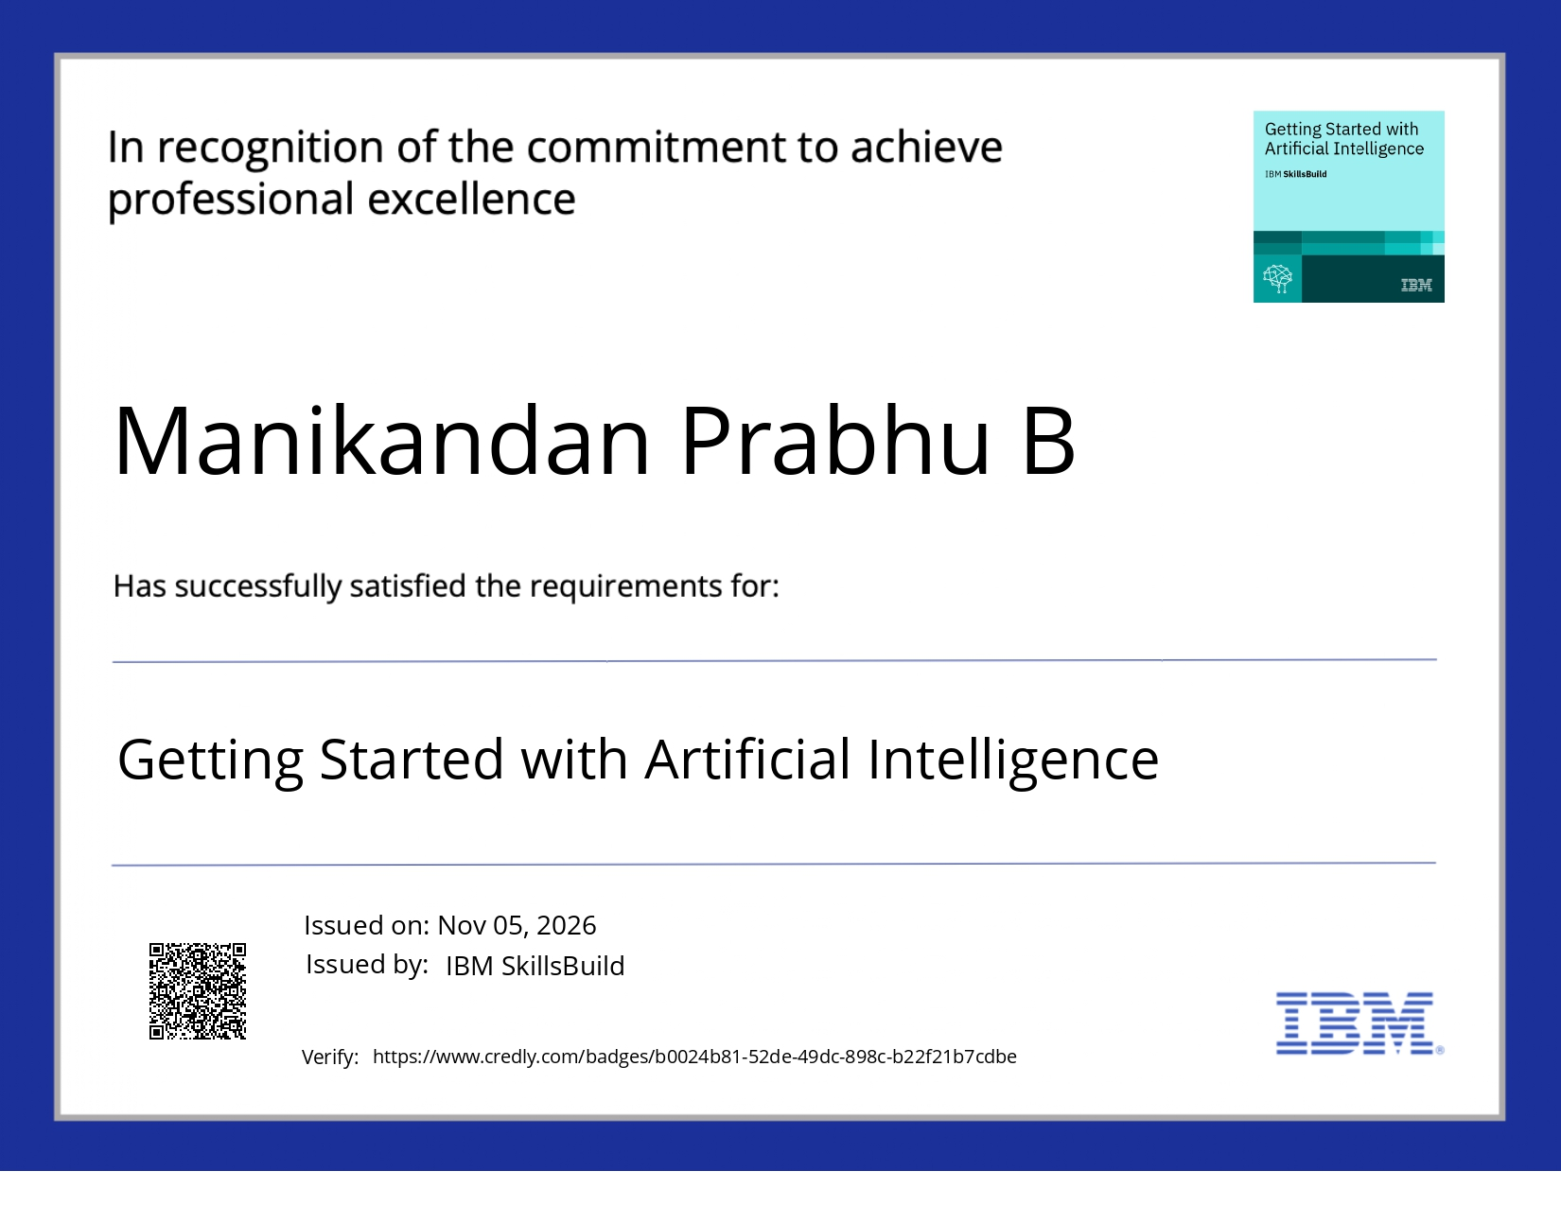
Certificates Earned:
Credly certificate

Slide 12
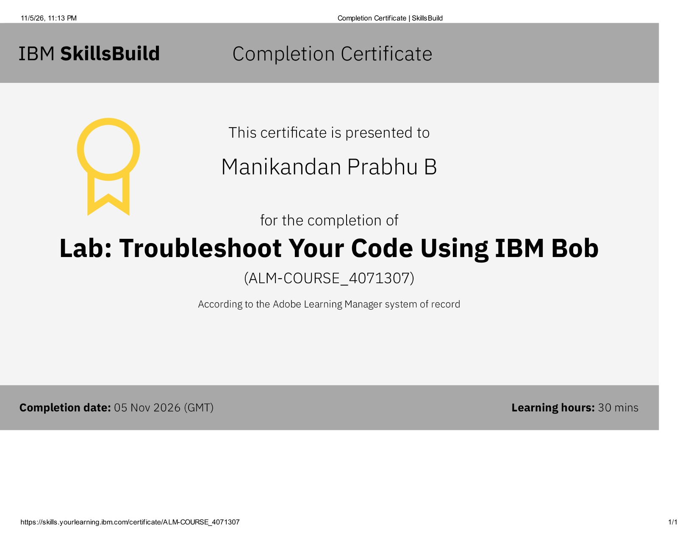
Certificates Earned:​
IBM BOB Certificate

Slide 13


