Slide 1

PRODUCT PRICE COMPARISON BOT
Presented By : Manikandan S

Slide 2
2
ABSTRACT
In today’s digital age, consumers often compare products across multiple e-commerce platforms to find the best deals, but doing so manually is time-consuming and inefficient. The Product Comparison Bot project leverages robotic process automation (RPA) to streamline this process by automatically gathering and comparing product information from various websites, such as Amazon and eBay. Built with UiPath, this bot takes a user-specified product name as input, navigates to each e-commerce site, performs a search, and scrapes relevant data—such as product name, price, and rating—into structured DataTables.
REC

Slide 3

3
PROBLEM STATEMENT
Comparing product prices across multiple e-commerce websites is time-consuming and repetitive. Manually searching each site, gathering prices, and evaluating options can lead to missed deals and errors. This project aims to develop a Product Comparison Bot using UiPath to automate these tasks. The bot will search for products, collect details like prices and ratings, and compile the information into a simple, organized format, helping users make quicker and more informed purchasing decisions.
REC

Slide 4
4
SOLUTION
The Product Comparison Bot automates the process of searching and comparing product information across multiple e-commerce websites using UiPath. The bot takes a product name as input, then performs the following steps:
Website Navigation and Search: For each target website (e.g., Amazon, eBay), the bot opens a browser, enters the product name into the search bar, and retrieves relevant results.
Data Extraction: Using UiPath’s data scraping tools, the bot gathers key product information, such as name, price, and rating, from the search results. This data is stored in a structured format (DataTable) for each website.
Data Aggregation: The bot consolidates the data from each site into a single DataTable, allowing for side-by-side comparison.
Output and Display: The collected data is displayed or saved in a user-friendly format, such as a table or Excel file, showing a direct comparison of prices and ratings across websites.
REC

Slide 5
5
IMPLEMENTATION
The implementation of the Product Comparison Bot begins with creating a main workflow in UiPath, which controls the entire process. This main workflow accepts a product name as input, which the bot will use to search across multiple e-commerce sites. For each website (such as Amazon or eBay), a separate workflow file is created. Each of these files automates navigation to the site, entering the product name into the search bar, and scraping the search results.
Using UiPath’s Data Scraping wizard, the bot extracts product details—like names, prices, and ratings—and stores this data in a structured DataTable format. Once each website's data is collected, the main workflow consolidates these tables into a single dataset, allowing easy comparison. Finally, the compiled results are displayed or exported, providing users with a clear, organized comparison of products across sites. This approach automates repetitive tasks, offering a faster and more efficient way for users to compare online deals.
REC

Slide 6
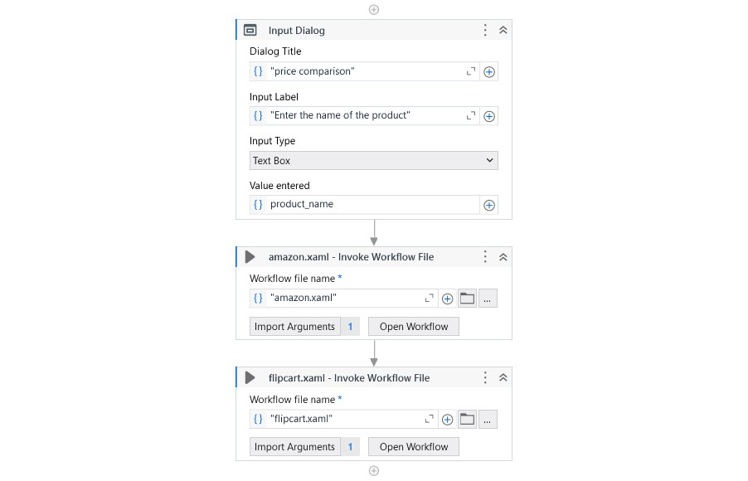
6
Main Workflow
REC

Slide 7
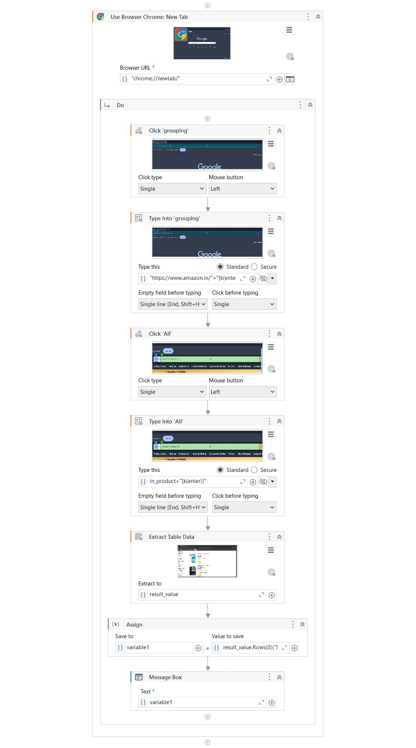
Amazon workflow
7
REC

Slide 8
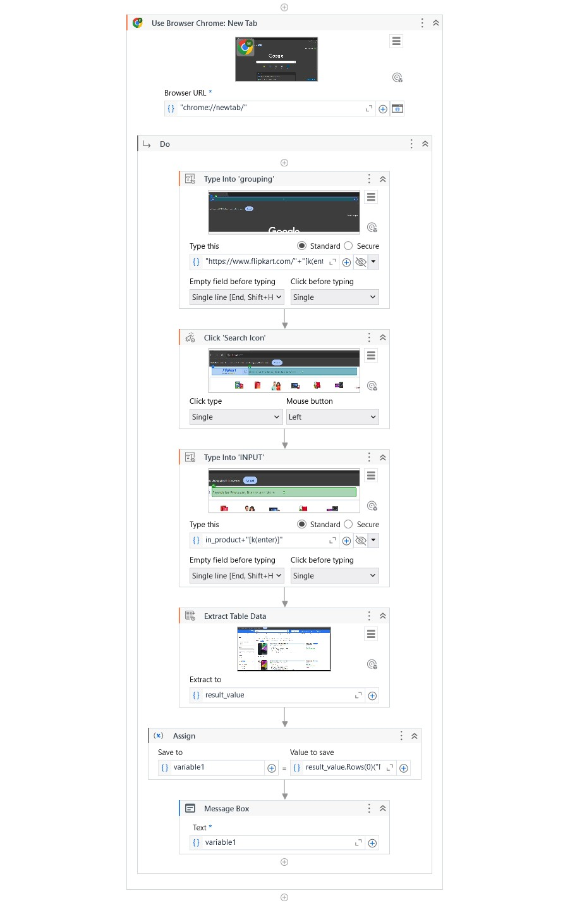
Flipkart workflow
8
REC

Slide 9
FUTURE SCOPE
9
The Product Comparison Bot can be expanded in several impactful ways to increase its functionality and user experience:
Incorporate More E-Commerce Platforms: Adding additional websites beyond Amazon and eBay will broaden the comparison options, giving users access to a wider range of products and prices.
Advanced Filtering and Sorting Options: By allowing users to set filters (such as price range, brand, or rating) and sort preferences, the bot can deliver more personalized and relevant search results.
Automated Alerts and Notifications: Integrating an alert system to notify users of price drops or promotions on specific products can enhance the bot’s usefulness and save users money.
Scheduled Data Collection for Price Tracking: Enabling the bot to perform daily or weekly data collection would allow users to track price trends over time, providing valuable insights into the best times to buy.
REC

Slide 10
10
CONCLUSION
The Product Comparison Bot effectively addresses the challenge of manually comparing products across multiple e-commerce platforms by automating data collection and comparison. Using UiPath, the bot streamlines the process, saving time and reducing the chance of human error. With its ability to retrieve and organize key product information like prices and ratings, this solution empowers users to make faster, more informed purchasing decisions. The project demonstrates the benefits of robotic process automation in simplifying repetitive tasks and can be expanded to include additional websites or features, making it a valuable tool for consumers seeking the best deals online.
REC

Slide 11
THANK YOU
Presented By : Manikandan S

