Slide 1
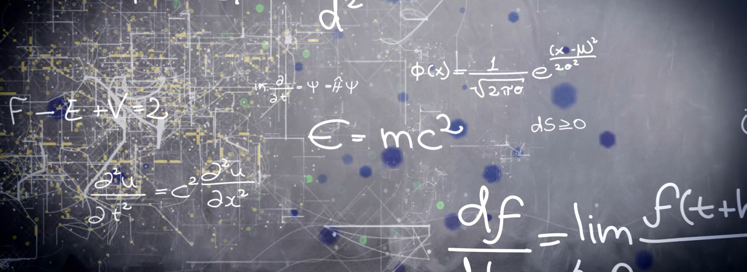
Machine Learning - Clustering

Slide 2
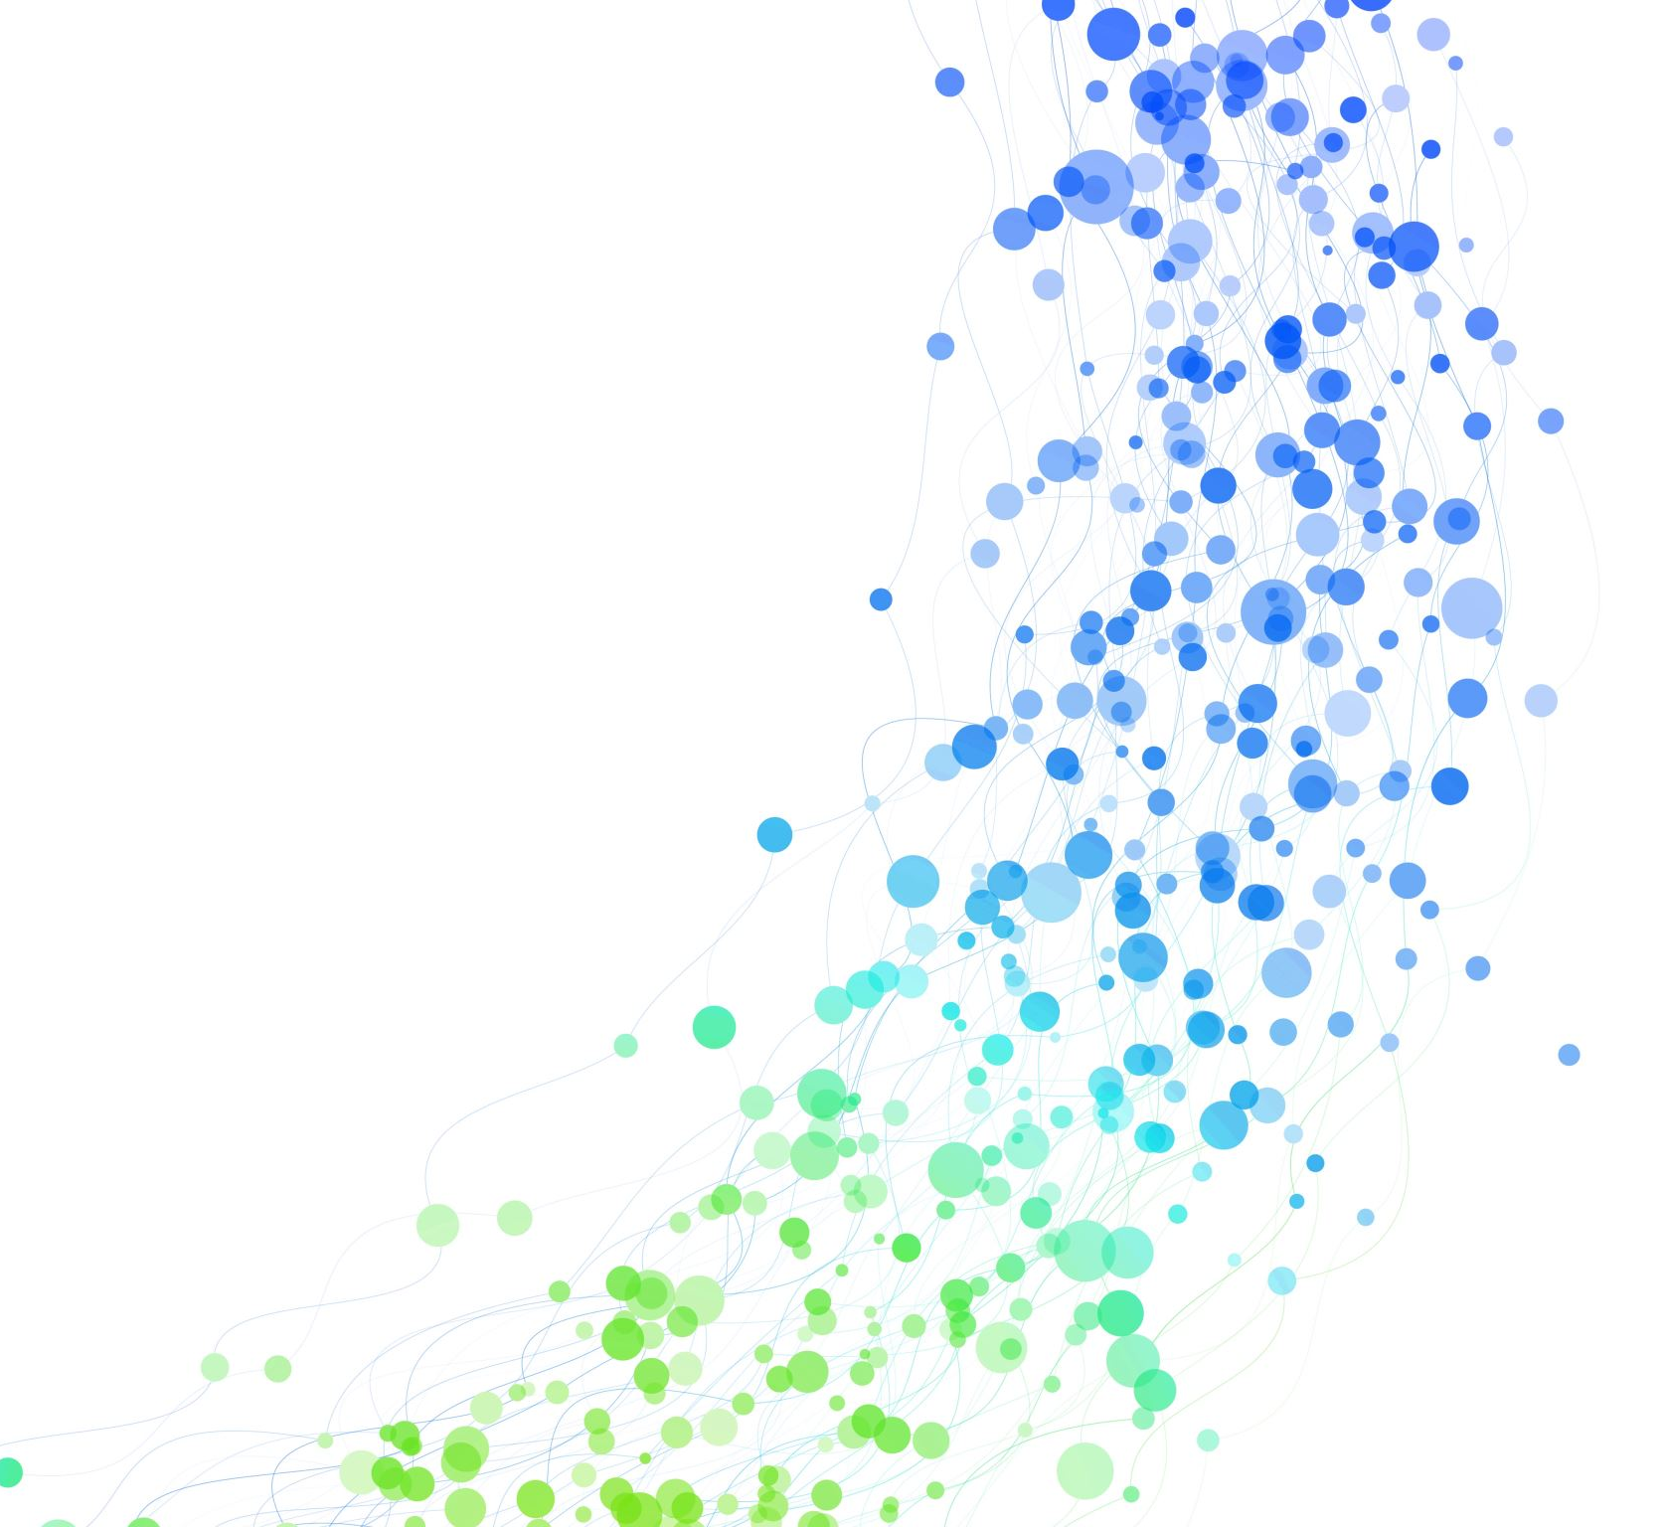
Affinity Propagation
Affinity Propagation is an unsupervised machine learning clustering algorithm that groups similar data points by exchanging responsibility and availability messages between data points. It automatically identifies representative data points called exemplars and does not require the number of clusters to be specified in advance.
MACHINE LEARNING | CLUSTERING ALGORITHMS
02

Slide 3
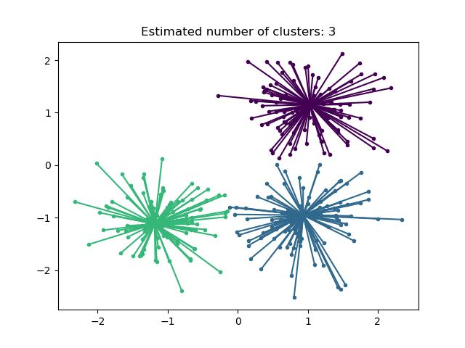
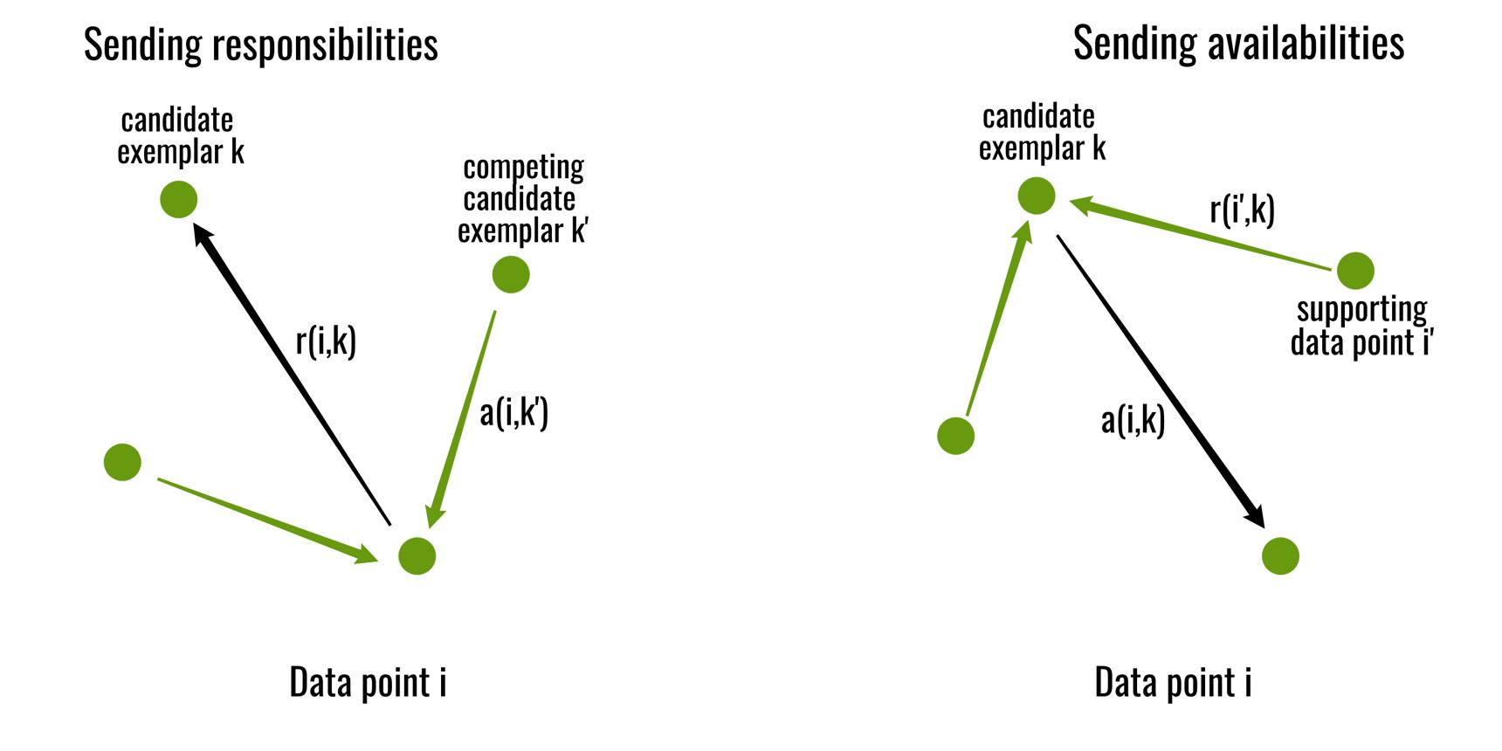
Affinity Propagation – Venn Diagram
MACHINE LEARNING | CLUSTERING ALGORITHMS
03

Slide 4
Steps to work in Affinity Propagation
Calculate similarity between data points.
Initialize responsibility and availability messages.
Exchange responsibility messages.
Exchange availability messages.
Identify exemplars.
Assign data points to exemplars
Form final clusters.
MACHINE LEARNING | CLUSTERING ALGORITHMS
09

Slide 5
Advantages
Number of clusters need not be specified beforehand.
Automatically identifies representative data points (exemplars).
Can work directly with similarity information.
Can identify useful cluster structures
Makes clusters easier to interpret using exemplars
Useful for moderate-sized datasets.
MACHINE LEARNING | CLUSTERING ALGORITHMS
09

Slide 6
Disadvantages
Computationally expensive for large datasets.
Can require high memory because of pairwise similarities.
Sensitive to the preference parameter.
Sensitive to the damping parameter.
May require many iterations to converge.
Results depend on the quality of the similarity measure.
Not suitable for very large datasets.
MACHINE LEARNING | CLUSTERING ALGORITHMS
09

Slide 7
Mean Shift
Mean Shift is an unsupervised machine learning clustering algorithm that identifies dense regions in a dataset by repeatedly shifting a window toward the mean of nearby data points. The process continues until a density peak or mode is reached, and points converging to the same mode are grouped into the same cluster.
MACHINE LEARNING | CLUSTERING ALGORITHMS
07

Slide 8
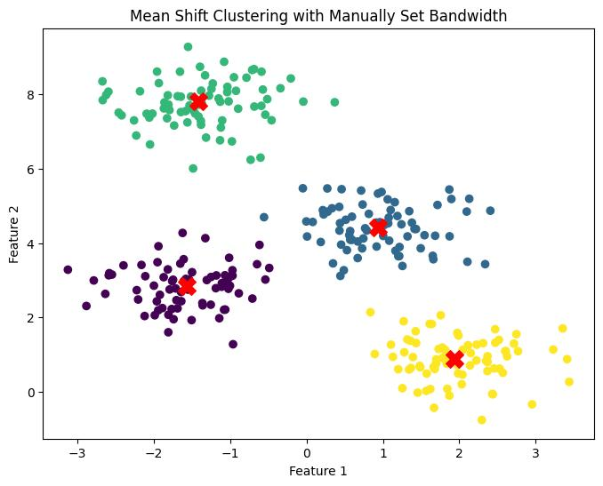
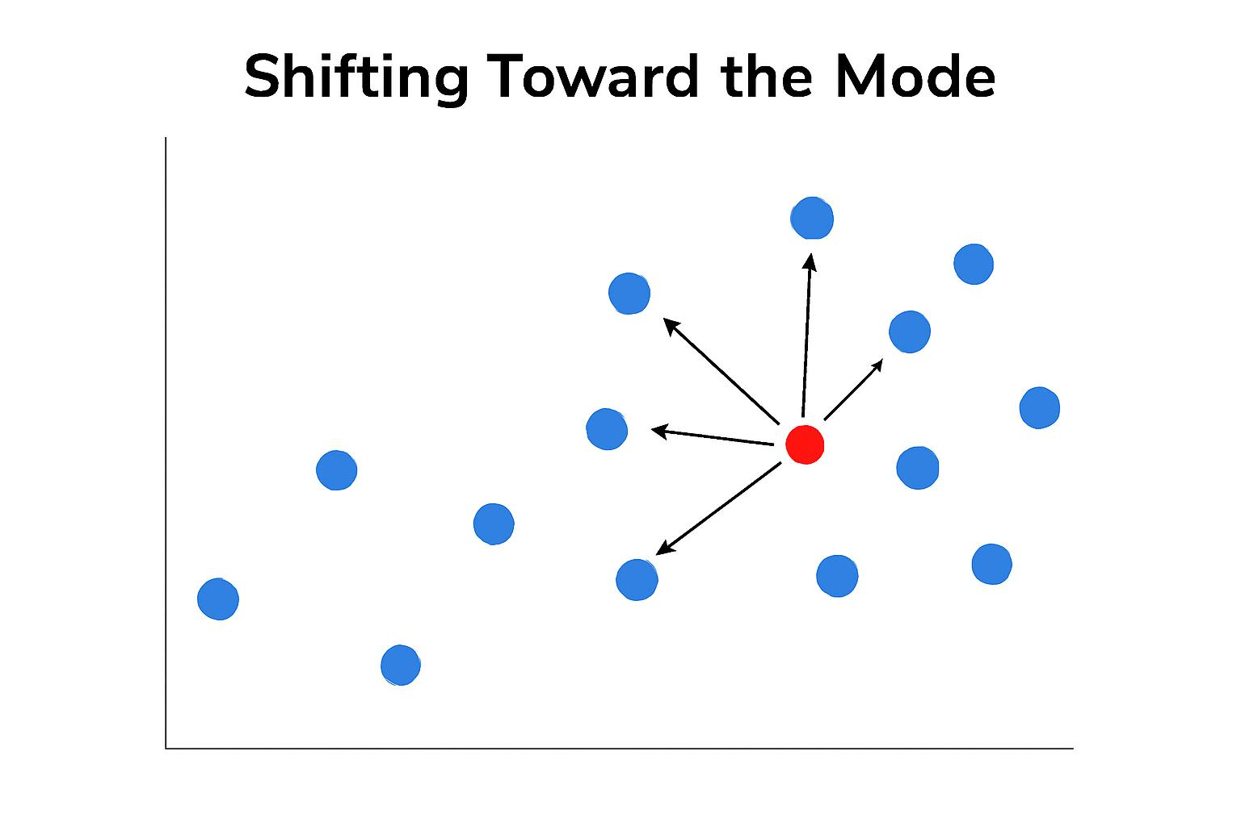
MeanShift – Venn Diagram
MACHINE LEARNING | CLUSTERING ALGORITHMS
08

Slide 9
Steps to work in MeanShift
Data Points
Select a point
Create a window around the point
Calculate the mean of points inside the window
Move the window toward the mean
Repeat the process
Reach a density peak (mode)
Group points reaching the same peak
Final clusters
MACHINE LEARNING | CLUSTERING ALGORITHMS
09

Slide 10
Advantages
Number of clusters need not be specified beforehand.
Finds clusters based on data density.
Can identify irregularly shaped clusters.
Automatically determines cluster centers.
Useful for exploratory data analysis.
Can identify isolated/outlying observations.
Simple density-based concept.
MACHINE LEARNING | CLUSTERING ALGORITHMS
10

Slide 11
Disadvantages
Computationally expensive.
Sensitive to bandwidth selection.
Not ideal for very large datasets.
Can be slow to converge.
Performance can decrease with high-dimensional data.
Depends on the density structure of the dataset.
Choosing a suitable bandwidth can be difficult.
MACHINE LEARNING | CLUSTERING ALGORITHMS
11

Slide 12
Spectral Clustering
Spectral Clustering is an unsupervised machine learning clustering algorithm that groups data points based on their similarity and connectivity. It constructs a similarity graph, uses eigenvectors of a graph-based matrix to transform the data, and then assigns the transformed data points to clusters.
MACHINE LEARNING | CLUSTERING ALGORITHMS
12

Slide 13
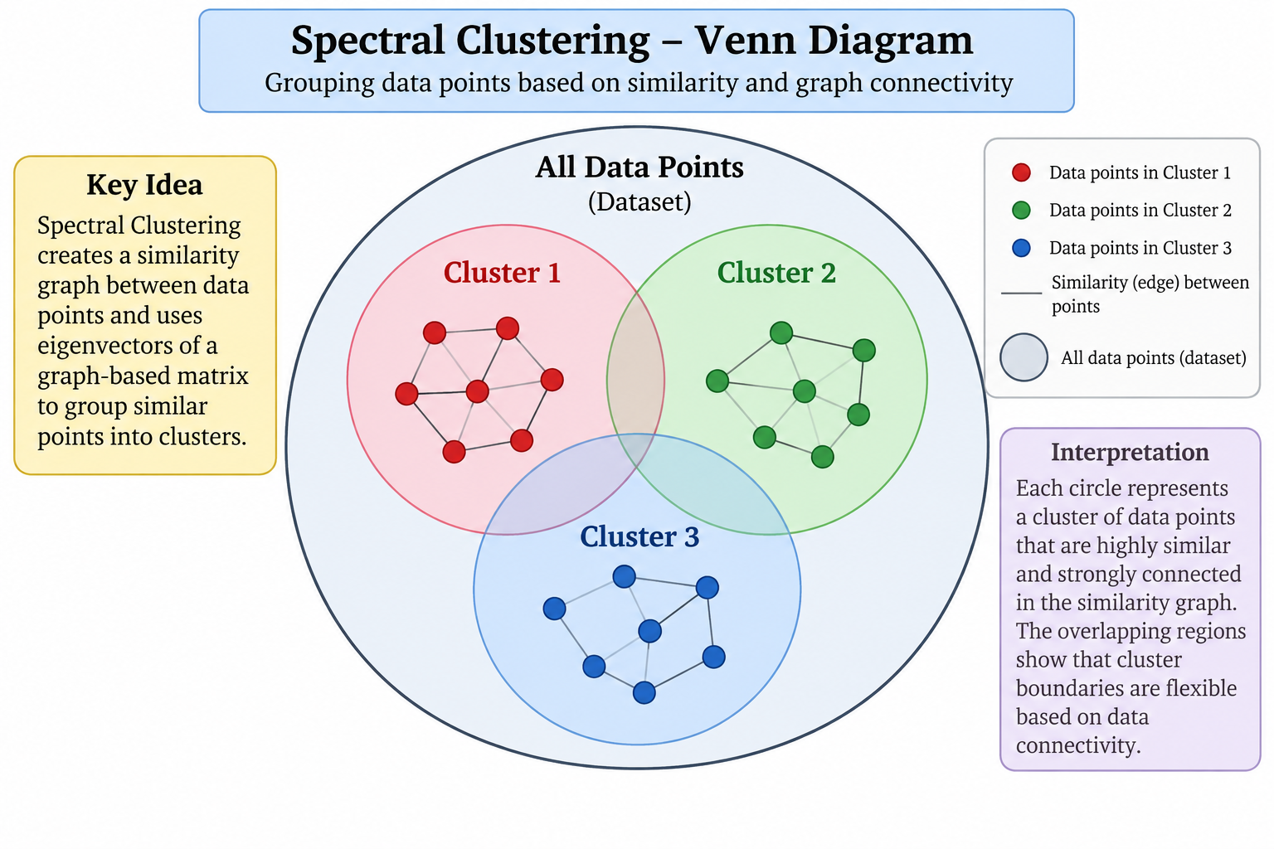
Spectral Clustering - Diagram
MACHINE LEARNING | CLUSTERING ALGORITHMS
13

Slide 14
Steps to work in Spectral cluster
Input Data
Calculate Similarity
Create Similarity Graph
Create Graph Laplacian
Calculate Eigenvectors
Transform data using eigenvectors
Form Clusters
Final Clusters
MACHINE LEARNING | CLUSTERING ALGORITHMS
14

Slide 15
Advantages
Can identify complex cluster structures.
Uses relationships between data points.
Useful for graph-based data.
Supports different similarity/affinity methods.
Can capture non-linear relationships.
Useful for image segmentation.
Can reveal connectivity patterns.
MACHINE LEARNING | CLUSTERING ALGORITHMS
15

Slide 16
Disadvantages
Number of clusters generally needs to be specified.
Computationally expensive for large datasets.
Can require high memory.
Sensitive to the selected affinity method.
Sensitive to parameters such as gamma and in neighbors.
Feature scaling can be important.
Not ideal for very large datasets.
MACHINE LEARNING | CLUSTERING ALGORITHMS
16

Slide 17
DBSCAN Clustering
DBSCAN (Density-Based Spatial Clustering of Applications with Noise) is an unsupervised, density-based clustering algorithm that groups data points based on their density using eps and min_samples. It can discover clusters of arbitrary shape and identify noise or outlier points without requiring the number of clusters to be specified in advance.
MACHINE LEARNING | CLUSTERING ALGORITHMS
17

Slide 18
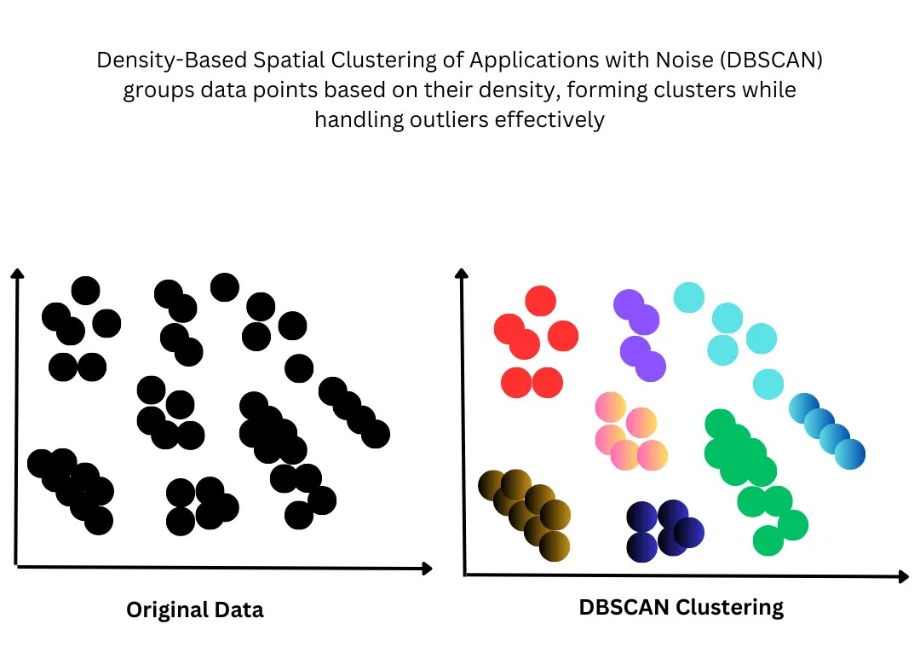
DBSCAN Clustering- diagram
MACHINE LEARNING | CLUSTERING ALGORITHMS
18

Slide 19
Steps to work in DBSCAN cluster
Select an unvisited data point
Define the eps radius
Check min_samples
Expand the cluster
Identify Border Points
Identify Noise
MACHINE LEARNING | CLUSTERING ALGORITHMS
19

Slide 20
Advantages
No need to specify number of clusters
Can detect outliers
Can find irregular-shaped clusters
No need for cluster centroids
Useful for noisy datasets
MACHINE LEARNING | CLUSTERING ALGORITHMS
20

Slide 21
Disadvantages
Sensitive to eps
Sensitive to min_samples
Struggles with varying-density clusters
Distance calculation can become difficult in high dimensions
Requires parameter tuning
MACHINE LEARNING | CLUSTERING ALGORITHMS
21

Slide 22
OPTICS Clustering
OPTICS (Ordering Points To Identify the Clustering Structure) is an unsupervised density-based clustering algorithm that identifies clusters of varying densities by ordering data points according to their density connectivity and reachability distance. It can also identify noise or outlier points
MACHINE LEARNING | CLUSTERING ALGORITHMS
22

Slide 23
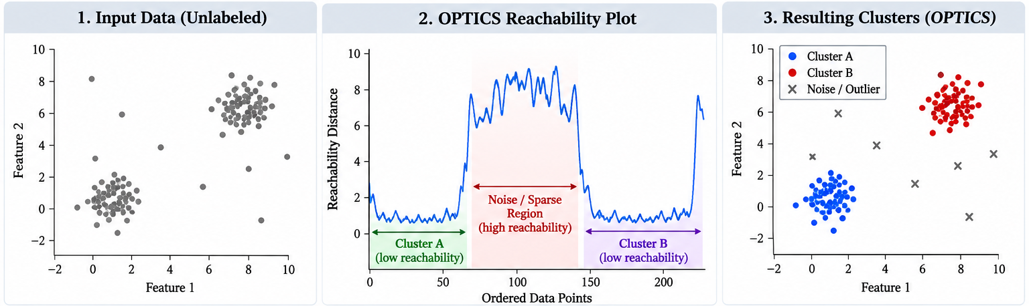
Optics Clustering- diagram
MACHINE LEARNING | CLUSTERING ALGORITHMS
23

Slide 24
Steps to work in Optics cluster
Input Data
Calculate distances
Find core distances
Calculate reachability distances
Create ordered points
Build Reachability Plot
Identify dense regions
Clusters + Noise
MACHINE LEARNING | CLUSTERING ALGORITHMS
24

Slide 25
Advantages
Detects clusters with different densities
Can identify noise
Does not require the number of clusters beforehand
Works with irregularly shaped clusters
Provides a reachability structure
Useful for exploratory analysis
MACHINE LEARNING | CLUSTERING ALGORITHMS
25

Slide 26
Disadvantages
More computationally complex
Parameter selection is important
Sensitive to feature scaling
Performance can decrease with high-dimensional data
Results can be difficult to interpret initially
Cluster extraction requires attention
MACHINE LEARNING | CLUSTERING ALGORITHMS
26

Slide 27
BIRCH Clustering
BIRCH (Balanced Iterative Reducing and Clustering using Hierarchies) is an unsupervised hierarchical clustering algorithm that efficiently clusters large datasets by incrementally constructing a Clustering Feature (CF) tree and using compact summaries of data points
MACHINE LEARNING | CLUSTERING ALGORITHMS
27

Slide 28
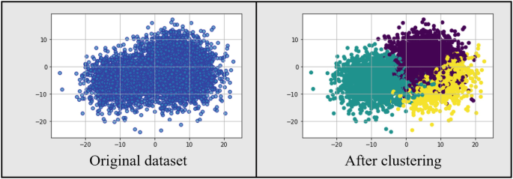
Birch Clustering- diagram
MACHINE LEARNING | CLUSTERING ALGORITHMS
28

Slide 29
Steps to work in Optics cluster
Dataset & Preprocessing
Incremental Data Processing
Clustering Features (CF)
CF Tree Construction
Sub-cluster Formation
CF Tree Compression
Global Clustering
Final Cluster Labels
MACHINE LEARNING | CLUSTERING ALGORITHMS
29

Slide 30
Advantages
Handles large datasets
Memory efficient
Incremental processing
Fast clustering
Compact representation
Suitable for large datasets
Hierarchical structure
Does not require storing every detail during tree construction
MACHINE LEARNING | CLUSTERING ALGORITHMS
30

Slide 31
Disadvantages
Sensitive to threshold
Sensitive to feature scaling
Works best with numerical data
CF tree depends on parameter settings
Can be affected by outliers
High-dimensional data can be challenging
Interpretation of clusters may require additional analysis
MACHINE LEARNING | CLUSTERING ALGORITHMS
31

