Slide 1

GLOBAL ECONOMIC AND DEMOGRAPHIC ANALYSIS
MANIKANDAN AYYASAMY
DA / DS – NOVEMBER 2024
MILESTONE 2
24/03/2025

Slide 2

CONTENTS OF THE DATASET
SQL:
Excel:
Country & Country code
Region
Population & Population Density
GDP Per Capita
Birth rate
Death rate
Infant Mortality
Literacy
Agriculture and Arable Percent
Area
Climate
Coastline Ratio
Industry
Net Migration
Service
Country & Country code
Years
GDP ( Gross Domestic Product)
Indicator code
Indicator name
Population
Region
Income Group
Special notes
Additionally Added column:
Total GDP

Slide 3



DATA CLEANSING AND IMPORT
Excel:
Power BI:
VLOOKUP
Duplicate removal
Data Import
Power Query:
SQL:
Manage blank cells and null values
Renamed and Unpivoted Columns
Remove duplicates
Regularize Datatype
Check for irregularities.
Query Execution

Slide 4

01
OBJECTIVE
To explain GDP and its role in measuring a country’s economic performance
To analyze its relationship with population, income, literacy, and infant mortality
To highlight key economic indicators and their impact on development
To identify region wise countries doing well in the growth of GDP
To provide data-driven insights for better policy decisions.

Slide 5





Key Point Indicators
Country with Highest GDP – USA
Country with Lowest GDP - Tuvalu
Most Populated Country - China, India
Least Populated Country - Tuvalu
Total Population – 6732.07M
Average GDP – $44,73,77,599K
Total Countries - 173
Total Regions - 11

Slide 6


DAX
Dax’s Used:
Mean, Median, Mode and Standard Deviation of Population
Countries with Highest and Lowest GDP
Average GDP
Average GDP Per Capita
Minimum, Maximum and Standard deviation of Infant Mortality
Average Literacy by both Country and Region
GDP Growth Rate
Total Population by Country
Total GDP and Population by Region
Additional Dax’s Used:
Number of Countries
Overall Literacy rate
Number of Regions
Average Population and GDP of region

Slide 7
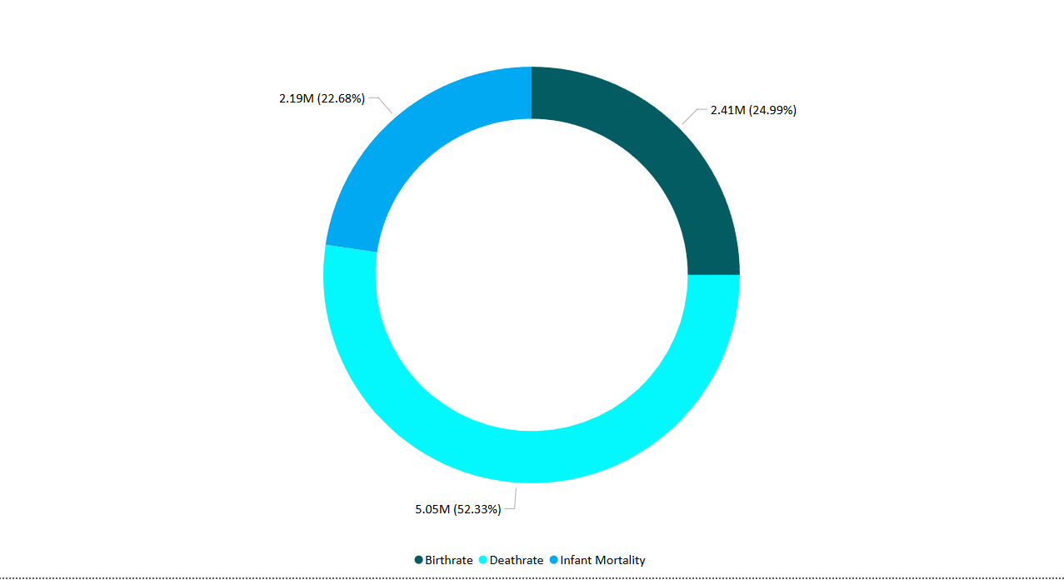
02
THE CYCLE OF LIFE
Country with highest Deathrate = Serbia
Country with Lowest Deathrate = Estonia
Country with highest Birth rate = Sweden
Country with lowest Birth rate = China
Country with highest Infant Mortality = Saudi Arabia
Country with lowest infant Mortality = Singapore
Western Europe does well in all the three fields compared to other regions
Latin America has the highest death rate and Baltics has the lowest
Africa has the lowest birth rate.

Slide 8
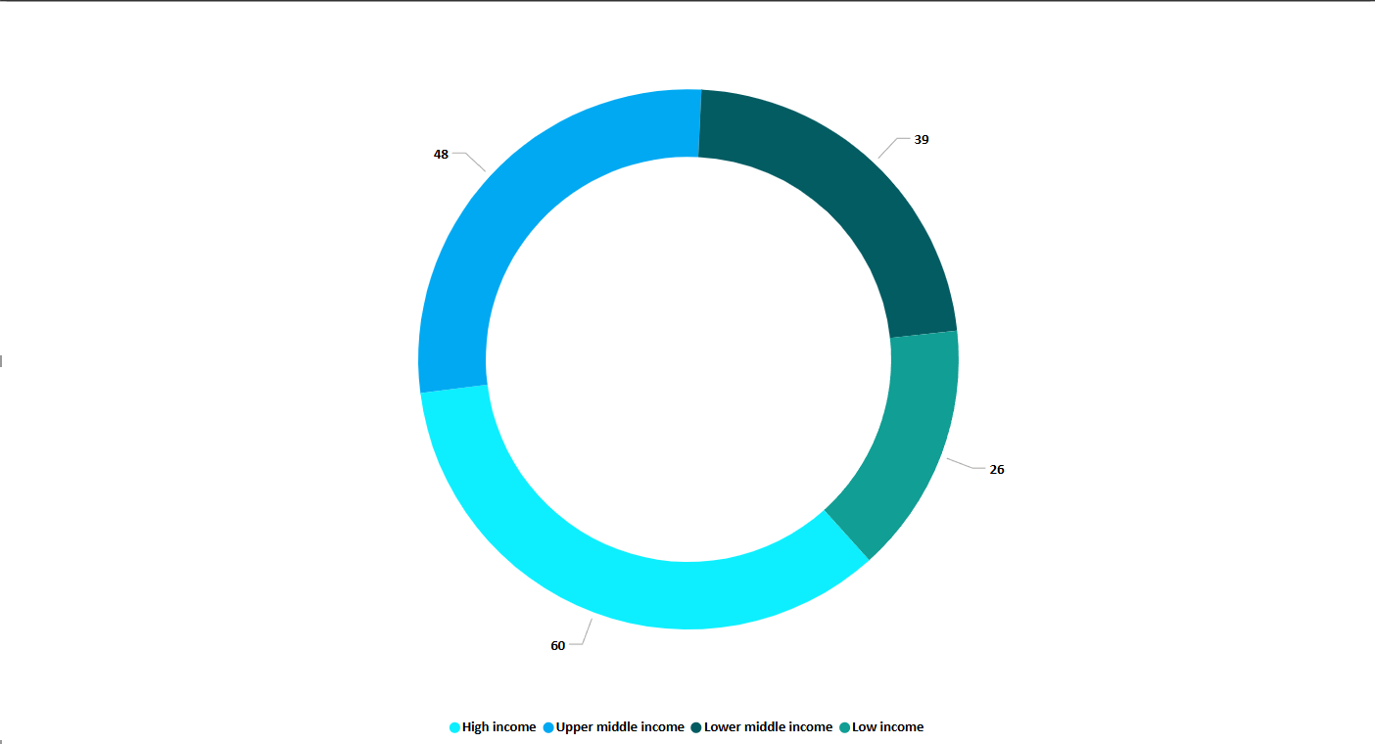
03
Income
Baltics is the only region with all High income countries
Western Europe has almost 50% of the High income countries
Sub Saharan Africa has more low income countries
Eastern Asia, Latin America, Sub Saharan Africa are the only three regions with countries from all the categories.

Slide 9
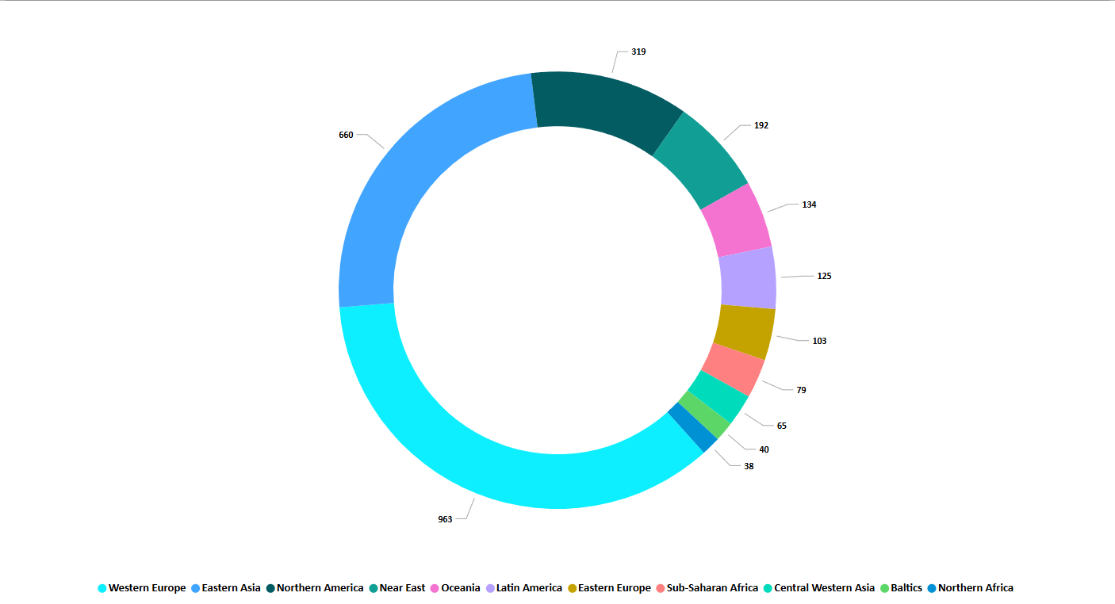
04
REGION & POPULATION DENSITY
Region with highest Population density = Western Europe, Eastern Asia
Northern Africa has the lowest Population Density
Eastern Asia is the most populated region
Baltics is the least populated region out of the 11.
Northern America has the highest GDP
Eastern Asia stands third but stands 1st in terms of population
Baltics is the region with lowest GDP in regards to the number of countries.

Slide 10




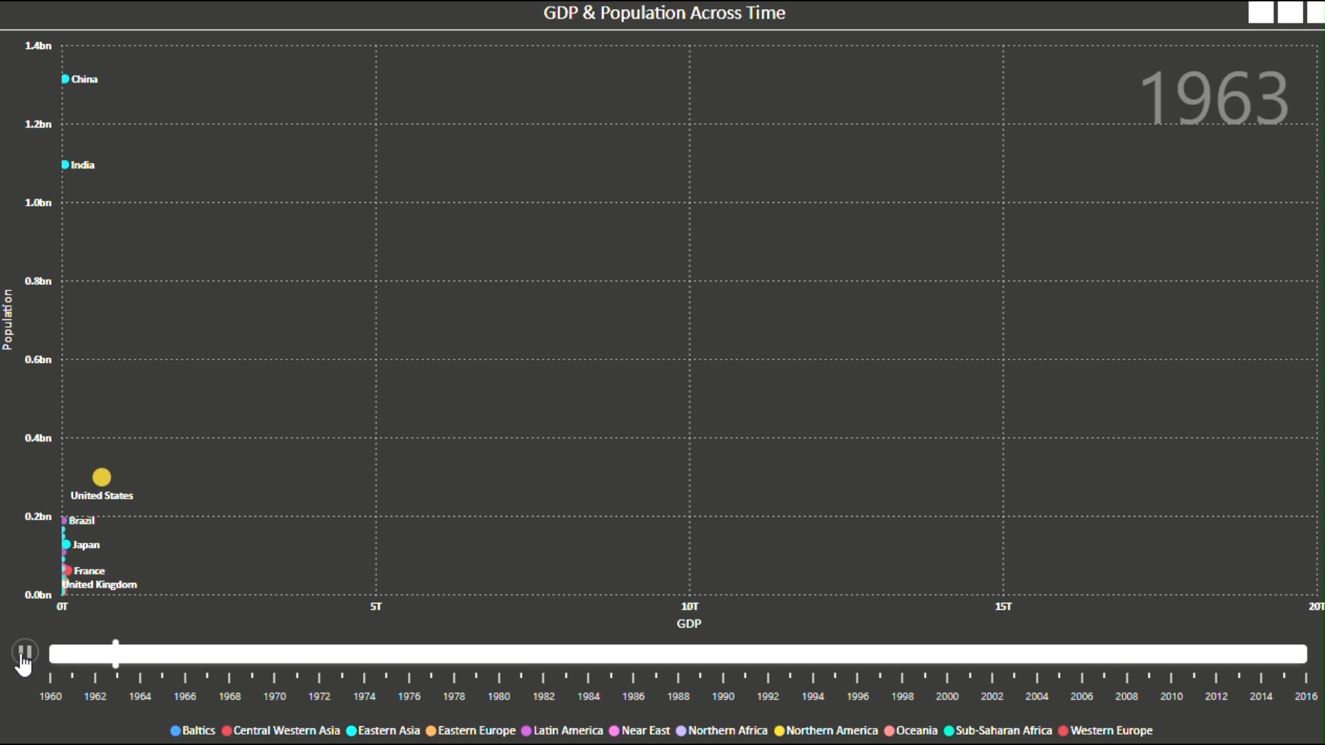
PREGRESION TIMELINE
05
GDP is often used to measure economic growth, standard of living, and overall economic health.
Between 2008 and 2010, China bypassed Japan to become the second largest country in terms of GDP
All the 3 countries from Baltics region has more than Average GDP and Average Population
Sub-Saharan Africa has the greatest number of countries with lowest GDP and Population.
1960 – 1980
1981 - 1999
2000 - 2016
USA, Japan and Germany were the countries with Highest GDP
China and India are the only two countries which started with highest population
More than half of the countries has achieved less than enough GDP and population.
Same roaster of Countries lead the list in highest GDP
Japan had a huge backslash between 1990 – early 2000 but was still among the top tier
UK, France, Canada and Italy rose steadily in terms of GDP.
USA Stands top with the highest GDP followed by China which dominates in Population
India stands 2nd in the list of most populous countries, 7th in the countries with highest GDP
Brazil shows consistence in both population & GDP.

Slide 11

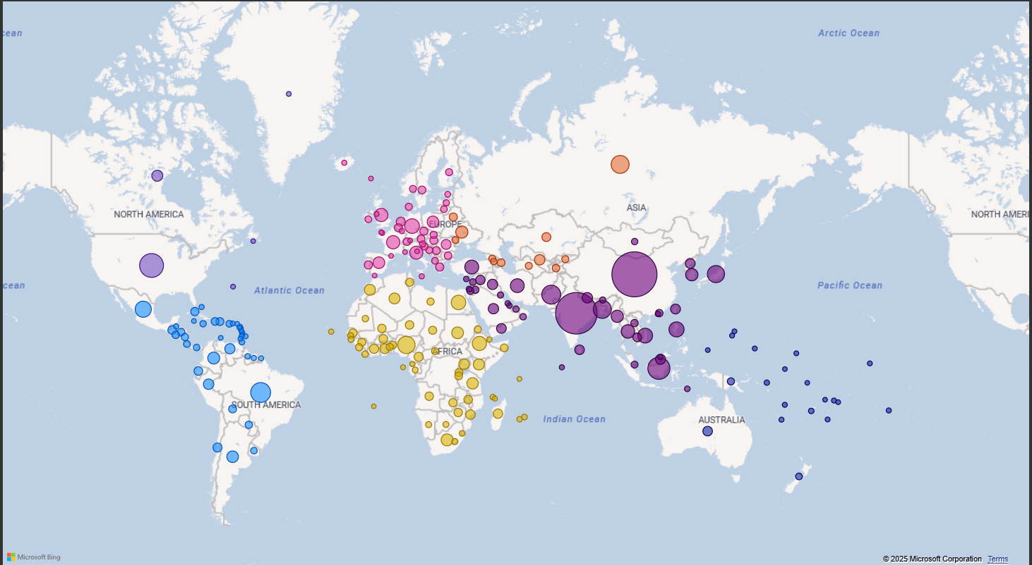
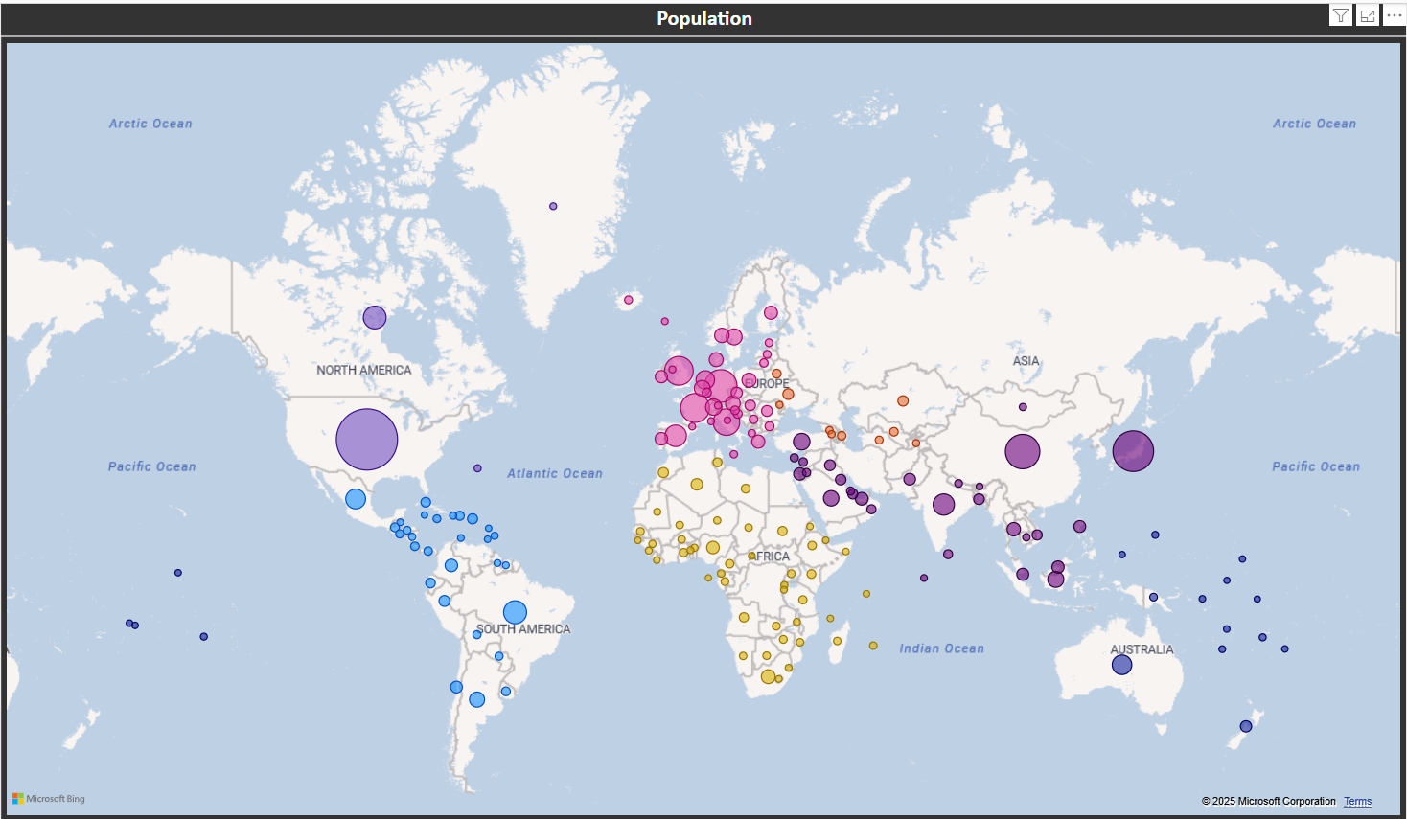
06
GLOBAL COMPARISON
POPULATION
GDP

Slide 12
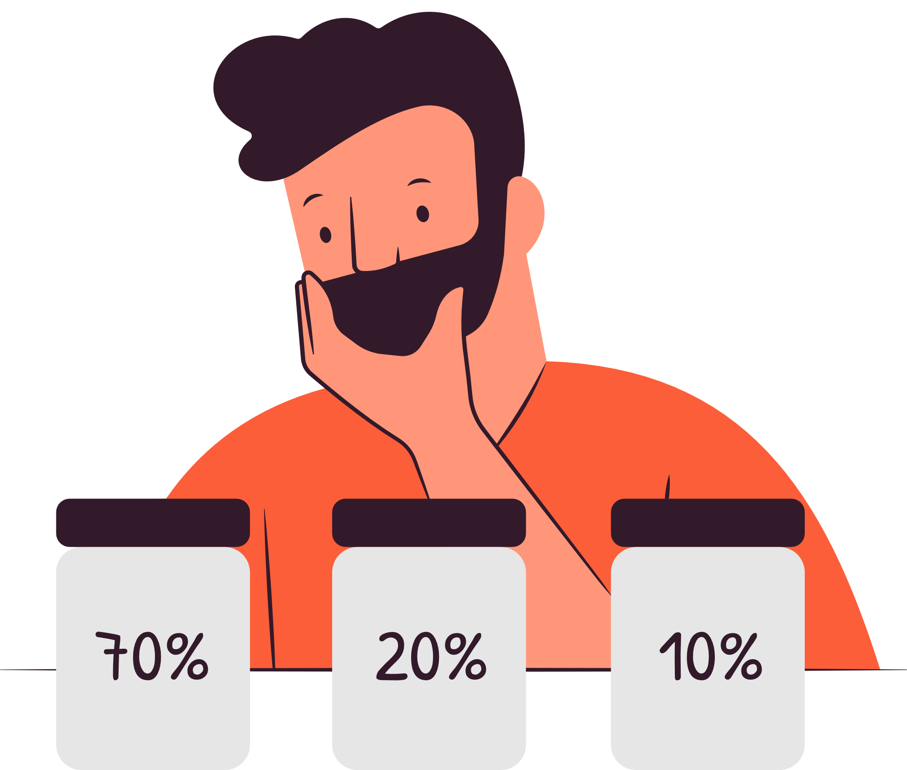
07
LITERACY & NET MIGRATION
Literacy:
7 Countries Australia, Andorra, Lichtenstein, Luxembourg, Finland, Denmark and Norway has 100 % Literacy rate
Niger has the lowest Literacy rate
Baltics has the highest Average Literacy rate whereas Sub Saharan Africa has the lowest Average Literacy rate
Africa is placed in the bottom of the list in having average Literacy rate.
Net Migration:
Baltics, Latin America and North Africa are the regions with Negative Net Migration rate
Western Europe and North America stands top of the list with huge difference
Belgium, Italy, Switzerland, UK, UAE, Malta and Andorra are the countries with highest Net Migration
American Samoa has the least net migration
82.43%
19%
-20.71%

Slide 13


PRICE LIST
Product/Service Category 1:
Product/Service Name 1: $XX.XX
Product/Service Name 2: $XX.XX
Product/Service Name 3: $XX.XX
Product/Service Name 4: $XX.XX
Product/Service Category 2:
Product/Service Name 1: $XX.XX
Product/Service Name 2: $XX.XX
Product/Service Name 3: $XX.XX
Product/Service Name 4: $XX.XX

Slide 14


08
GDP & POPULATION
USA has the highest GDP from the year 1960 to 2016 with few setbacks
China has taken over the second place after the year 2010
Tuvalu has the least GDP
Northern American region dominates all the other regions in terms of GDP followed by Eastern Asia which dominates all the regions in the aspect of Population
Baltics region with lowest GDP and lowest Population
Top 10 countries with highest GDP include UK, UAE and France even though their population is lower than top 10% populous countries
Luxembourg has the highest GDP per capita and Sierra Leone has the lowest
Monaco is the country with most population density whereas Greenland has the lowest population density.

Slide 15

09
Sectors
Agriculture:
Top Arable-Agriculture Pairs: Gabon & Algeria
Low Arable-Agriculture Pairs: Tuvalu & Gibraltar.
2. Industry & Service:
Top Industry-Service Pairs : Equatorial Guinea, Qatar
Low Industry-Service Pairs: Cayman Islands & Comoros.​
Area:
Country with Vast area – Canada & USA
Country with smallest area – Monaco & Gibraltar.
Coastline:
37 countries in total does not have a coastline ratio including Mali and Burkin Faso.
5. Phones:
Countries with less phones in average for 1000 members mostly face network connectivity problems leading to minimized usage of the said appliance, example Burkin Faso, Sierra Leone.

Slide 16
FINAL INSIGHTS AND RECOMMENDATION
10
1. GDP and Population
Insight: A larger population does not guarantee higher GDP per capita.
Recommendation: Invest in infrastructure, education, and job creation to improve productivity and economic output.
2. Literacy and Economic Growth
Insight: Countries with higher literacy rates generally have better GDP per capita, as a skilled workforce drives economic growth.
Recommendation: Prioritize education reforms, vocational training, and digital literacy to enhance human capital.
3. Infant Mortality and Economic Conditions
Insight: Higher GDP per capita is linked to lower infant mortality rates, indicating better healthcare and living conditions.
Recommendation: Increase investment in healthcare facilities, maternal care programs, and child nutrition to reduce infant mortality.
4. Coastline Ratio and Economic Influence
Insight: Countries with significant coastlines tend to have better trade opportunities and tourism-driven economies.
Recommendation: Develop ports, maritime trade policies, and tourism infrastructure to maximize coastal economic benefits.
5. Sector Contributions to GDP
Insight: Countries with high service sector contributions tend to have higher GDP, while lower-GDP nations rely more on agriculture.
Recommendation: Diversify the economy by modernizing agriculture, boosting industrialization, and expanding digital services to sustain growth.

Slide 17


Any Question?
THANK YOU!
INDIAN STATES WITH HIGHEST GDP
Maharashtra
Tamil Nadu
Karnataka
Gujarat

