Slide 1

PREDICTING THE RATING OF RESTAURANTS
MIS637 Final Project
Submitted by : Manikandan Vinodh Kumar [10450856]
Instructor : Dr. Mahmoud Daneshmand

Slide 2
Introduction
The food culture in India is always fascinating where there are restaurants at every corner of the city area. The number of restaurants is increasing day by day. Our problem concerns about the Bangalore restaurants. There are approximately 12,000 restaurants currently and the competition is intense with such a high number of restaurants. The new restaurants are opening every day. In this problem, we will try to identify the perfect combination for opening a new restaurant by predicting the rating with the dataset

Slide 3
CRISP-DM – INDUSTRY STANDARD PROCESS
We will leverage the CRISP-DM to understand the problem and to solve it.
CRISP-DM(Cross Industry Standard Process for Data Mining) has 6 phases.
1.Business Understanding
What is the research question that we are trying to solve?
2.Data Understanding
We have to understand about the data and get initial insights.
Obtain the data from source and speak with subject matter experts
Familiarize with the data.
3.Data Preparation
Execute Transformations on data.
Cleaning missing values, renaming column, analyzing outliers from dataset
Make the data ready for analysis.

Slide 4
CRISP-DM – INDUSTRY STANDARD PROCESS
4. Modeling
Choose the number of appropriate machine learning model.
Optimizing the model.
Fix the best model for the project
5.Evaluation
Evaluate the model in various real world setting .
Analyze the model performance in various circumstances.
Whether our model have met objective, the research question?
6. Deployment
We can then leverage the model for deployment with production data
Execute and generate reports on data to verify the success.
Provision of model with deployment instructions to the business

Slide 5
Business Understanding
It may also be called as research question phase. In this project, it follows the below objectives.
We have to mention the project objective in terms of the business or research question.
What is the best place to open the particular type of restaurant?

Slide 6
Data Understanding
Data source
This is a Zomato dataset which has been originally scrapped from the web, but it is available from the Kaggle source. This dataset consists of 50,000 observations and 17 fields.
We will use the rating column as a dependent variable and all other columns are independent variables.
It mostly contains categorial variables, but the dependent variable is a numerical variable. There are also missing values in the columns and it has to be taken care by relevant methodologies

Slide 7
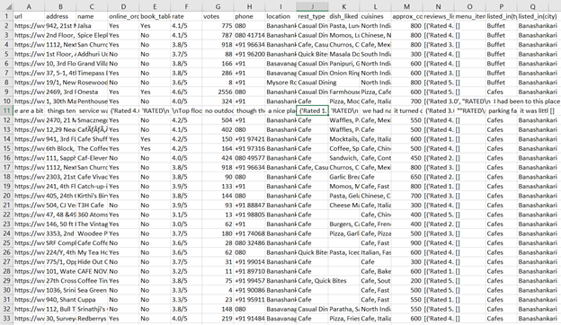
Data understanding
Sample Data

Slide 8
Data Understanding
COLUMNS DESCRIPTION:
url contains the url of the restaurant in the zomato website
address contains the address of the restaurant in Bengaluru
name contains the name of the restaurant
online_order whether online ordering is available in the restaurant or not
book_table table book option available or not
rate contains the overall rating of the restaurant out of 5
votes contains total number of rating for the restaurant as of the above mentioned date
phone contains the phone number of the restaurant

Slide 9
Data Understanding
COLUMNS DESCRIPTION
Location contains the neighborhood in which the restaurant is located
rest_type restaurant type
dish_liked dishes people liked in the restaurant
cuisines food styles, separated by comma
approx_cost(for two people) contains the approximate cost for meal for two people
reviews_list list of tuples containing reviews for the restaurant, each tuple consists of two values, rating and review by the customer
menu_item contains list of menus available in the restaurant
listed_in(type) type of meal
listed_in(city) contains the neighborhood in which the restaurant is listed

Slide 10
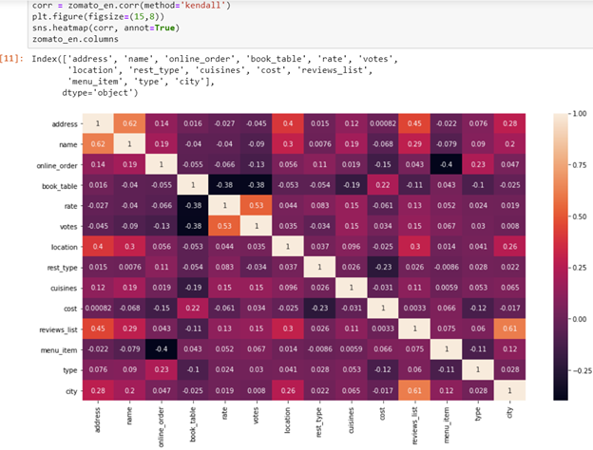
Data Understanding
Exploratory Data Analysis
The correlation gives the important aspects of any data set for initial exploratory data analysis.
The figure below shows the correlation between the important columns of the dataset such as address, name, online_order, city, etc.,

Slide 11
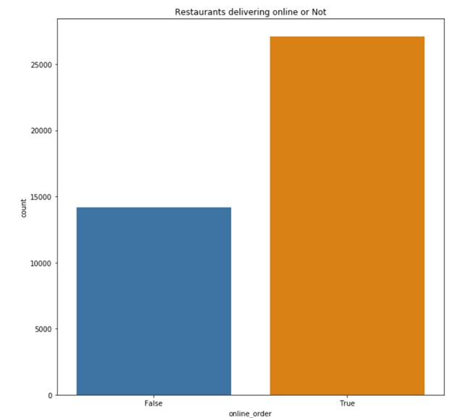
Data Understanding
Exploratory Data Analysis
The figure shows the number of restaurants that are delivering online and offline. True indicates that it delivers online and False indicates that it delivers offline.er, city, etc.,

Slide 12
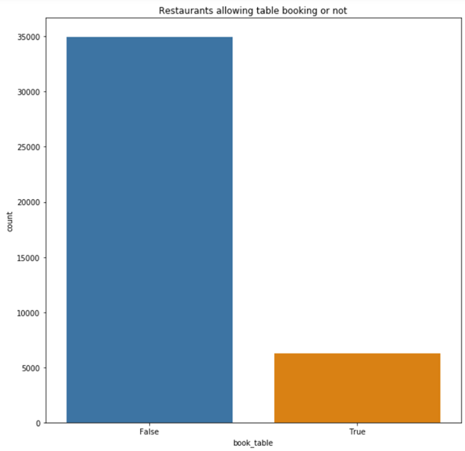
Data Understanding
Exploratory Data Analysis
The figure shows the number of restaurants that are allowing table booking or not
True indicates that it has table booking allowed and False indicates table booking not allowed

Slide 13
Data Preparation
This is also an important step in machine learning process. In the data preparation phase, several key steps are performed to clean the data and make it available for modeling.
We have deleted the redundant columns.
We have renamed the columns.
We have dropped the duplicates.
We have cleaned the individual columns.
We have removed the NaN values from the dataset
We have also performed some transformations

Slide 14
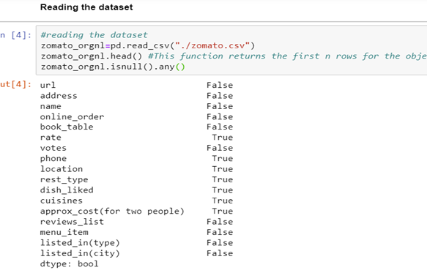
Data cleaning
Null values have been identified and filled with imputer with median strategy since the mean will bias the data towards one direction as this is sensitive data to rating of the restaurant based on number of factors
Some columns have been renamed too for the sake of convenience and understanding
Some columns have been removed which are 'url','dish_liked','phone'
Some columns such as cost which is converted from string to float as desired type is numeric

Slide 15
Modeling
This phase in our project is obtain the fruit after we have done many analysis from setting a research question to data preparation.
We have to run the regression model since our dependent variable is continuous
Input (X) Training and test columns include name, online_order, book_table, location etc.,
Output(y) training and test column contains only rate which is rating that is the rating of the restaurants.
We have made the 10% as testing dataset and remaining 90% as training dataset due to the large number of observations

Slide 16
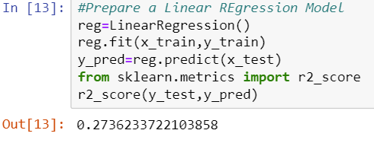
Linear Regression
The common linear regression imported from the dataset gives us only r2 score of 0.273 which is very low and not a good model for the dataset.

Slide 17
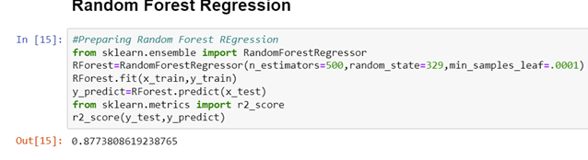
Random Forest Regression
The random forest regression which is based on number of decision trees gives us a good accuracy of around 87%

Slide 18
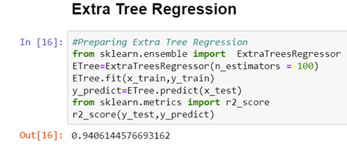
Extra Tree Regression
Using the special ensemble technique available from the scikitlearn package called ExtraTreesRegressor, we obtained the accuracy of around 94%

Slide 19
Evaluation
Considering the evaluation phase in our project, it is observed that we have evaluated various machine learning models.
Out of the models that tried to predict the rating based on number of factors, the Random forest performed quiet well compared to linear regression.
However, the Extra Tree Regression performed best of all the models and we will go with this model with 94% accuracy which is a good accuracy rate for the model to implement

Slide 20
Deployment Phase
The deployment phase in our project requires the necessity to open a new restaurant in the suggested location. It is dependent on the client about what type of restaurant they need to open and what are their preferences. According to which, we can suggest recommendations and we will have deployed our model.
We can understand about the specific location using visualization such as famous outlets and their type and feed this into machine learning model to find whether it will get good rating or not.

Slide 21
DATA VISUALIZATION
It is important to visualize the data to recommend the client to open a new restaurant with a specific type of cuisine.
Then we can send the restaurant with specific features to machine learning model to predict the rating of an impending restaurant that will be established in the specific location.
Several visualizations have been obtained to accomplish this task.

Slide 22
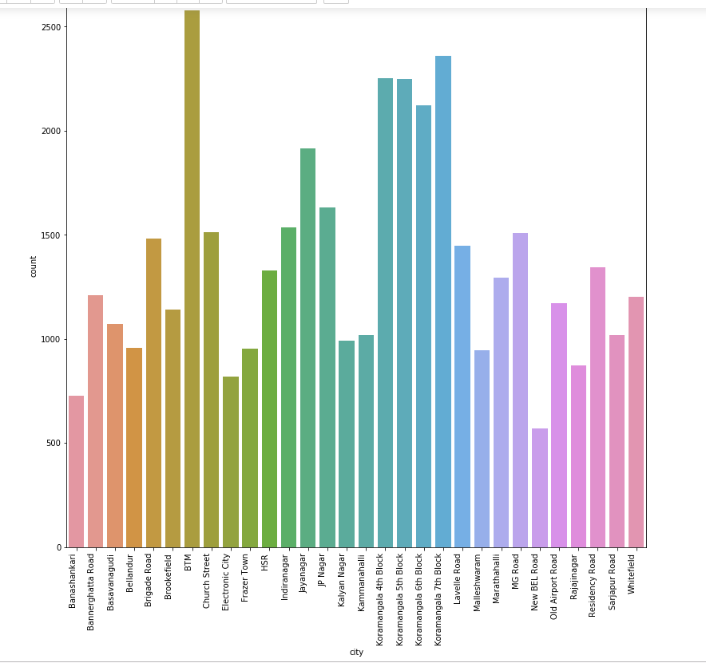
DATA VISUALIZATION
City versus count plot shows the number of restaurants in the location

Slide 23
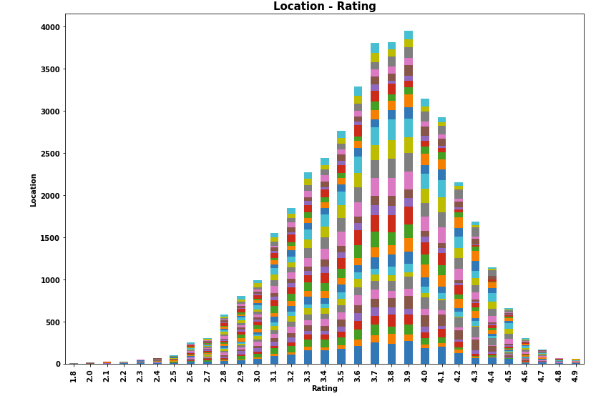
DATA VISUALIZATION
The plot shows the stacked Barplot of rating in each location where the color helps to find the location or city name

Slide 24
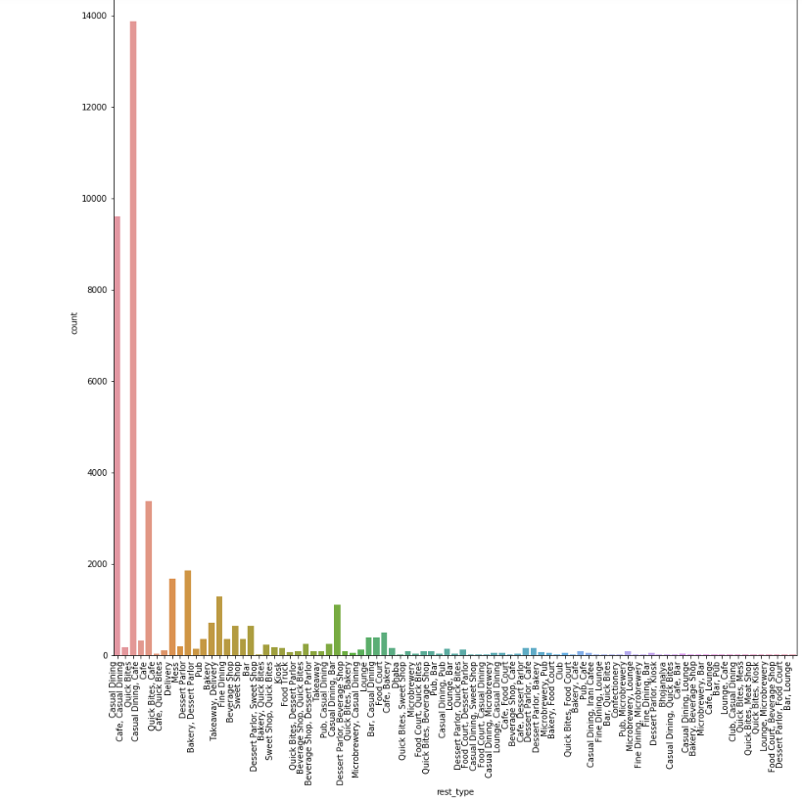
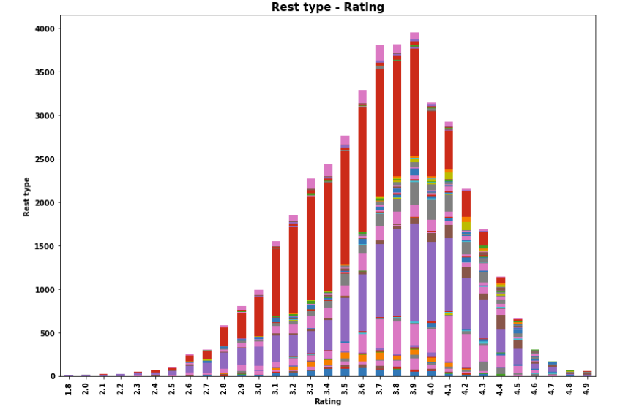
Data Visualization
Restaurant type vs Count
Restaurant type vs Rating

Slide 25
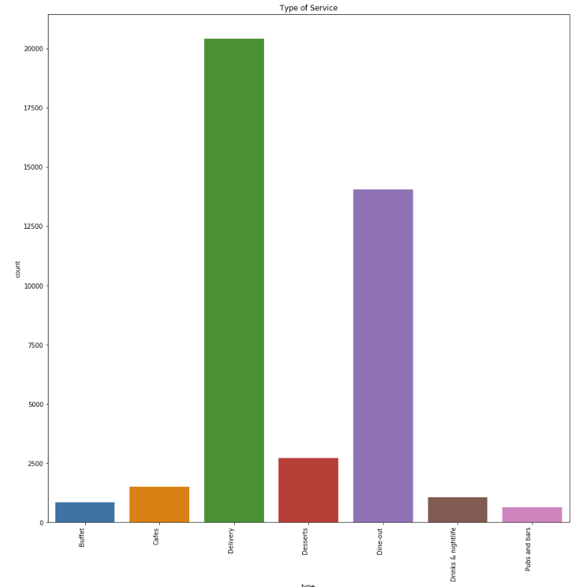
Data Visualization
The plot shows the type of service restaurants offer and their counts in Bangalore

Slide 26
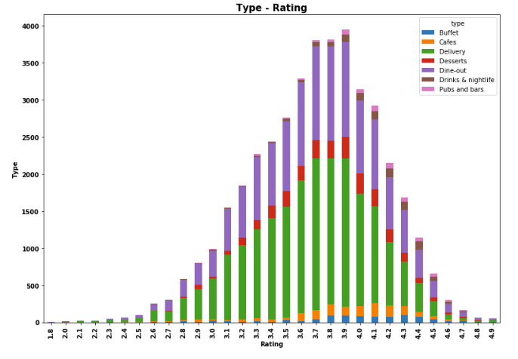
Data Visualization
This plot shows the type vs rating of restaurants

Slide 27
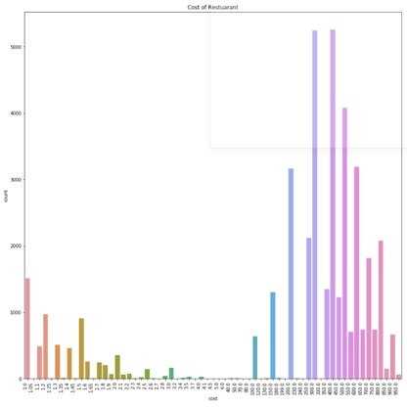
Data Visualization
Approximate cost of eating in a restaurant vs count in bangalore

Slide 28
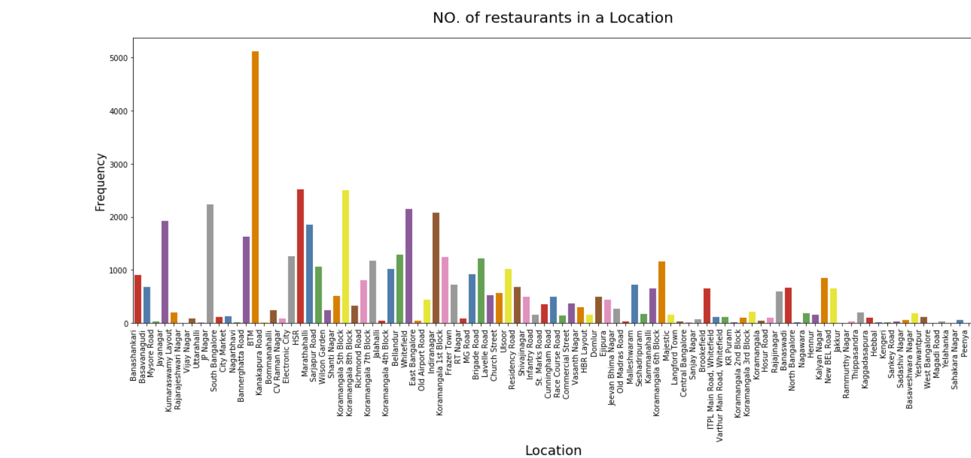
Data Visualization
The plot shows the frequency of number of restaurants in a location

Slide 29
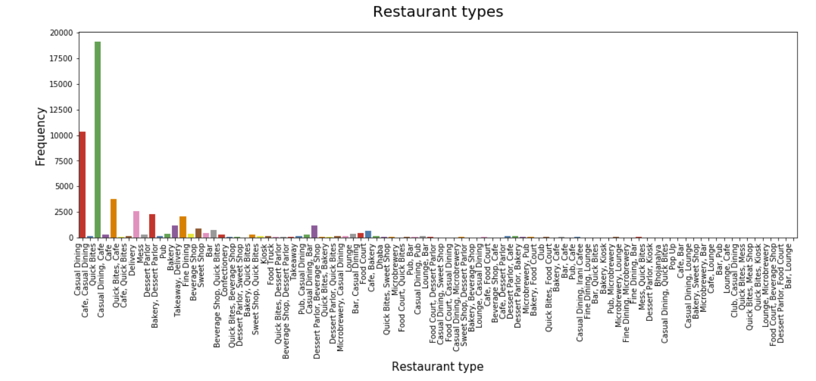
Data Visualization
The plot shows the restaurant type and their frequency

Slide 30
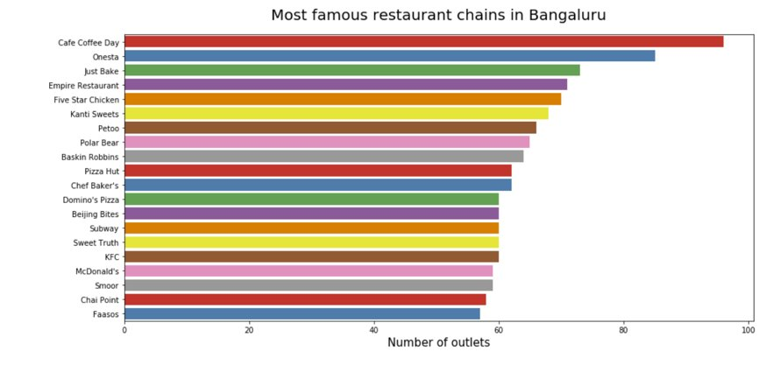
Data Visualization
Most famous restaurant chains depending on the number of outlets they possess have been plotted

Slide 31
Conclusion
Thus, the resources are in place and initial analysis has been performed. Sample data, methodologies and software is sorted out.
We have followed the CRISP-DM process and several key aspects of machine learning have been implemented
We have implemented various machine learning models and found that the Extra Tree Regression performs better with 94% accuracy with this dataset
The data visualization is performed to give the recommendations to the client to open a new restaurant with particular cuisine and also, we will predict the rating of that restaurant

Slide 32
References
Discovering Knowledge in Data: An Introduction to Data Mining, Daniel T. Larose
www.medium.com
www.towardsdatascience.com
www.kaggle.com
www.coursera.org
Introduction to Machine Learning with Python, A Guide for Data Scientists, Andreas C. Müller and Sarah Guido

