Slide 1
The effects of natural genetic variation on patterns of transcription initiation during development
Genetic Analysis of High-dimensional Traits: methods meet applications
29th Nov 2013
Jacob Degner

Slide 2
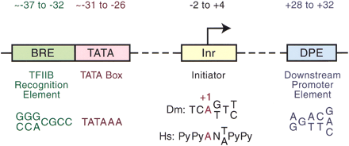
Transcription initiation pre-genomics
1998
1980
1980
1996
Butler and Kadonaga, 2002

Slide 3
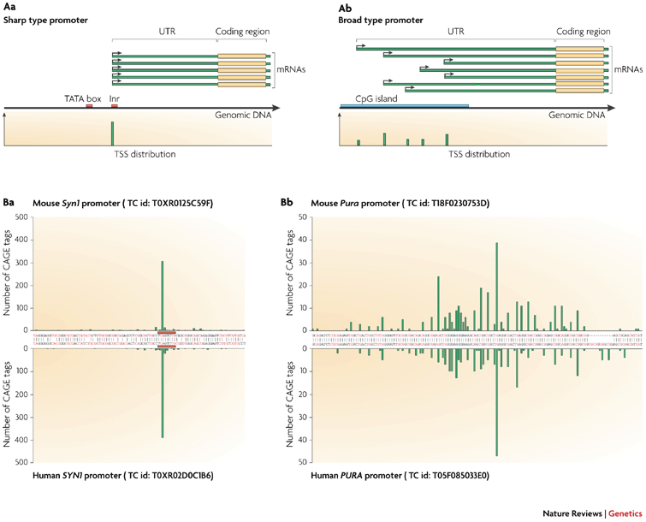
Transcription initiation post genomics
Sandelin et al., 2007

Slide 4
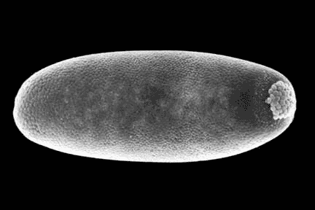
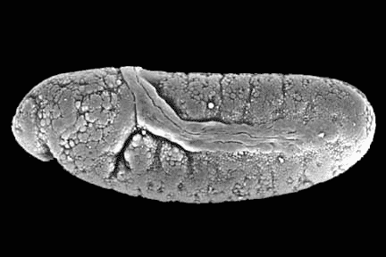
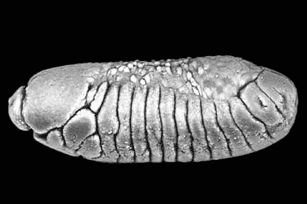
Experimental methods
79 fly lines (DGRP)
2-4h embryos
6-8h embryos
3 different time-points across development
10-12h embryos
Whole embryo RNA was extracted and is being used to prepare CAGE libraries for each line at each time-point.

Slide 5
Experimental methods
Sequencing
(HiSeq 2000, 50nt, single end, 10 samples per lane)
C
PCR amplification
RT (random priming)
Cap biotinylation
Cap capture
3’ adapter ligation
EcoP15I
Cut 27 nt downstream
NN
Generation of small fragments
B
C
cDNA release
2nd strand synthesis
5’ adapter ligation
RNA
cDNA
5’ adapter
3’ adapter
EcoP15I site

Slide 6
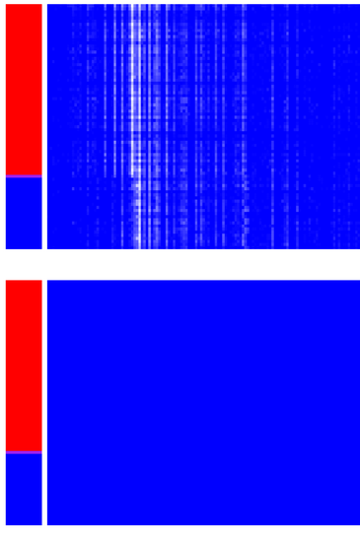
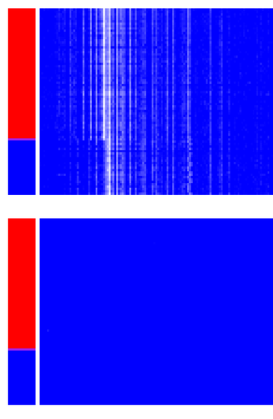
Transcription initiation as a high-dimensional phenotype
3 discrete developmental stages
~500 bp initiation region
~500 bp initiation region
~500 bp initiation region
Sense strand initiation
79 DGRP lines sorted by genotype
Antisense strand initiation

Slide 7
3 approaches to treating multi-dimensionality in bp space
1-dimension in bp-space
Association on mean CAGE tag signal in promoter region
Any dimension in bp space
Association on full wavelet-decomposition of CAGE-tag signal
Shim and Stephens (2013)
Several dimensions in bp space
Association on projections onto first several principle components
With Paolo Casale and Oliver Stegle
With Paolo Casale and Oliver Stegle

Slide 8
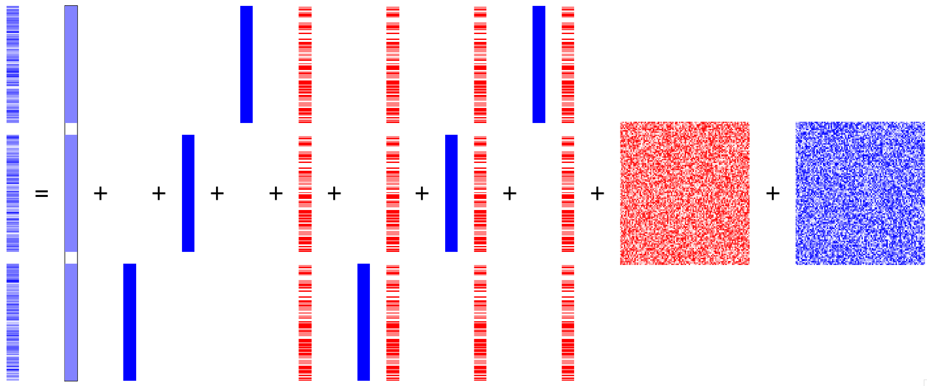
Approach 1: Association with mean
79 lines
3 developmental stages
79 lines
Stage
effects
79 lines
Notes:
Build model in parts

Slide 9
Approach 1: Association with mean
79 lines
3 developmental stages
79 lines
Stage
effects
Genotype
effect
Genotype X
Stage effects
79 lines
Notes:
Build model in parts

Slide 10
Approach 1: Association with mean
79 lines
3 developmental stages
79 lines
Stage
effects
Genotype
effect
Genotype X
Stage effects
79 lines
Random effects
Casale and Stegle in prep
Notes:
Build model in parts

Slide 11
Approach 1: Association with mean
Variance decomposition shows most variance is explained by developmental stage
Variance explained by genotype is split between cis-effects, trans-effects, and interactions with developmental stage

Slide 12
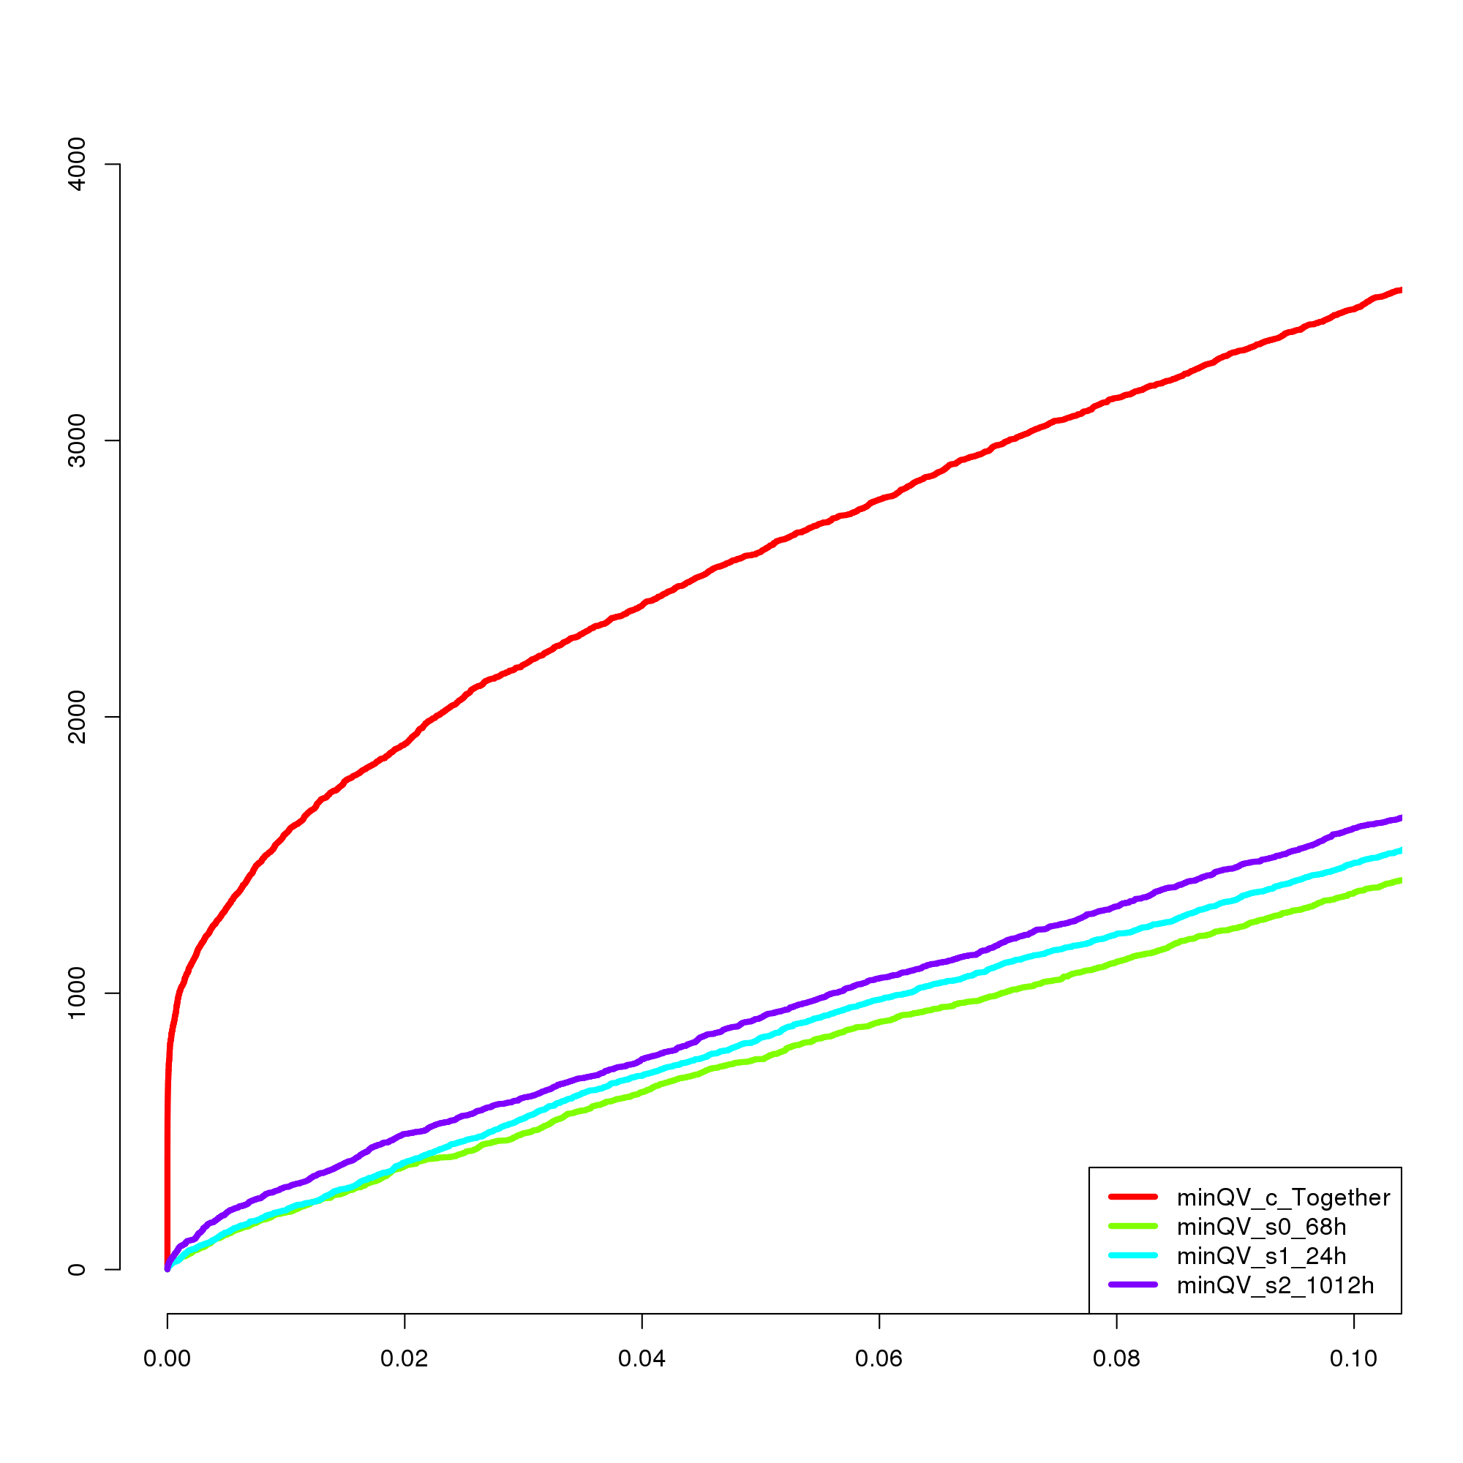
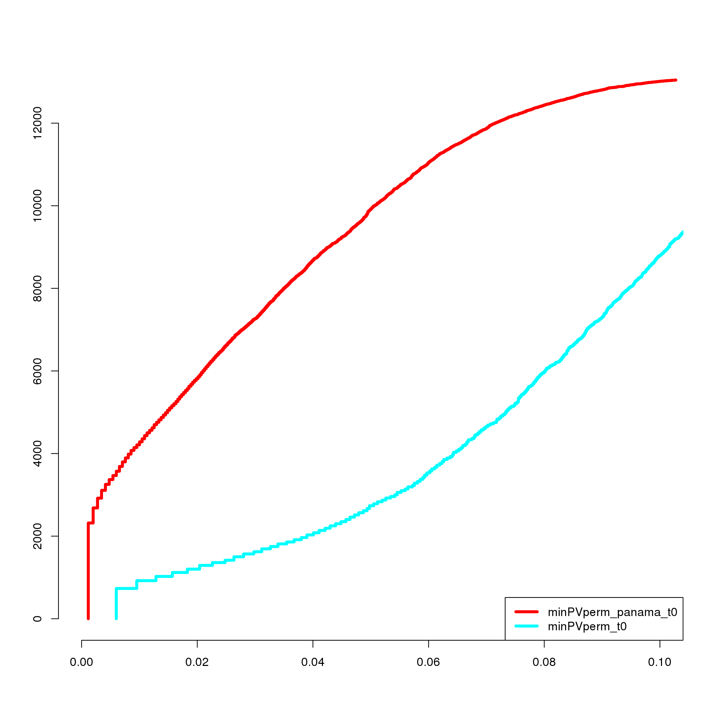
Approach 1: Association with mean
Many more joint than stage X genotype QTL detected
Random effect components improve power
Number significant
FDR
FDR

Slide 13
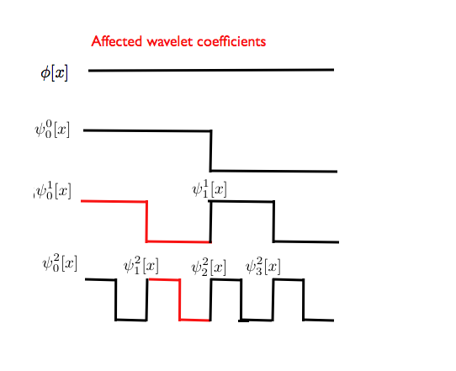
Approach 2: Association with any projections onto wavelet bases
Projections onto wavelet bases
Stage
effects
Genotype
effect
Other covariates
Shim and Stephens 2013
Notes:
Build model in parts

Slide 14
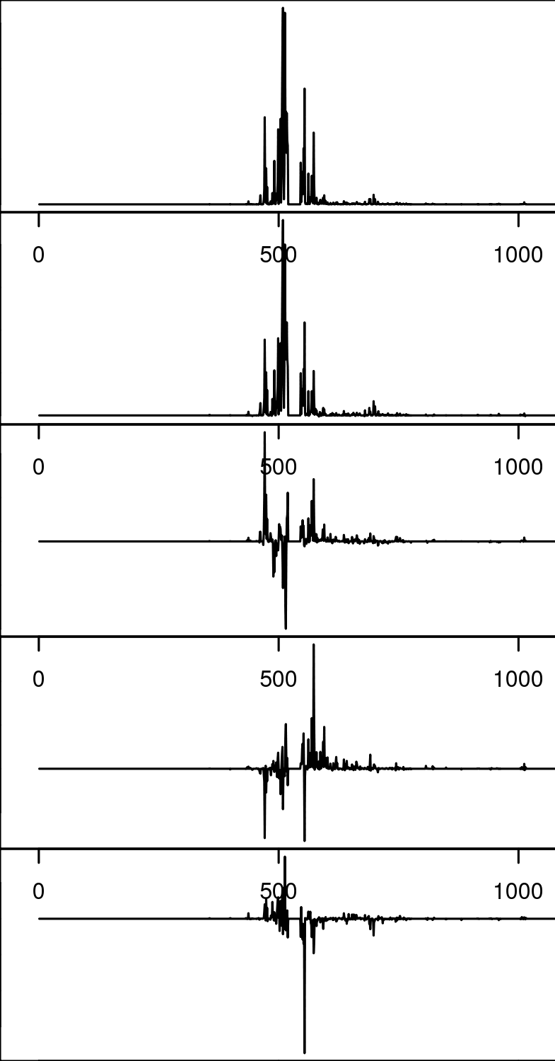
Approach 3: Association with projections onto top PCs
Mean
PC1
PC2
PC3
Projections onto top N principle components
Stage
effects
Genotype
effect
Genotype X
Stage effects
PC4
Random effects
Casale and Stegle in prep
Notes:
Build model in parts

Slide 15
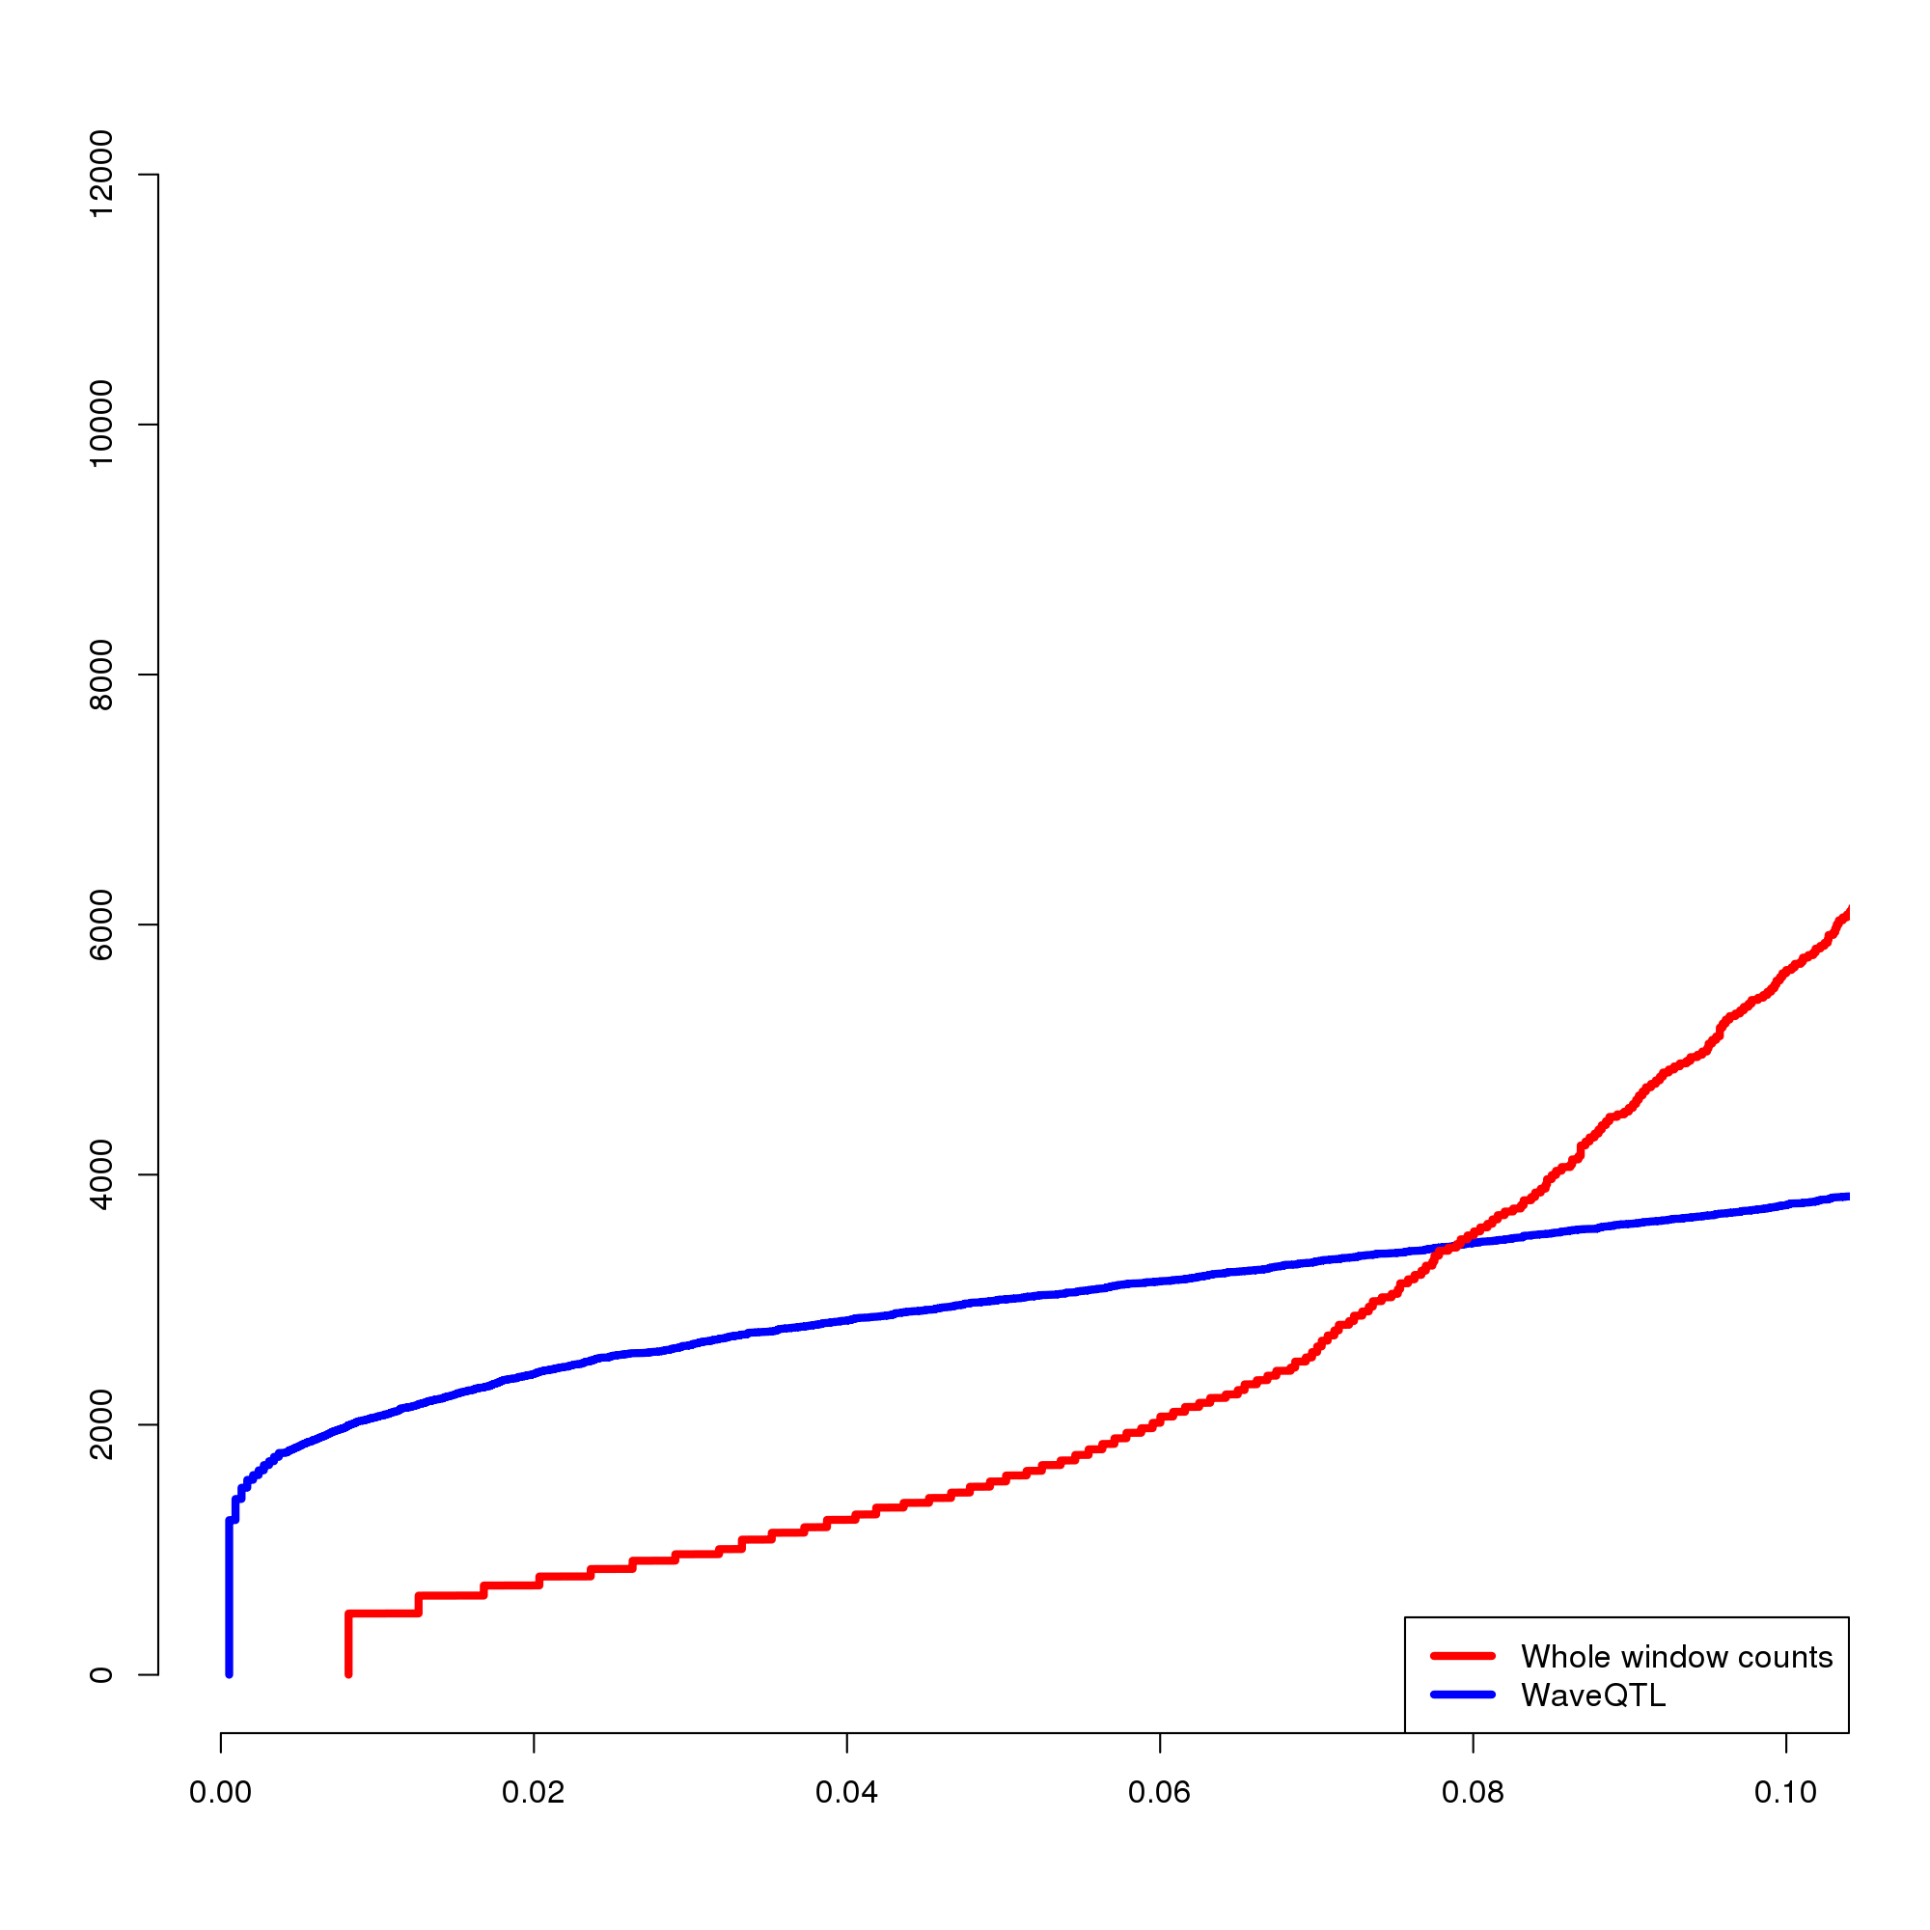
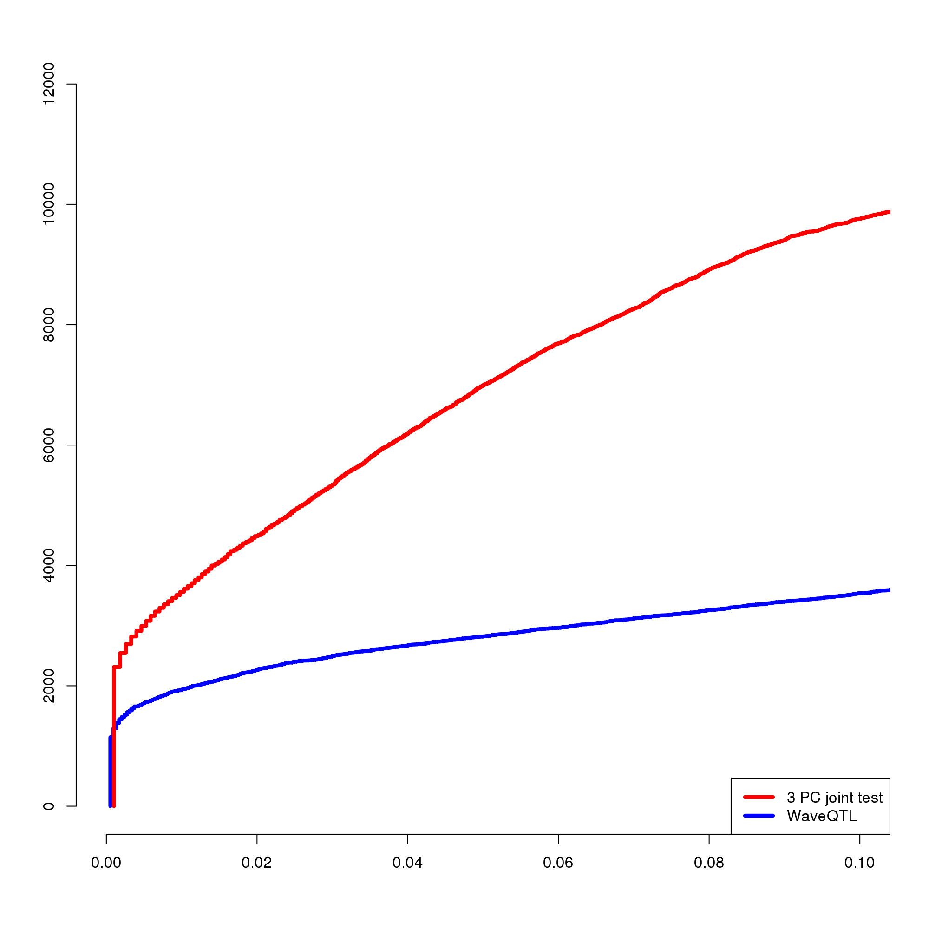
Many new associations with both higher-dimension methods
Wavelets vs. Mean
Wavelets vs. first 3 PCs

Slide 16
Fundamentally new types of eQTL are detected using higher-dimension methods
Overall intensity of initiation changes
Change in peakedness of initiation
Change in strandedness of initiation
Subset of initiation sites change intensity, size, or peakedness

Slide 17
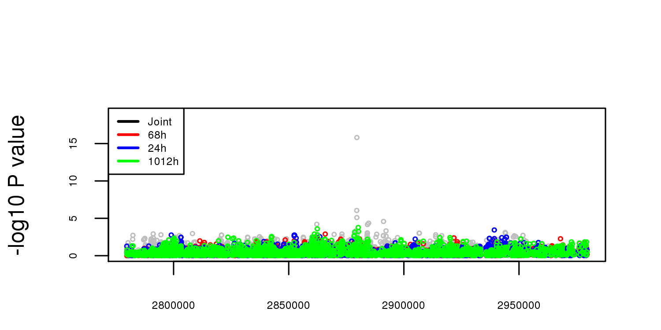
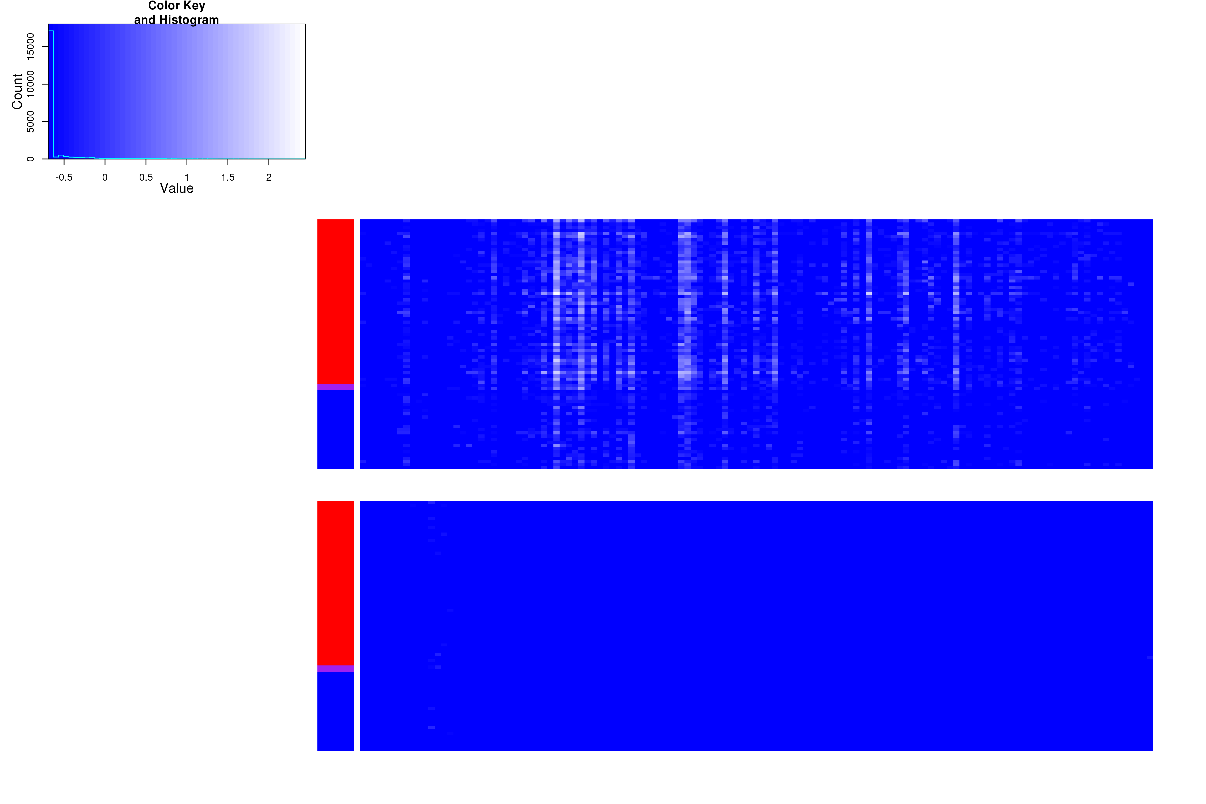

Slide 18
Fundamentally new types of eQTL are detected using higher-dimension methods
Overall intensity of initiation changes
Change in peakedness of initiation
Change in strandedness of initiation
Subset of initiation sites change intensity, size, or peakedness

Slide 19
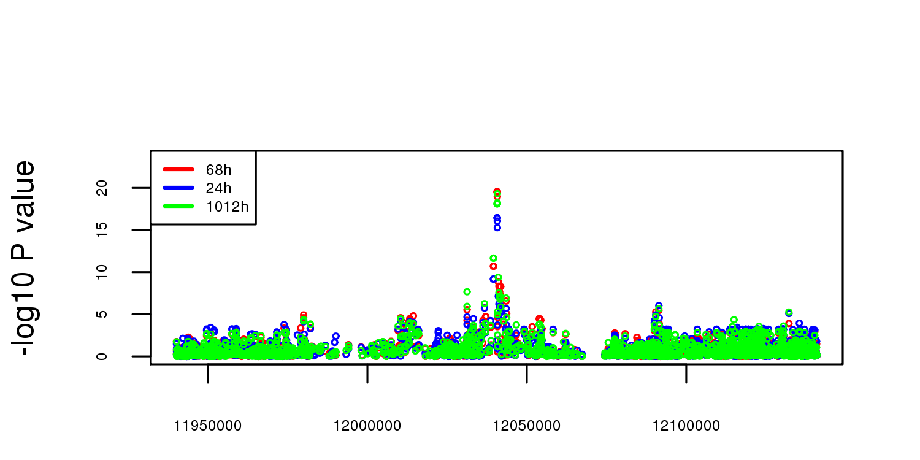
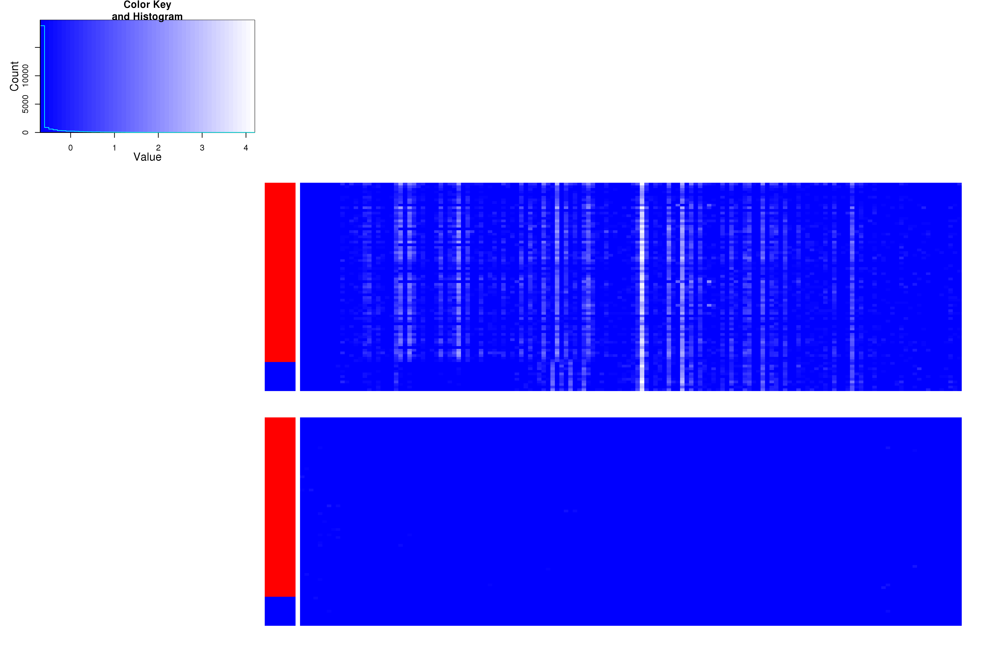

Slide 20
Fundamentally new types of eQTL are detected using higher-dimension methods
Overall intensity of initiation changes
Change in peakedness of initiation
Change in strandedness of initiation
Subset of initiation sites change intensity, size, or peakedness

Slide 21
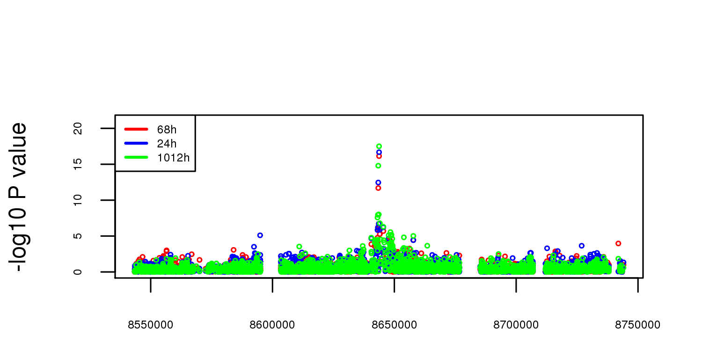
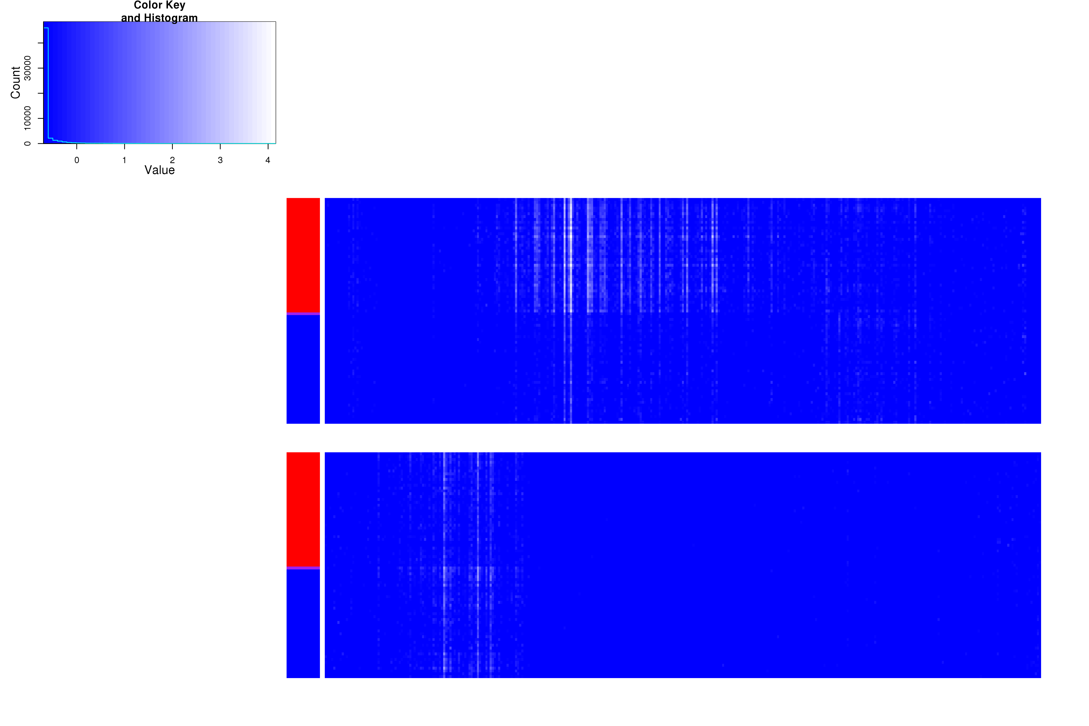

Slide 22
Fundamentally new types of eQTL are detected using higher-dimension methods
Overall intensity of initiation changes
Change in peakedness of initiation
Change in strandedness of initiation
Subset of initiation sites change intensity, location, or peakedness

Slide 23
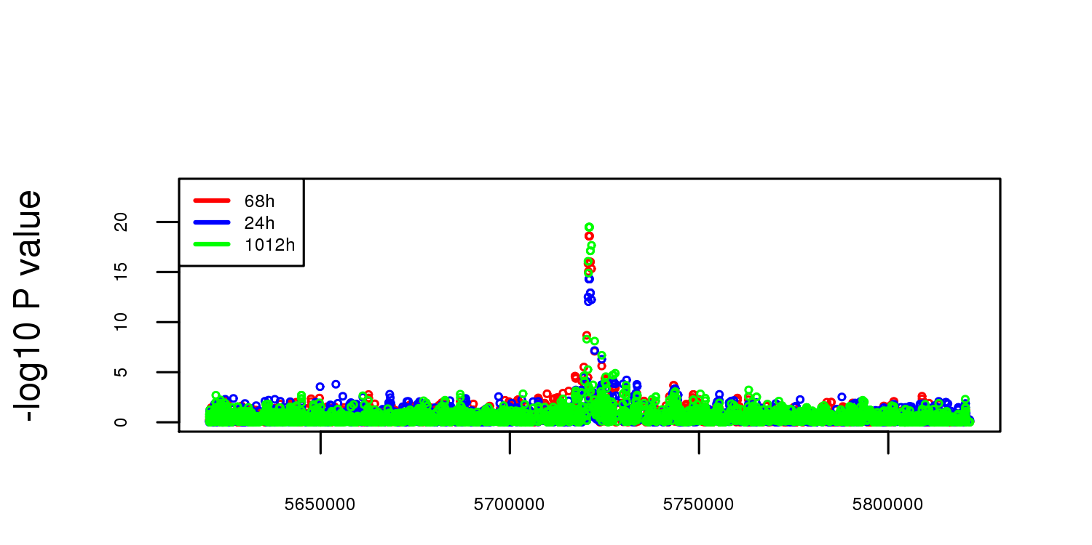
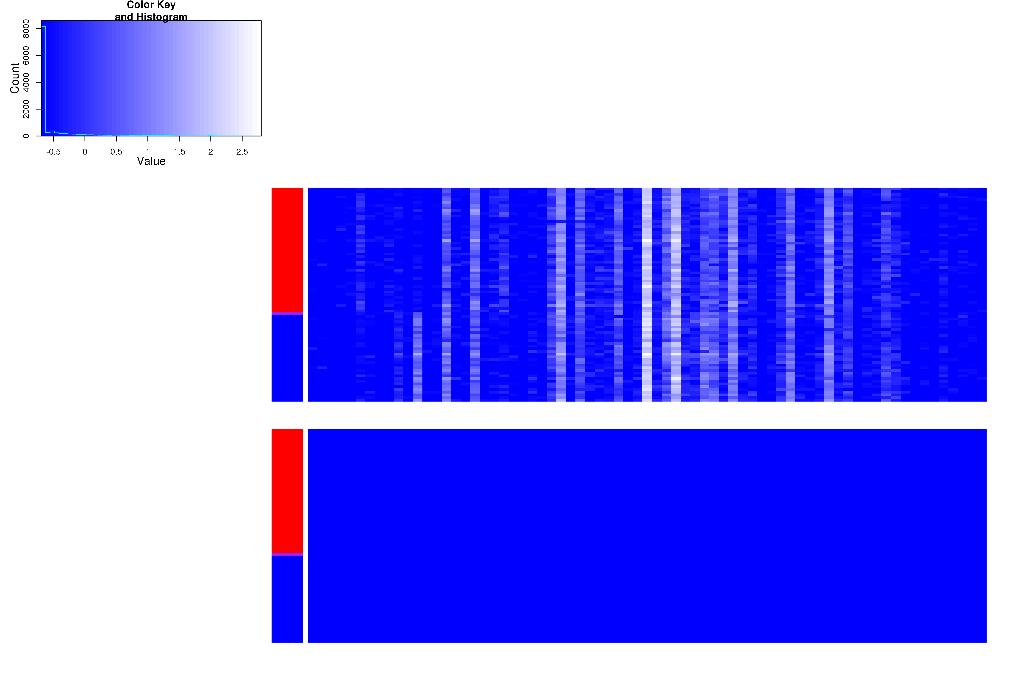

Slide 24
Conclusions
Genetic variation affects patterns of transcription initiation in a wide variety of ways
Associations allowing more complex functions of genotype X TSS signal are able to detect types of QTL that are fundamentally different from standard eQTL studies
Further dissection of individual TSS-QTL will illuminate the mechanisms through which sequence and developmental history specify locations and intensity of TSS usage

Slide 25
Acknowledgements
Ignacio Schor, Enrico Cannavo, and Eileen Furlong
Paolo Casale and Oliver Stegle for developing and sharing pre-publication code and methods
Heejung Shim and Mathew Stephens for use of their pre-publication statistical method and code
The Furlong lab for useful discussions and for computational and laboratory support. Especially, David Garfield, Charles Girardot, Hilary Gustafson, Tibor Pakozdi, and Dermot Harnett.
Ewan Birney and Nils Kölling for computational discussions, advice, and for sharing pre-publication analysis.

