Slide 1

INTRODUCTION
A Red-Black Trees are a type of self-balancing binary search tree.
Why they are named as “Red-Black" because each node in the tree is marked with one of two colors, either red or black.
Red-Black Trees were introduced by Rudolf Bayer and Volker Strassen in 1972.
These colours are used to ensure that the tree remains balanced during insertions and deletions.

Slide 2
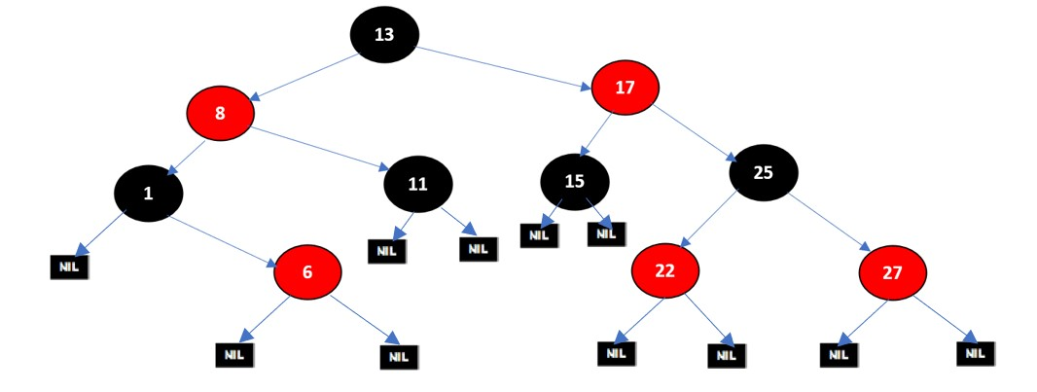
EXAMPLE OF RED-BLACK TREE
Constructing Red-Black tree with 10 nodes

Slide 3
REQUIREMENTS
A red-black tree is a Binary tree where a particular node has colour as an extra attribute, either red or black.
Red-black trees maintain a slightly looser height invariant than AVL trees.
In AVL trees, balancing restricts the difference in heights to at most one.
For red-black trees, we have a different set of rules related to the colors of the nodes

Slide 4
SYNTAX OF RED-BLACK TREE
To create a node in Red-Black Trees
Syntax:
struct Node
{
int key;
enum Color color;
struct Node *left, *right, *parent;
};

Slide 5
PROPERTIES OF RED-BLACK TREE
1. Root property: The root is black.
2. External property: Every leaf (Leaf is a NULL child of a node) is black in Red-Black tree.
3. Internal property: The children of a red node are black. Hence possible parent of red node is a black node.
4. Depth property: All the leaves have the same black depth.
5. Path property: Every simple path from root to descendant leaf node contains same number of black nodes.

Slide 6
RULES FOR INSERTION OF NODE
If the tree is empty, make newnode as root and color it with black.
If tree is not empty, create newnode as leaf node and color it with red.
If parent of newnode is black then exit.
If parent of newnode is red then check the color of parent sibling
a) If parent sibling color is black or null rotate and recolor.
b) If parent sibling color is red, then recolor parent and parent sibling
c) And check parent's parent is not root node. Then recolor and recheck.

Slide 7


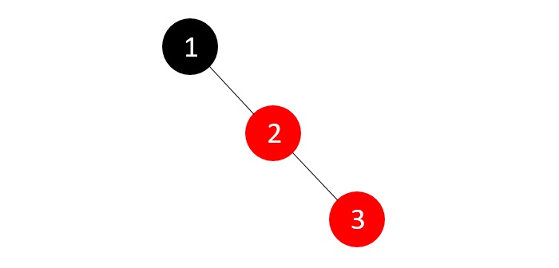
CONSTRUCTION OF RB TREES
HO
Let's understand the inserting elements with following the red-black tree properties and rules
Construct a red black tree with 1 to 7 numbers.
1
2
3

Slide 8
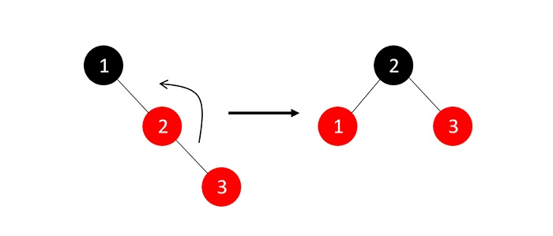
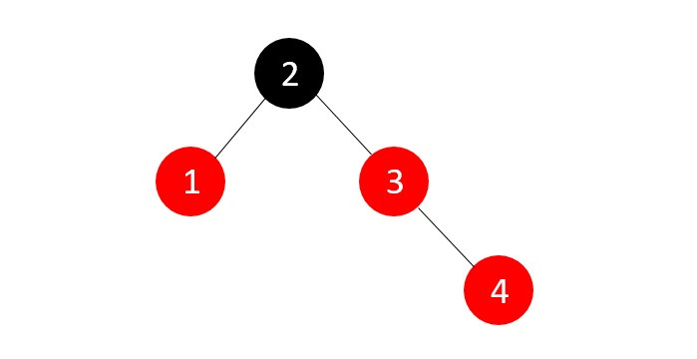
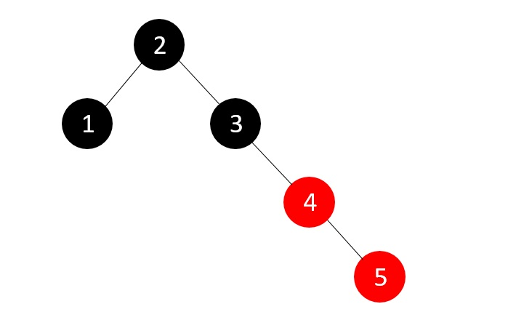
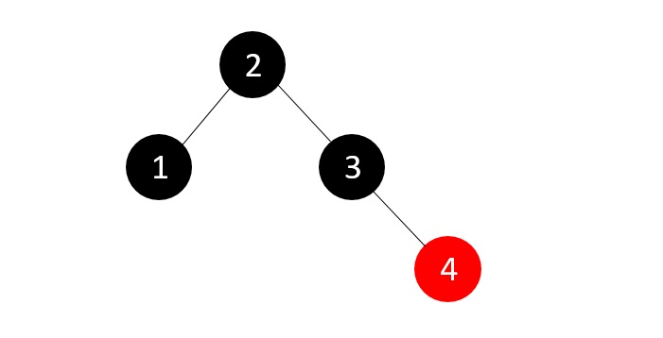
Example of RED-BLACK Tree
4
5

Slide 9
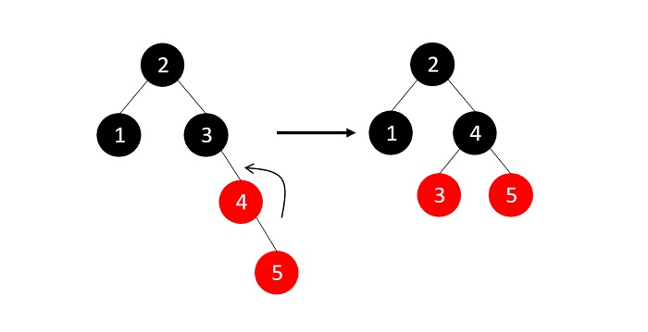
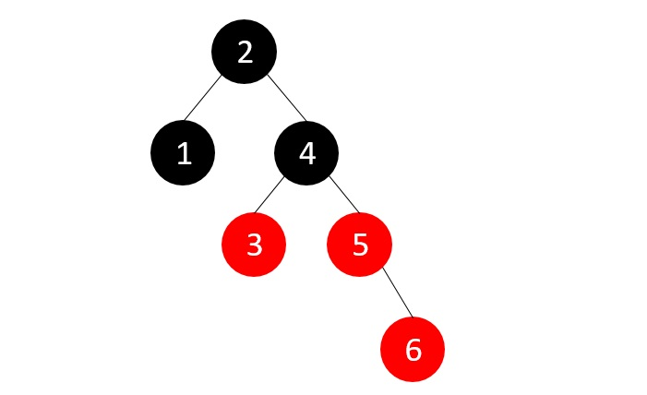
Example of RED-BLACK Tree
6

Slide 10
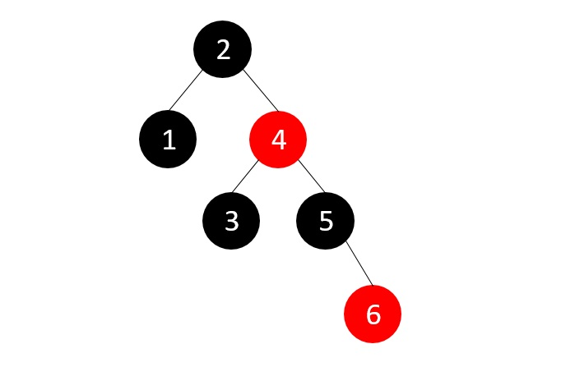
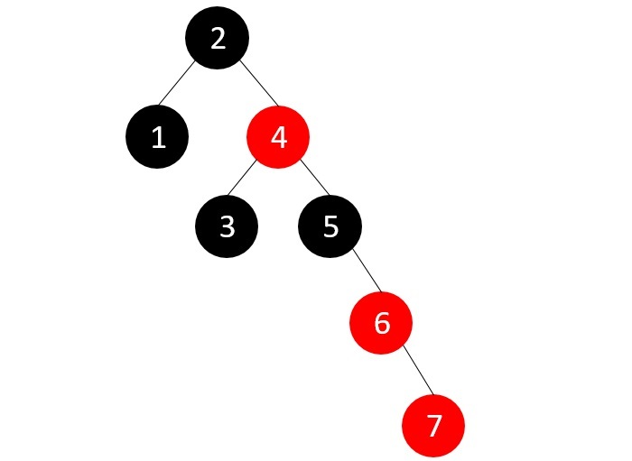
Example of RED-BLACK Tree
7

Slide 11
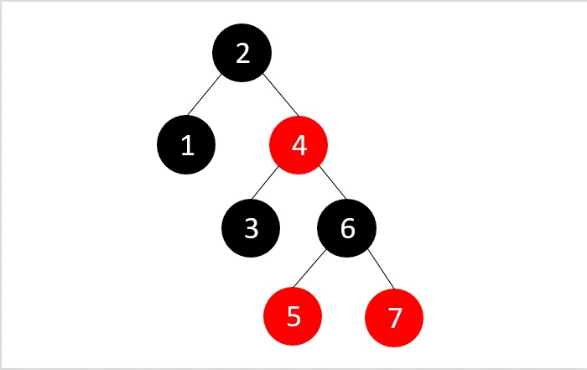
Example of RED-BLACK Tree
t
The final Red Black Tree with 1 to 7 Numbers

Slide 12
ADVANTAGES
Red Black Trees have a guaranteed time complexity of O(log n) for basic operations like insertion, deletion, and searching.
Red Black Trees are self-balancing.
Red Black Trees can be used in a wide range of applications due to their efficient performance and versatility.
The process which is used to maintain balance in Red Black Trees is relatively simple and easy to understand.

Slide 13
DISADVANTAGES
A red black trees in a lot of cases is that it is a binary tree and thus lookups are O(log(n)) where as hash tables have a lookup of O(1).
Red Black Trees require one extra bit of storage for each node to store the color of the node (red or black).
Complexity of Implementation.
Although Red Black Trees provide efficient performance for basic operations, they may not be the best choice for certain types of data or specific use cases.

Slide 14
EXAMPLE
1. Describe RED –BLACK tree with proper syntax and example
2. Construct the RED-BLACK tree with these elements
a) 10,85,15,70,20,60,30,50,65,80,90,40,5,55.
b) 10,18,7,15,16,30,25,40,60,2,1,70.
3. List out the time complexities of RED –BLACK tree based on different cases
4. Analyze the different cases of RED-BLACK tree operations and example

Slide 15
SUMMARY
The Red-Black tree properties ensure a balanced structure, limiting the longest path from the root to any leaf to at most twice the length of the shortest path.
This balance guarantees efficient average-case performance for search, insertion, and deletion operations, with a worst-case time complexity of O(log n).

Slide 16
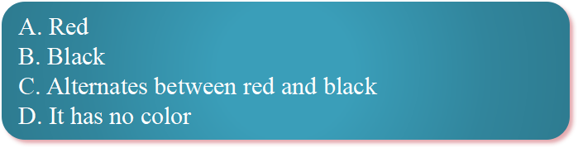
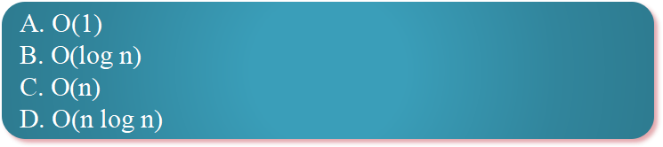
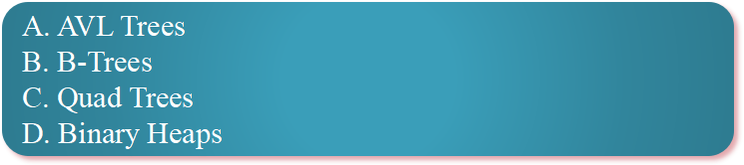
SELF-ASSESSMENT QUESTIONS
1. What is the color of the root node in a Red-Black Tree?
2. What is the worst-case time complexity for searching a key in a Red-Black Tree?
3. Which self-balancing tree structure is a common alternative to Red-Black Trees?

Slide 17
TERMINAL QUESTIONS
1.What is the color of root in red black tree?
2.What is the color property of red black tree?
3.What is the color of null node?

Slide 18
REFERENCES FOR FURTHER LEARNING OF THE SESSION
TEXTBOOKS:
  Mark Allen Weiss, Data Structures and Algorithm Analysis in C, 2010 , Second Edition, Pearson Education.
  Ellis Horowitz, Fundamentals of Data Structures in C: Second Edition, 2015
REFERENCE BOOKS:
A.V.Aho, J. E. Hopcroft, and J. D. Ullman, “Data Structures And Algorithms”, Pearson Education, First Edition Reprint2003.
Horowitz, Sahni, Anderson Freed, “Fundamentals of data structures in C” , Second Edition-2007.
R. F. Gilberg, B. A. Forouzan, “Data Structures”, Second Edition, Thomson India Edition, 2005
Robert Kruse, C.L. Tondo, Bruce Leung, Shashi Mogalla, “Data Structures & Program Design in C”, FourthEdition-2007.
WEB REFERNCES/MOOCS:
https://nptel.ac.in/courses/106102064
https://nptel.ac.in/courses/106101060/4
https://www.edx.org/course/algorithms-and-data-structures-1
https://in.udacity.com/course/intro-to-algorithms--cs215
https://www.coursera.org/learn/data-structures?action=enroll

Slide 19
THANK YOU

