Slide 1
Last Lecture:
Traditional Approach Vs Agile Approach
Agile Manifesto
Agile Methodology

Slide 2
Today’s Lecture
Agile Scrum Framework in detail

Slide 3
Scrum –in Detail
The scrum framework is heuristic; it’s based on continuous learning and adjustment to fluctuating factors. It acknowledges that the team doesn’t know everything at the start of a project and will evolve through experience.
Scrum is structured to help teams naturally adapt to changing conditions and user requirements, with re-prioritization built into the process and short release cycles so your team can constantly learn and improve.
While scrum is structured, it is not entirely rigid. Its execution can be tailored to the needs of any organization. There are many theories about how exactly scrum teams must work in order to be successful.

Slide 4
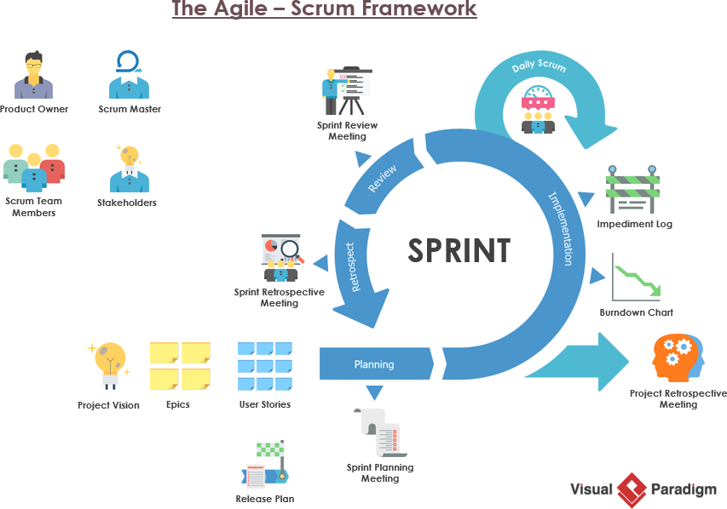

Slide 5
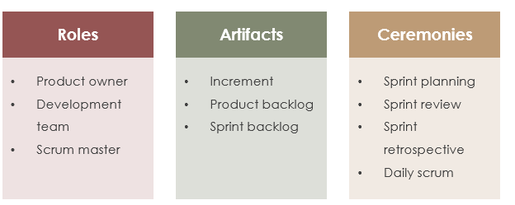

Slide 6
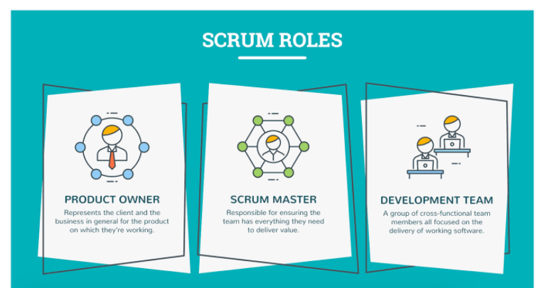

Slide 7
Three essential roles for scrum success
A scrum team needs three specific roles:
product owner,
scrum master, and
the development team. [Scrum Team]
And because scrum teams are cross-functional, the development team includes testers, designers, UX specialists, and ops engineers in addition to developers.

Slide 8
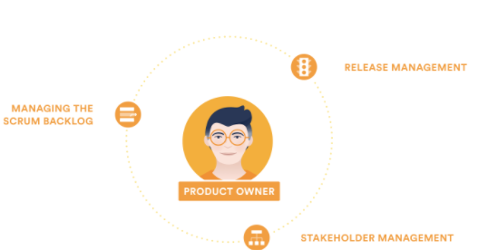
The scrum product owner-Setting clear direction
Product owners are the champions for their product. They are focused on understanding business, customer, and market requirements, then prioritizing the work to be done by the engineering team accordingly.

Slide 9
The scrum product owner
Effective product owners:
Build and manage the product backlog.
Closely partner with the business and the team to ensure everyone understands the work items in the product backlog.
Give the team clear guidance on which features to deliver next.
Decide when to ship the product with a predisposition towards more frequent delivery.
The product owner is not always the product manager. Product owners focus on ensuring the development team delivers the most value to the business. Also, it's important that the product owner be an individual. No development team wants mixed guidance from multiple product owners.

Slide 10
The scrum master-Holding it all together
Scrum masters are the champions for scrum within their teams. They coach teams, product owners, and the business on the scrum process, and look for ways to fine-tune their practice of it.
An effective scrum master deeply understands the work being done by the team and can help the team optimize their transparency and delivery flow.
As the facilitator-in-chief, he/she schedules the needed resources (both human and logistical) for sprint planning, stand-up, sprint review, and the sprint retrospective.

Slide 11
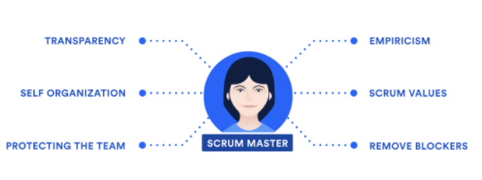
The scrum master-Holding it all together

Slide 12
The scrum development team-Redefining “developer”
They are the champions for sustainable development practices. The most effective scrum teams are tight-knit, co-located, and usually five to seven members.
Team members have differing skill sets, and cross-train each other so no one person becomes a bottleneck in the delivery of work. Strong scrum teams are self-organising and approach their projects with a clear ‘we’ attitude.
All members of the team help one another to ensure a successful sprint completion.

Slide 13
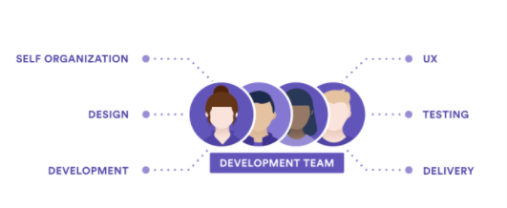
The scrum team drives the plan for each sprint.
They forecast how much work they believe they can complete over the iteration using their historical velocity as a guide.
Keeping the iteration length fixed gives the development team important feedback on their estimation and delivery process, which in turn makes their forecasts increasingly accurate over time.

Slide 14
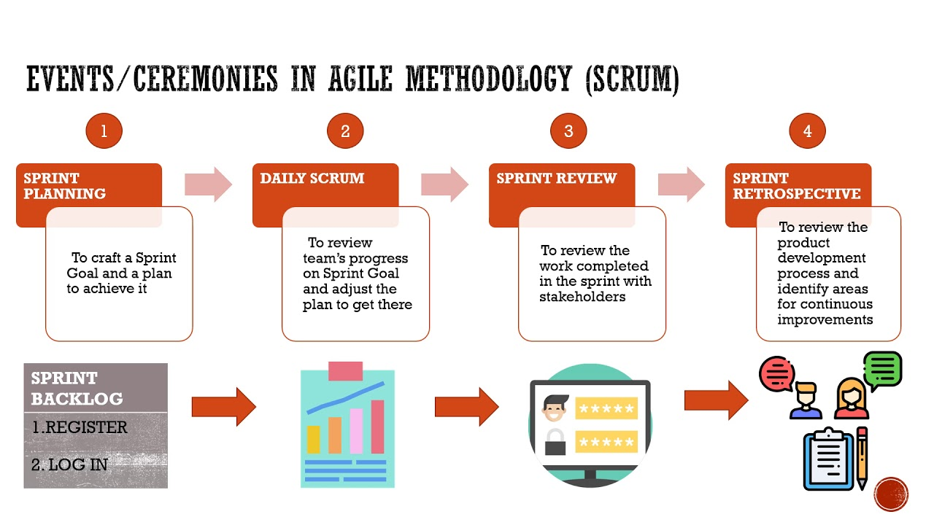

Slide 15
Scrum ceremonies or events
Some of the more well-known components of the scrum framework are the set of sequential events, ceremonies, or meetings that scrum teams perform on a regular basis. The ceremonies are where we see the most variations for teams. For example, some teams find doing all of these ceremonies cumbersome and repetitive, while others use them as a necessary check-in.

Slide 16
key events a scrum team might partake in
Organize the backlog:
Sometimes known as backlog grooming, this event is the responsibility of the product owner.
The product owner’s main jobs are to drive the product towards its product vision and have a constant pulse on the market and the customer.
Therefore, he/she maintains this list using feedback from users and the development team to help prioritize and keep the list clean and ready to be worked on at any given time

Slide 17
key events a scrum team might partake in
Sprint planning:
The work to be performed (scope) during the current sprint is planned during this meeting by the entire development team.
This meeting is led by the scrum master and is where the team decides on the sprint goal.
Specific use stories are then added to the sprint from the product backlog.
These stories always align with the goal and are also agreed upon by the scrum team to be feasible to implement during the sprint.
At the end of the planning meeting, every scrum member needs to be clear on what can be delivered in the sprint and how the increment can be delivered.

Slide 18
key events a scrum team might partake in
Sprint :
A sprint is the actual time period when the scrum team works together to finish an increment.
Two weeks is a pretty typical length for a sprint, though some teams find a week to be easier to scope or a month to be easier to deliver a valuable increment.
Dave West, from Scrum.org advises that the “more complex the work and the more unknowns, the shorter the sprint should be. But it’s really up to your team, and you shouldn’t be afraid to change it if it’s not working! “
During this period, the scope can be re-negotiated between the product owner and the development team if necessary. This forms the crux of the empirical nature of scrum.

Slide 19
key events a scrum team might partake in
Daily scrum or stand up:
This is a daily super-short meeting that happens at the same time (usually mornings) and place to keep it simple.
Many teams try to complete the meeting in 15 minutes, but that’s just a guideline. This meeting is also called a ‘daily stand-up’ emphasizing that it needs to be a quick one.
The goal of the daily scrum is for everyone on the team to be on the same page, aligned with the sprint goal, and to get a plan out for the next 24 hours. The stand up is the time to voice any concerns you have with meeting the sprint goal or any blockers. A common way to conduct a stand up is for every team member to answers three questions in the context of achieving the sprint goal:
• What did I do yesterday?
• What do I plan to do today?
• Are there any obstacles?

Slide 20
key events a scrum team might partake in
Sprint review:
At the end of the sprint, the team gets together for an informal session to view a demo of, or inspect, the increment.
The development team showcases the backlog items that are now ‘Done’ to stakeholders and teammates for feedback.
The product owner can decide whether or not to release the increment, although in most cases the increment is released. This review meeting is also when the product owner reworks the product backlog based on the current sprint, which can feed into the next sprint planning session.
For a one-month sprint, consider time-boxing your sprint review to a maximum of four hours.

Slide 21
key events a scrum team might partake in
Sprint retrospective:
The retrospective is where the team comes together to document and discuss what worked and what didn’t work in a sprint, a project, people or relationships, tools, or even for certain ceremonies.
The idea is to create a place where the team can focus on what went well and what needs to be improved for the next time, and less about what went wrong.

Slide 22
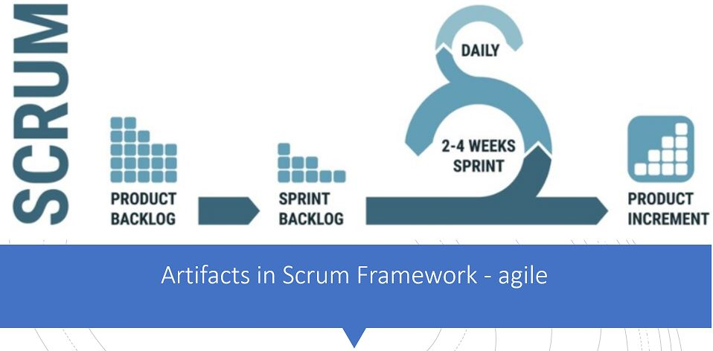

Slide 23
Agile scrum artifacts
Agile scrum artifacts are information that a scrum team and stakeholders use to detail the product being developed, actions to produce it, and the actions performed during the project.
These artifacts provide metadata points that give insight into the performance of a sprint.
They are essential tools for every scrum team since they enable core scrum attributes of transparency, inspection, and adaption.

Slide 24
Artifacts are created during the main activities of a scrum sprint:
Plan work and future goals
Create tasks to achieve these goals
Organize tasks into sprints based on dependency and priority
Execute the tasks
Review and analyze results in order to compare to the goals
Repeat these steps

Slide 25
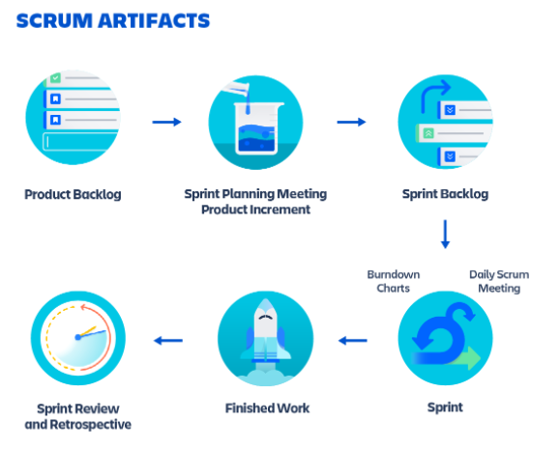
The main artifacts of agile scrum

Slide 26
Product backlog
The product backlog is a list of new features, enhancements, bug fixes, tasks, or work requirements needed to build a product. It’s compiled from input sources like customer support, competitor analysis, market demands, and general business analysis.

Slide 27
Sprint backlog
The sprint backlog is a set of product backlog tasks that have been promoted to be developed during the next product increment.
Sprint backlogs are created by the development teams to plan deliverables for future increments and detail the work required to create the increment.
Sprint backlogs are created by selecting a task from the product backlog and breaking that task into smaller, actionable sprint items.

Slide 28
Consider an example task like “build a shopping cart page”, which requires many design and development subtasks.
The product backlog is home to the primary task while the supporting tasks like “create a shopping cart visual design mockup” or “program the shopping cart sessions” are housed in the sprint backlog.

Slide 29
The sprint backlog is updated during the sprint planning phase of scrum.
The smaller sprint tasks are assigned to the relevant teams like design and development.
If a team does not have the capacity to deliver all the sprint tasks, the remaining sprint tasks will standby in the sprint backlog for a future sprint.

Slide 30
Product increment
A product increment is the customer deliverables that were produced by completing product backlog tasks during a sprint.
It also includes the increments of all previous sprints. There is always one increment for each sprint and an increment is decided during the scrum planning phase.
An increment happens whether the team decides to release to the customer.
Product increments are incredibly useful and complementary to CI/CD in version tracking and, if needed, version rollback.

Slide 31
Artifact transparency
Scrum artifacts are powerful aids that help teams operate more efficiently. Therefore, it's important all teams have access and visibility into the artifacts.
Product owners and scrum masters need to make it a regular practice to review and discuss artifacts with development teams.
This will help teams stay aware of operational inefficiencies and produce creative ways to improve velocity.

