Slide 1

Project Title - Seasonal Agriculture Performance Analysis
Student Name-Kanusu Manikanta Sai
College Name-Amrita Vishwa Vidyapeetham, Bengaluru
AICTE STU ID : STU6a6cc7a5a25d11785513893

Slide 2

PROBLEM STATEMENT
Agricultural activities are influenced by seasonal variations in environmental conditions, farming practices, resource availability and market conditions. As a result, agricultural performance may differ from one season to another.
However, raw agricultural data does not clearly explain how agricultural performance changes across seasons or what patterns can be observed in different seasonal conditions.
The problem is to analyze the given agricultural dataset and investigate seasonal differences in agricultural performance by identifying meaningful patterns, trends, relationships and variations within the available data.

Slide 3
Project Description
The Seasonal Agriculture Performance Analysis project uses data analytics to study how agricultural performance changes across different seasons. The dataset contains information related to crops, geographical areas, environmental conditions, farming practices, resource usage, production, and economic performance.

Slide 4
Project Description
The project involves data exploration, data cleaning, preprocessing, visualization, statistical analysis, and interpretation. Agricultural performance is analyzed and compared across seasons to identify differences in crop productivity, resource consumption, environmental conditions, operating costs, and profitability.
The analysis helps identify important seasonal trends, relationships, variations, and unusual patterns and provides data-driven insights that can support better agricultural planning, resource management, and decision-making.

Slide 5

WHO ARE THE END USERS?
Farmers – To understand seasonal crop performance and improve farming practices.
Agricultural Planners and Agronomists – To analyze seasonal trends and agricultural outcomes.
Government and Agricultural Departments – To support agricultural planning and policy decisions.
Water Resource Managers – To understand seasonal water usage and irrigation requirements.
Agricultural Researchers – To study relationships between environmental conditions and agricultural performance.
Agri-businesses and Cooperatives – To evaluate production, costs, and seasonal profitability.

Slide 6

Technology Used
Programming and Development
Python
Jupyter Notebook
Data Analysis
Pandas
NumPy
Data Visualization
Matplotlib
Seaborn

Slide 7
Technology Used
Statistical Analysis
SciPy
Statistical models
ANOVA
Kruskal-Wallis Test
Tukey HSD
Mann-Whitney U Test
Effect Size Analysis
Data Processing
Data Cleaning and Preprocessing
Feature Engineering
Outlier Detection using IQR and Modified Z-Score
Dataset
Seasonal agricultural data containing crop, environmental, resource, production, and economic attributes.

Slide 8
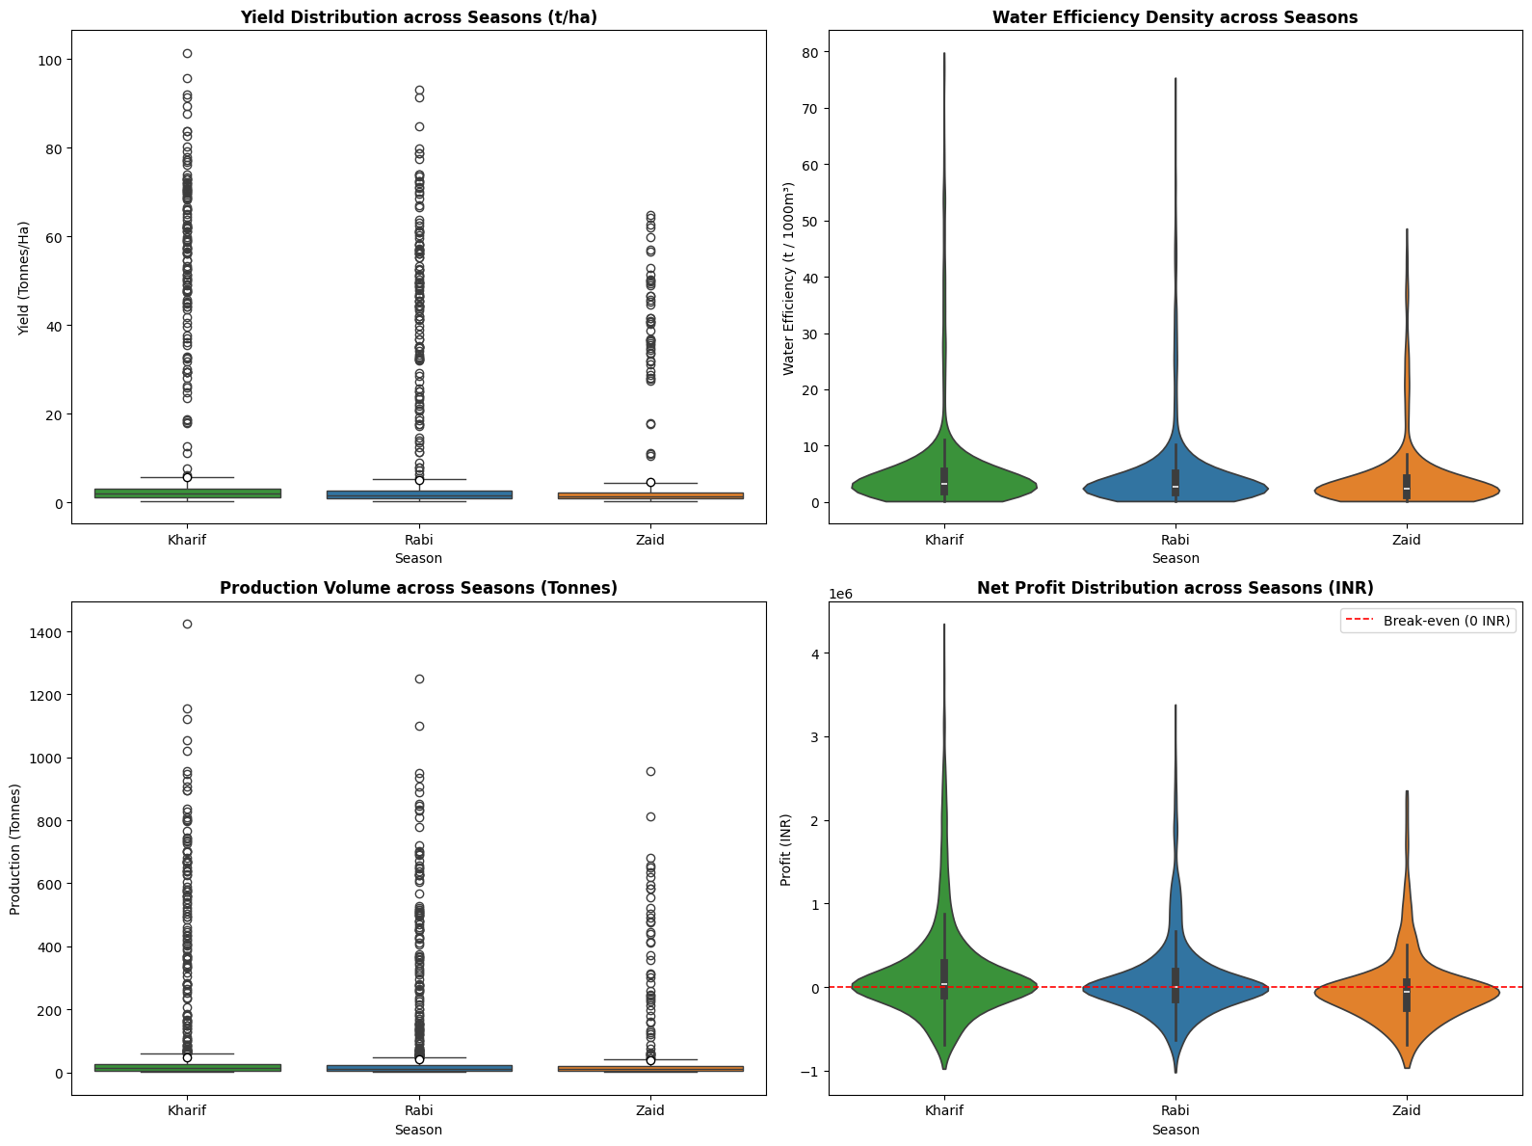
RESULTS
Box plot of Yield (Tonnes/Ha) across Kharif, Rabi, and Zaid seasons showing extreme high-value outliers.
Violin plot of Net Profit (INR) across seasons highlighting distribution density and a red dashed break-even line (0 INR).

Slide 9
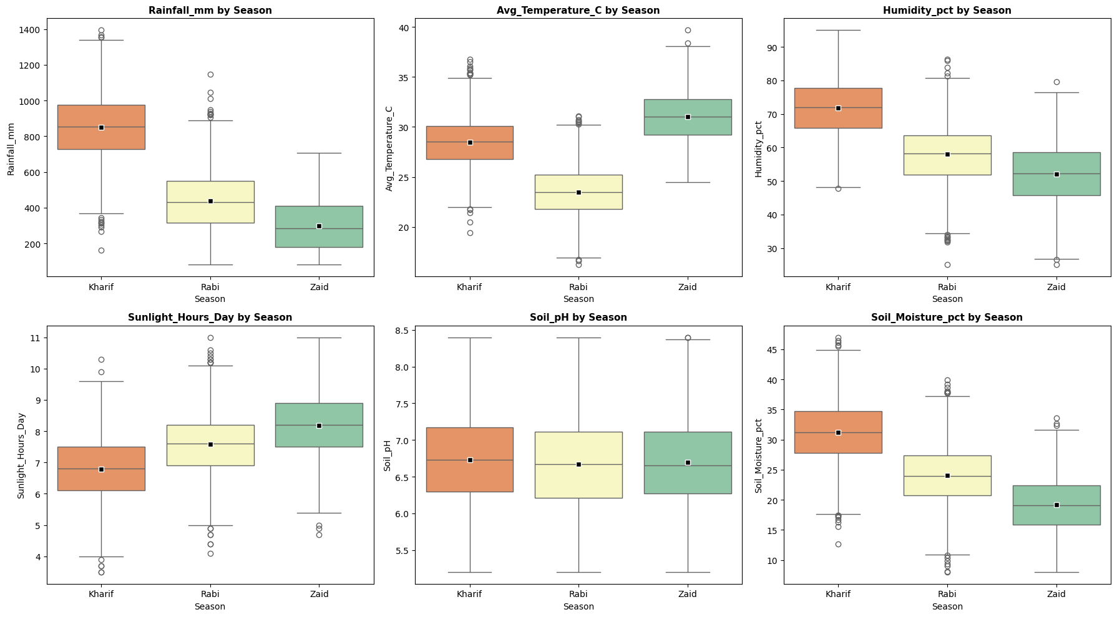
RESULTS
Box plot of Seasonal Rainfall (mm) showing median, interquartile range (IQR), and mean markers.
Box plot of Seasonal Average Temperature (°C) across Kharif, Rabi, and Zaid.

Slide 10
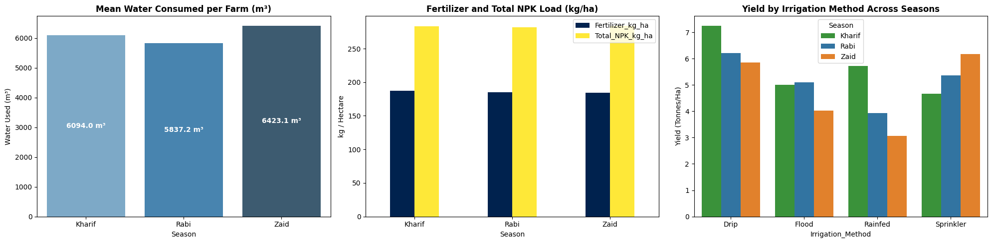
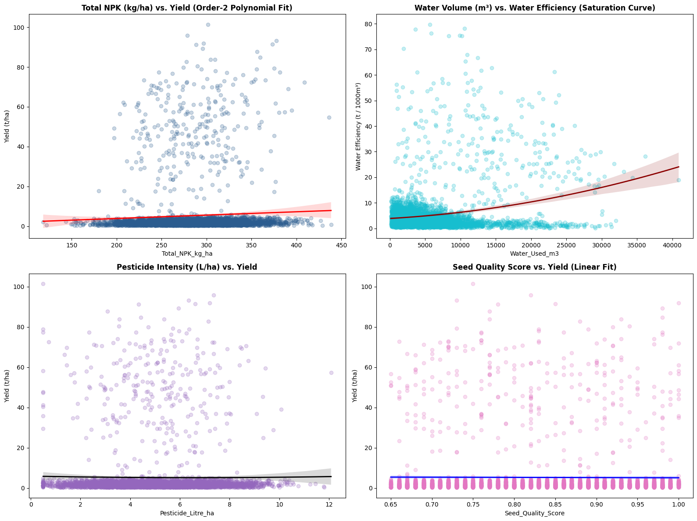
RESULTS
Bar chart showing Mean Water Consumed per Farm (m³) across Kharif, Rabi, and Zaid.
Scatter plot and non-linear regression curve for Water Volume (m³) vs. Water Efficiency (t / 1,000m³).

Slide 11
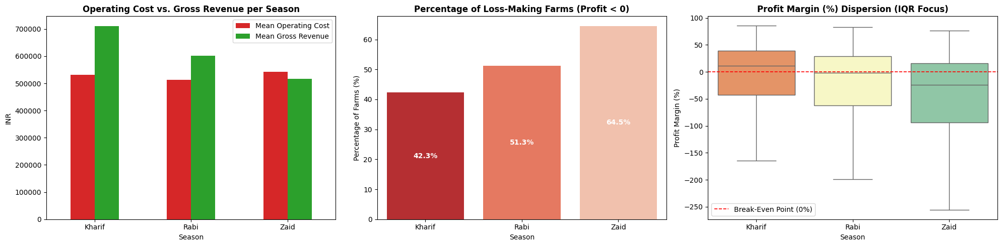
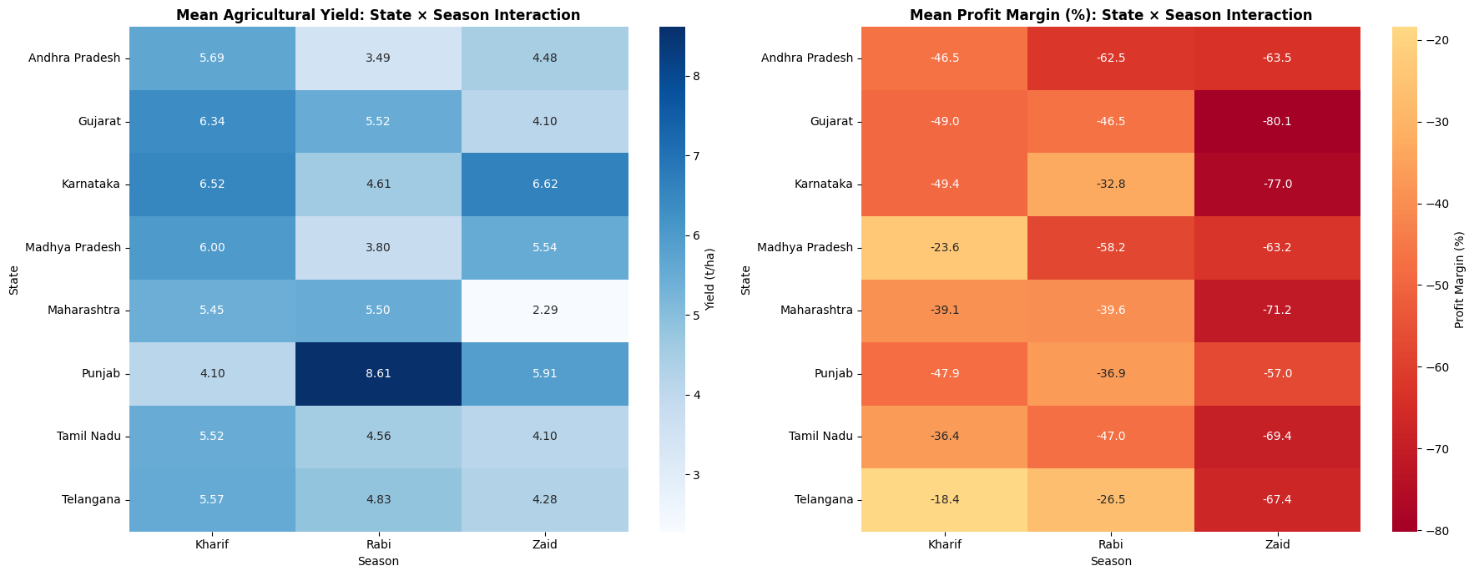
RESULTS
Bar chart illustrating the percentage of loss-making farms (Profit < 0) across seasons.
State × Season interaction heatmap displaying mean agricultural yields (t/ha).

Slide 12
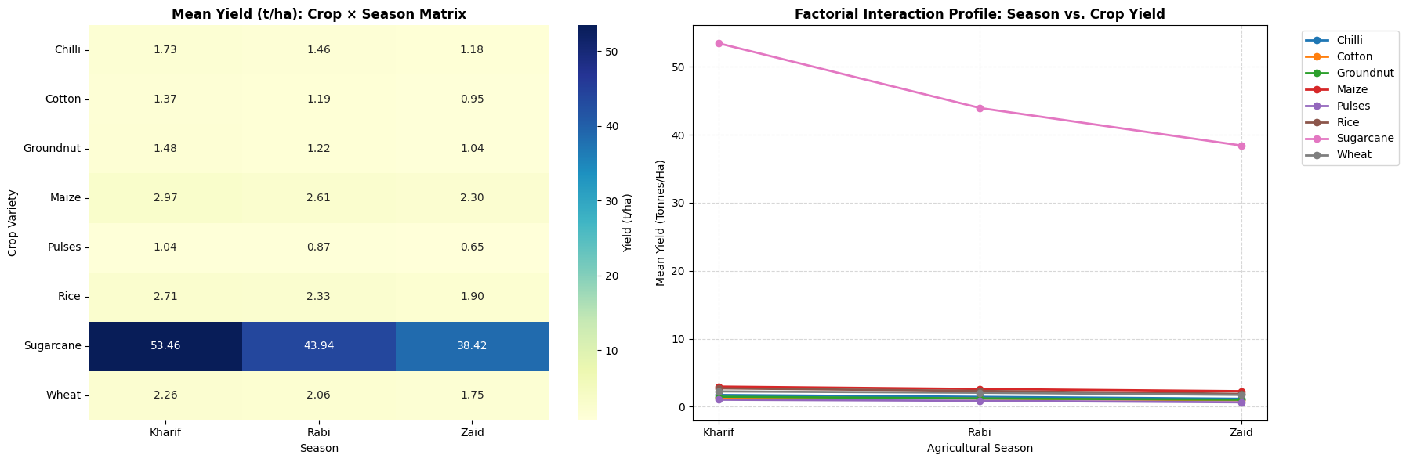
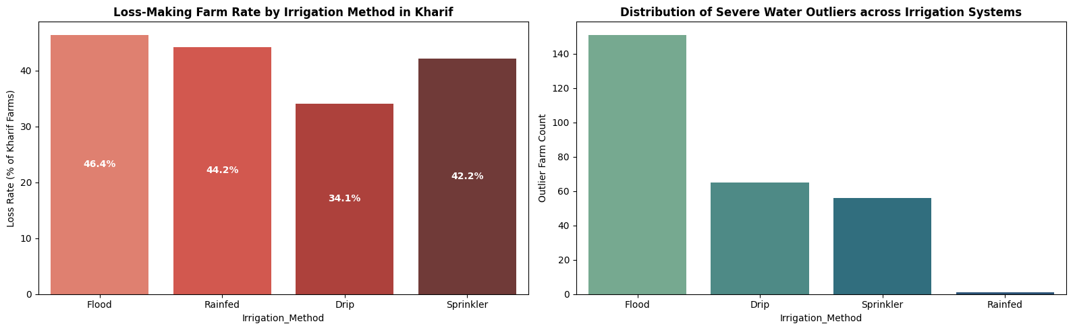
RESULTS
Factorial interaction line plot comparing mean yields (t/ha) of eight crops across Kharif, Rabi, and Zaid.
Bar chart showing the count of severe water consumption outliers by irrigation method.

Slide 13
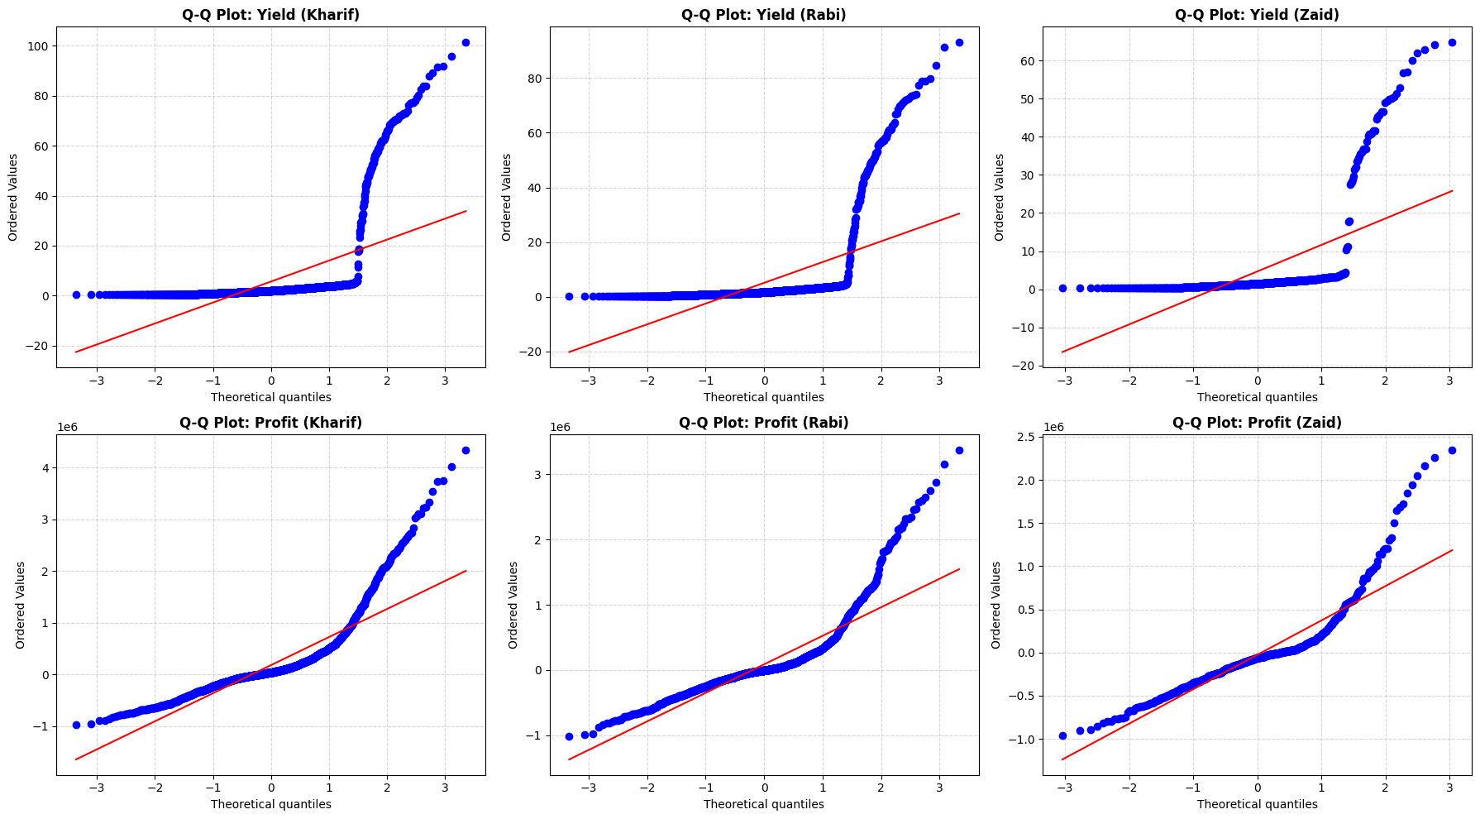
RESULTS
Top Row: Quantile-Quantile (Q-Q) plots for Yield distribution across Kharif, Rabi, and Zaid.
Bottom Row: Q-Q plots for Net Profit distribution across Kharif, Rabi, and Zaid against theoretical normal quantiles.

Slide 14
Future scope
Develop Machine Learning models to predict crop yield and agricultural performance.
Build a Crop Recommendation System based on seasonal and environmental conditions.
Integrate real-time weather data for improved agricultural planning.

Slide 15
Future scope
Use IoT sensors to monitor soil, water, and environmental conditions.
Develop smart irrigation solutions to improve water efficiency.
Integrate GIS and satellite data for geographical agricultural analysis.
Develop an agricultural decision-support system with actionable recommendations.

Slide 16
GitHub Link
https://github.com/Manikanta-sai-kanusu/Seasonal-Agriculture-Performance-Analysis/tree/main

Slide 17

VOIS Course completion certificate - Course name- Data Visualization

Slide 18
Thank you
.

