Slide 1
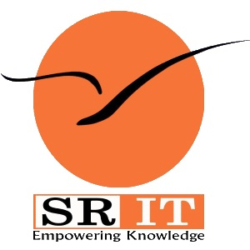
PROCESS MINING VIRTUAL INTERNSHIP
by
MANIKANTA B
Roll No. 224G1A3252
Department of Computer Science and Engineering (Data Science)
Srinivasa Ramanujan Institute of Technology
(Affiliated to JNTUA & Approved by AICTE) (Accredited by NAAC with ‘A’ Grade & Accredited by NBA (EEE, ECE & CSE)
Rotarypuram Village, B K Samudram Mandal, Ananthapuramu – 515701.
2024 - 2025

Slide 2

Contents
Course Objective
Introduction
Technology
Applications
Modules
Real Time applications
Learning outcomes
GitHub Link
Queries

Slide 3
Course Objective
Understand the basics of process mining and its role in analyzing business processes.
Learn to automatically discover process models and perform conformance checking.
Analyze process performance to identify inefficiencies and suggest improvements.
Gain practical experience with tools like Celonis and Disco for process visualization.
Use process mining to monitor and enhance business processes continuously.

Slide 4
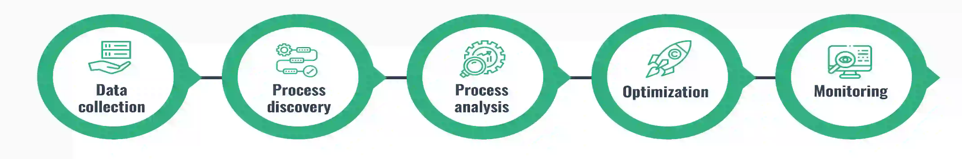
Introduction
Process Mining is a technique that helps analyze business processes using event logs from systems like ERP, CRM, and EHR.
It uncovers how processes are truly performed by discovering variations, inefficiencies, and areas for improvement.
Key Techniques:
Process Discovery: Creating models from event logs without prior knowledge of the process.
Conformance Checking: Comparing the actual process with the intended model to identify deviations.
Process Enhancement: Improving existing models with new data insights.

Slide 5
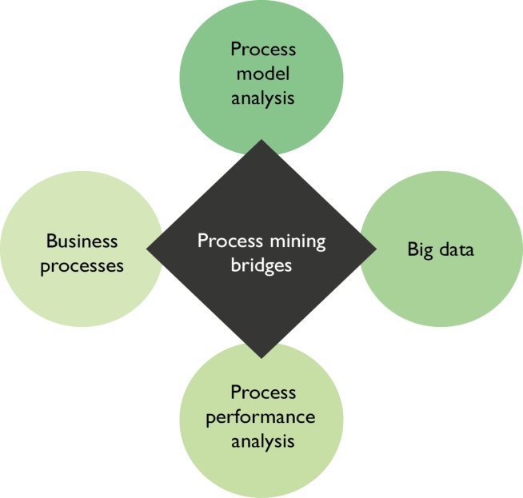
Introduction
Why Process Mining Matters:
Real-Time Insights: Provides a clear, data-driven view of how business processes actually function, not just how they are supposed to work.
Optimization: Identifies inefficiencies and suggests ways to streamline processes, improving performance and reducing costs.
Data-Driven Decisions: Helps organizations make informed decisions by uncovering hidden patterns and trends within their operations.
Scalability: Easily applies to various industries such as finance, healthcare, and manufacturing, allowing businesses to continuously improve and adapt.

Slide 6
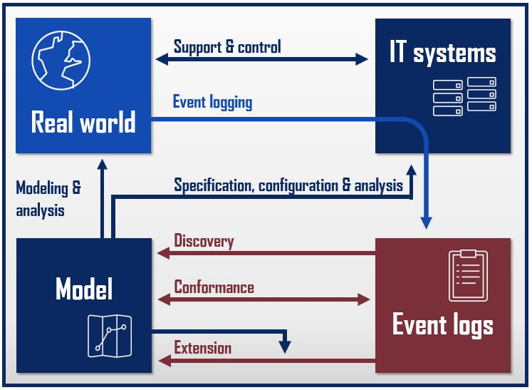
Technology
Key Technologies in Process Mining:
Process Discovery
Algorithms (Alpha Miner, Heuristic Miner)
Petri Nets: Visualize and model processes
Enhancement
Machine Learning: Predict outcomes and optimize processes
AI: Anomaly detection and process improvement
Data Integration
Big Data: Handle large-scale event logs
Cloud Platforms: Store and process data (AWS, Google Cloud)
Process Mining Tools
ProM (Open-source), Celonis (Commercial)
Visualization
Dashboards: Power BI, Tableau for real-time insights

Slide 7
Applications
Process Mining Applications:
Healthcare:
Optimizes the care treatment by releasing the delay in the waiting time by performing process analysis on patient care.
Finance:
Fraud detection as well as compliance could be improved through the ability to analyze real-time transaction processes through process mining.
Telecommunications:
This application helps improve customer service processes by facilitating process analysis on call handling and service delivery.
Retail:
This improves the customer's journey through enhancement in sales and inventory management.
Supply Chain Management:
Streamlines logistics and inventory management to reduce costs and improve delivery times.

Slide 8
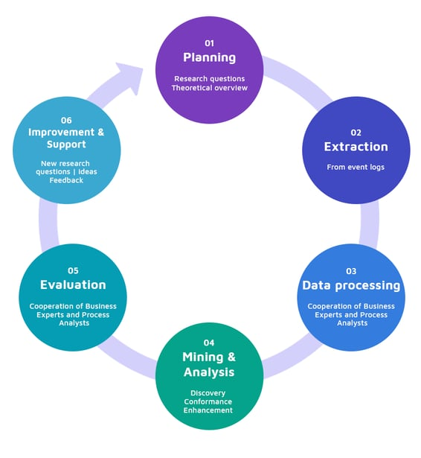
Modules
Modules of Process Mining
Planning:
Define research questions and establish a theoretical overview to guide the process mining initiative.
Extraction:
Gather data from event logs to ensure a comprehensive dataset for analysis.
Data Processing:
Collaborate with business experts and process analysts to preprocess and refine the data for mining.
Mining & Analysis:
Perform process discovery, conformance checking, and enhance process models to identify inefficiencies.
Evaluation:
Engage business experts and analysts to evaluate findings and assess process performance against standards.
Improvement & Support:
Implement new research ideas and feedback mechanisms to support ongoing enhancements in process mining efforts.

Slide 9
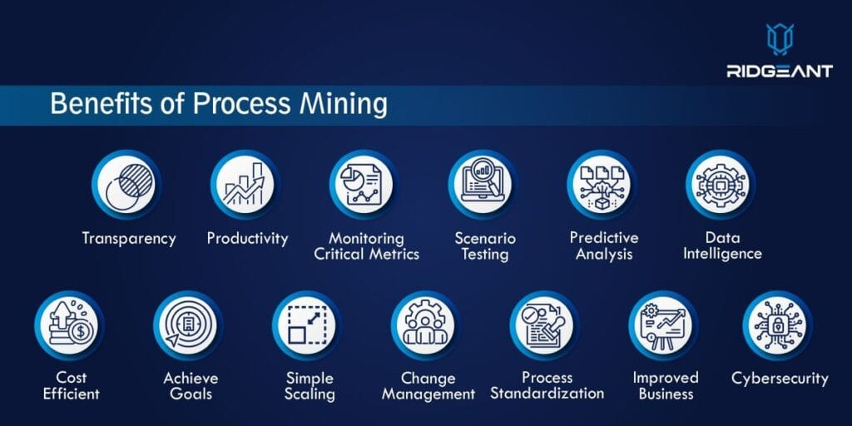
Real Time Applications
Retail Industry: Monitoring stock levels, delivery times, and sales processes to enhance customer satisfaction.
Financial Services: Managing compliance, risk, and fraud detection in banking and insurance.
Telecommunications: Optimizing service delivery, billing systems, and customer support processes.
Agile Decision-Making: Allows organizations to adapt their processes rapidly based on real-time insights, ensuring they remain competitive and responsive to changes
Predictive Analytics: Predict bottlenecks before they occur in real-time.
Process Automation: Automate mundane tasks like order processing or invoice approvals.

Slide 10
Learning Outcomes
Understand the core concepts of process mining and how to implement it using Celonis.
Gain hands-on experience in extracting, preparing, and analyzing data for process improvement.
Develop skills in identifying process inefficiencies and implementing AI-driven optimizations.
Learn how to apply process mining to real-world scenarios and drive business outcomes.
Gain a solid understanding of process mining principles and how they apply to real-world scenarios.
Be able to interpret process mining models and derive actionable insights.
Develop the ability to use Celonis to identify inefficiencies and opportunities for improvement in business processes.
Learn how to apply automation and AI to optimize processes.
Enhance their analytical and problem-solving skills with hands-on experience using Celonis tools.

Slide 11
Git Hub Dashboard

Slide 12
Any Queries?

Slide 13
Thank You!!!

