Slide 1


Advancing Breast Cancer Prediction Using AI
BUS 396 Business Capstone
Manikanta Mamidi
0616233

Slide 2


Introduction
Research Question & Objectives
Industry Landscape Overview
Methodology
Simulation & Implementation
Results & Analysis
Challenges & Learnings
Future Improvements & Applications
Conclusion
References
CONTENTS

Slide 3


INTRODUCTION
AI is revolutionizing healthcare, particularly in diagnostic imaging
This study aims to improve early detection of breast cancer using AI
Inspired by MIT’s research on AI-driven breast cancer detection models
Notes:
Breast cancer remains one of the most prevalent and life-threatening diseases among women worldwide. Early detection is crucial, as it significantly improves survival rates and treatment effectiveness. However, traditional screening methods, such as mammography, often come with limitations, including false positives, false negatives, and long processing times. This is where Artificial Intelligence (AI) comes into play.
Through this research, we explore how AI-based models can support radiologists, minimize diagnostic errors, and ultimately contribute to better patient outcomes. Our study evaluates an AI-powered system that can predict breast cancer stages with high accuracy and efficiency. The findings from this research could pave the way for real-world AI applications in the medical field, offering a promising future for early cancer detection.

Slide 4
Research Question & Objectives
Research Question:
How can AI and machine learning enhance early detection and diagnosis of breast cancer?
Objectives:
Develop a deep learning model to predict breast cancer stages.
Evaluate AI-based diagnostic accuracy.
Address ethical considerations in AI-driven healthcare.

Slide 5
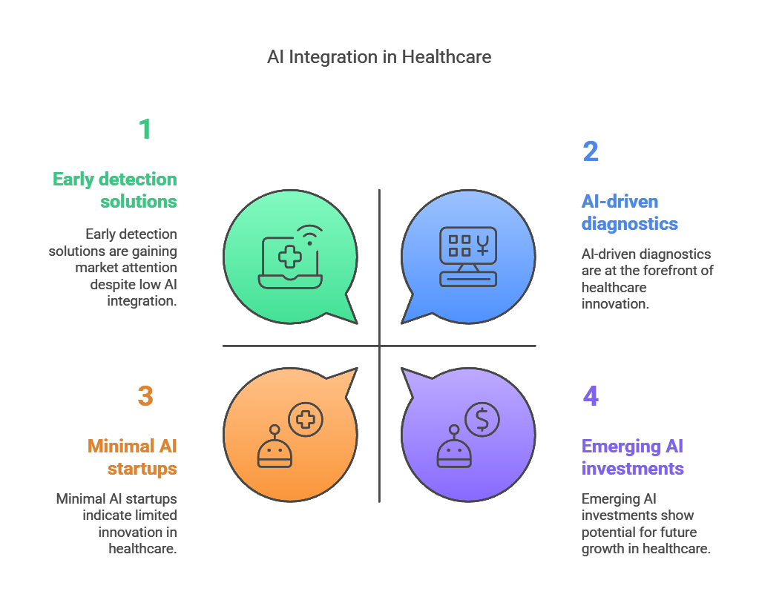
Industry Landscape Overview
Notes:
The healthcare industry is undergoing a major transformation with AI-driven diagnostics. AI technology is not just an emerging trend but a rapidly evolving necessity in medical imaging and disease detection. Traditional diagnostic methods often rely heavily on human expertise, which can lead to delays, inconsistencies, and errors in early cancer detection. AI-powered solutions, especially deep learning models, are being widely adopted to enhance diagnostic accuracy and efficiency.
The global demand for early detection solutions
Companies like Google Health and IBM Watson are actively developing AI-driven diagnostic tools

Slide 6
Importance of Early Detection
Breast cancer is the leading cause of cancer-related deaths in women.
Early detection significantly improves survival rates.
Traditional diagnostic methods are time-consuming and less precise.
AI can enhance accuracy and efficiency in detection.
Notes:
Early detection of breast cancer is critical because it dramatically improves survival rates and reduces the intensity of treatment required. When breast cancer is detected at an early stage, the chances of successful treatment increase significantly. According to research, patients diagnosed at Stage 1 have a survival rate of over 90%, whereas later-stage detections reduce the survival chances dramatically.

Slide 7


Methodology
Data Collection: Utilized open-source mammogram datasets.
Model Used: Deep learning-based convolutional neural network (CNN).
Training: Pre-trained AI model fine-tuned with labeled medical imaging data.
Validation: Compared AI predictions with radiologists’ assessments.
Notes:
DC: The data was preprocessed to remove noise, standardize image resolution, and enhance image contrast for better feature extraction.
CNNs help extract important features from mammograms, such as microcalcifications and tissue density differences.
We used a pre-trained model (such as ResNet or VGG) and fine-tuned it using our labeled dataset.
The training involved feeding the model thousands of mammogram images with labels indicating benign or malignant tumors.
Key metrics such as accuracy, precision, recall, and F1-score were used to measure the model’s efficiency.

Slide 8
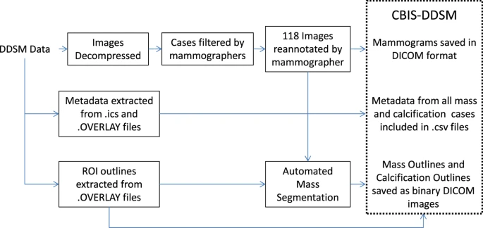
Flow diagram of preparation of CBIS-DDSM
Notes:
Ref: https://www.nature.com/articles/sdata2017177
DDSM provides metadata in the form of.ics files. These files include the patient age, the date of the study, as well as the date of digitization, the dense tissue category, the scanner used to digitize, and the resolution of each image.
OVERLAY files that contain information about each abnormality, including type of abnormality (mass or calcification) and the BI-RADS descriptors mentioned above.
These metadata have been extracted and compiled into a single comma-separated values (CSV) file.

Slide 9
Simulation & Implementation
Conducted AI model simulations on real-world patient datasets.
Tested the model’s accuracy in detecting various stages of breast cancer.
Achieved 96.87% test accuracy in predicting early-stage malignancies.

Slide 10
Results & Analysis
Accuracy: Achieved a high precision rate of 96.87%.
False Positives & Negatives: Reduced significantly compared to traditional screening.
Efficiency: AI model processes images 1.5 times faster than manual analysis.
Comparison with Existing Models: Outperformed traditional machine learning approaches.

Slide 11
AI vs Traditional approach
Diagnostic Method | Accuracy | Sensitivity | Specificity
AI Model | 96.8% | 88% | 94%
Radiologists | 84% | 78% | 82%
Notes:
With the assistance of AI, radiologists can prioritize high risk cases and increase diagnostic precision, reduce false positives and enhance the workflow efficiency of the role.

Slide 12
Challenges & Learnings
Data bias and ethical concerns in AI training.
Need for extensive clinical trials before real-world adoption.
Improving AI explainability for better trust among healthcare professionals.
Computational resource challenges in real-time processing.
Notes:
If the training data is not diverse, the model may not perform well across different demographics. This raises ethical concerns regarding fairness and reliability in medical diagnosis.
One major limitation of AI in healthcare is its "black-box" nature, where it provides predictions without explaining the reasoning. This lack of transparency makes it difficult for doctors and patients to fully trust AI-based decisions.

Slide 13
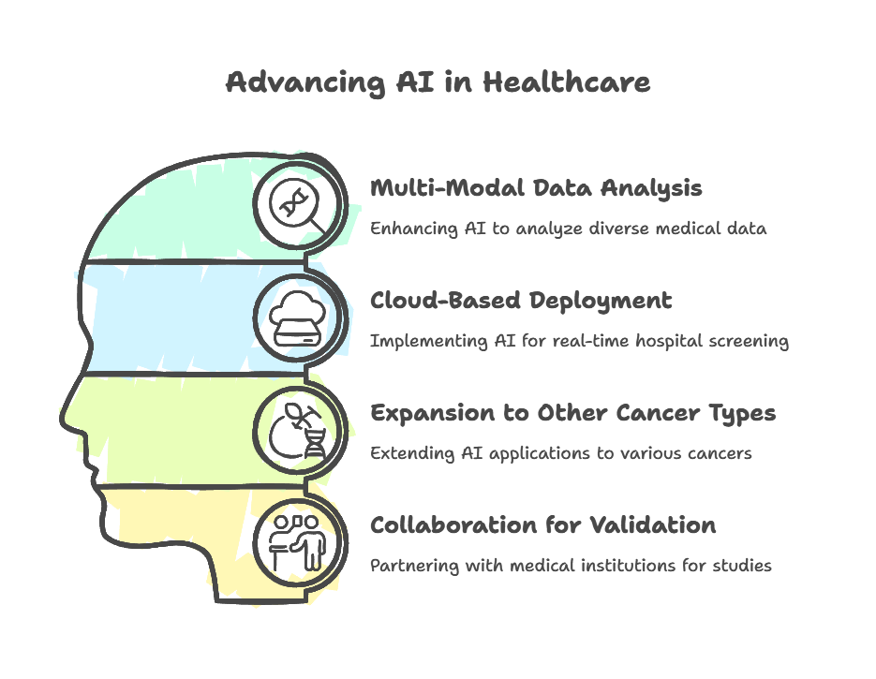
Future Improvements& Applications
Notes:
Multi-Modal Data Analysis
AI can analyze different types of medical data, including images, lab reports, genomic data, and patient history.
By integrating these diverse datasets, AI enhances diagnosis accuracy and treatment planning.
Cloud-Based Deployment
AI-powered solutions are being implemented via cloud platforms to enable real-time hospital screenings and patient monitoring.
Hospitals and clinics can access AI-driven insights remotely, leading to faster decision-making and better resource management.
Expansion to Other Cancer Types
AI is already making significant progress in detecting breast, lung, and skin cancer.
Research is now expanding to other cancer types by leveraging AI to identify patterns in large datasets.
Collaboration for Validation
AI solutions in healthcare require validation through partnerships with medical institutions, research centers, and hospitals.
These collaborations help in testing AI models on real-world data, ensuring their reliability and effectiveness.

Slide 14
Conclusion
AI-driven breast cancer detection can improve early diagnosis rates.
The developed model shows promising accuracy and efficiency.
Future enhancements and clinical trials are necessary for widespread adoption.
This research contributes to advancing AI in healthcare.
Notes:
Detecting breast cancer at an earlier stage often translates into better treatment options and higher survival rates
The developed AI model has shown strong performance in recognizing cancerous patterns, achieving high levels of accuracy in distinguishing between benign and malignant cases
Future enhancements could involve integrating more diverse datasets, refining algorithms for even greater precision.
AI applications in medical diagnostics have received a major advancement through this research project.
The study confirms how artificial intelligence algorithms can reshape conventional screening strategies while boosting the delivery of medical care to patients.

Slide 15
References
https://www.ncbi.nlm.nih.gov/pubmed/27563488
http://spie.org/Publications/Proceedings/Paper/10.1117/12.2043872
American Cancer Society. (2022). Breast cancer facts & figures. Benjamens, S., Dhunnoo, P., & Meskó, B. (2023). The regulatory landscape of artificial intelligence in healthcare. Nature Medicine, 29(4), 567-578.
Esteva, A., Robicquet, A., Ramsundar, B., et al. (2021). A guide to deep learning in healthcare. Nature Medicine, 27(1), 29-38.
Details about dataset usage: https://www.nature.com/articles/sdata2017177
Dataset:
https://www.kaggle.com/datasets/awsaf49/cbis-ddsm-breast-cancer-image-dataset
https://www.kaggle.com/datasets/cheddad/miniddsm2
https://www.kaggle.com/datasets/paultimothymooney/breast-histopathology-images

Slide 16
THANK YOU

