Slide 1

Employee Management System Using MySQL
By
Bolla Sai Durga Siva Manikanta

Slide 2
Why Data Science
Data Science helps organizations turn large amounts of raw data into meaningful insights.
It enables smarter decision-making, predicts future trends, and improves business efficiency.
By solving real-world problems across industries, it drives innovation and growth.
As data continues to grow, Data Science has become essential and highly in demand.

Slide 3
Objective of the Project:
The main objective of this project is to analyze employee-related data using SQL to gain meaningful insights into workforce management and business operations.
It focuses on understanding employee distribution, salary structure, job roles, qualifications, leave patterns, and overall payroll performance.
By examining relationships between different tables such as JobDepartment, Employee, SalaryBonus, Qualification, Leaves, and Payroll, the project aims to identify trends that can support better decision-making in human resource planning and financial management.
Ultimately, the goal is to transform raw employee data into actionable insights that enhance organizational efficiency and employee productivity.

Slide 4
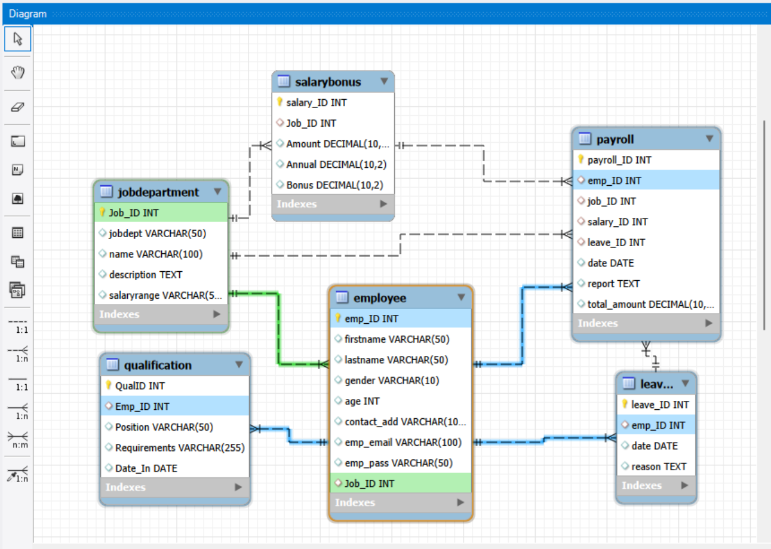
ER Diagram

Slide 5
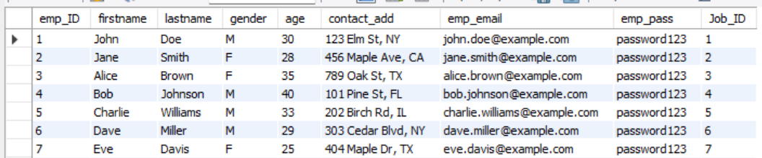
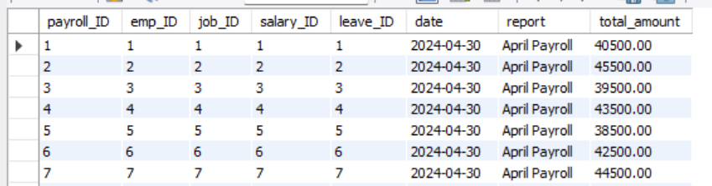
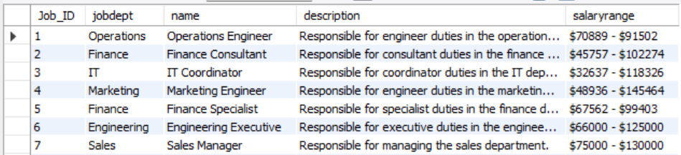
Tables
Employee
Payroll
Job
Department

Slide 6
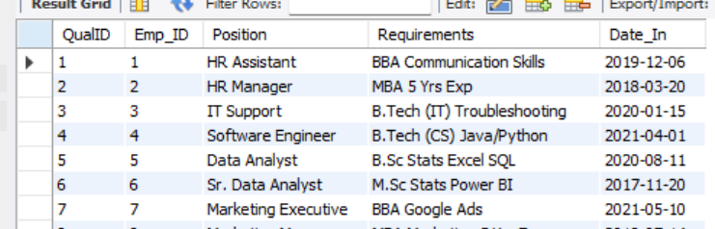

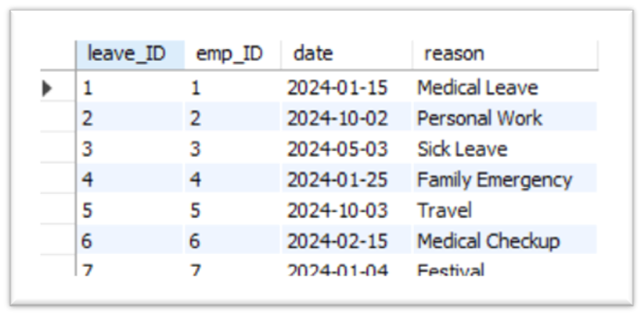
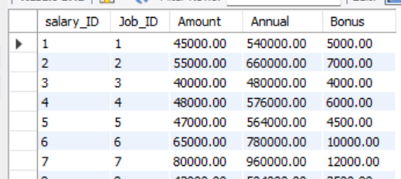
Qualification
Leaves
SalaryBonus

Slide 7
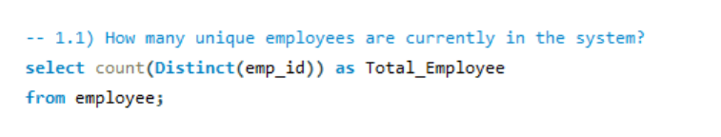
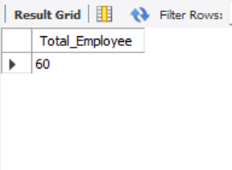
Query
How many unique employees are currently in the system?

Slide 8

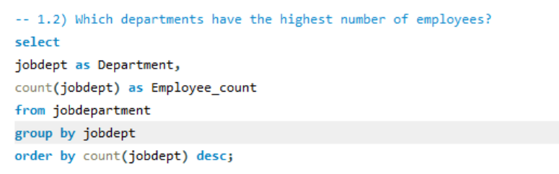
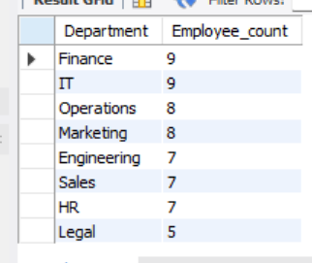
Which departments have the highest number of employees?

Slide 9
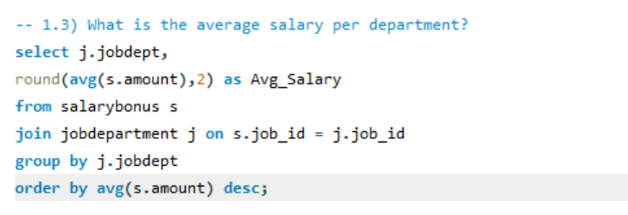
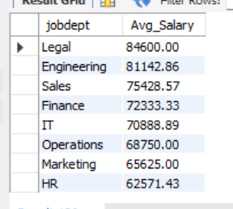
What is the average salary per department?

Slide 10
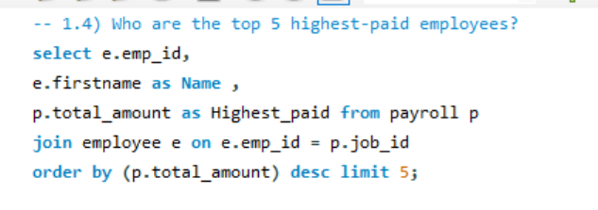
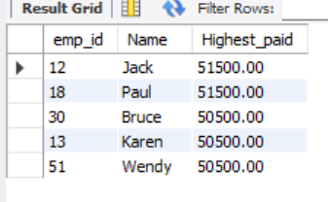
Who are the top 5 highest-paid employees?

Slide 11
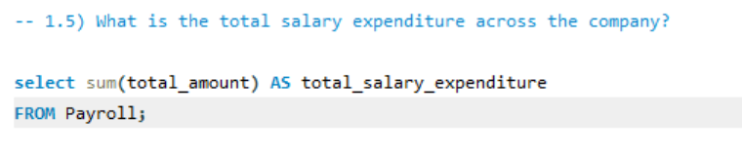
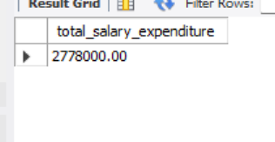
What is the total salary expenditure across the company?

Slide 12
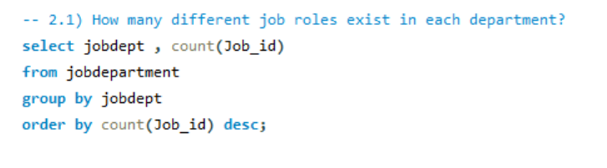
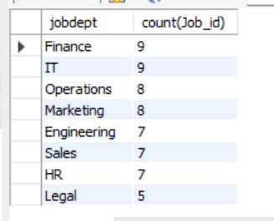
How many different job roles exist in each department?

Slide 13
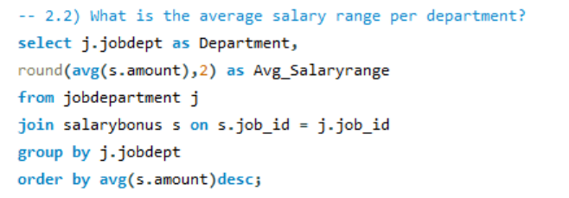
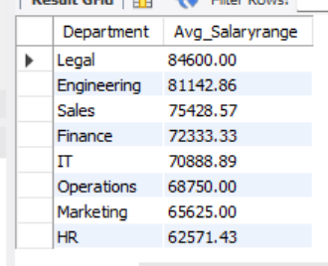
What is the average salary range per department?

Slide 14
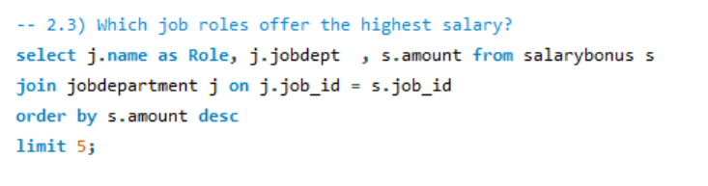
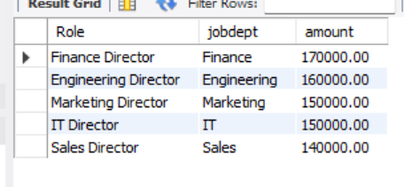
Which job roles offer the highest salary?

Slide 15
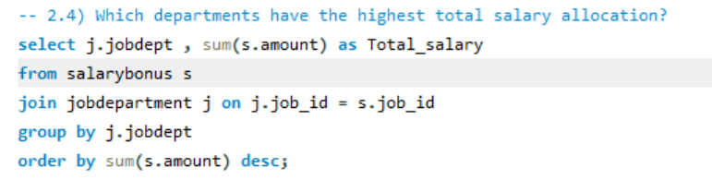
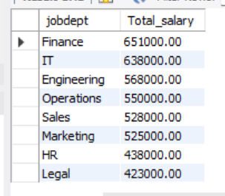
Which departments have the highest total salary allocation?

Slide 16
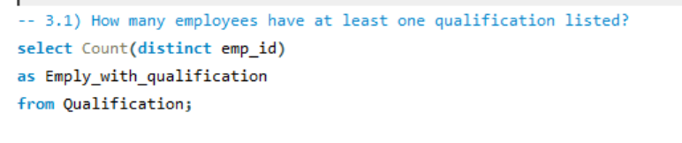
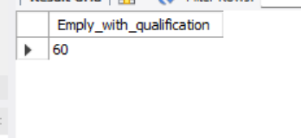
How many employees have at least one qualification listed?

Slide 17
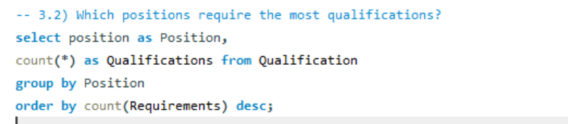
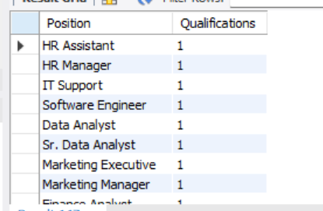
Which positions require the most qualifications?

Slide 18
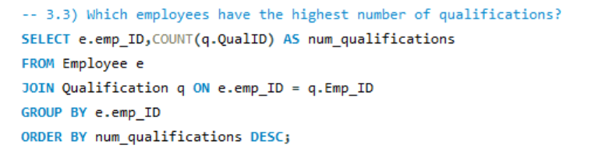
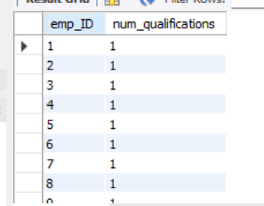
Which employees have the highest number of qualifications?

Slide 19
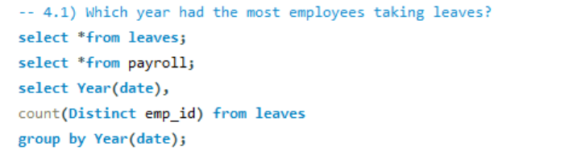
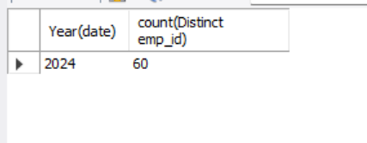
Which year had the most employees taking leaves?

Slide 20
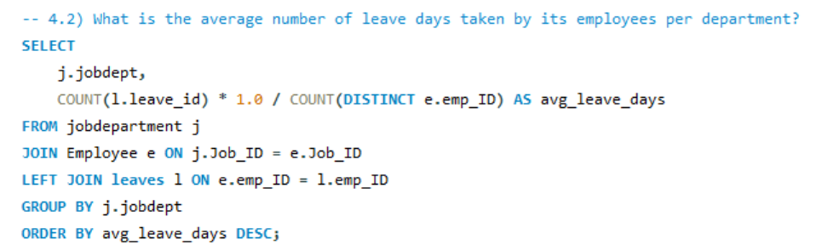
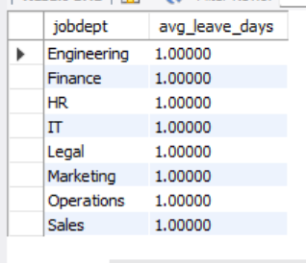
What is the average number of leave days taken by its employees per department?

Slide 21
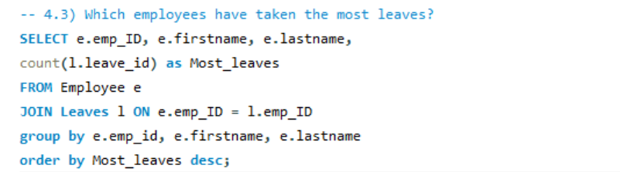
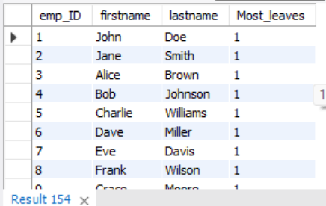
Which employees have taken the most leaves?

Slide 22
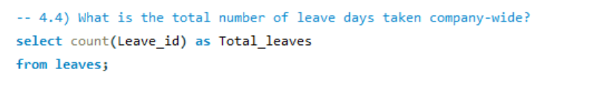
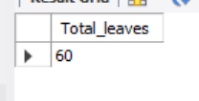
What is the total number of leave days taken company-wide?

Slide 23
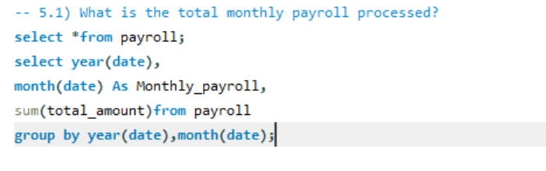
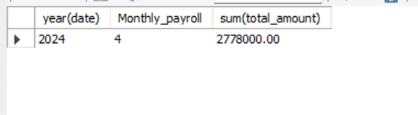
What is the total monthly payroll processed?

Slide 24
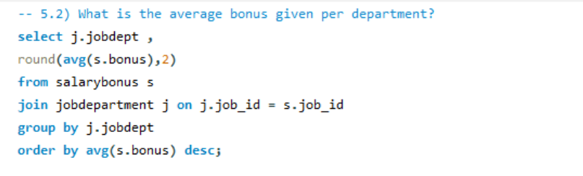
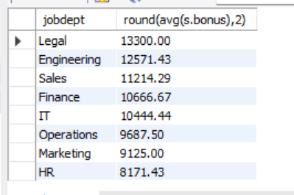
What is the average bonus given per department?

Slide 25
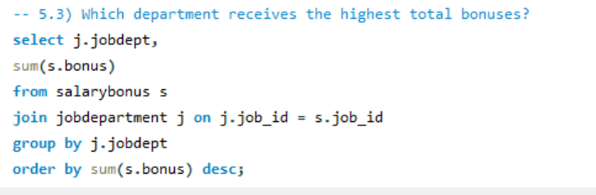
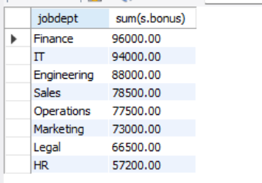
Which department receives the highest total bonuses?

Slide 26
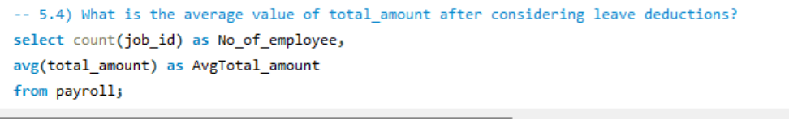
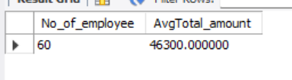
What is the average value of total amount after considering leave deductions?

Slide 27
Final business insights and recommendations :
Departments with more employees may require additional resources and better management oversight.
Highest-paid roles indicate key positions; these employees should be retained and motivated.
Average salaries and total salary expenditures help in budget planning and financial forecasting.
Employees with multiple qualifications can be considered for promotions or critical projects.
Tracking leaves and absence patterns helps in workforce planning and minimizing productivity loss.
Payroll and bonus analysis can optimize compensation strategies and reward performance effectively.
Data-driven insights support HR decisions in recruitment, training, and role allocation.
Monitoring employee trends ensures better operational efficiency and organizational growth.

Slide 28
Conclusion:
The Employee Management System helps store and manage all employee-related data in one place.
SQL queries make it easy to analyze departments, salaries, leaves, and qualifications.
The project provides clear insights that support better HR decisions and planning.
Overall, the system improves data organization, accuracy, and understanding of employee activities.

Slide 29
Challenges:
Handling large and interconnected employee data.
Ensuring accurate relationships between tables using foreign keys.
Cleaning and formatting salary and leave data for proper analysis.
Writing SQL queries that join multiple tables correctly.
Maintaining data consistency and avoiding duplicate entries.
Understanding and analyzing different patterns like salary trends and leave behavior.

Slide 30


Slide 31

THANK YOU

