Slide 1
Exploratory Data Analysis (EDA) & Business Intelligence Project
Retail Sales Analysis using Python, SQL, and Dashboarding
Presented by :-
CHAPPA MANIKANTA

Slide 2
PROJECT OBJECTIVE
The objective of this project is to uncover patterns, trends, and relationships in sales data and build business intelligence skills using Python, SQL, and dashboarding. This directly matches the task requirement shown in the project brief
The dataset contains retail transaction data with fields such as Order ID, Order Date, Customer ID, Age, Product Category, Product Name, Quantity, Price, Total Amount, City, and Payment Method. These fields are enough to perform descriptive analysis, SQL-based business analysis, multivariate exploration, and KPI reporting

Slide 3
HYPOTHESES
Electronics products may generate the highest revenue.
Monthly sales may show a trend or seasonality.
Age may influence purchase amount.
Payment method usage may show customer preference.
Revenue may be concentrated in a few products or cities.

Slide 4
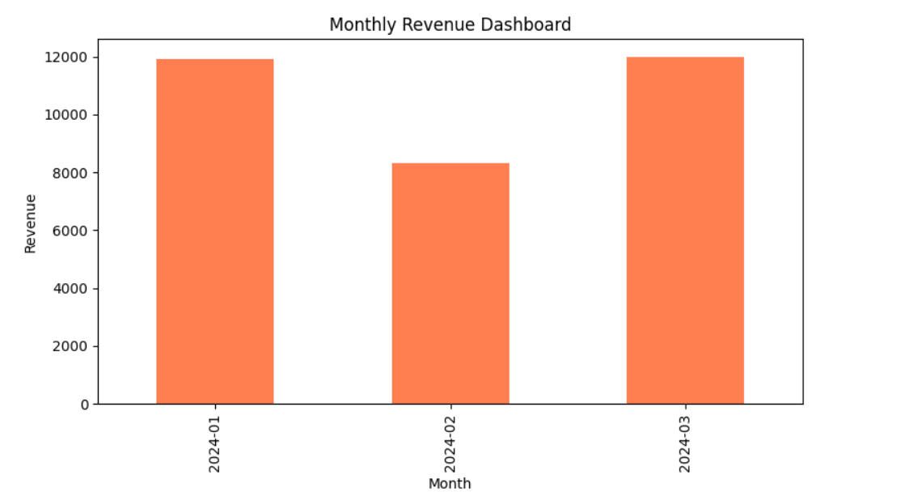
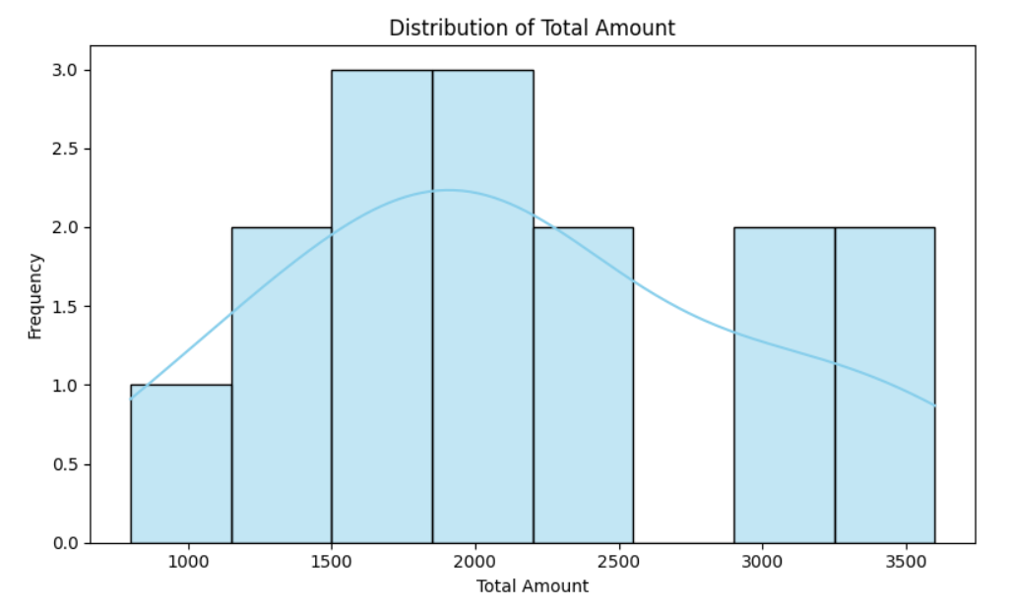
Descriptive statistics and univariate analysis
summary statistics were calculated for numerical and categorical columns. Histograms and bar charts were used to understand sales distribution, category frequency, and payment method usage, which aligns with the first required step in the task

Slide 5
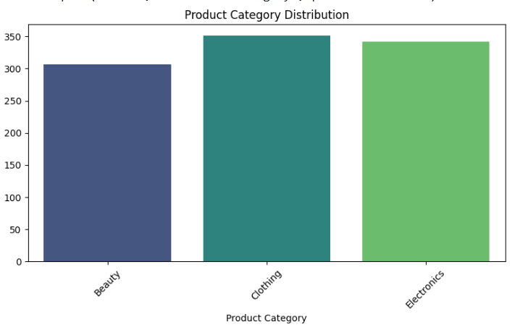
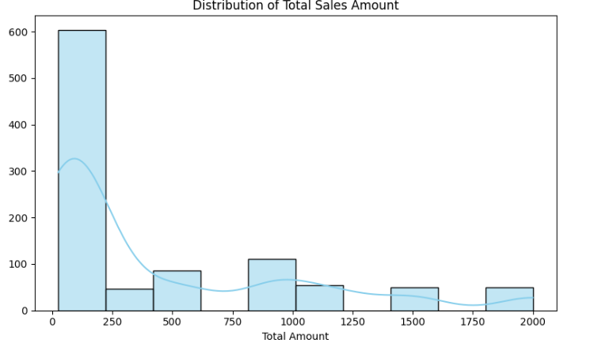
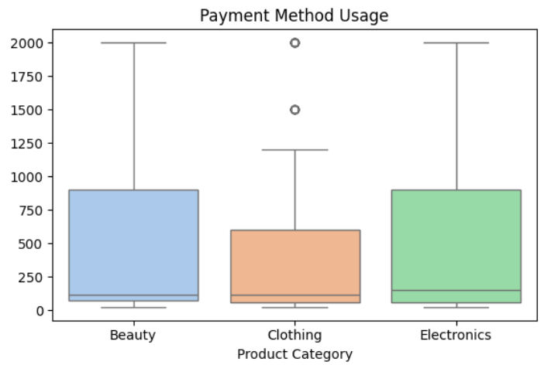
SQL (OUTPUTS)

Slide 6
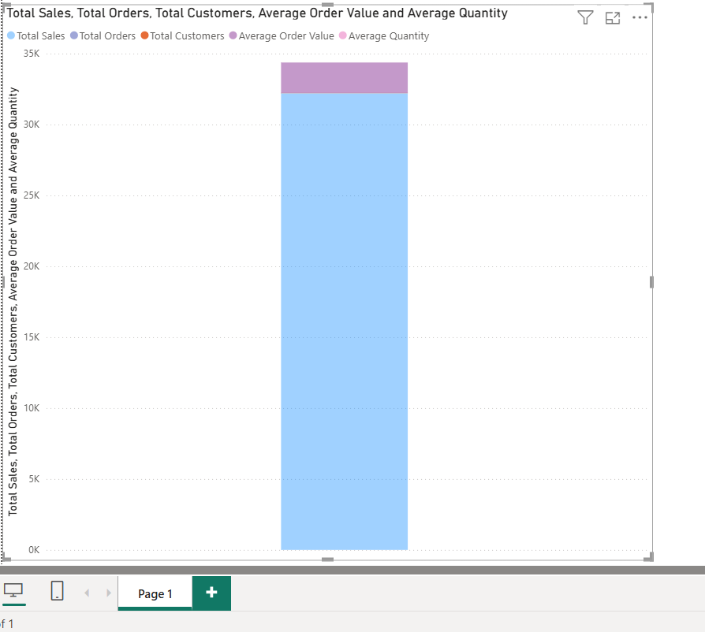
MULTIVARIATE ANALYSIS
Scatter plots, heatmaps, and pair plots were used to examine relationships between age, quantity, price, and total sales amount. This matches the multivariate analysis and correlation

Slide 7
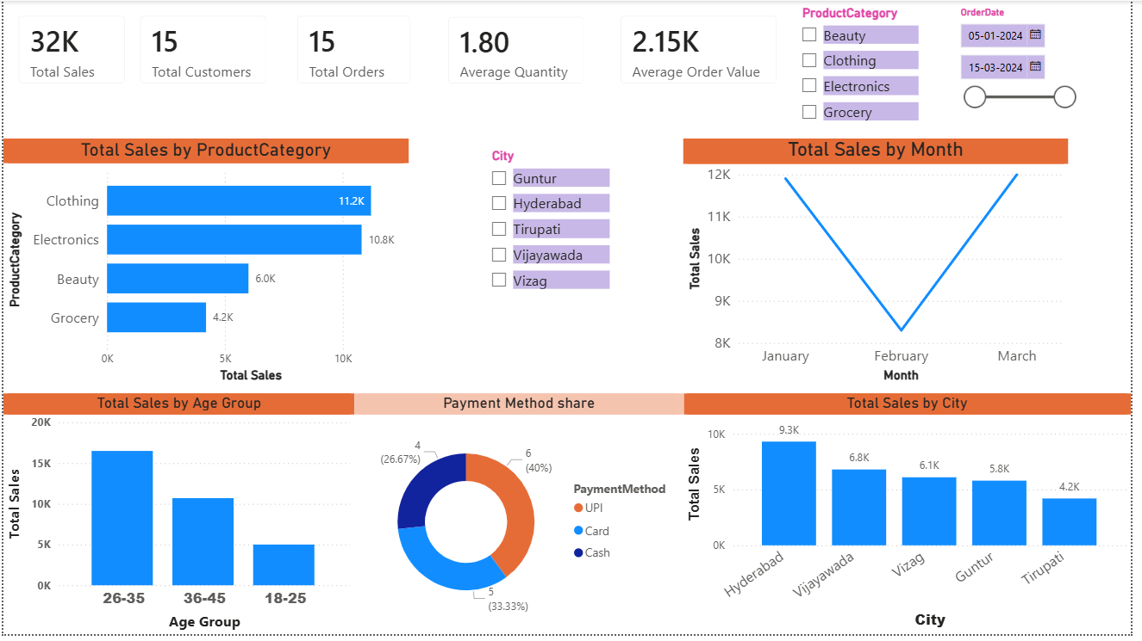
DASHBOARD & CONCLUSION
The dashboard summarizes monthly revenue performance visually. It helps quickly identify high-sales and low-sales months for business review and planning

