Slide 1
SR in thin-film ferro-electric capacitor

Slide 2
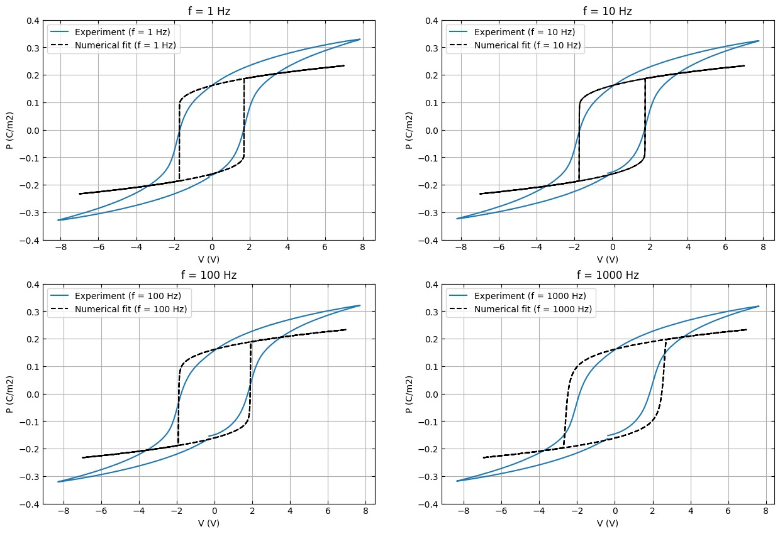
Hysteresis Fit IIT PKD
For extracting alpha, beta we used 1Hz hysteresis loop
For 1, 10, 100 Hz the fit is okay. For higher frequency the fit is not good.
Rho possibly a frequency dependent term!
In paper should we indicate 100Hz loop and fit or 1Hz loop and fit??
All with rho = 390 ohm m. Note that we have expt data for different freqeuncy as well for IITPKD data

Slide 3
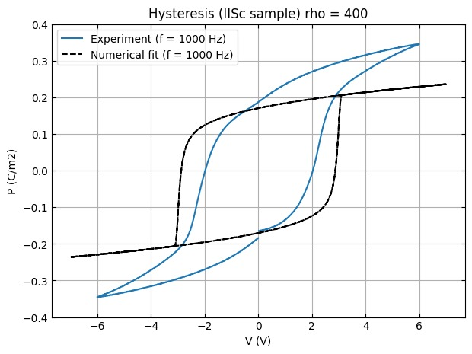
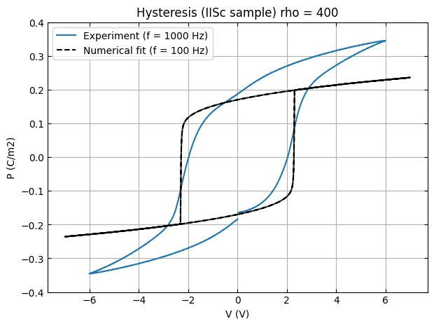
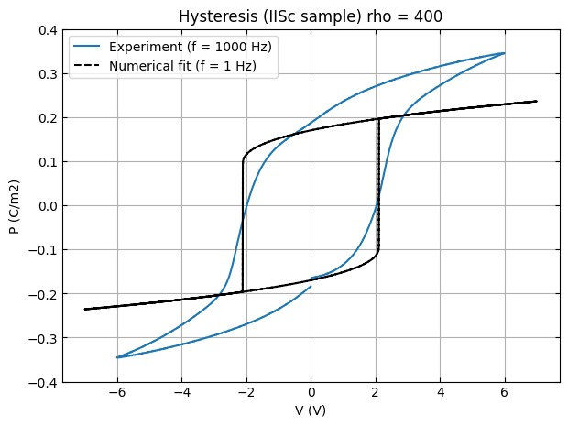
Hysteresis Fit IISc PKD
Note that we have expt data for only for 1kHz for IISc data

Slide 4

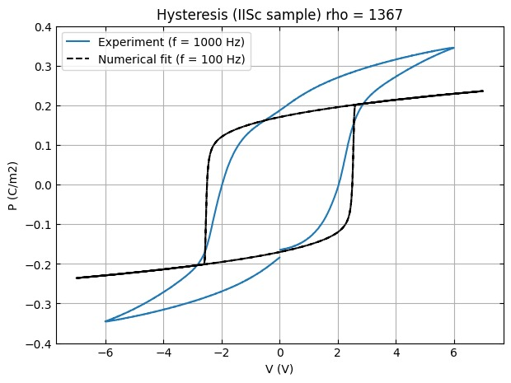
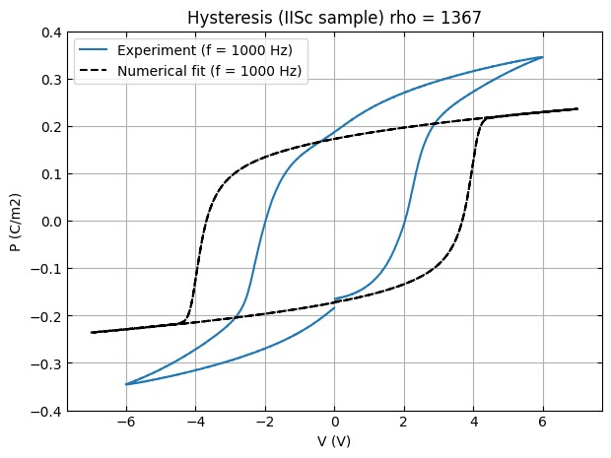
Hysteresis Fit IISc PKD
Note that we have expt data for only for 1kHz for IISc data
We are going ahead with rho = 1367 ohm m (but not giving any figures in the paper). This value seems to fit the SR results best. Maybe the sample has degraded between the meaurement of hysterisis and meausrment of SR.

Slide 5
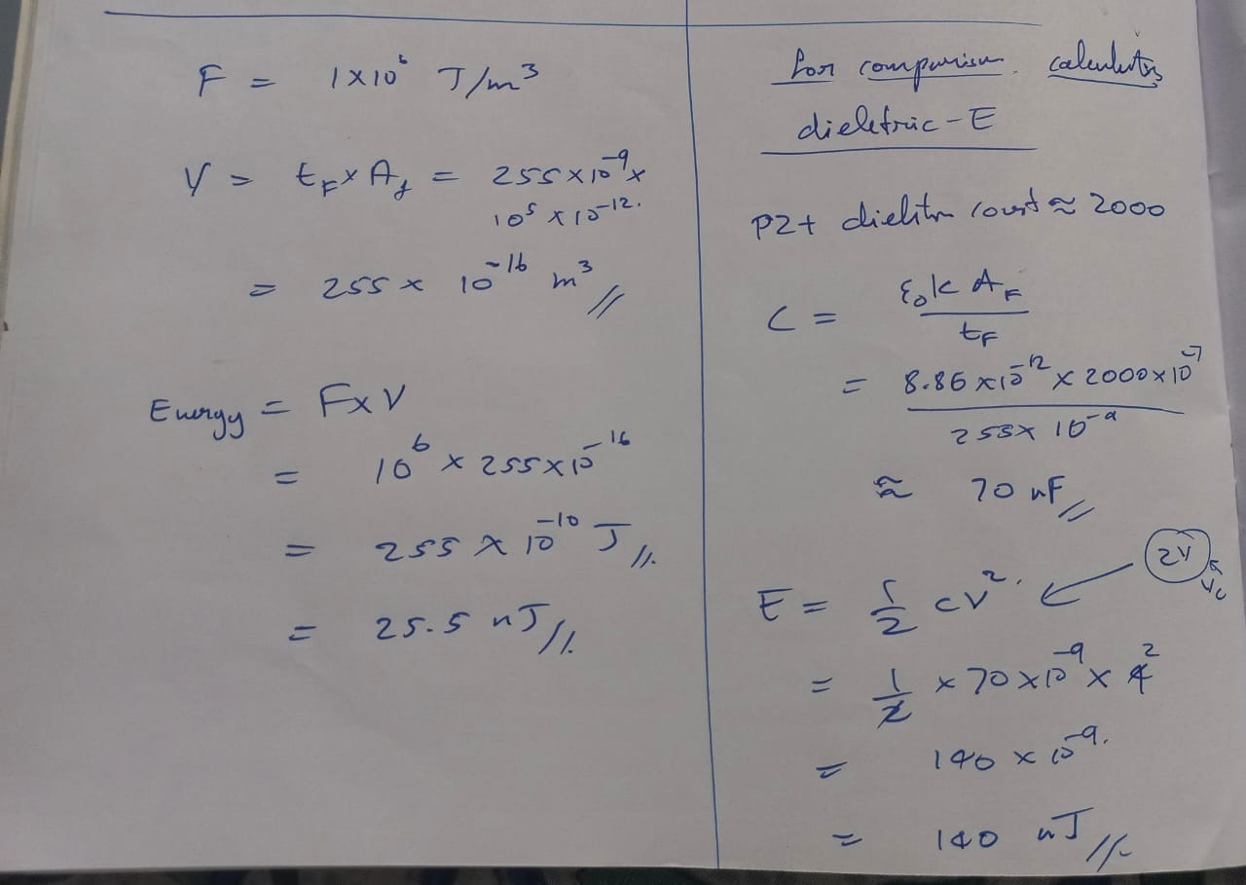
Free energy density value
Order of magnitude check!

Slide 6
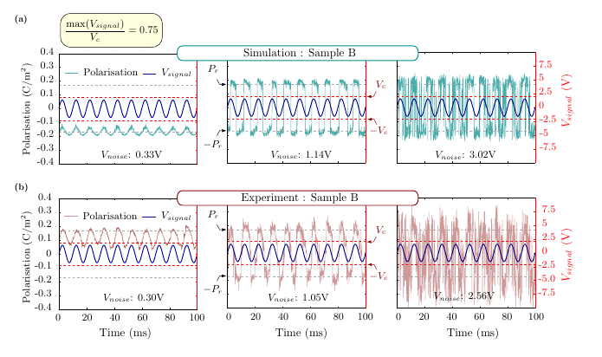
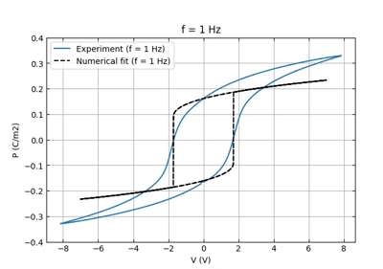
Time series data Exp vs Num
In numerical simulation the polarization value is bounded near to the Pr value
Reason: the fit is not capturing the dielectric loss
In Experiment the polarization sometimes crosses the bound and goes to higher value compared to the Pr value

Slide 7
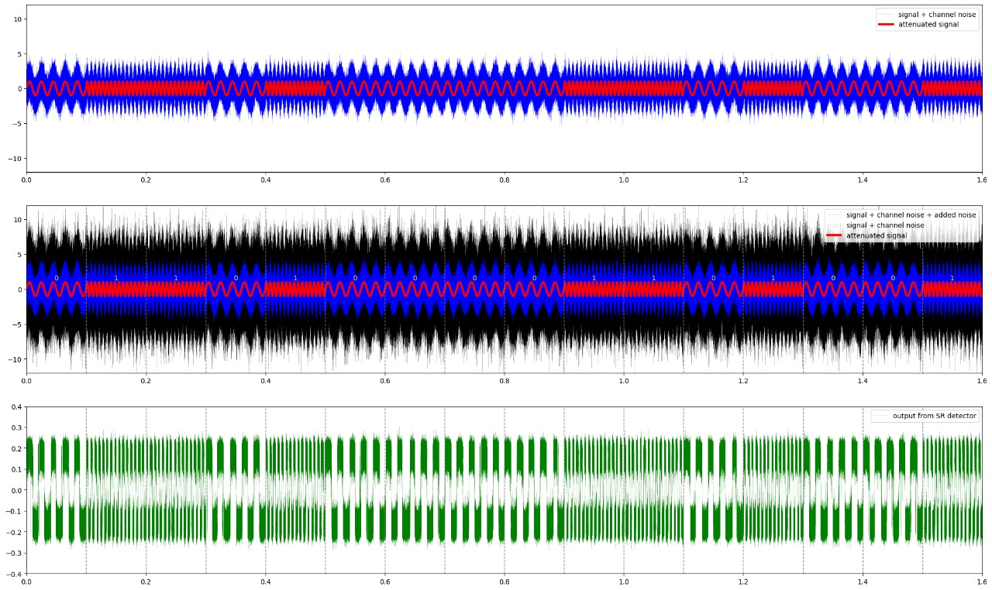
FSK SNR of the signal improves or not?

