Slide 1
SR in thin-film ferro-electric capacitor

Slide 2
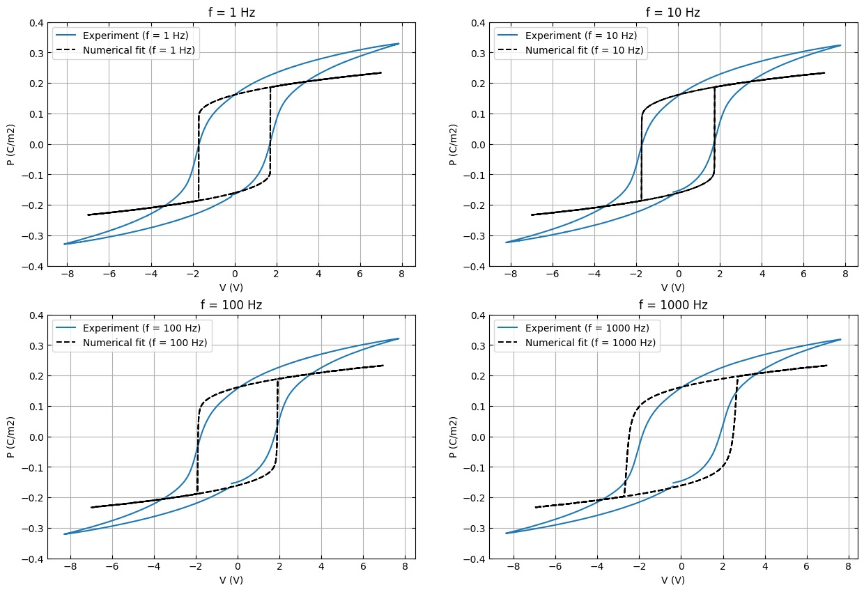
Hysteresis Fit IIT PKD
For extracting alpha, beta we used 1Hz hysteresis loop
For 1, 10, 100 Hz the fit is okay. For higher frequency the fit is not good.
Rho possibly a frequency dependent term!
In paper should we indicate 100Hz loop and fit or 1Hz loop and fit??
All with rho = 390 ohm m. Note that we have expt data for different freqeuncy as well for IITPKD data

Slide 3
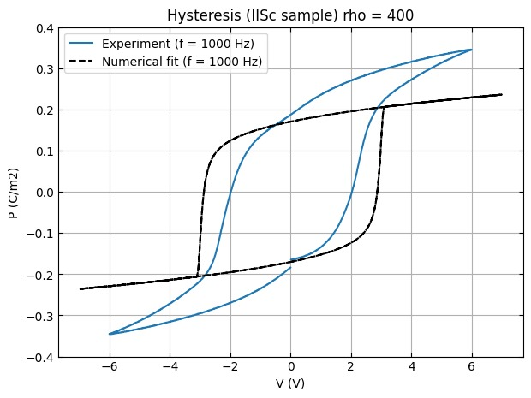
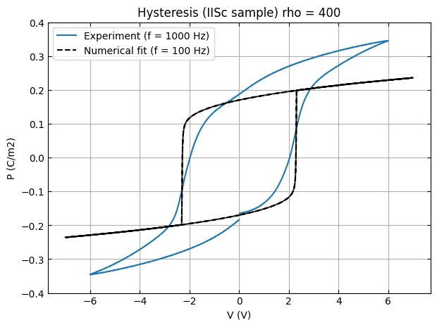
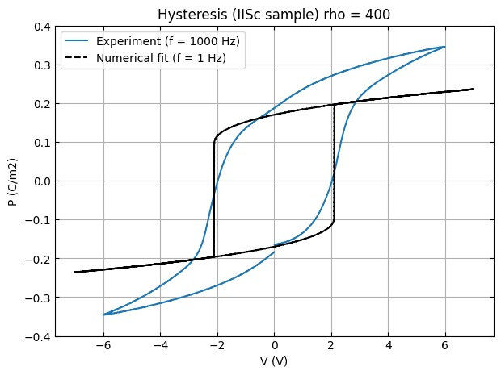
Hysteresis Fit IISc PKD
Note that we have expt data for only for 1kHz for IISc data

Slide 4

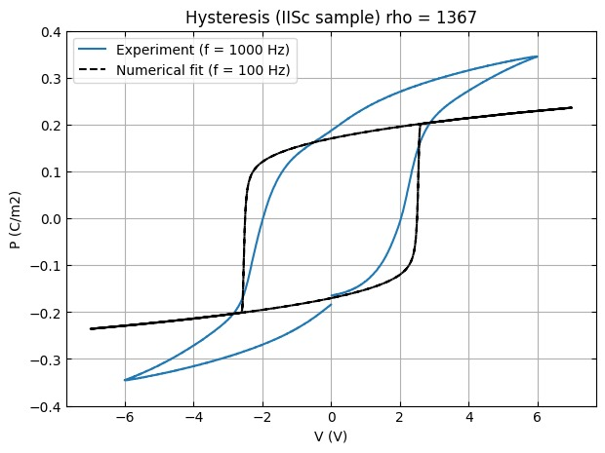
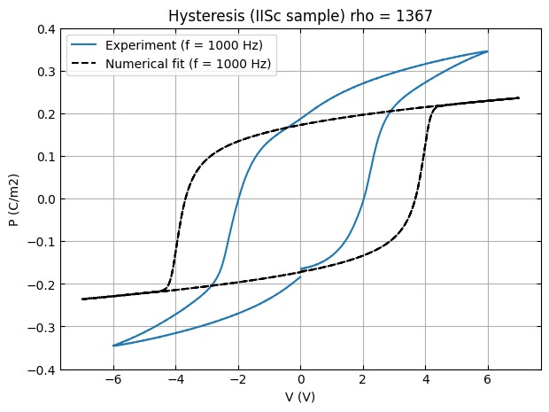
Hysteresis Fit IISc PKD
Note that we have expt data for only for 1kHz for IISc data
We are going ahead with rho = 1367 ohm m (but not giving any figures in the paper). This value seems to fit the SR results best. Maybe the sample has degraded between the meaurement of hysterisis and meausrment of SR.

Slide 5
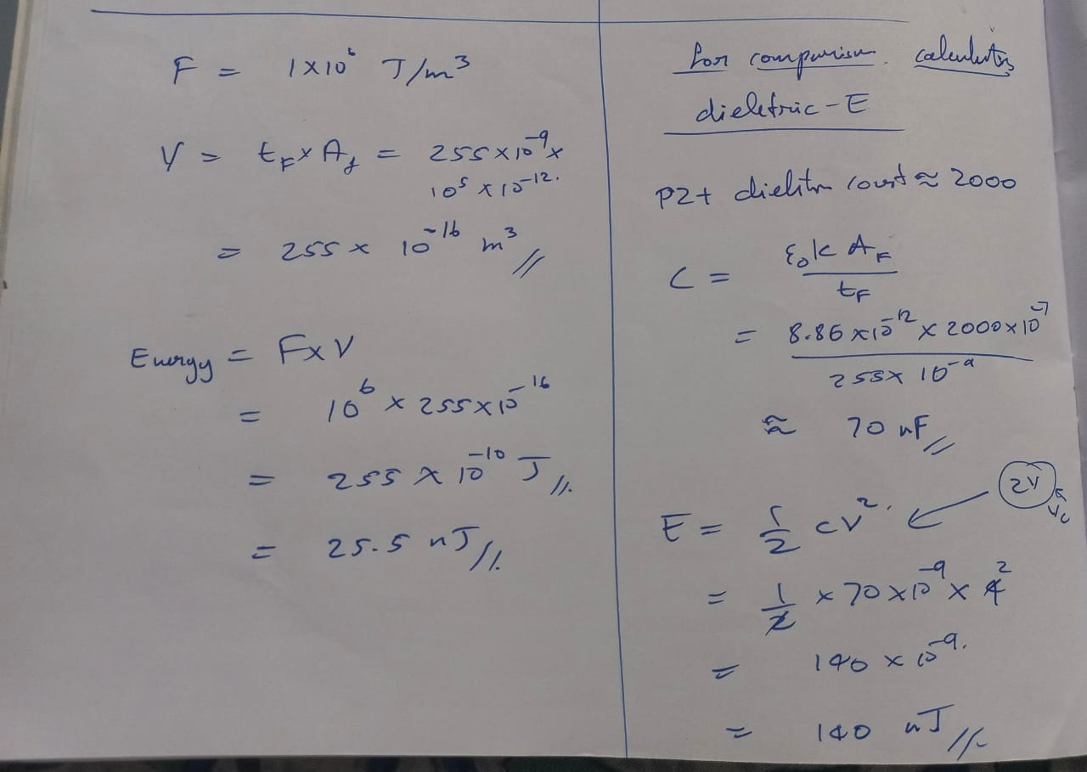
Free energy density value
Order of magnitude check!

Slide 6
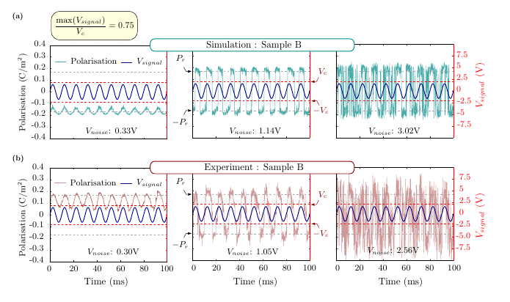
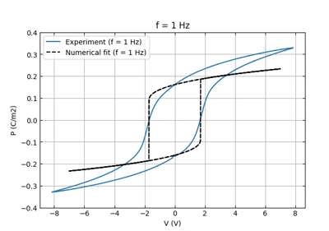
Time series data Exp vs Num
In numerical simulation the polarization value is bounded near to the Pr value
Reason: the fit is not capturing the dielectric loss
In Experiment the polarization sometimes crosses the bound and goes to higher value compared to the Pr value

Slide 7
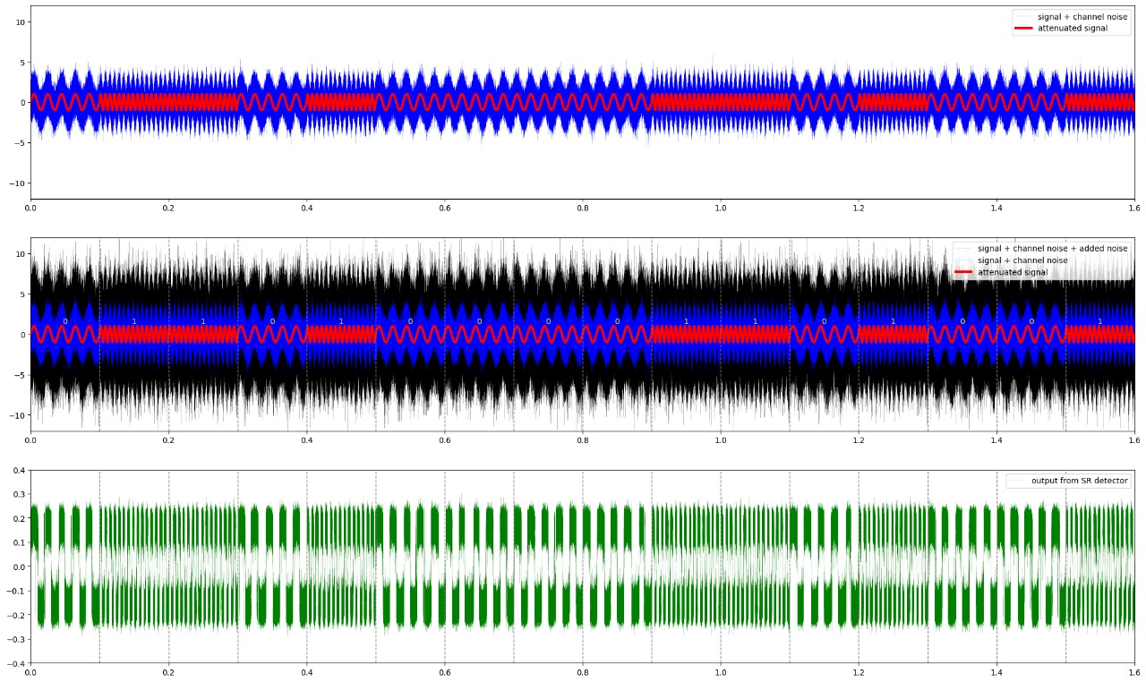
FSK SNR of the signal improves or not?

Slide 8
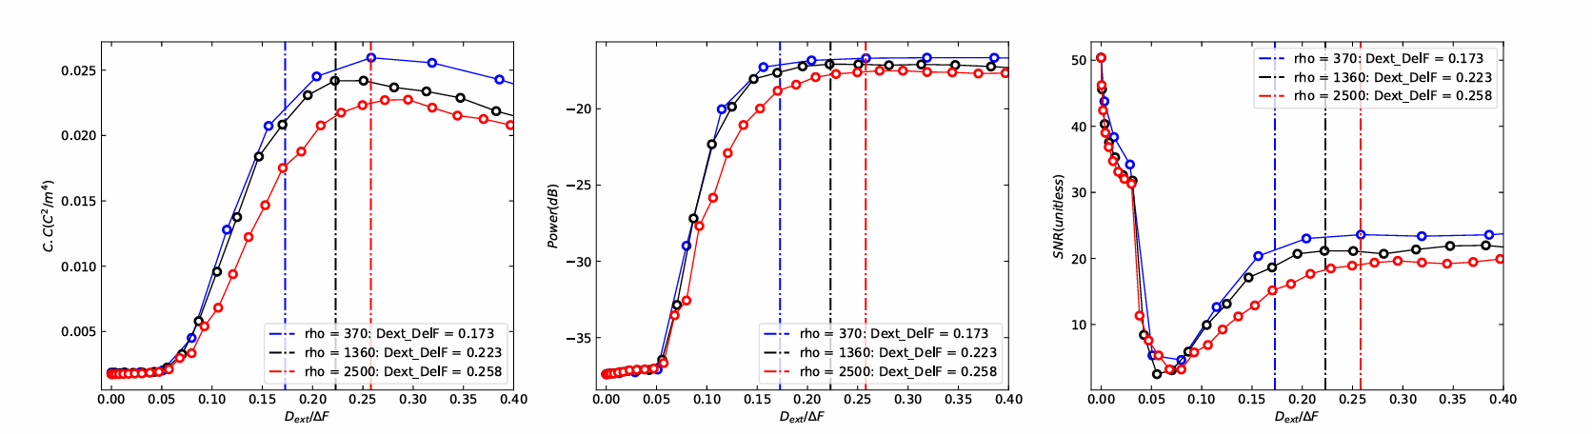
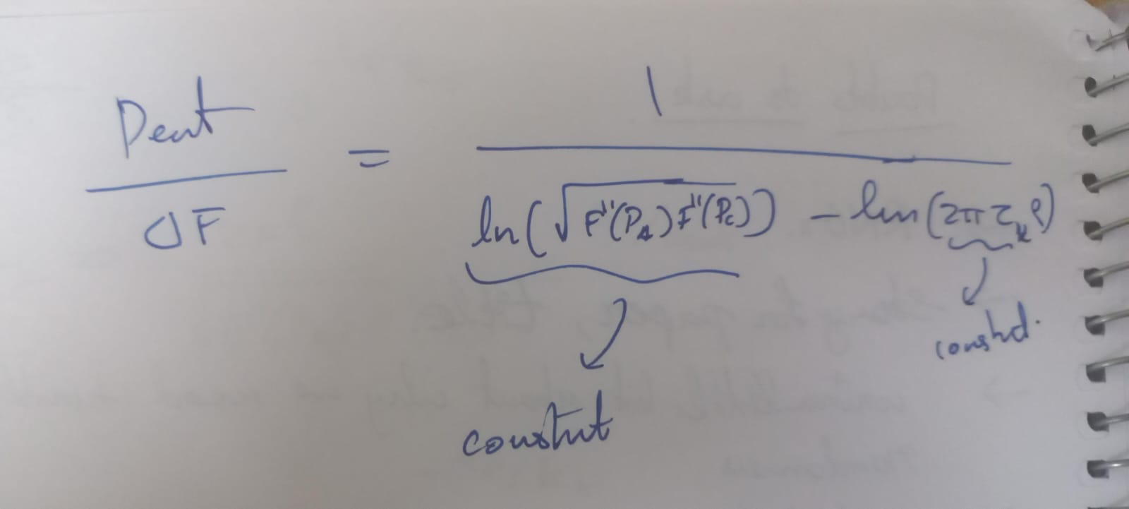
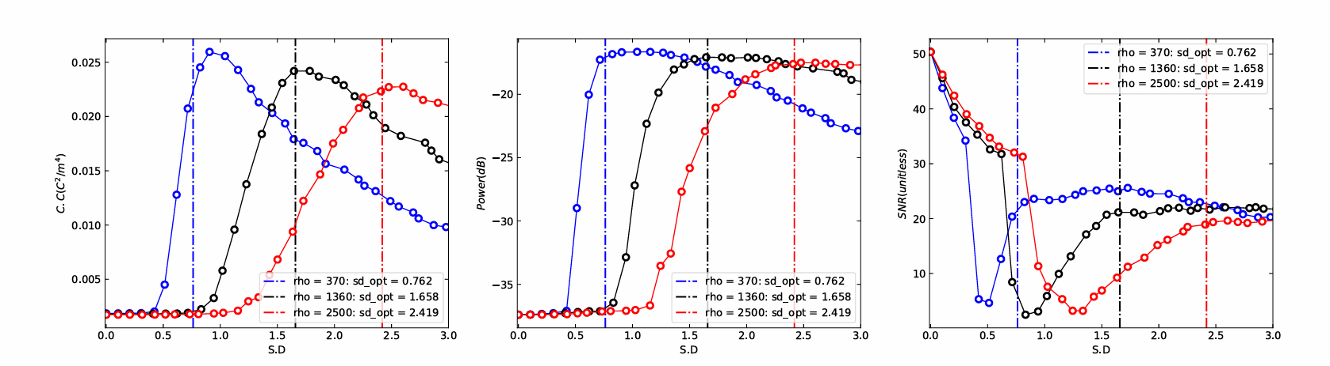
Effect of rho in SR
Re-arranging Ktime formula, rho dependency is very less when indicated in terms of Dext/DelF
Difference is visible when shown in terms of Vrms (SD)

Slide 9
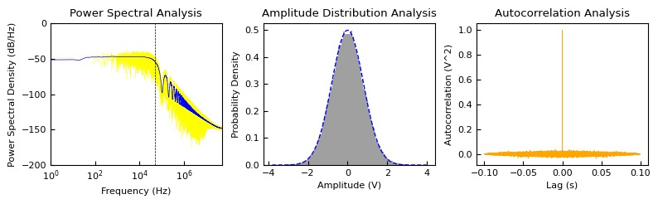
Noise Characterization
How noise is generated for simulation ?
N samples from
WGD
Zero hold interpolation for (Sample rate/ simulation time step)
This is not an ideal white noise, we are following this methodology to reproduce the experimental conditions
Note: 3dB BW is not exactly 10 kHz, it is close to 5kHz. But in calculation we are going with the assumption that BW is same as 1/dt
Only the corrected SD will match the amplitude distribution

Slide 10
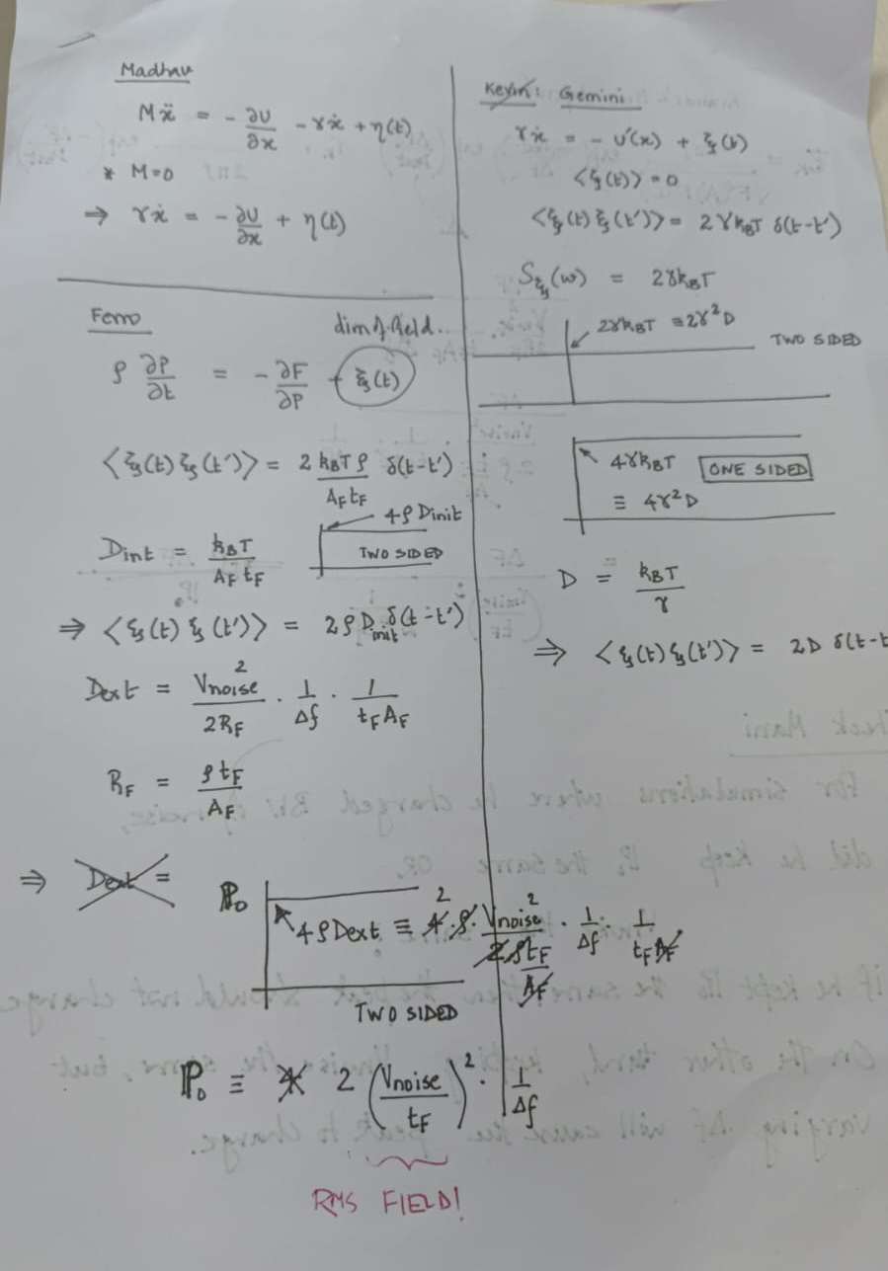
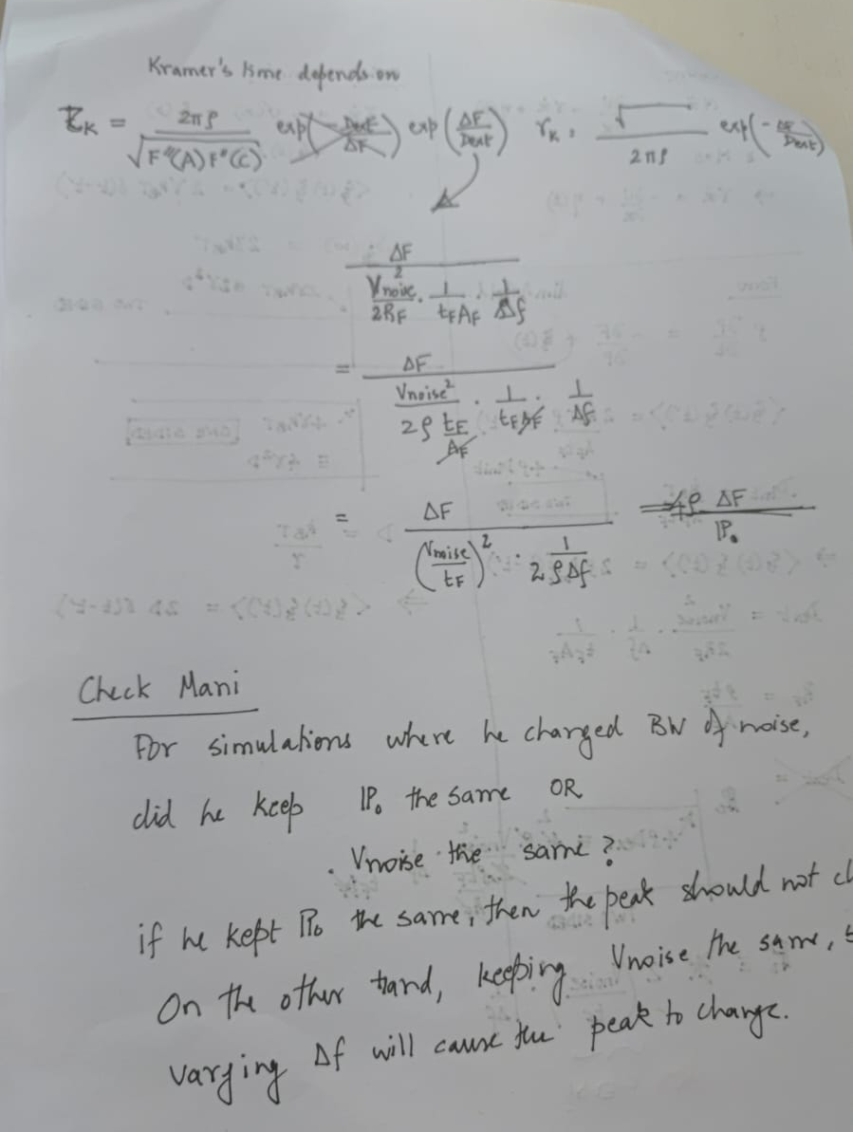
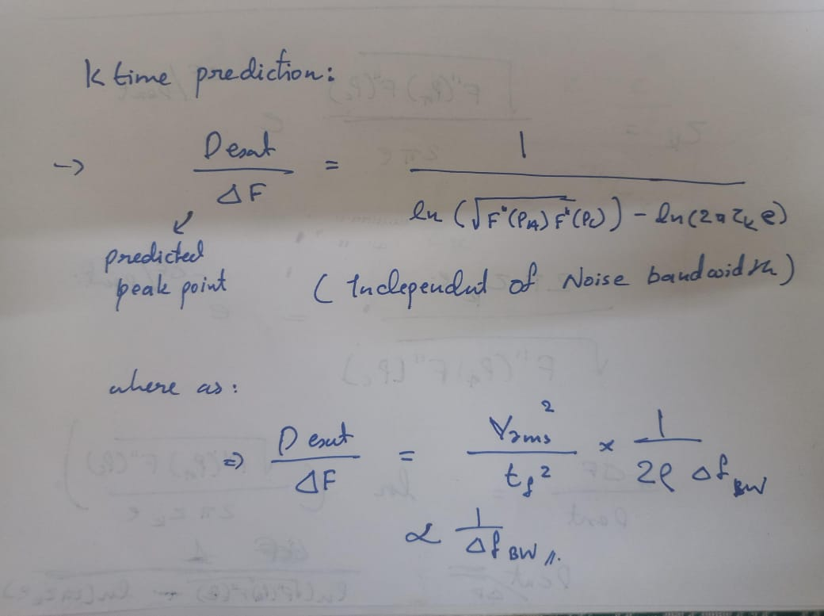
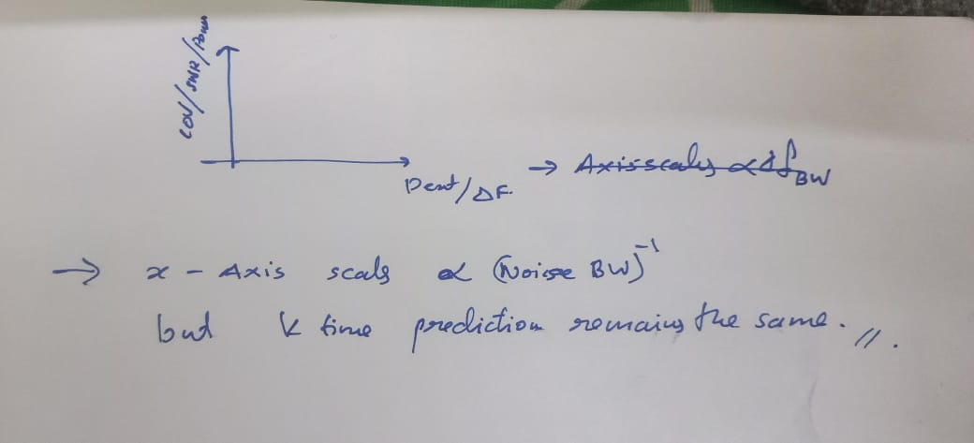
Noise Characterization

Slide 11
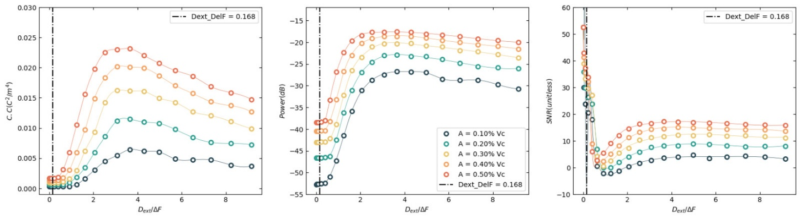
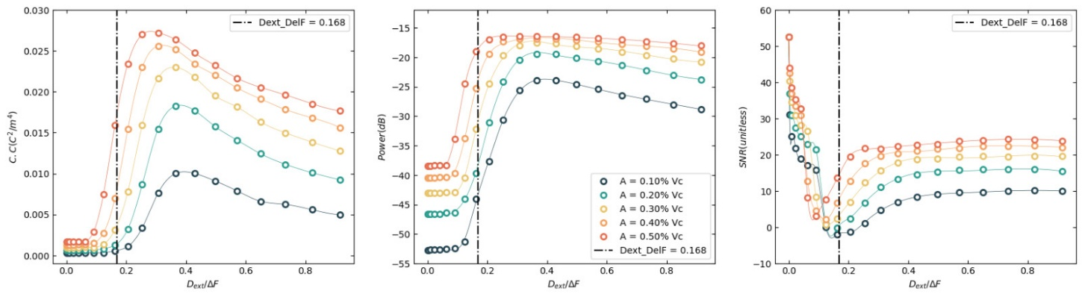
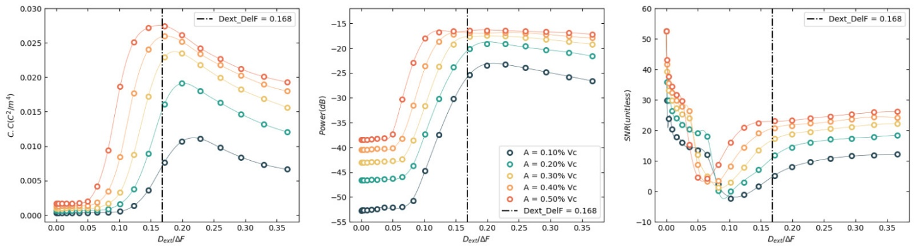
Found an inconsistency in our assumptions
Noise BW
Take away: we can’t assume Kramers rate formula for a bandlimited noise. The prediction is off by orders of magnitudes.
10 kHz
100 kHz
Dependency on perturbation magnitude is minimal, all though the absolute prediction matching is observed for small magnitude of perturbation signal
The SR peak prediction point is aligning only for higher BW noise
1 MHz

Slide 12
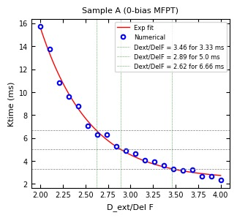
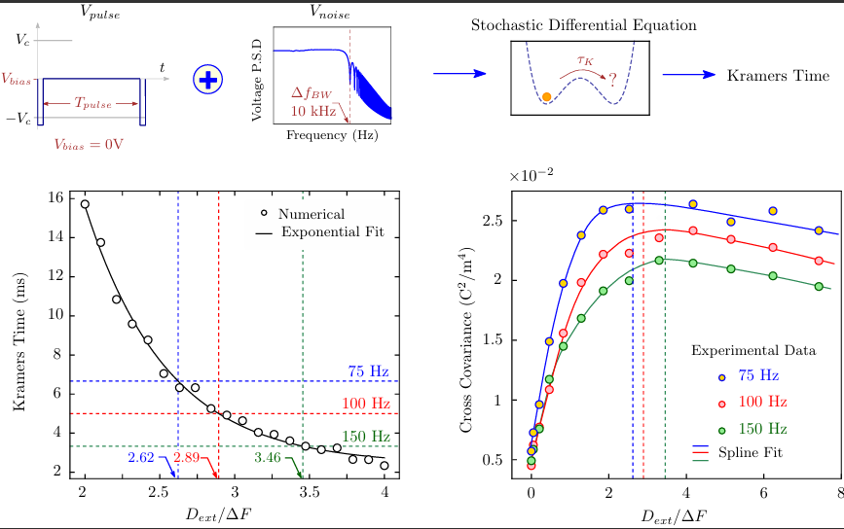
To solve the SR prediction, we use MFPT
MFPT: Mean First Passage Time
Instead of Ktime formula we extract the MFPT by simulating the SDE with the Ktime measurement experiment.
MFPT prediction matches exactly!

Slide 13
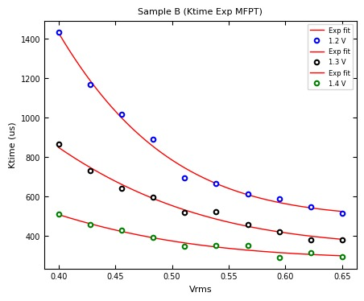
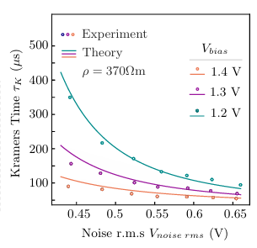
Inconsistency in extraction of rho from Ktime exp
The rho is extracted with the assumption that Ktime formula hold valid for BW = 100 kHz,
But it’s not! (evident from the MFPT simulation)
Re-work for future:
first find the analytical expression for MFPT with bandlimited noise, use that formula to fit the experiment data
MFPT: Simulation
Exp + Ktime Analytical Overlap

