Slide 1
Test Bench for Measurement

Slide 2
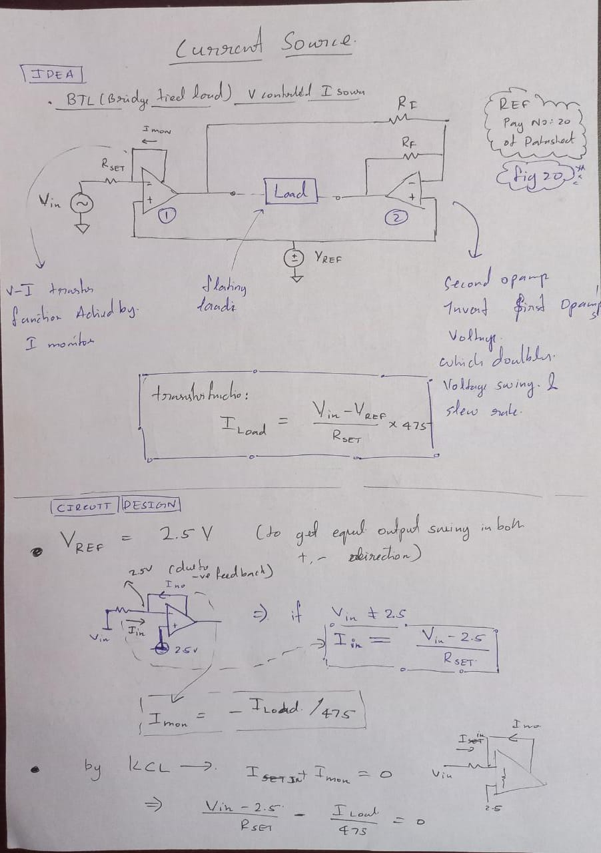
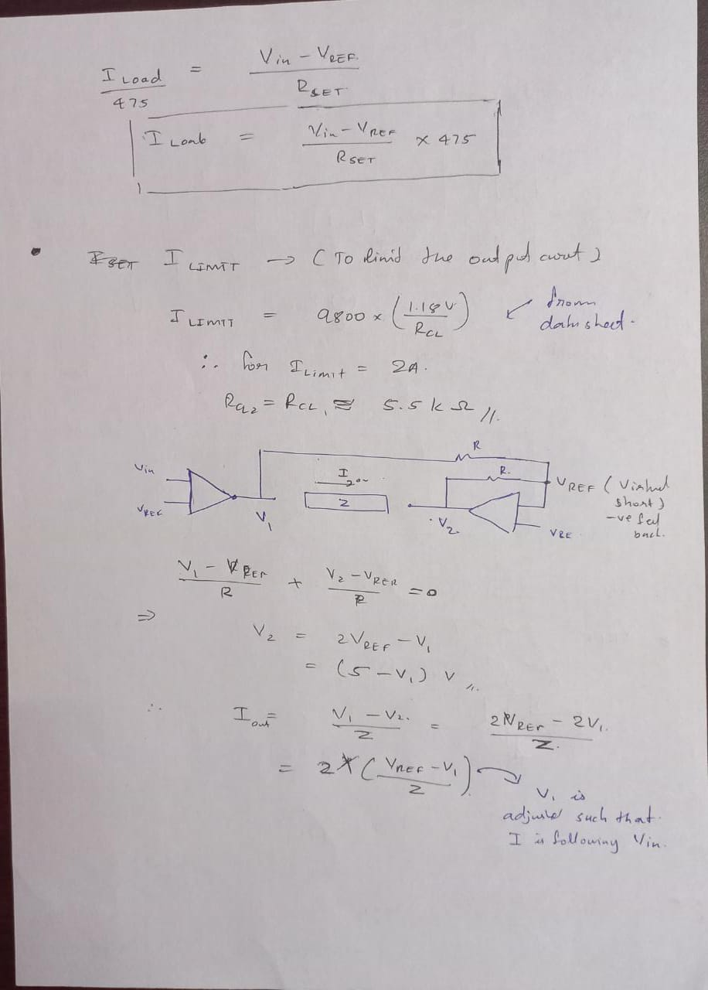
BRIDGE-TIED-LOAD (BTL), V-I CONVERTER

Slide 3
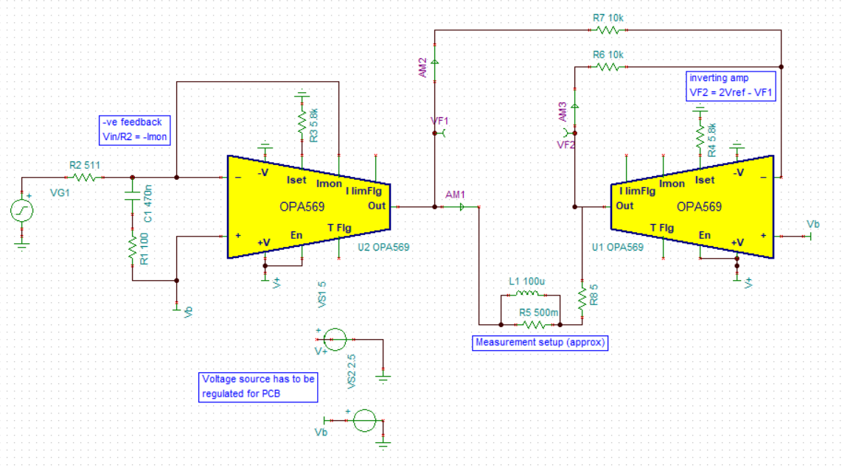
SCHEMATIC IN TINA CLOUD

Slide 4
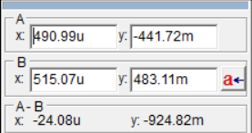
SIMULATION RESULTS
We want a step current source of approx. 1k Hz frequency with switching time approx. 10us
Simulated for that, results are given above, the input voltage with 10us delay is feed to the circuit output has a switching time of approx. 15us

Slide 5
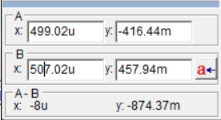
SIMULATION RESULTS
1us delay, output has a switching time 8us

Slide 6
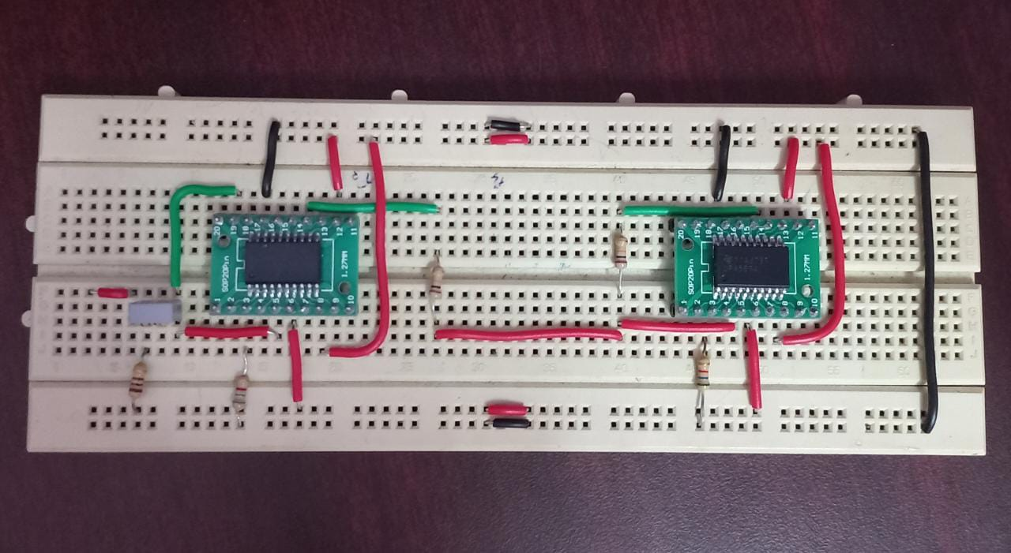
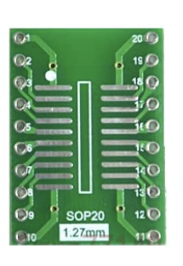
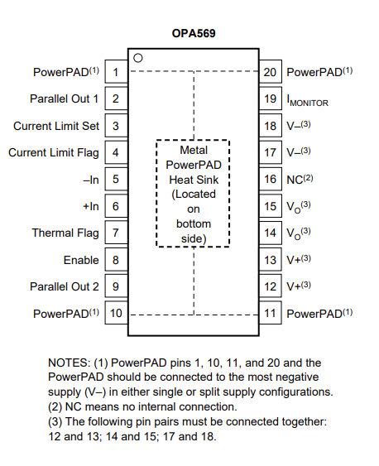
BREADBOARD TESTING
Colour code for the breadboard connection:
Red: voltage
Black: ground
Green: current
Ground
Used SOIC TO DIP 20 PIN adapter for breadboard connection
+V (5V)
I_{out} (floating)
V_{func} (2.5 offset)
V_{ref} (2.5V)
Ground

Slide 7
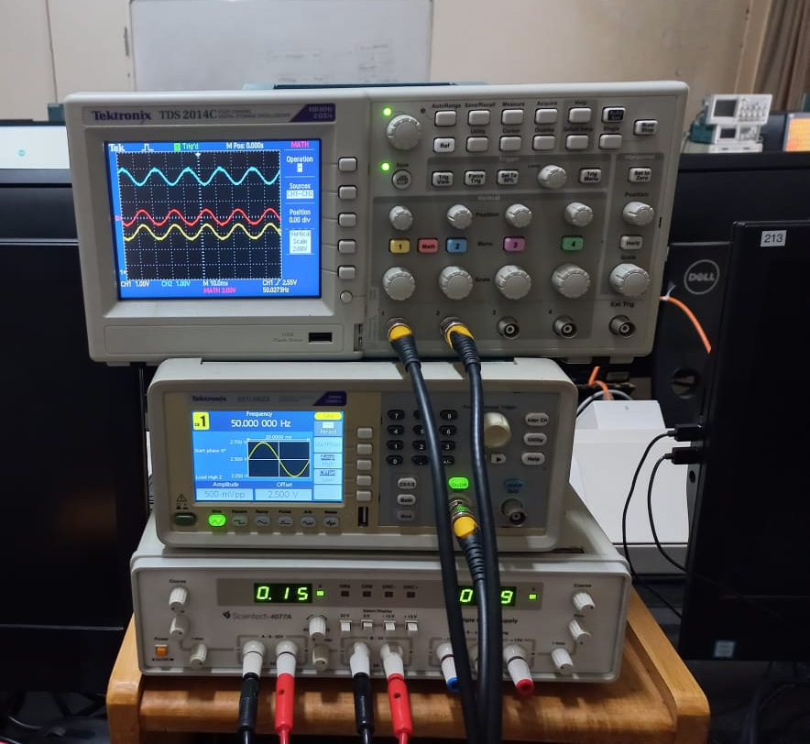
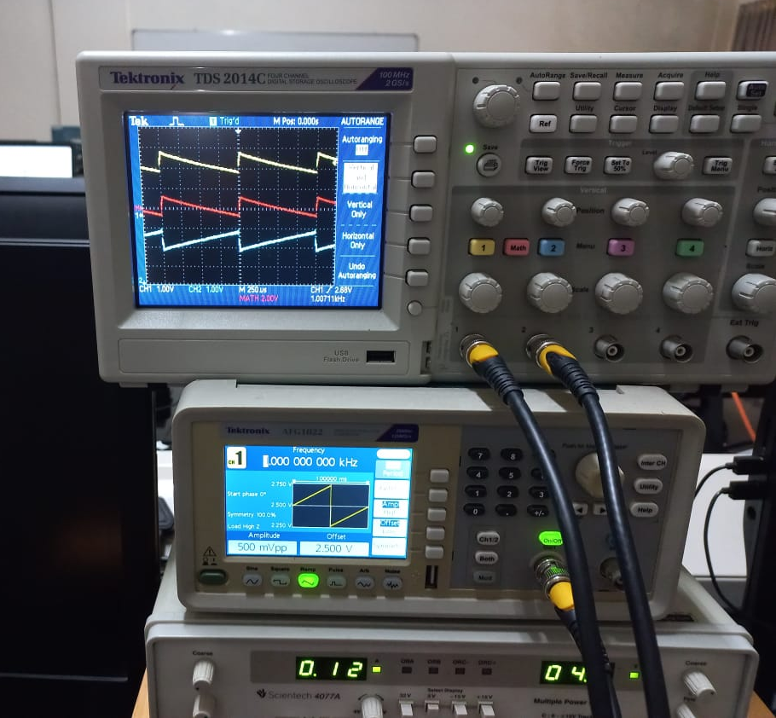
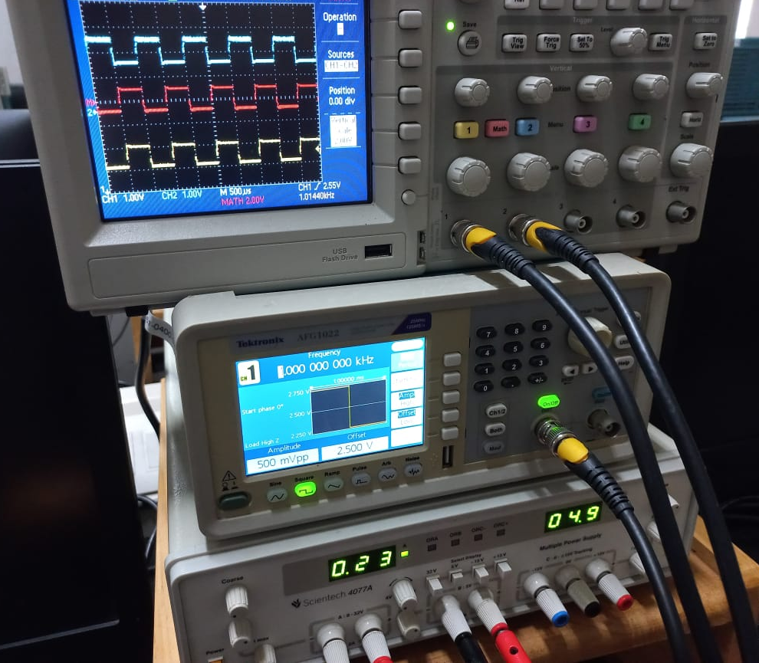
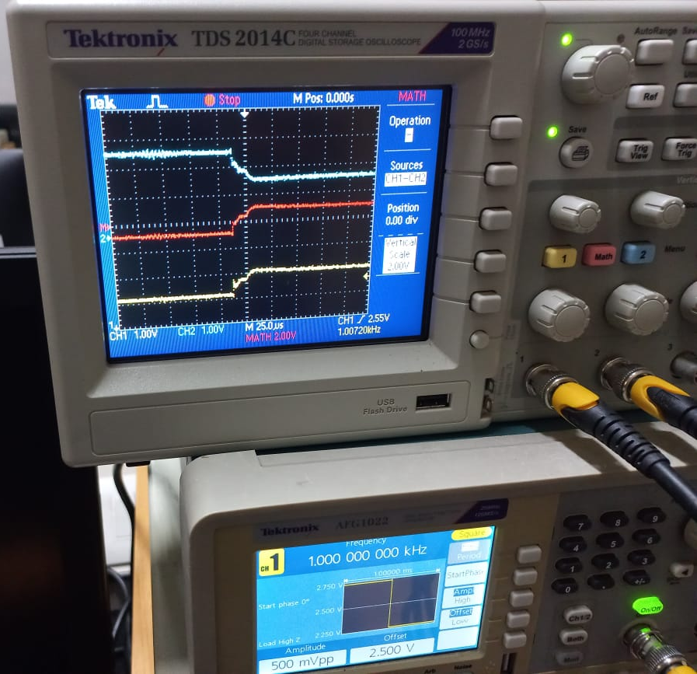
TEST OUTPUT
4.2ohm power resistor were used to test the current source with different functions of voltage with 1kHz frequency

Slide 8
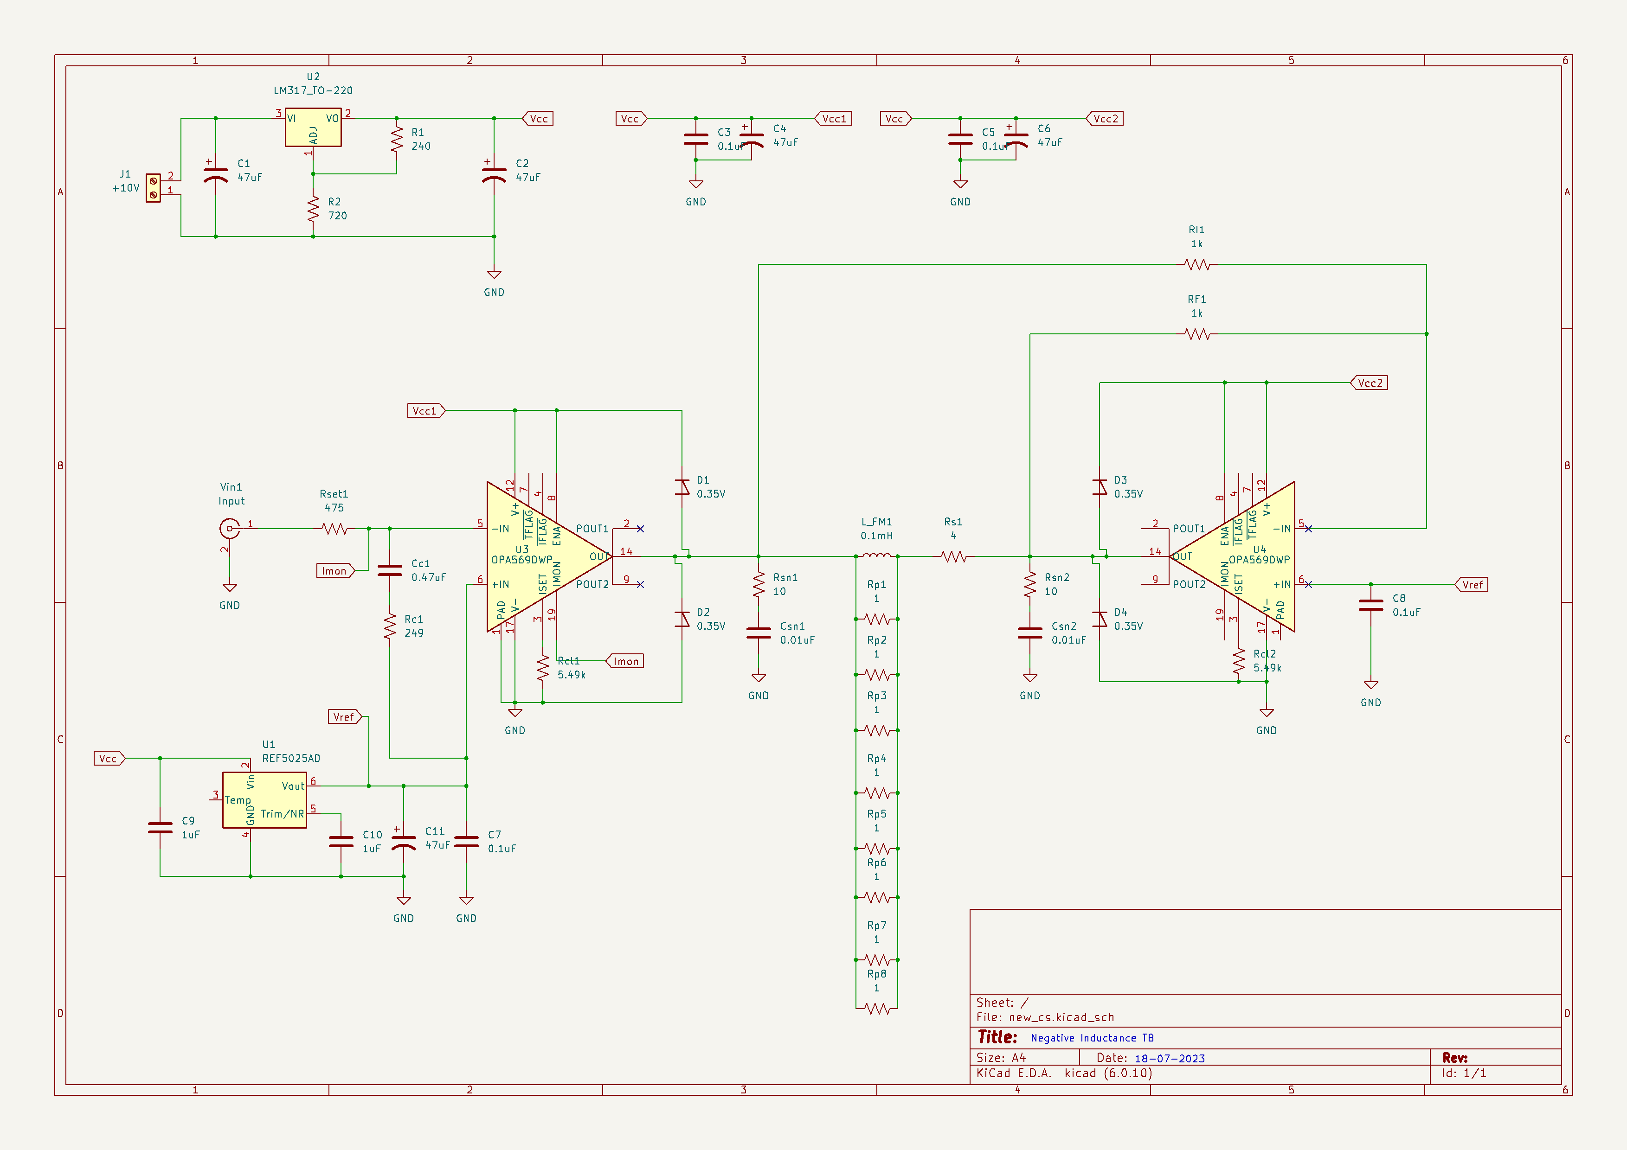
PCB DESIGN

Slide 9
REFRENCES
https://www.ti.com/tool/TIPD103?HQS=ti-null-null-productcentre_refdes-manupromo-rd-ElectronicSpecifier-eu#tech-docs
https://www.youspice.com/spiceprojects/spice-simulation-projects/general-electronics-spice-simulation-projects/driver-circuits-spice-simulation-projects/differential-output-voltage-controlled-current-source-tec-driver/
https://www.amazon.in/SOIC-DIP-20-PIN-Adapter/dp/B098DYH47N/ref=mp_s_a_1_1?crid=1VJ1TW79ROV5X&keywords=SOIC+TO+DIP+20+PIN+Adapter&qid=1686400132&sprefix=soic+to+dip+20+pin+adapter%2Caps%2C286&sr=8-1

