Slide 1
Ltspice Model
Ferromagnetic inductor

Slide 2

Landau-Ginzburg Equation
Time dependent switching equation
$U= αφ^{2}+βφ^{4}−φI_{L}$
$ρ\frac{dφ}{dt}=−\frac{dU}{dφ} Landau−Ginzberg relation$
$ρ\frac{dφ}{dt}=−2αφ−4βφ^{3}+I_{L}$
${ ⇒I}_{L} = ρ\frac{dφ}{dt}+2αφ+4βφ^{3}$

Slide 3
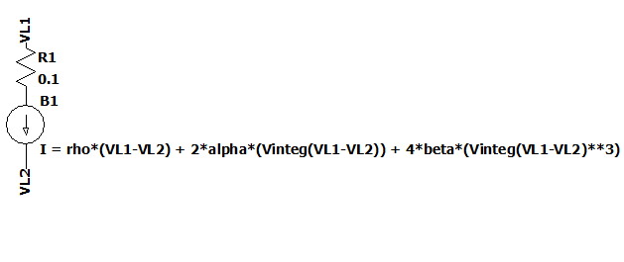
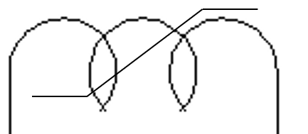

We can model inductor as a current source
${ I}_{L} = ρ\frac{dφ}{dt}+2αφ+4βφ^{3}$
$φ= ∫V_{L} dt$
Ferromagnetic inductor

Slide 4
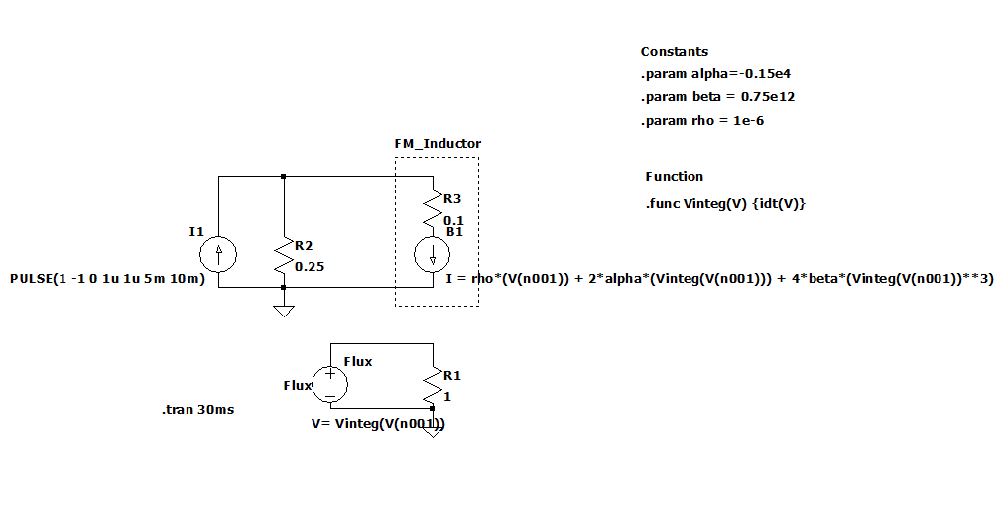
Spice Model Exp.1
Measuring transient behaviour using step current source.
Constants used

Slide 5
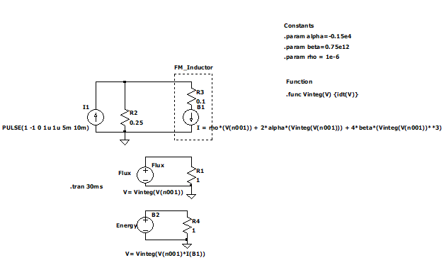
Spice Model Exp.1
Compute the flux
Compute the Energy
In the inductor

Slide 6
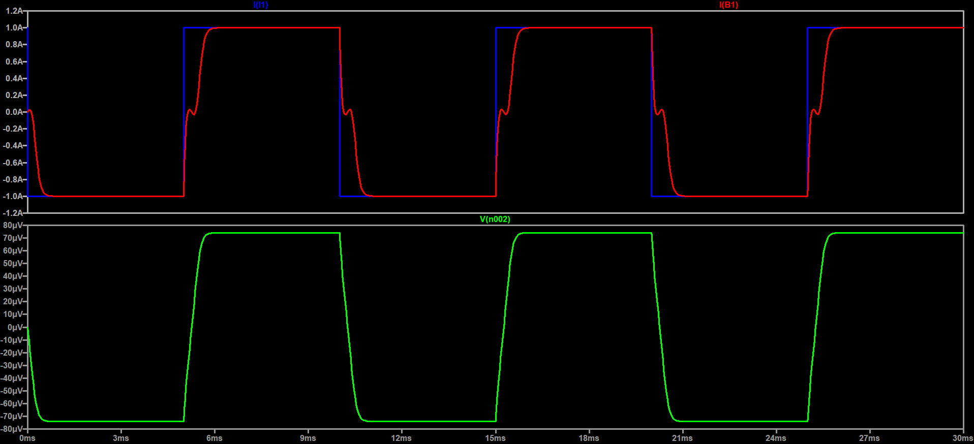
Results Exp1
I - blue
IL - red
phi

Slide 7
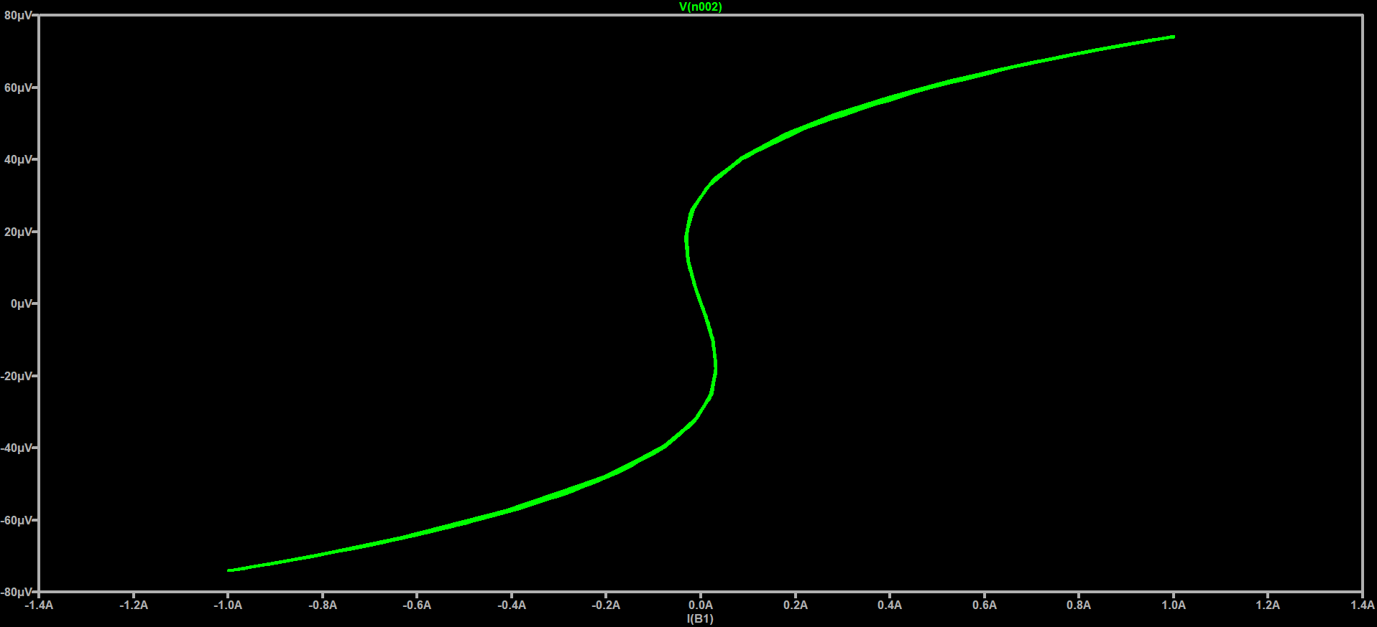
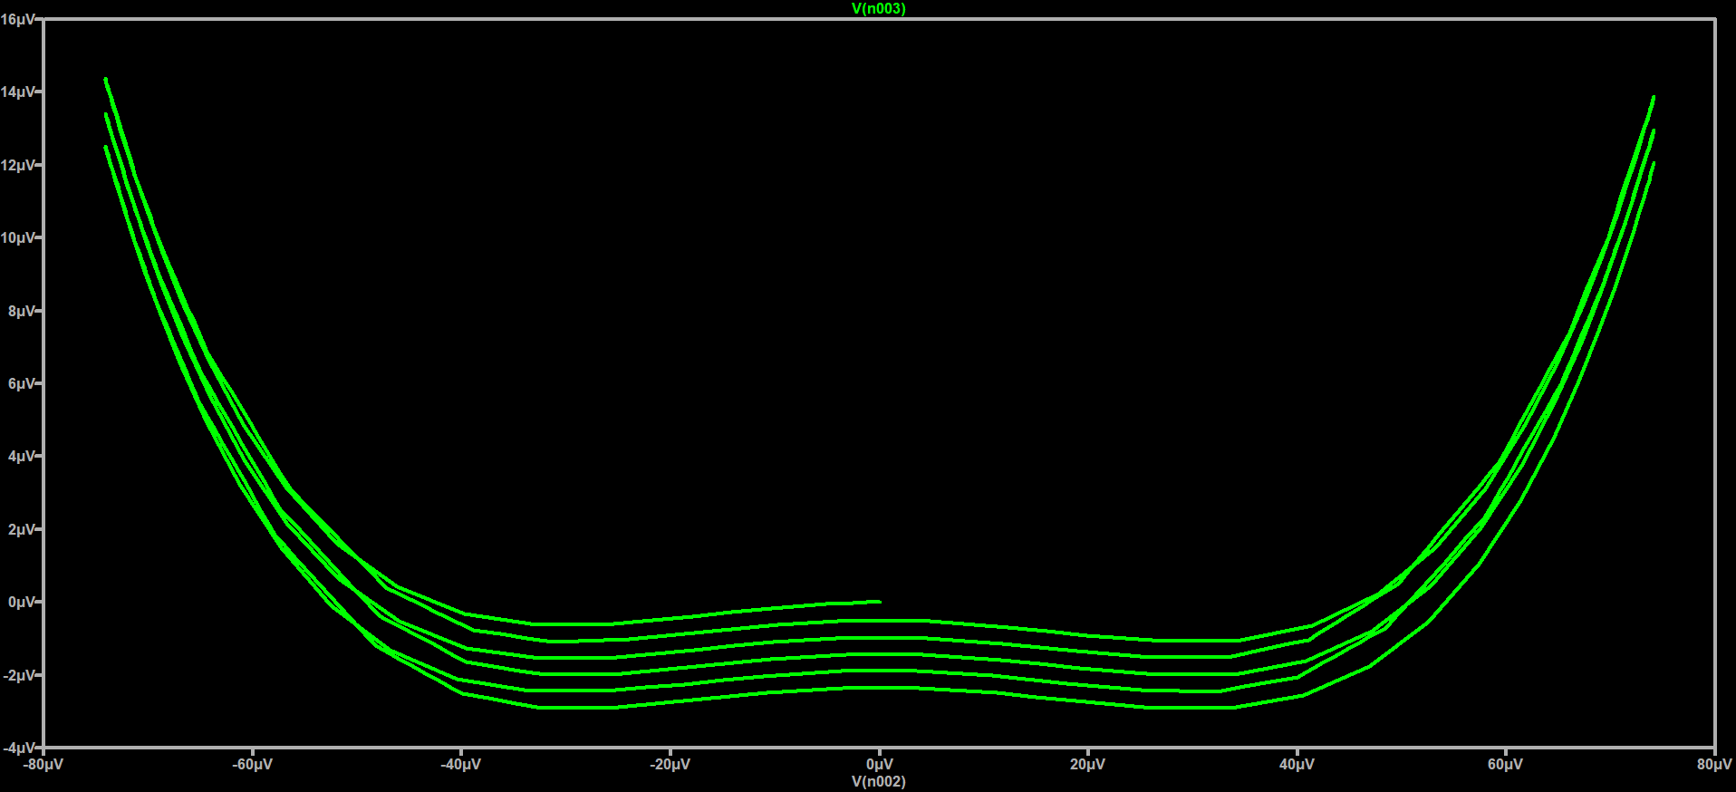
Results Exp1
Phi – IL
(S curve)
U – Phi
(double well)

Slide 8
Next work
Try with positive inductor
Try to fit the exp data to real data
Get hysteresis curve
Energy double well
If possible try Ising model in Ltspice

